Slide 1
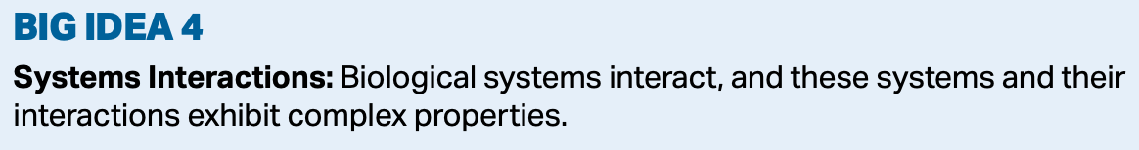
Biodiversity

Slide 2
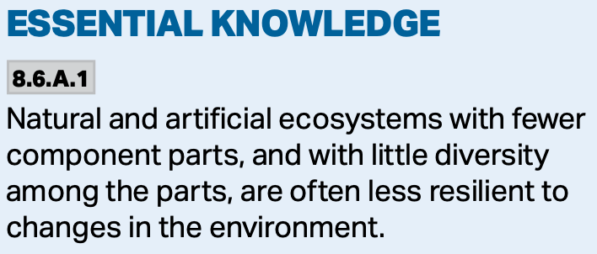
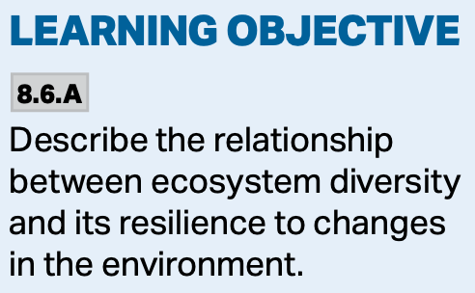
Ecosystems and Change
More diverse ecosystems are those that have many organisms at various trophic levels.
There are bottom-up, and top-down influences on ecosystems.
https://www.science.org/cms/10.1126/science.1215855/asset/3ec40010-ec35-4c57-ac1d-eb3e56290b59/assets/graphic/336_1401_f3.jpeg

Slide 3
Keystone species
Prior to the 1960s, scientists believed that the number of species in an ecosystem was controlled by the numbers of producers.
But this did not explain why the consumers did not eat all of the predators.
The Green World hypothesis proposed that predators and disease kept the herbivore populations in check so they didn’t consume all of the plants.
https://slidetodoc.com/presentation_image/1e32ba8f41200214ffec7f3a6bc338a4/image-5.jpg

Slide 4
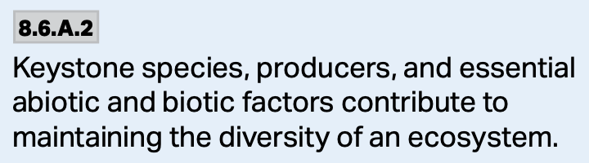
Keystone species
The discovery of the keystone species changed this thinking and confirmed the Green World hypothesis.
A keystone species is one that contributes an inordinate amount to an ecosystem.
The entire system depends on this species, and if it is removed the ecosystem will change drastically.
https://i.ytimg.com/vi/JGcIp4YEKrc/maxresdefault.jpg

Slide 5
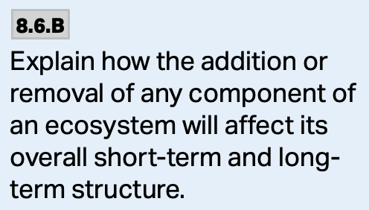
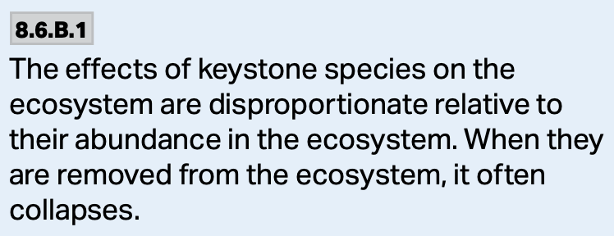
Starfish
Starfish were one of the first examples of studies involving a keystone species that was studied.
This was an example of a keystone species that had a top-down influence on the system, and exerted a disproportionate influence on the system.
https://media.hhmi.org/biointeractive/click/keystone/images/details/sea-star-before-removal.jpg
https://www.biointeractive.org/sites/default/files/styles/square_thumbnail/public/Biointeractive/landing_pg/poster-thumb.jpg?itok=V6Y7cing

Slide 6
Sea Otters
Many keystone species are apex-predators, but not all. In the case of sea-otters, orcas are the apex predator, and if orcas are present, the system is less diverse.
As the sea otter population decreased due to predation by the orcas, the kelp disappears because the sea urchins eat it all.
https://www.science.org/cms/10.1126/science.282.5388.473/asset/54e9154d-031f-4a29-b5a4-6e9f5cdbe4b2/assets/graphic/se3686805001.jpeg

Slide 7
Sea Otters
When orcas eat the sea otters, the sea urchin population increases and this leads to a decline in the amount of kelp and a reduction in the biodiversity of the ecosystem.
https://slideplayer.com/slide/14636179/90/images/10/Observation+Of+Sea+Otter+Populations+And+Their+Predation.jpg

Slide 8
Sea Otters
Keystone species also contribute to the abiotic components in an ecosystem that maintain diversity.
Sea otters also feed on crabs, and when the otters are removed, the crab population explodes, they eat all of the sea slugs and isopods that feed on the algae. The algae then grows out of control and depletes the oxygen in the water and the biodiversity decreases.
https://64.media.tumblr.com/c5416fe6f21311eb0be377160fb56a50/tumblr_inline_nv78zrt3211qk45js_1280.png

Slide 9
Sea Otters
A keystone species’ effect on the ecosystem are disproportionate relative to their abundance in the ecosystem.
A relatively small number keystone organisms controls the entirety of the system.
They allow for more diversity (numbers of species) and more organisms. Small number = big influence.
Removal of the keystone often results in the collapse of the ecosystem.
https://media.hhmi.org/biointeractive/click/keystone/images/details/sea-star-before-removal.jpg

