Slide 1

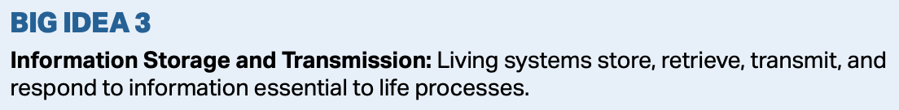
Cell Communication

Slide 2
Multicellular Organisms
Many multicellular organisms have trillions of cells which must communicate with one another.
Such communication enables the creature to coordinate cellular activities ensuring the vitality of the organism.

Slide 3
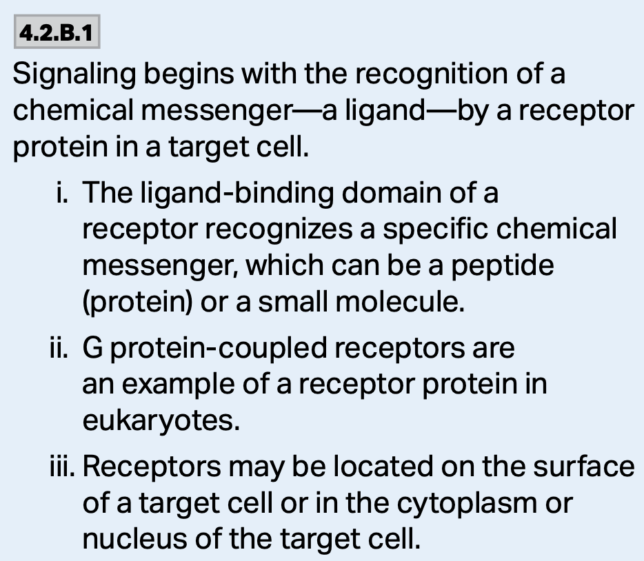
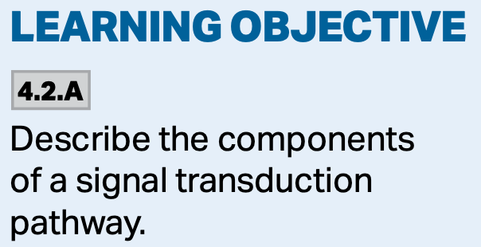
Signal Transduction Pathways
There are three main stages to a signal transduction pathway:
  1. Reception—a surface protein in the cell membrane receives a signal on its surface.
  2. Transduction—the change in the protein stimulates a series of events that leads to changes in the cell.
  3. Response—nearly all cellular activity changes in one way or another.

Slide 4
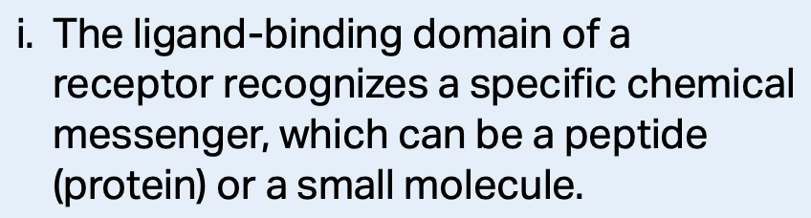
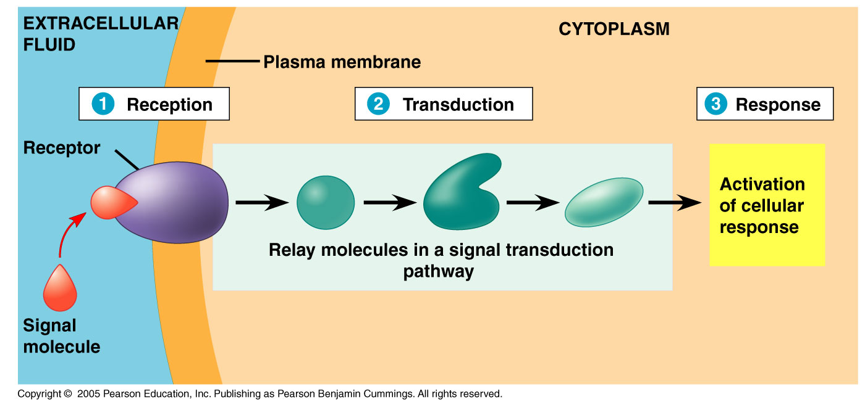
Cell Signaling
So, how do cell signals elicit changes?
This process is called a signal transduction pathway, and is a series of steps whereby the signal received by the surface of the cell is passed through a series of steps in the cell bringing about changes in transcription and translation.

Slide 5
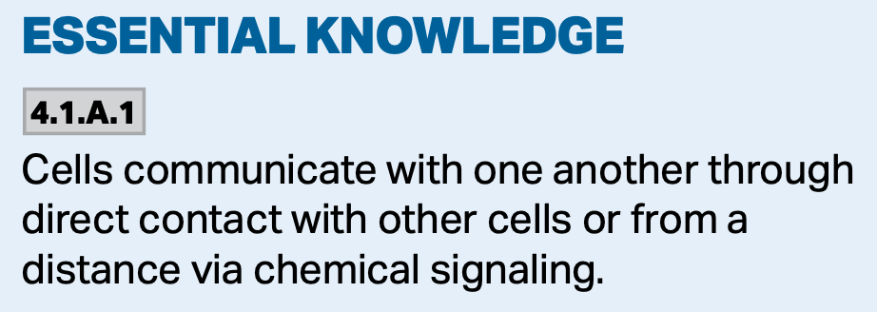
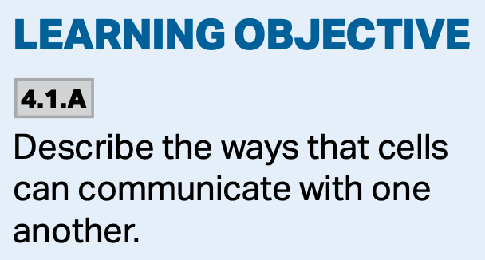
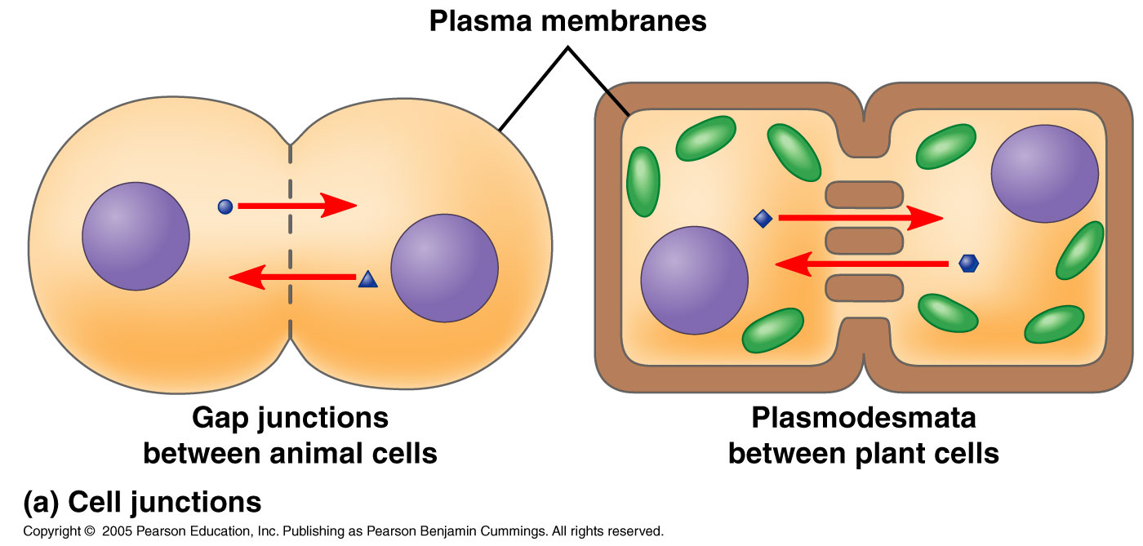
Local Signaling
Plants and animals have gap junctions and plasmodesmata that connect the cytoplasms of adjacent cells.
Cytosolic signals can pass freely from cell to cell.

Slide 6
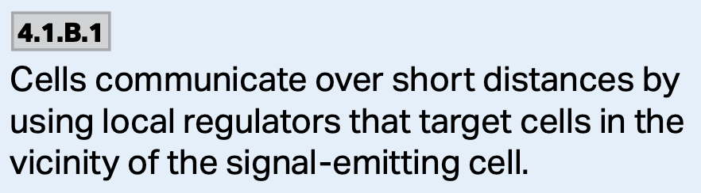
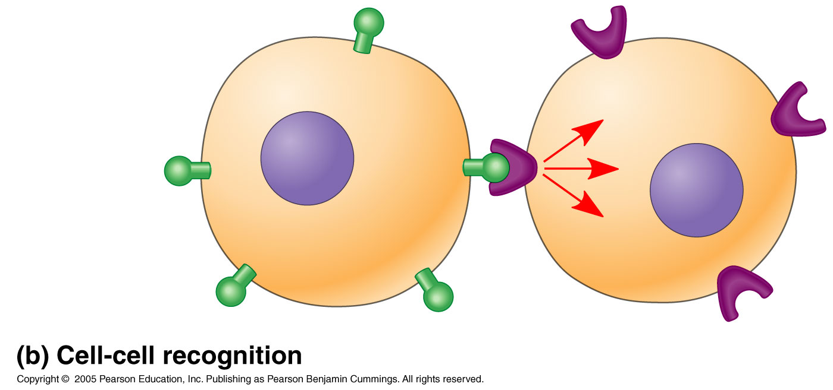
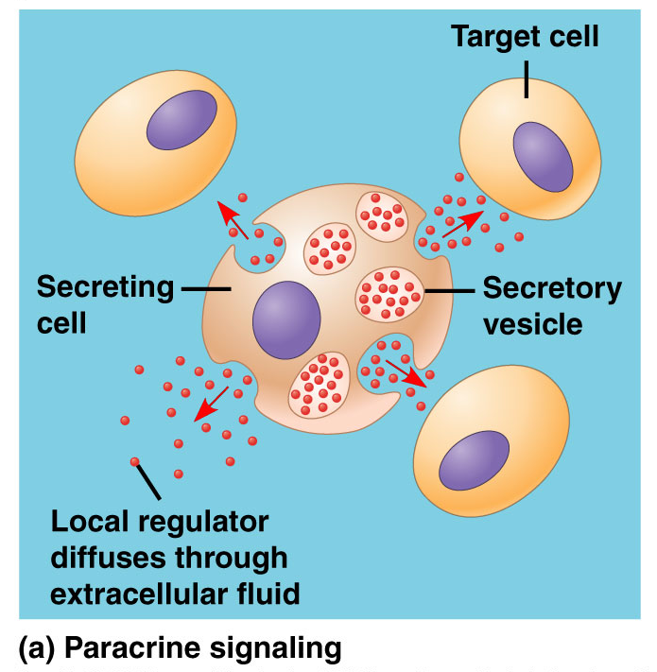
Local Signaling
Additionally, animal cells can also communicate locally via direct contact of membrane-bound cell-surface molecules, or through local diffusion.
  Juxtracrine signaling—signaling through touching.
  Paracrine signaling—side by side communication.

Slide 7
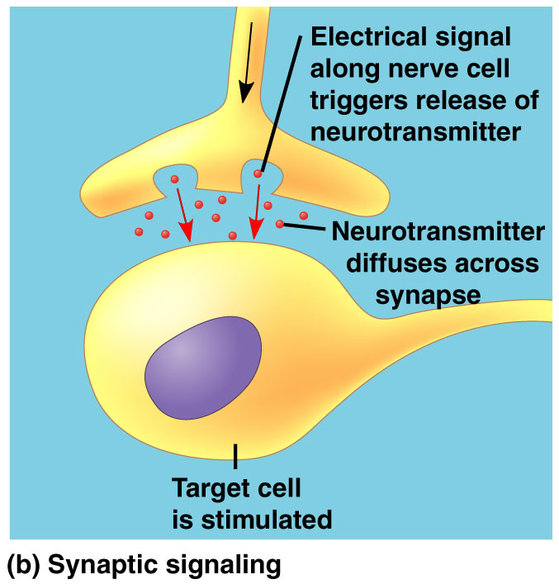
Local Signaling
A specialized type of local signaling is called synaptic signaling.
This occurs in an animal’s nervous system and involves the release of a chemical signal in response to an electrical signal from the nervous system.
These neurotransmitters diffuse across the synapse and elicit a change in the target cell.

Slide 8
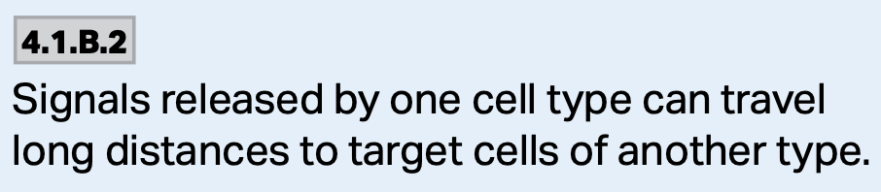
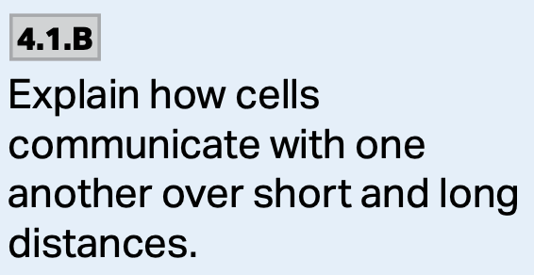
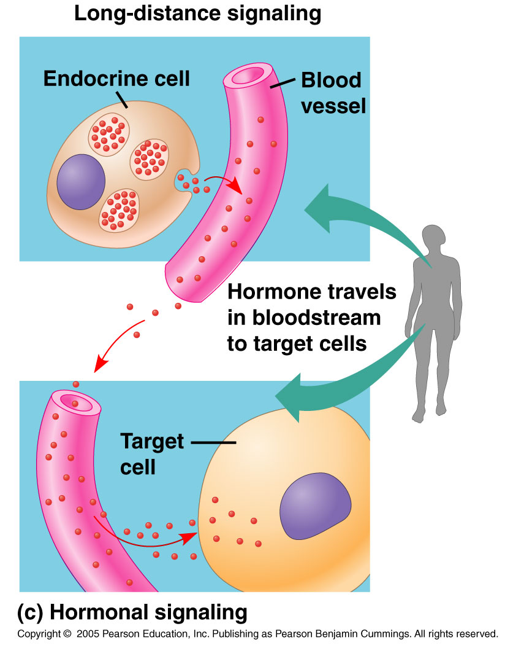
Long-Distance Signaling
Plants and animals use hormones for long-distance signaling.
This type of signaling is also called endocrine signaling, and involves specialized cells releasing hormones into vessels of the circulatory system. When these hormones reach the target cells, they elicit a change.

Slide 9
So, how does this Happen?
One main way with two options:
  1. A receptor molecule on the surface of a cell must recognize the chemical signal and the information it carries.
  OR: A receptor molecule within the cell must recognize the chemical signal and its information.
Then,
  2. The transduction of the signal must occur before the cell can respond.
  3. Then the cell must respond to the signal.
Let’s look at this in more detail.

Slide 10
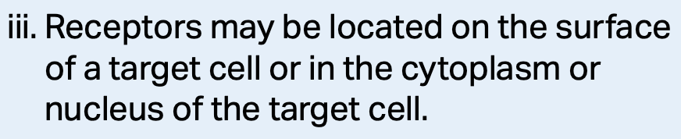
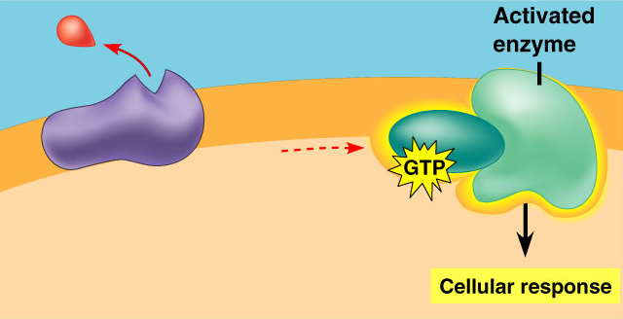
3 Stages of Cell Signaling
1. Reception. This is the process by which the target cell detects the outside signal.
  Detection occurs when a signal molecule binds to a receptor protein on the surface or inside the cell.

Slide 11
1. Reception
The signal created is received by a receptor protein on or in the target cell.
The signal-receptor interaction is similar to the enzyme-substrate reaction.
The signal behaves as a ligand—a molecule that binds specifically to another molecule.
This binding generally causes a shape change that allows for further events to occur inside the cell.

Slide 12
Plasma Membrane Receptors
Most water-soluble signaling molecules bind to sites on receptor proteins embedded in the cell’s plasma membrane.
The signal is then transmitted to the inside of the cell.

Slide 13
Plasma Membrane Receptors
There are three major types of membrane receptors:
  A. G protein-coupled receptors (GPCR)
  B. Receptor tyrosine kinases (RTK)
  C. Ion channel receptors

Slide 14
A. G Protein-Coupled Receptors
These protein receptors are very widespread and diverse in their functions.
They are involved in embryonic development and sensory reception such as vision and smell, as well as many other functions.
They bind:
  Odors
  Pheromones
  Hormones
  Neurotransmitters
https://www.pnas.org/content/116/3/1053

Slide 15
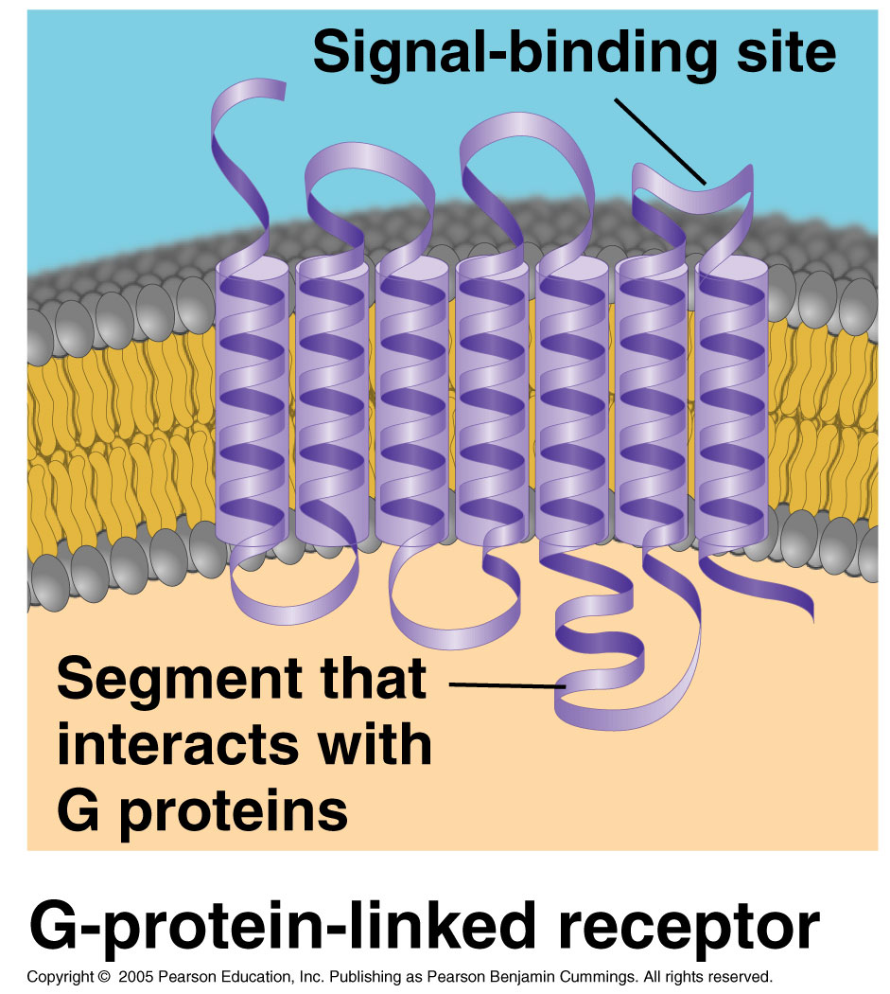
A. G Protein-Coupled Receptors
These receptors are embedded in the plasma membrane and work with the help of a G-protein.
G-proteins are proteins that bind energy rich GTP molecules.
They are all similar in structure and have seven α helicies which span the membrane.

Slide 16
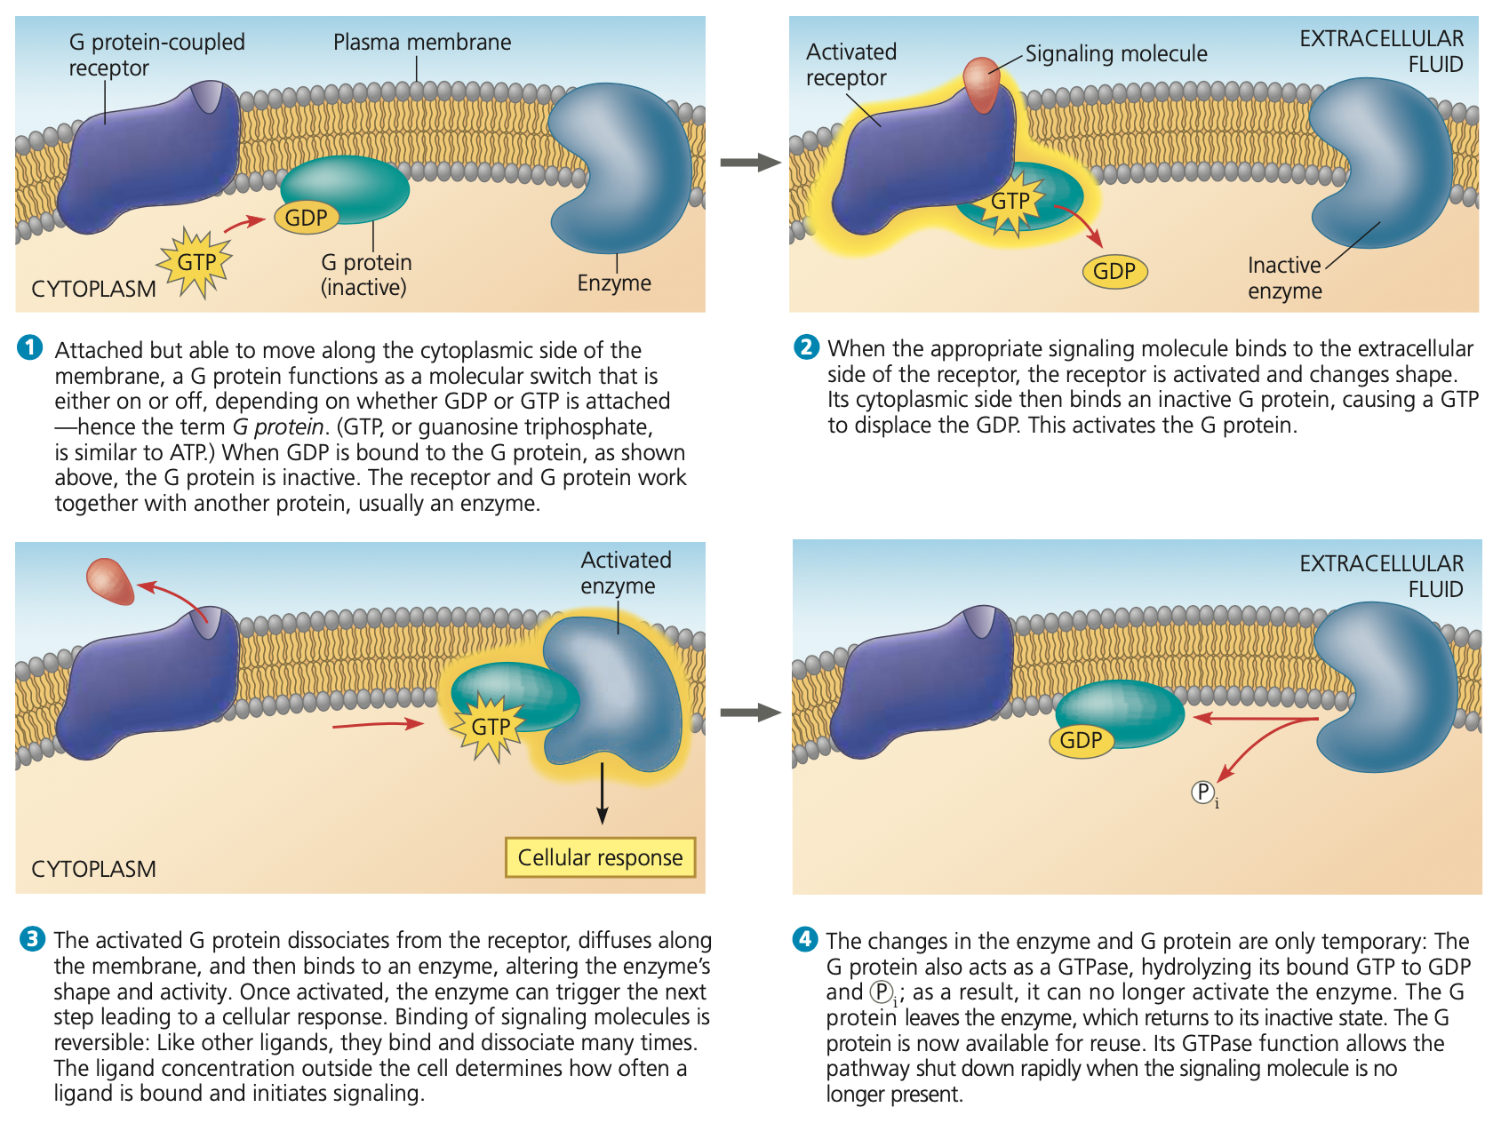
A. G protein-coupled receptors

Slide 17
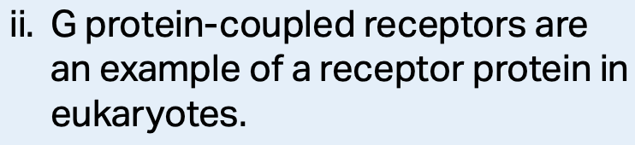
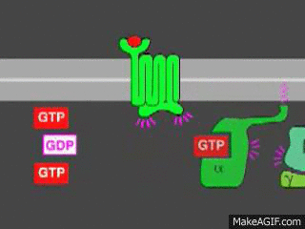
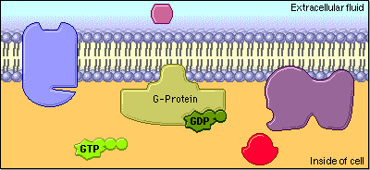
A. G Protein-Coupled Receptors
G-protein receptors are embedded in the plasma membrane. When they receive the signal, they activate the associated G-protein which, in turn, activates an enzyme starting the signal cascade.
https://www.google.com/url?sa=i&url=http%3A%2F%2Fwww.phschool.com%2Fscience%2Fbiology_place%2Fbiocoach%2Fbiomembrane2%2Fsurface.html&psig=AOvVaw1R96fLmq_TCmYUJMVTJL3-&ust=1607517144627000&source=images&cd=vfe&ved=0CAIQjRxqFwoTCOCbjpeyvu0CFQAAAAAdAAAAABAy
https://www.google.com/url?sa=i&url=https%3A%2F%2Fmakeagif.com%2Fgif%2Fg-protein-coupled-receptor-kinetics-w1rNI8&psig=AOvVaw1R96fLmq_TCmYUJMVTJL3-&ust=1607517144627000&source=images&cd=vfe&ved=0CAIQjRxqFwoTCOCbjpeyvu0CFQAAAAAdAAAAABAd

Slide 18

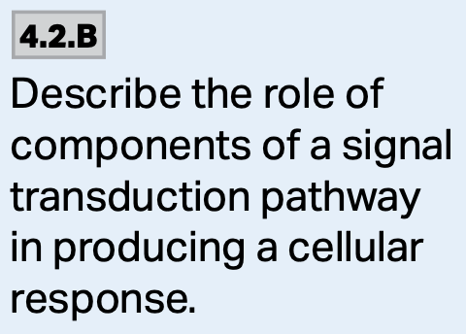
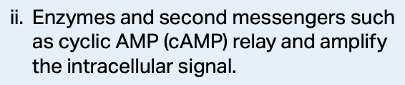
A. G protein-coupled receptors
A common example in animals:
  Epinephrine is released in the fight-or-flight response.
  It binds to the GPCR on the muscle cell.
  Relay molecules (cAMP and protein kinase) amplify and transmit the signal through the cytoplasm.
  Glycogen phosphorylase is activated which catalyzes the release of glucose monomers from glycogen.

Slide 19
https://www.google.com/url?sa=i&url=https%3A%2F%2Fwww.slideshare.net%2FAngelVega24%2Fchapter-11-cell-communication&psig=AOvVaw1o6HIaXgFOZ-xsuqXoNW7T&ust=1607548839739000&source=images&cd=vfe&ved=0CAIQjRxqFwoTCODfxaCov-0CFQAAAAAdAAAAABAO

Slide 20
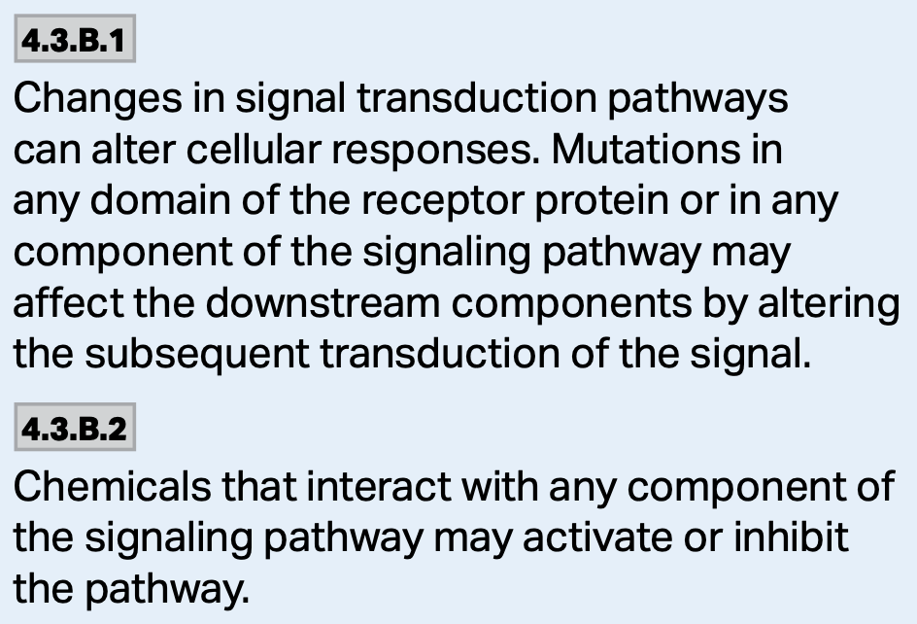
A. G Protein-Coupled Receptors
G-protein systems are involved in numerous human diseases.
Cholera and pertussis are common bacteria-induced illnesses that produce toxins which interfere with G-protein function.
  This interference causes the symptoms associated with the illnesses-massive diarrhea, coughing attacks, etc.

Slide 21
Cholera Toxin
For instance, cholera toxin binds to the cell, is brought in by endocytosis, and is processed and sent back to the membrane where it causes a lot of problems.
The toxin essentially inactivates the G-protein’s ability to catalyze GTP into GDP-P_{i}.
The G-protein remains in a permanently activated state.
This leads increased adenylate cyclase activity which increases cAMP levels well above normal.
This leads to an overactivation of PKA.
This leads to phosphorylated CFTR chloride channels and an efflux of chloride ions.

Slide 22
Cholera toxin
The overactive efflux of chloride ions leads to the secretion of water, Na⁺, K⁺, and HCO₃⁻ ions into the intestinal lumen by the intestinal mucosa.
This leads to rapid dehydration and an electrolyte imbalance due to massive diarrhea (2+ liters per hour) which results in death of not treated.

Slide 23
Pertussis Toxin
Pertussis toxin works in essentially the same way as cholera toxin, except a different subunit of the G-protein is affected, and this acts to inactivate the G-protein.
In this case, adenylate cyclase activity cannot be inhibited, and cAMP levels continue to increase interfering with normal signaling.
This leads to a variety of systemic effects: hypoglycemia, fever, pulmonary hypertension, etc.
https://www.google.com/url?sa=i&url=https%3A%2F%2Fwww.mdpi.com%2F2072-6651%2F3%2F7%2F884%2Fhtm&psig=AOvVaw3kYuqe7acN-QlYp3Ew41Gl&ust=1607378621516000&source=images&cd=vfe&ved=0CAIQjRxqFwoTCOD_6JCuuu0CFQAAAAAdAAAAABBX

Slide 24
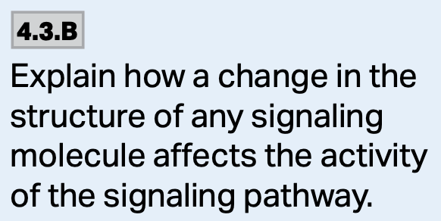
Cholera & Pertussis toxin Summary
https://www.google.com/url?sa=i&url=https%3A%2F%2Fwww.sciencedirect.com%2Ftopics%2Fneuroscience%2Fgi-alpha-subunit&psig=AOvVaw3kYuqe7acN-QlYp3Ew41Gl&ust=1607378621516000&source=images&cd=vfe&ved=0CAIQjRxqFwoTCOD_6JCuuu0CFQAAAAAdAAAAABAw

Slide 25
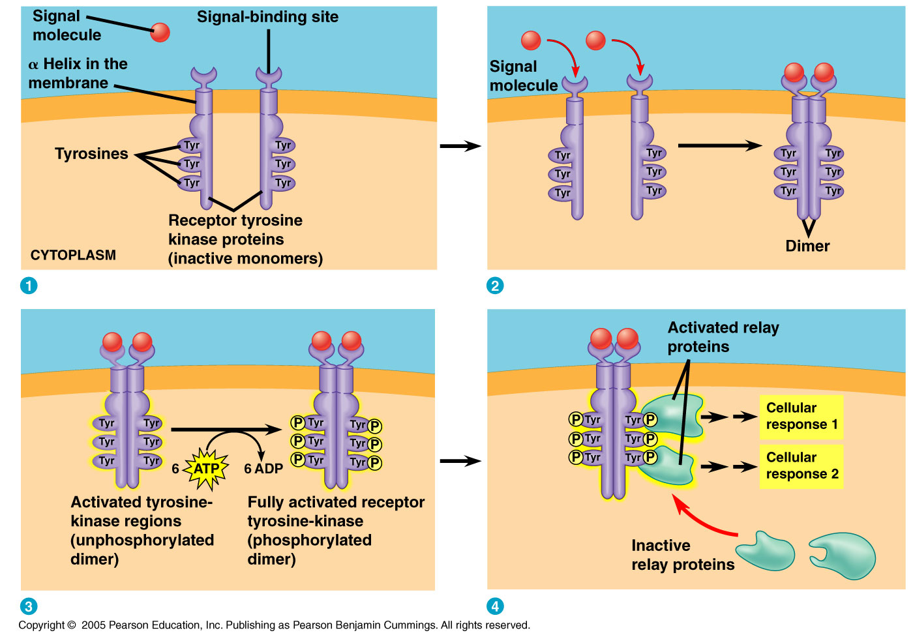
B. Receptor Tyrosine Kinases
Receptor tyrosine kinases belong to a major class of plasma membrane receptors which have enzymatic activity.

Slide 26
B. Receptor Tyrosine Kinases
The part of the receptor protein which extends into the cytoplasm acts as the tyrosine kinase—the enzyme that catalyzes the transfer of the phosphate from ATP to the amino acid tyrosine on the substrate protein.

Slide 27
B. Receptor Tyrosine Kinases
One receptor tyrosine kinase can activate a number of different transduction pathways.
The ability of these receptors to trigger so many pathways is a key difference between receptor tyrosine kinases and G-protein coupled receptors.

Slide 28
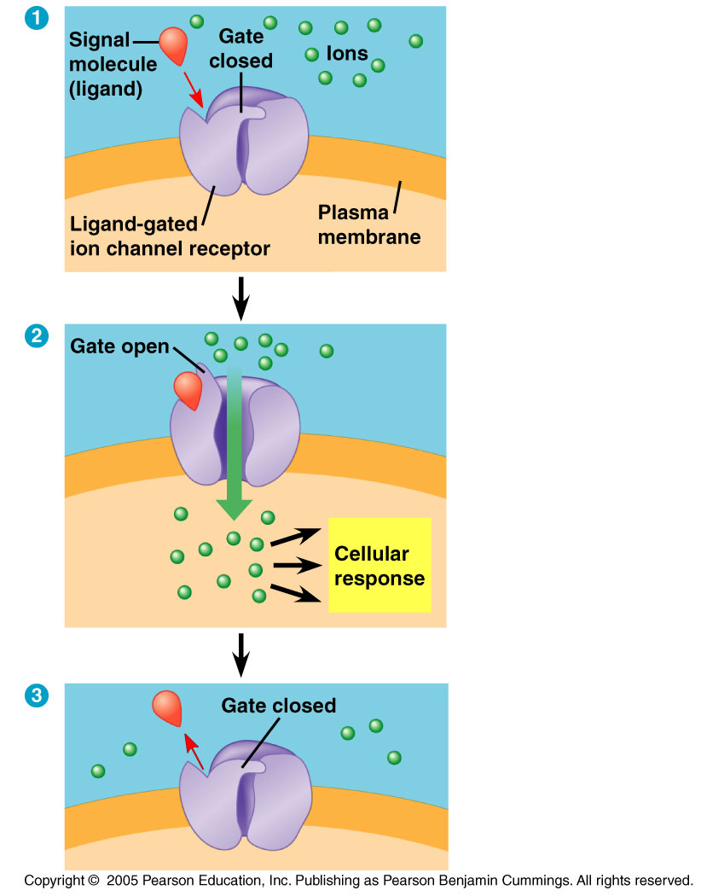
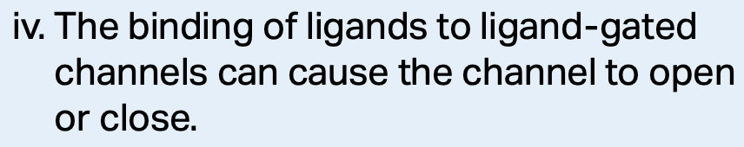
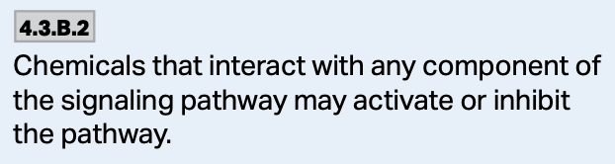
C. Ion Channel Receptors
Ligand-gated ion channels are a type of membrane receptor with a region that acts as a gate.
In this example the ligand is acetylcholine-excitatory.

Slide 29
C. Ion Channel Receptors
Ligand-gated ion channels are a type of membrane receptor with a region that acts as a gate.
In this example the ligand is GABA-inhibitory.

Slide 30
C. Ion Channel Receptors
When a signaling molecule binds to the receptor, a conformational change occurs and a gate opens or closes.
This opening or closing allows for the flow or blockage of specific ions—eg. Ca²⁺, Na⁺, Cl⁻ etc.
These are often associated with neurons and when the neurotransmitter (ACh/GABA) is released, it binds to and activates the channel allowing passage of ions.

Slide 31
C. Ion Channel Receptors
These channels are very important to the nervous system.
When a signaling molecule such as a neurotransmitter is released at the synapse, it acts as a ligand and binds to the ion channel on the receiving cell.
https://www.google.com/url?sa=i&url=https%3A%2F%2Fwww.chegg.com%2Fflashcards%2Fch-11-nervous-system-5f46b190-fa7a-4b3c-b03b-15f917df74bb%2Fdeck&psig=AOvVaw0n_edO1j8vw-P1w33drtgn&ust=1608301998142000&source=images&cd=vfe&ved=0CAIQjRxqFwoTCMj084Ce1e0CFQAAAAAdAAAAABAD

Slide 32
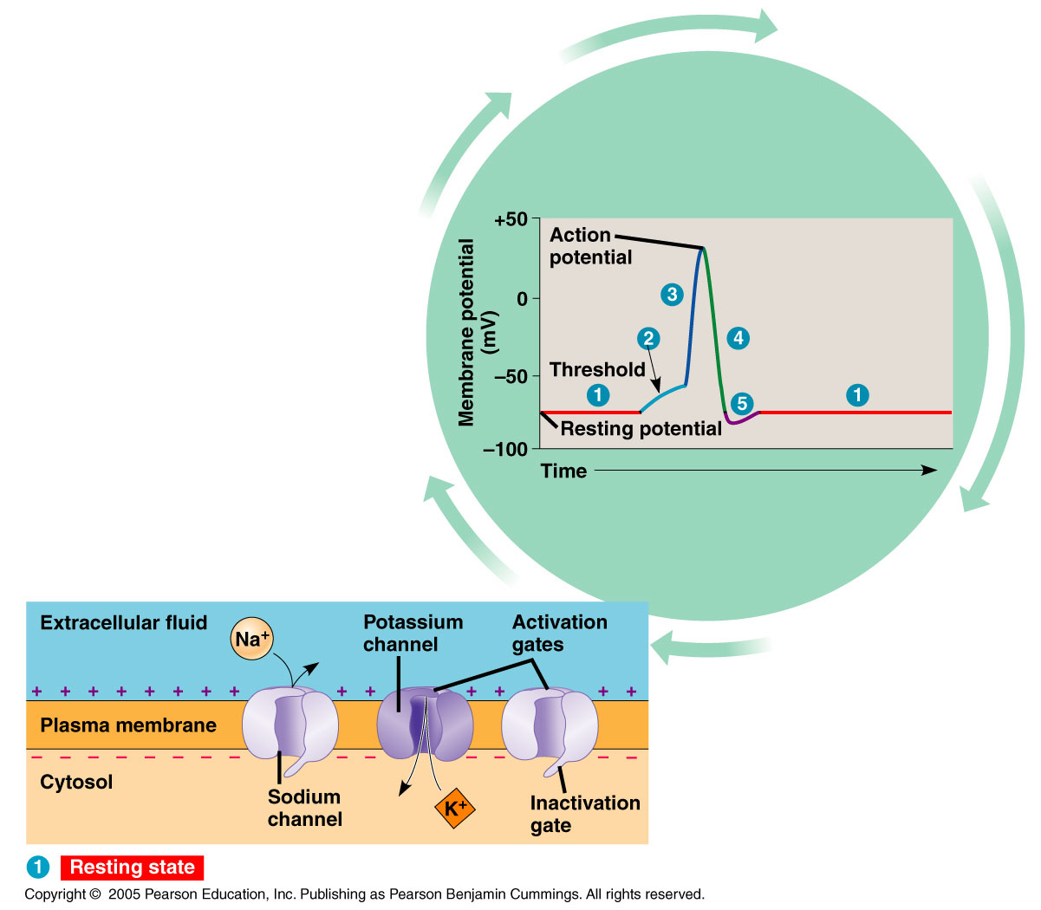
C. Ion Channel Receptors
Binding, in turn, causes the channel to open and ions flow through the gate triggering an electrical signal that rapidly moves along the length of the receiving cell.

Slide 33
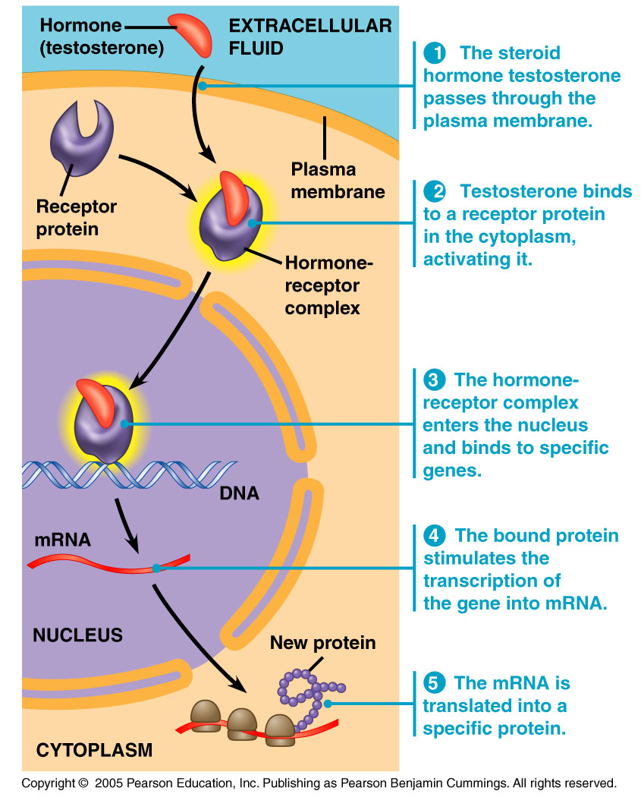
Intracellular Receptors
Intracellular receptor proteins can also be found in the nucleus or the cytoplasm of target cells.
In order to reach these receptors, the chemical messenger must pass through the plasma membrane.
Hydrophobic signaling molecules such as steroid hormones, thyroid hormones, and nitric oxide are common messengers that pass through the plasma membrane.

Slide 34
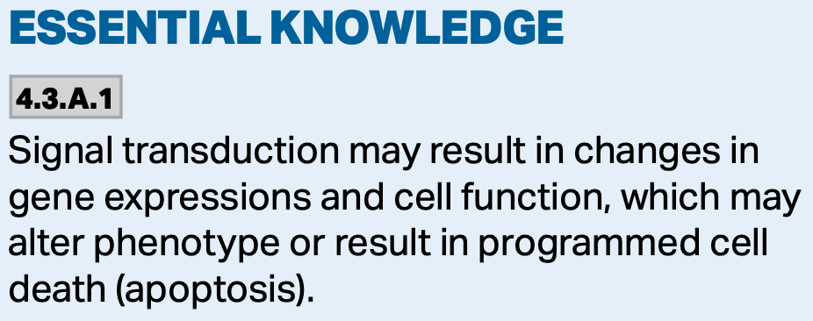
Intracellular Receptors
Once they pass through the membrane, the signals activate a receptor protein which then enters the nucleus and turns on transcription and translation.

Slide 35
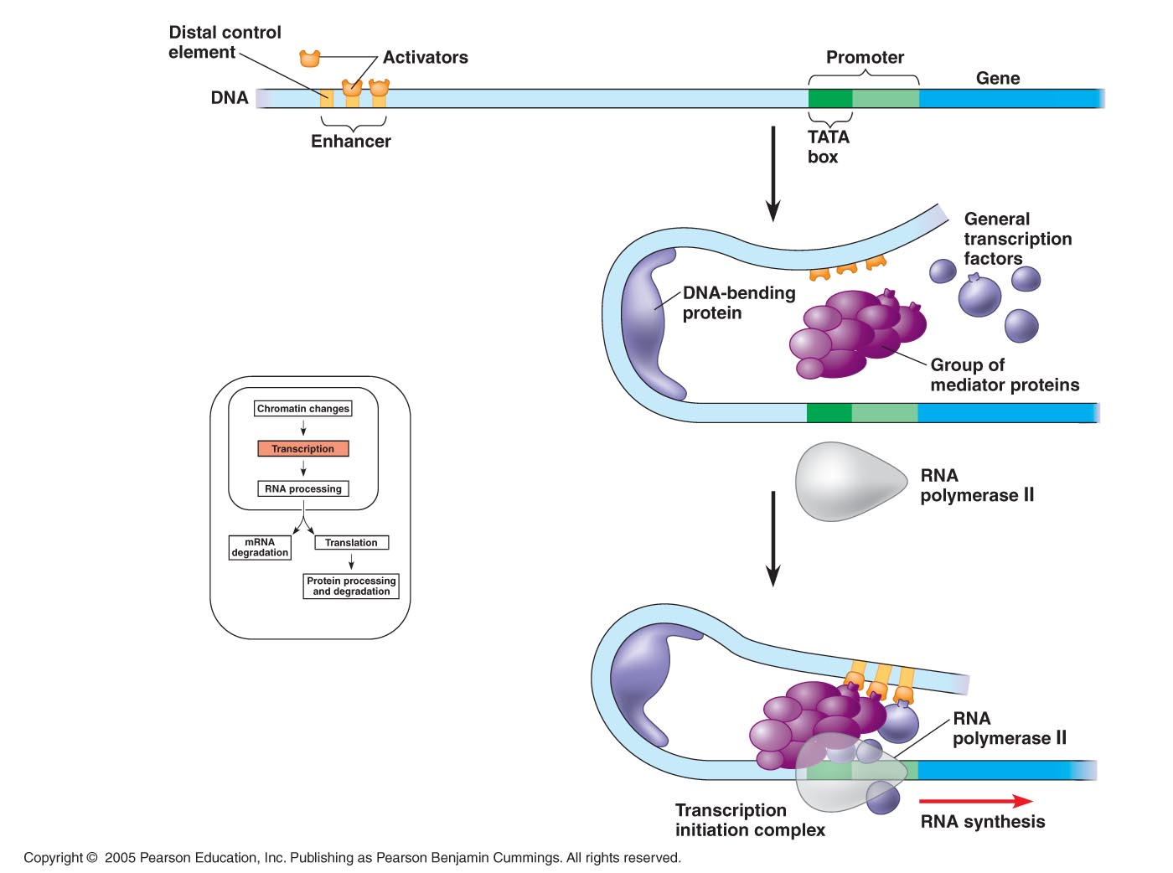
Intracellular Receptors
How does this happen?
These activated receptor proteins act as transcription factors which control the transcription of genes into mRNA, and ultimately the production of protein.

Slide 36
Aldosterone
This steroid hormone diffuses into the cell where it causes a signal transduction pathway leading to the production of protein pumps that move sodium ions from the urine into the interstitial fluid.
As sodium moves into the fluid, water follows. This is one of the mechanisms used to promote water reabsorption by the kidney.
https://www.google.com/url?sa=i&url=https%3A%2F%2Fslideplayer.com%2Fslide%2F10475134%2F&psig=AOvVaw1JezT2tVgc_1PNyru55_uU&ust=1608228875275000&source=images&cd=vfe&ved=0CAIQjRxqGAoTCKDEuciN0-0CFQAAAAAdAAAAABDOAQ

Slide 37
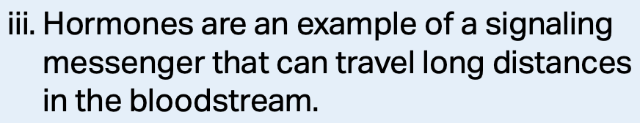
ADH/Vasopressin
This water-soluble hormone is released by the posterior pituitary and stimulates a signal transduction pathway in the cells of the collecting duct leading to the expression of genes which produce aquaporin proteins.
This promotes reabsorption of water from the urine.
http://humanbiologylab.pbworks.com/w/page/109374862/ADH%20Tutorial

Slide 38
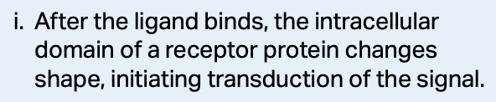
3 Stages of Cell Signaling
2. Transduction. When the signaling molecule changes the receptor protein in some way (usually a shape change in the intracellular portion of the receptor protein), transduction is initiated.
This is the stage where the signal is converted into a form bringing about a specific cellular response.

Slide 39
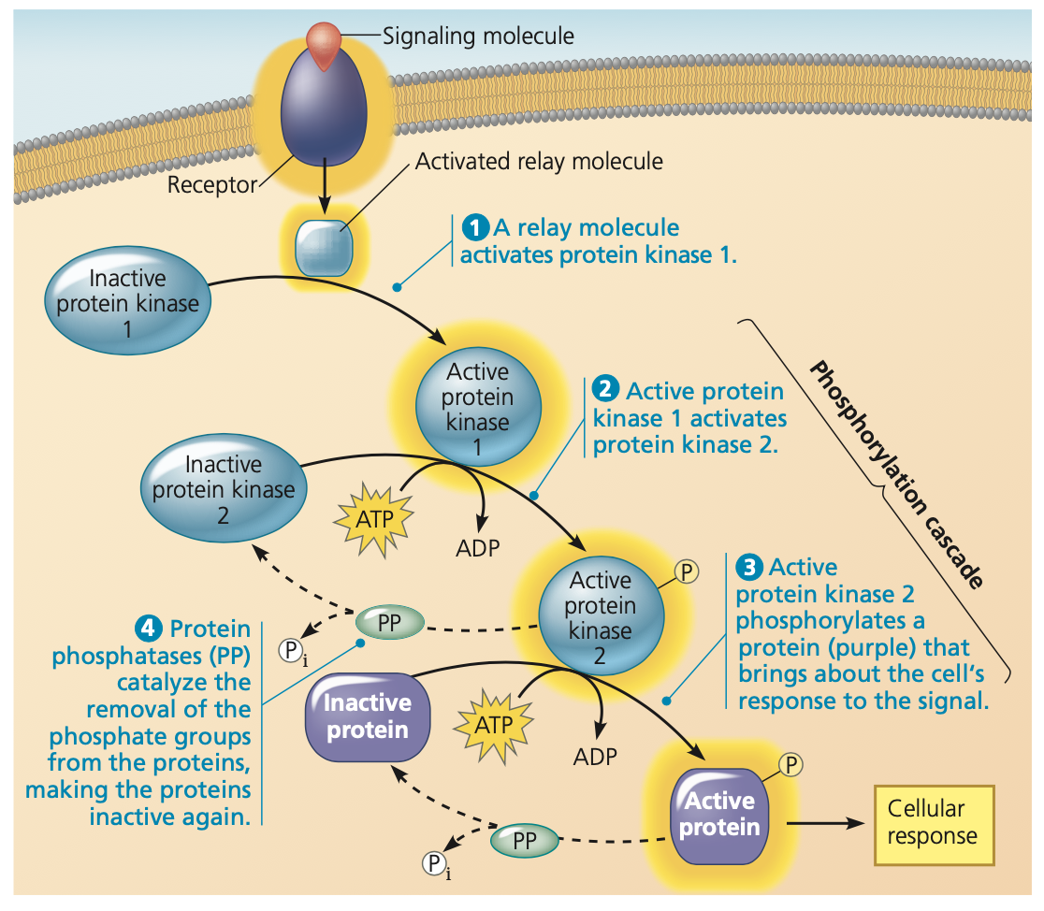
3 Stages of Cell Signaling
Transduction can occur in one step, but often involves many steps.
https://www.google.com/url?sa=i&url=https%3A%2F%2Fmedium.com%2F%40thanradayawichai%2Fcampbell-16-nucleic-acids-and-inheritance-4315304f7651&psig=AOvVaw3E0mZHN2NYJB8S7i9lNXrJ&ust=1607707945973000&source=images&cd=vfe&ved=0CAIQjRxqFwoTCIjJopn5w-0CFQAAAAAdAAAAABAT

Slide 40
2. Signal Transduction
Cell signaling is usually a multistep pathway.
These steps can include:
  The addition of phosphate groups (kinases).
  The removal of phosphate groups (phosphatases).
  Release of small molecules or ions which act as messengers (often called second messengers).

Slide 41
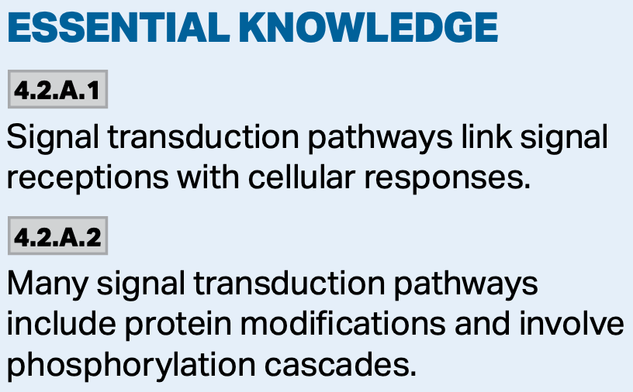
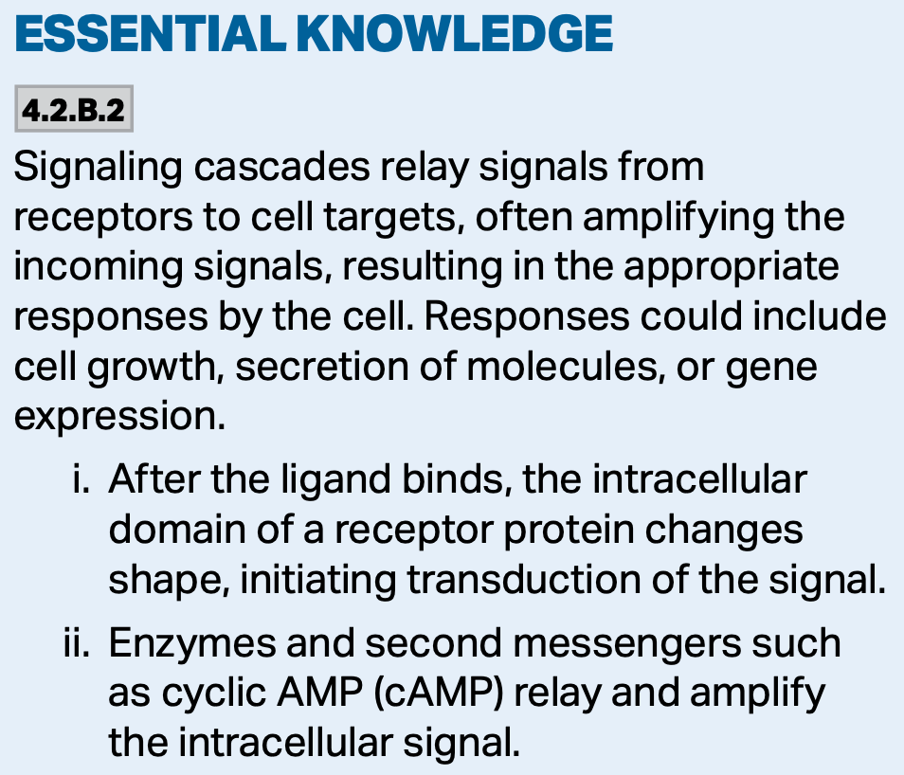
2. Signal Transduction
By this method, the signal is often amplified as a small number of initial molecules interact with a larger number of molecules in the next step of the pathway.
https://www.google.com/url?sa=i&url=https%3A%2F%2Fcz.pinterest.com%2Fpin%2F426645764676682859%2F&psig=AOvVaw3uQV_5QF5WEeSLkyurGLDc&ust=1607710156746000&source=images&cd=vfe&ved=0CAIQjRxqFwoTCKCfj5mBxO0CFQAAAAAdAAAAABAN

Slide 42
Signal Transduction Pathway
Recall in the first step of the pathway, the signaling molecule attaches to the receptor protein.
From here, the relay molecules (mostly proteins) transmit the signal to the next step—usually resulting in a change in protein conformation.
These pathways can regulate both the activity of the proteins, or the synthesis of them.

Slide 43
Kinases and Phosphatases
The phosphorylation and dephosphorylation of proteins is a common cellular mechanism for regulating protein activity.
  Protein kinases are enzymes that transfer a phosphate group from ATP to a protein.
    These are very important—at least 2% of our genes code for protein kinases.
  Phosphatases rapidly remove phosphate groups from proteins in a process called dephosphorylation.
  They act as off switches in the signal pathway, and they make the protein kinases available for reuse.
Each cell may have more than 100 different kinds of protein kinases.
It seems far fewer phosphatases are needed than kinases as the percentage of genes coding for them is much lower.

Slide 44
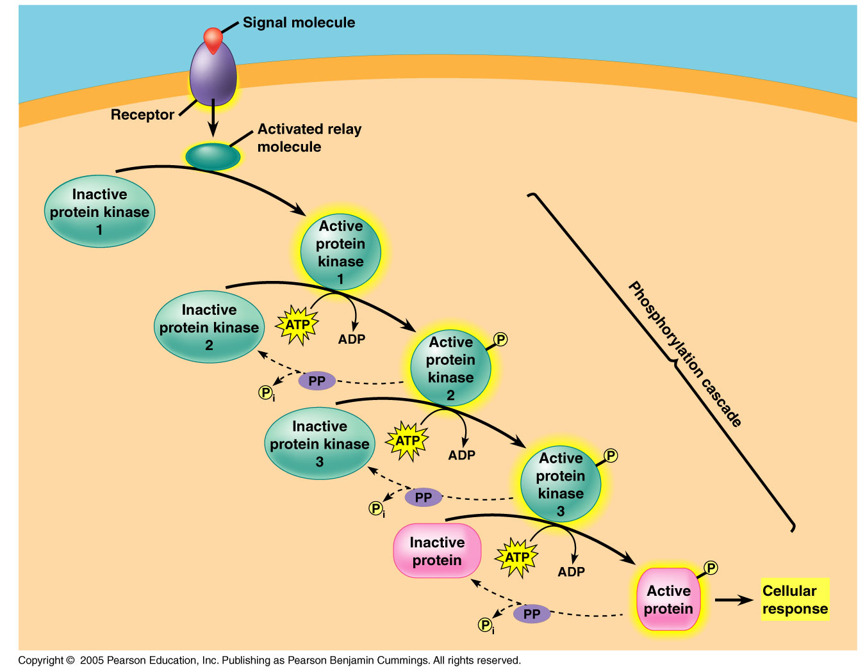
Protein Kinases
Many relay molecules in a signal transduction pathway are protein kinases; these often act on other protein kinases in the pathway.

Slide 45
Phosphorylation Cascade
In such a cascade, a series of different molecules in the pathway are phosphorylated, and in turn, each molecule adds a phosphate group to the next one in the series.

Slide 46
Phosphorylation Cascade
Generally speaking, phosphorylation activates each molecule, and dephosphorylation returns it to its inactive form; each often results in a change in molecular shape.

Slide 47
Second Messengers
Some components of the signal transduction pathways are NOT proteins.
Many of these pathways involve second messengers, which are often small, water soluble molecules or ions. Additionally, they can easily diffuse through the cytoplasm.
Second messengers participate in signal transduction pathways initiated by both G protein-coupled receptors and receptor tyrosine kinases.
  cAMP and Ca²⁺ are the two most commonly used second messengers.

Slide 48
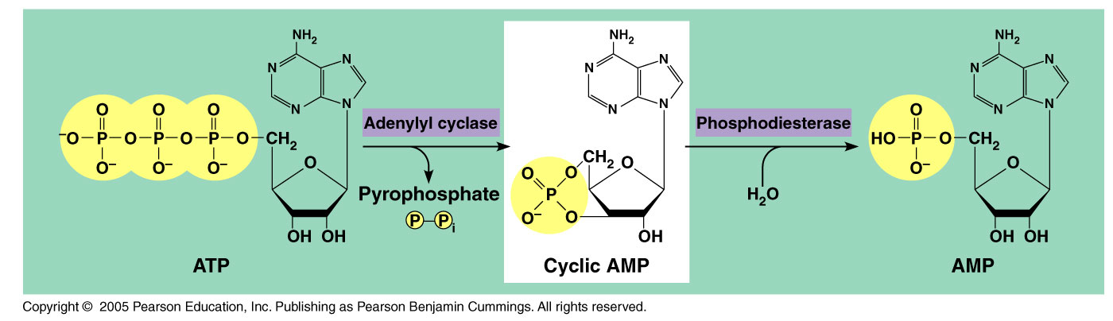
Cyclic AMP
Embedded within the membrane is an enzyme called adenylyl cyclase which converts ATP to cAMP in response to the extracellular signal.

Slide 49
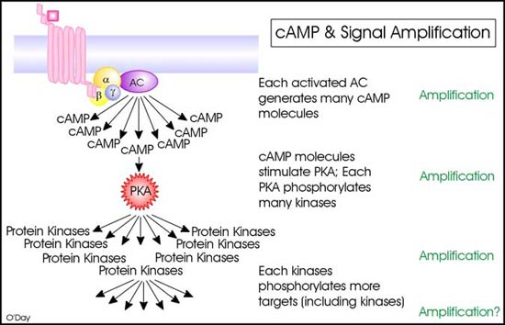
Cyclic AMP
Thus, in a matter of seconds, the amount of cAMP can be dramatically increased.
https://www.google.com/url?sa=i&url=https%3A%2F%2Fnptel.ac.in%2Fcontent%2Fstorage2%2Fcourses%2F102103012%2Fpdf%2Fmod5.pdf&psig=AOvVaw3uDeyGajhNk-BtRmboYgq3&ust=1608141472459000&source=images&cd=vfe&ved=0CAIQjRxqFwoTCJiRi5bI0O0CFQAAAAAdAAAAABAD
https://www.google.com/url?sa=i&url=https%3A%2F%2Fwww.slideshare.net%2FDrHumeraWaheed%2Fhormones-62995608&psig=AOvVaw3KLJIINZa7VgUv7Dpibdzm&ust=1608141240288000&source=images&cd=vfe&ved=0CAIQjRxqFwoTCOiLs47H0O0CFQAAAAAdAAAAABAT

Slide 50
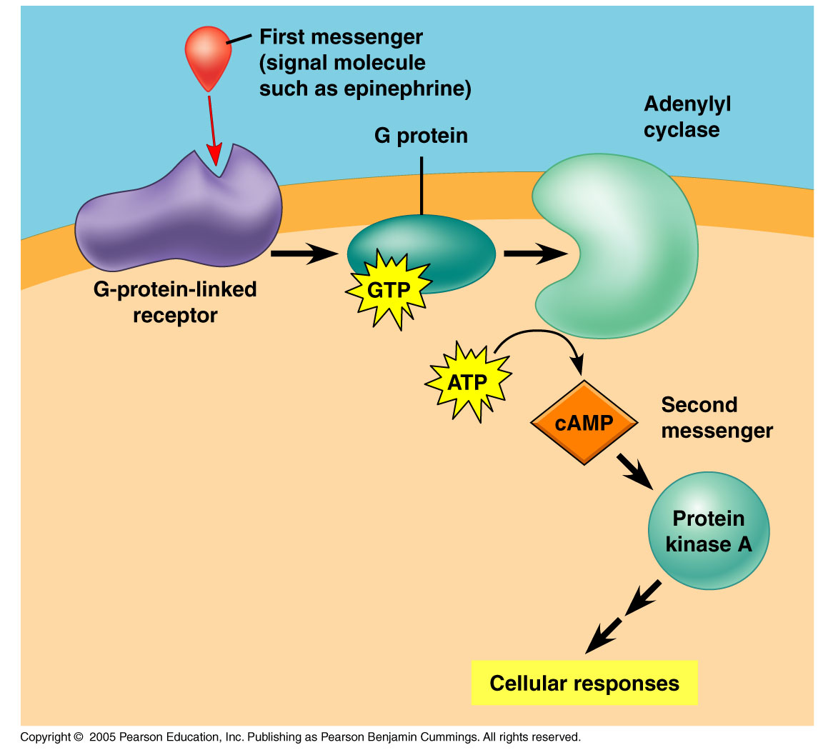
Cyclic AMP
Not long after cAMP is created, phosphodiesterase converts it to AMP and the pathway shuts down.
  The immediate effect of cAMP is usually the activation of a serine/threonine kinase called protein kinase A.
  This leads to further transmission of the signal.

Slide 51
Cyclic AMP
Cell metabolism can be further regulated by other G-protein systems that inhibit adenylyl cyclase.
In such cases, a different signaling molecule activates different receptors which, in turn, activate inhibitory G-proteins.
https://www.google.com/url?sa=i&url=https%3A%2F%2Fwww.mdpi.com%2F2072-6651%2F3%2F7%2F884%2Fhtm&psig=AOvVaw0DZkxR_dBwfTA7vtwFXbuW&ust=1608142033807000&source=images&cd=vfe&ved=0CAIQjRxqFwoTCKjWoIrK0O0CFQAAAAAdAAAAABAD

Slide 52
Calcium ions and IP₃
Many signaling molecules induce responses in their target cells by signal transduction pathways.
These pathways increase the cytosolic concentration of Ca²⁺ ions.

Slide 53
Calcium ions and IP₃
Calcium is actively pumped out of the cell and thus the concentration of Ca²⁺ is normally about 10,000x lower in the cytoplasm of the cell.

Slide 54
Calcium ions and IP₃
When an appropriate signal is received, a variety of second messengers get involved resulting in an increase in cytoplasmic calcium concentration.

Slide 55
Calcium ions and IP₃
IP₃ and diacylglycerol are two messengers produced by the alteration of a phospholipid in the plasma membrane.
This leads to the increase in the Ca²⁺ concentration within the cytoplasm.

Slide 56
Calcium ions and IP₃
Calcium ions cause many responses in animals such as neurotransmission, hormone release, muscle contraction, etc.
In plants, calcium ions are responsible for signaling pathways such as the greening response.

Slide 57
Calcium ions and IP₃
The release of calcium often involves IP₃ and DAG, two other second messengers.

Slide 58
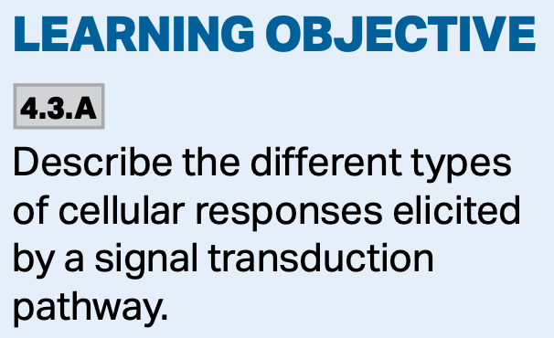
3 Stages of Cell Signaling
3. Response. The response occurs when the transduced signal triggers a specific cellular response.

Slide 59
3. Cellular Responses
Many signaling pathways ultimately regulate protein synthesis, usually by turning specific genes on and off.

Slide 60
Fine Tuning Cellular Response
There are many benefits to having multiple events in a signal transduction pathway.
Two important benefits:
  1. They easily amplify the signal.
  2. They provide different points where the response can be regulated.

Slide 61
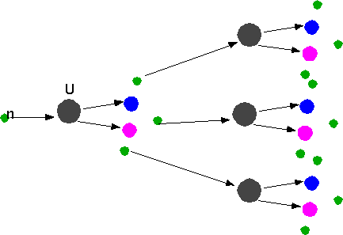
1. Signal Amplification
Elaborate enzyme cascades amplify a cell’s response to an external signal.
  Such cascades serve to activate many more products in the following stage—in much the same way as occurs during a nuclear chain reaction.
http://www.utm.utoronto.ca/~w3bio315/lecture10.htm
http://www.physics.carleton.ca/~watson/Physics/1000_level/1008_Modern_Physics/1008_Nuclear_Physics_app.html

Slide 62
2. Different Regulation Points
When there are many steps involved, different substances can bind to different proteins, inactivating them, and ultimately controlling the pathway and hence the response.
https://www.google.com/url?sa=i&url=https%3A%2F%2Fm.youtube.com%2Fwatch%3Fv%3DW3ZASYwqjNc&psig=AOvVaw0wYthPiAk5pqIbthaa9JnW&ust=1608216738385000&source=images&cd=vfe&ved=0CAIQjRxqFwoTCJCQya7g0u0CFQAAAAAdAAAAABA5

Slide 63
Signal Efficiency
There are many large relay molecules and scaffolding proteins that assist in increasing the efficiency of the signal transduction.
They are necessary because the signal alone cannot simply diffuse through the cytosol.
https://www.google.com/url?sa=i&url=http%3A%2F%2Ffig.cox.miami.edu%2F~cmallery%2F150%2Fmemb%2Fcellcomm.htm&psig=AOvVaw2wskWpalKrO1gc-LD8JB3I&ust=1608218764766000&source=images&cd=vfe&ved=0CAIQjRxqFwoTCOjSrvTn0u0CFQAAAAAdAAAAABAV

Slide 64
Signal Termination
Signal termination occurs because of the reversibility of the changes the signals produce.
The receptor reverts to its inactive form as do the relay molecules and the cell is now ready to respond to fresh stimuli.

Slide 65
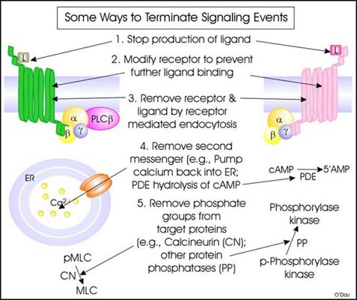
Signal Termination
Eventually, the signal needs to be terminated so that the cell doesn’t unnecessarily make too much product or waste energy.
Below are some ways in which signal termination occurs:
  Remove ligand.
  Modify receptor.
  Endocytose receptor.
  Remove 2nd messenger.
  Remove phosphates.
http://www.utm.utoronto.ca/~w3bio315/lecture10.htm#section10

