Slide 1
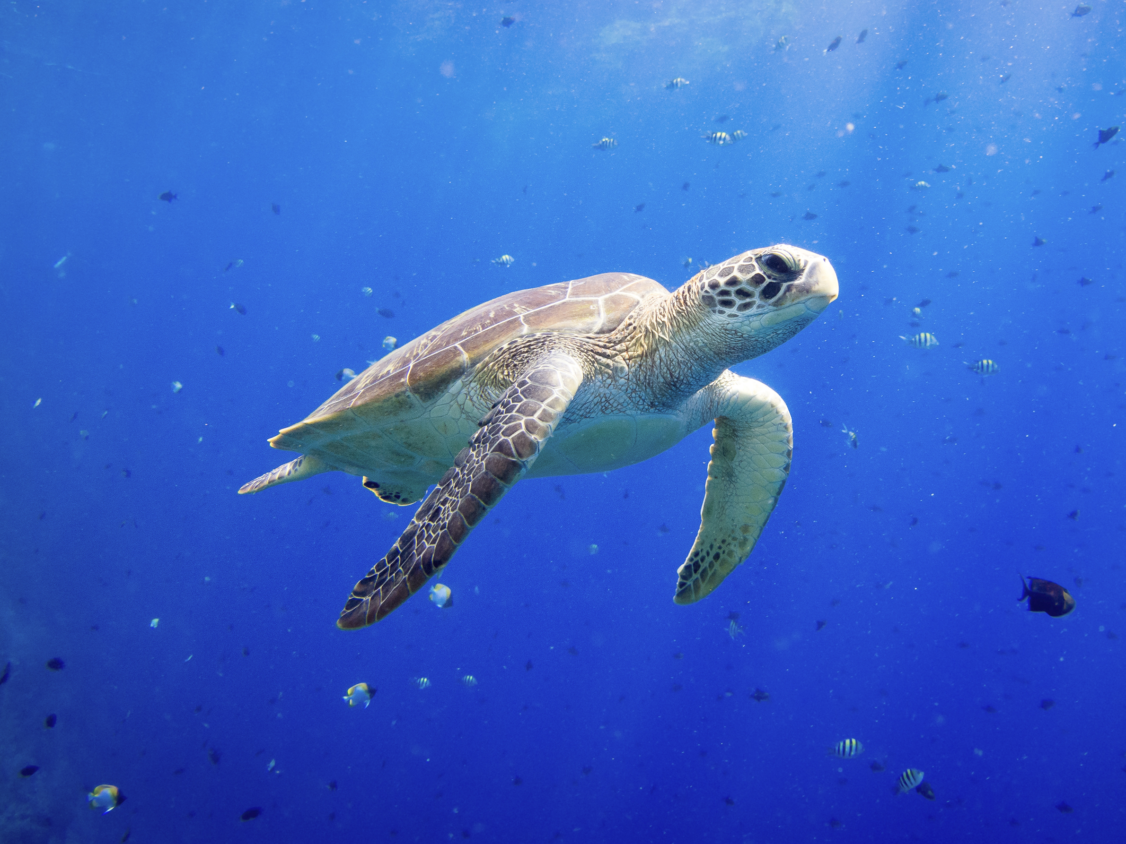
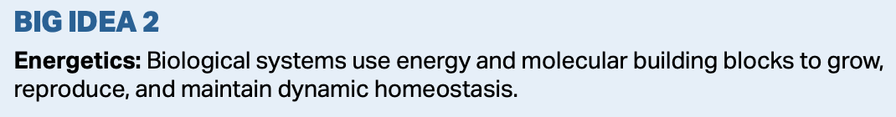
Responses to the Environment

Slide 2
Environmental Change
Organisms respond to changes in their environment by altering their behavior, or through physiological mechanisms.

Slide 3
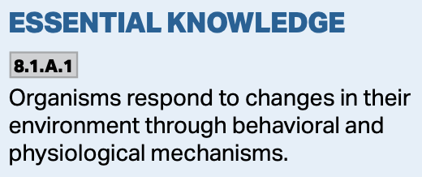
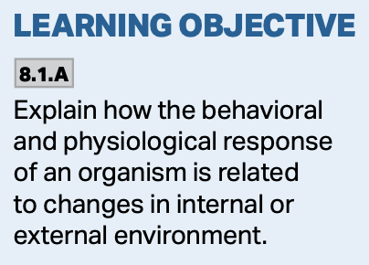
Behavioral Changes
Taxis and kinesis.
Taxis is the movement of an animal in response to a stimulus like light or food.
This is directed movement in response to a stimulus.
https://onlinesciencenotes.com/taxis-and-its-types-on-the-basis-of-stimulus/

Slide 4
Behavioral Changes
Taxis and kinesis.
Kinesis is non-directional movement by an animal in response to a stimulus such as light or food.

Slide 5
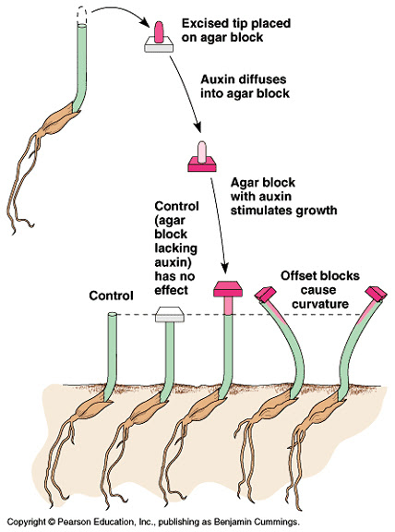
Behavioral Changes
Taxis applies to animals, phototropism applies to plants.
Plants have the ability to sense light and direct their movement towards it through differential growth.

Slide 6
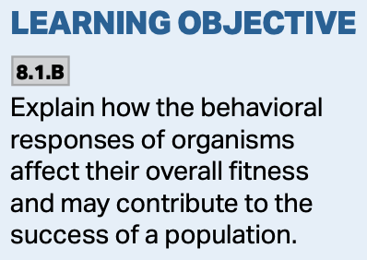
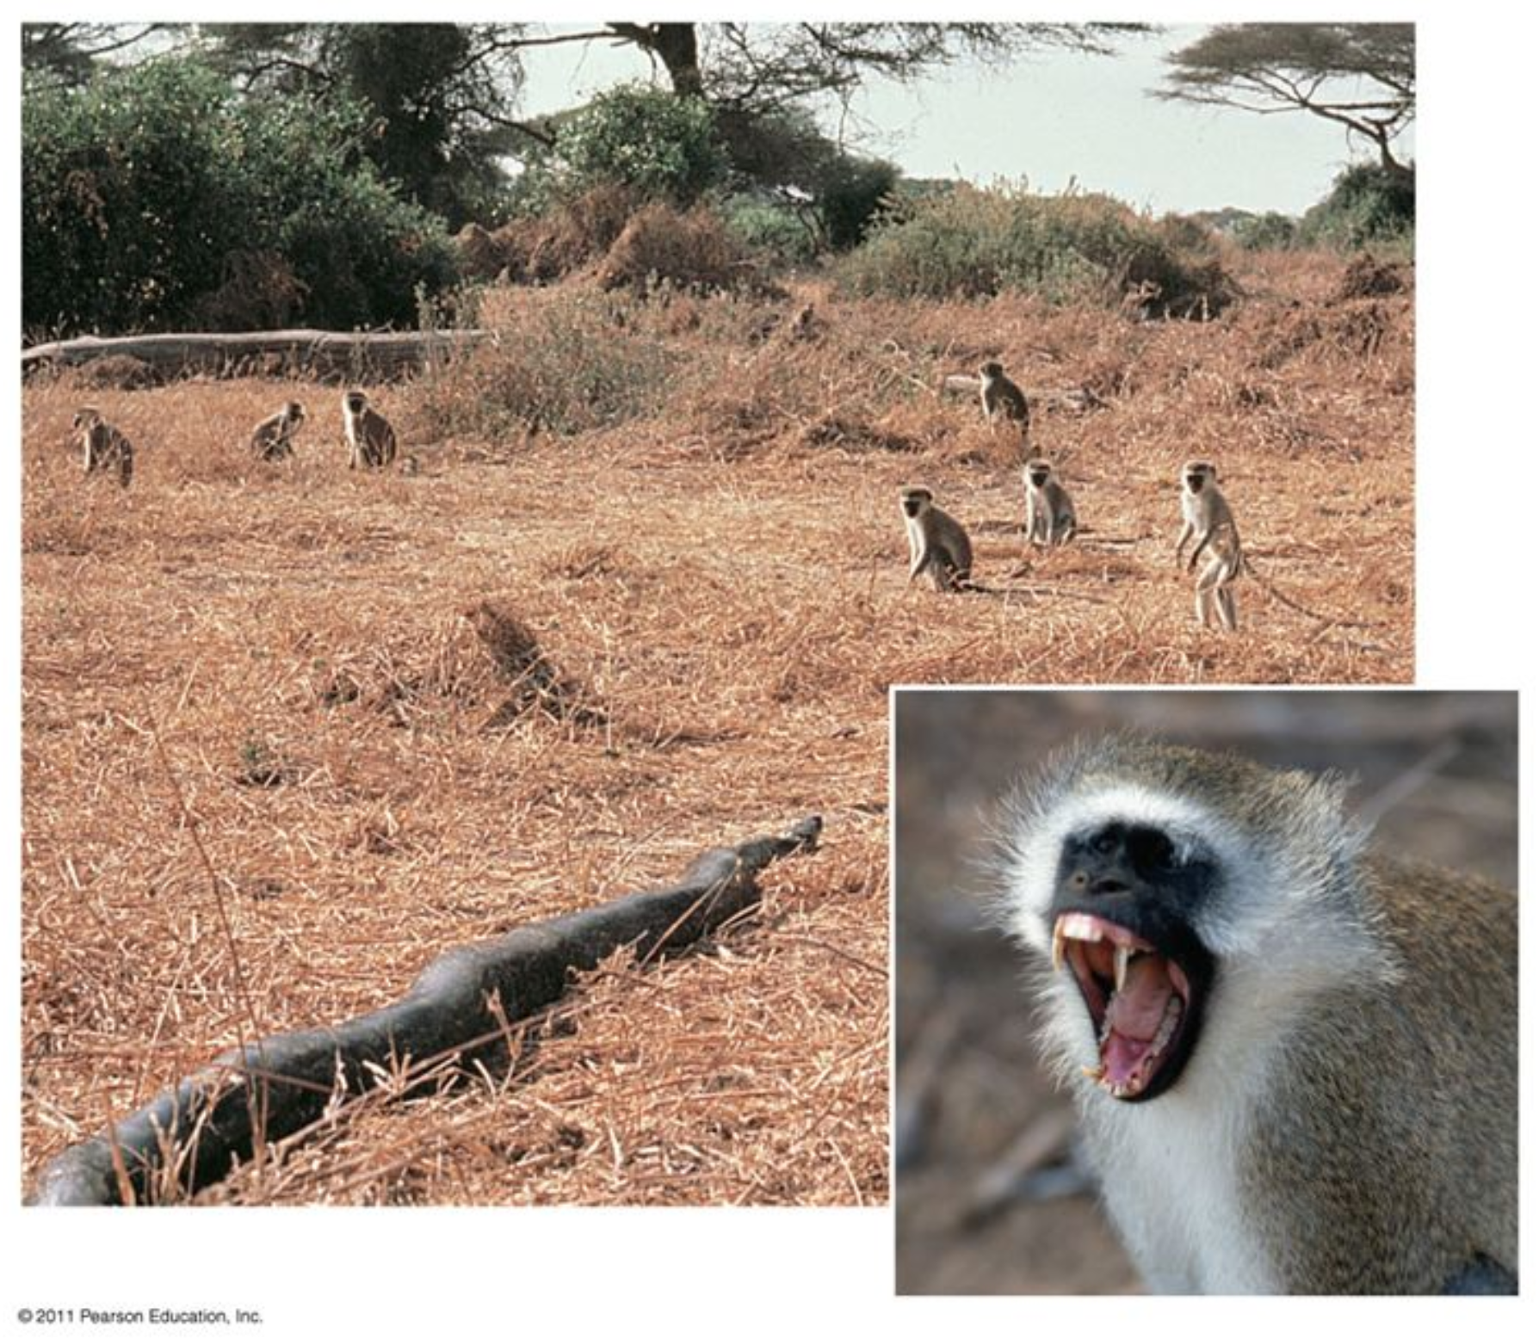
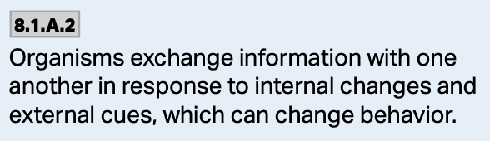
Behavioral Changes
There are other ways for organisms to change their behavior as well.
Many of them exchange information with each other in response to both internal and external cues.
The exchange in information often results in behavioral changes.

Slide 7
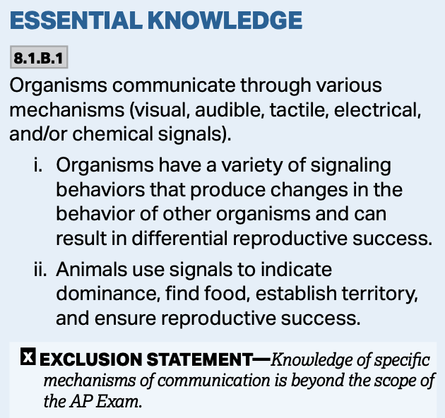
Types of Signals
Animals can use a variety of signals to communicate with other organisms and to try to ensure reproductive success.
Visual, audible, tactile, electrical, and chemical signals can be used to indicate the following:
  Where food is located
  Dominance over others
  Territory

Slide 8
Types of Signals
Visual, audible, tactile, electrical, and chemical signals can be used to indicate the following:
  Where food is located
  Dominance over others
  Territory
https://www.frontiersin.org/articles/10.3389/fevo.2018.00093/full (A) Harlequin bug, Tectocoris diophthalmus; (B) Eastern newt (eft form), Notophtalmus viridescens; (C) Burnet moths, Family Zygaenidae; (D) Sea slug, Chomodoris annae; (E) Eastern coral snake, Micrurus fluvius; (F) Appalachian mountains millipede, Apheloria polychroma; (G) Harlequin poison frog, Oophaga occultator; (H) ladybird, family Coccinelidae.

Slide 9
Behavioral Changes
Bacteria exchange information with each other through a process known as quorum sensing.
Using this mechanism, bacterial cells exchange information about the environment with other cells to help them regulate gene expression using signaling molecules.

Slide 10
Behavioral Changes
By changing gene expression, bacteria can work together to promote biofilm formation, disease mechanisms, production of metabolites, and other factors that enhance survival.

Slide 11
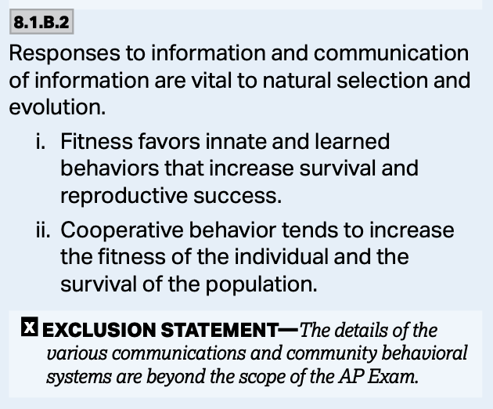
The Evolutionary Connection
How an organism responds to the environmental information, and how it communicates it to others is vital to natural selection and evolution.

Slide 12
The Evolutionary Connection
Natural selection will favor both innate and learned behaviors that increase survival.
This will increase reproductive fitness within those individuals who have the traits that enable them to perform these behaviors.
It will reduce the fitness of those who can’t.

Slide 13
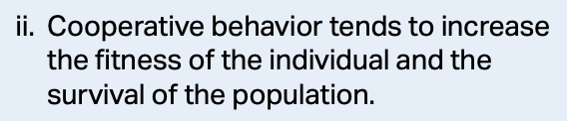
Cooperative Behavior
Cooperative behavior occurs when organisms work together to enhance fitness.
Both organisms benefit.
  Wolves hunting for a meal as a pack are a good example of cooperative behavior.
  Cooperative breeding is another example. Meerkats and some birds work together to raise young. Non-breeding members work to protect and feed offspring that aren’t theirs.

Slide 14
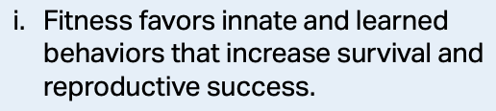
The Evolutionary Connection
Imprinting is an innate behavior that some organisms possess that is crucial to their survival.
When some organisms hatch, they imprint on their parent and follow them around.
This increases fitness.
https://i.imgur.com/KoVDqIm.jpg

Slide 15
The Evolutionary Connection
Cooperative behavior will work to increase the fitness of the individual and the survival of the population.
When organisms can work together to achieve a common goal, there is usually mutual benefit.
It is often in the interest of both organism to cooperate when it involves survival—say for hunting, but it may not be in the case of reproduction—fighting for a mate.

Slide 16
The Evolutionary Connection
Communication in bees regarding the location of the food source enhances the survivability of the hive.

Slide 17
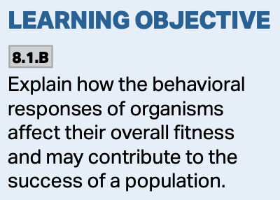
The Evolutionary Connection
Schooling in fish is a mechanism of communication about a pending threat.
Staying in the school increases the chances of survival.
More fit individuals congregate in the middle of the school. Less fit ones are towards the outside.
https://i.pinimg.com/originals/06/c7/18/06c718a66692fde63f4e3bc40620c023.jpg

Slide 18
Significance
There are a wide variety of communication and behavior mechanisms organisms use, and many examples that can be cited. Knowledge of any specific example is not necessary.
What is important is that you understand how the example is a response to the change in the environment, and how it changes fitness and influences the evolution of the population.

