Slide 1
Chapter 10 Photosynthesis
“Sunshine splits apart the carbon dioxide that a plant has absorbed from the air, the plant throws out at that time the oxygen alone and keeps the carbon to itself as nourishment.” — Jan Ingenhousz (1779)

Slide 2
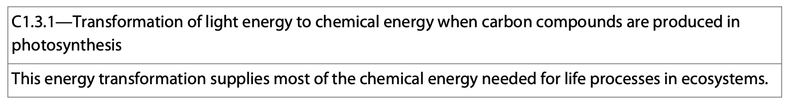
Essential Idea: Photosynthesis uses the energy in sunlight to produce the chemical energy needed for life.
Essential Idea: Light is converted into chemical energy.

Slide 3
TOK
To what extent is the creation of an elegant protocol similar to the creation of a work of art?

Slide 4
Autotrophs and Heterotrophs
Autotrophs are organisms that make their own food.
They obtain everything they need by using CO₂ and inorganic compounds from the environment.
Heterotrophs are unable to make their own food and survive on compounds made by other organisms.
Plants are autotrophic and animals are heterotrophic.

Slide 5
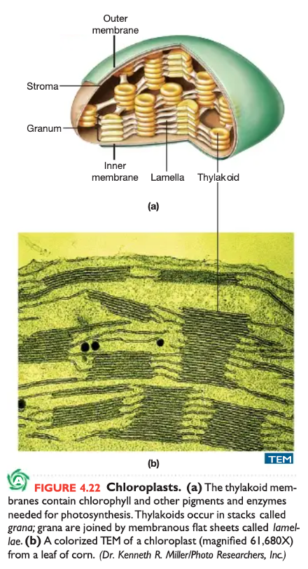
Chloroplasts
Chloroplasts are the main site of photosynthesis in plants.
They are found in all green parts of plants.
Chlorophyll is the green pigment found in chloroplasts and is responsible for a plant’s color.
Chlorophyll a is the main photosynthetic pigment.
There are many other pigments involved as well.

Slide 6
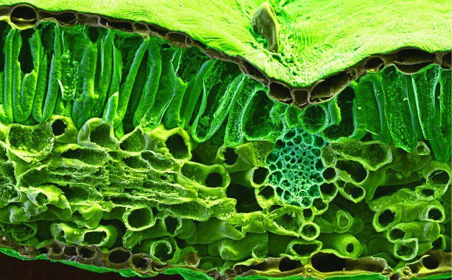
Chloroplasts
They are found in the mesophyll and absorb light and drive the synthesis of organic molecules.

Slide 7
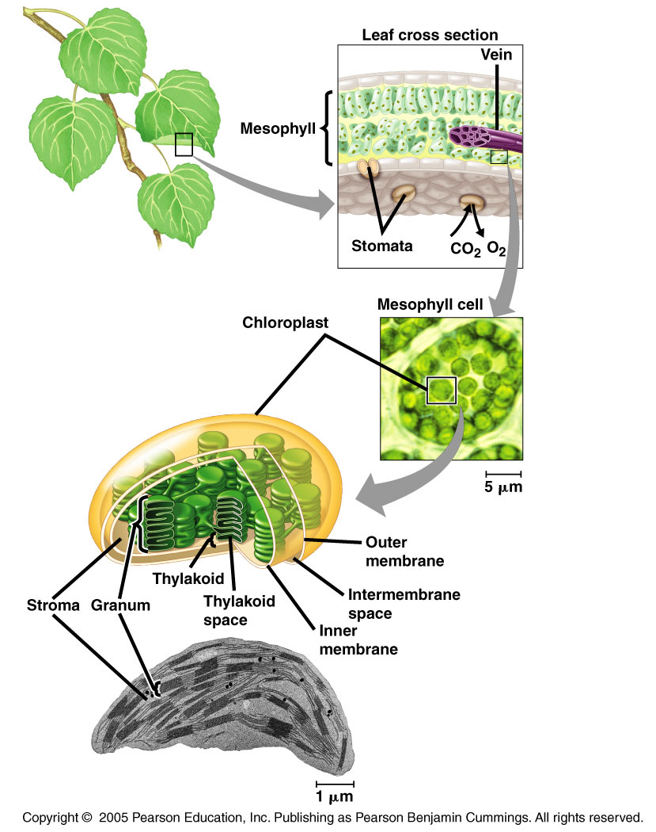
Chloroplasts
CO₂ and O₂ enter and exit the leaf through pores called stomata.
The leaves contain veins that deliver water to the leaves and sugar to the roots of the plant.

Slide 8
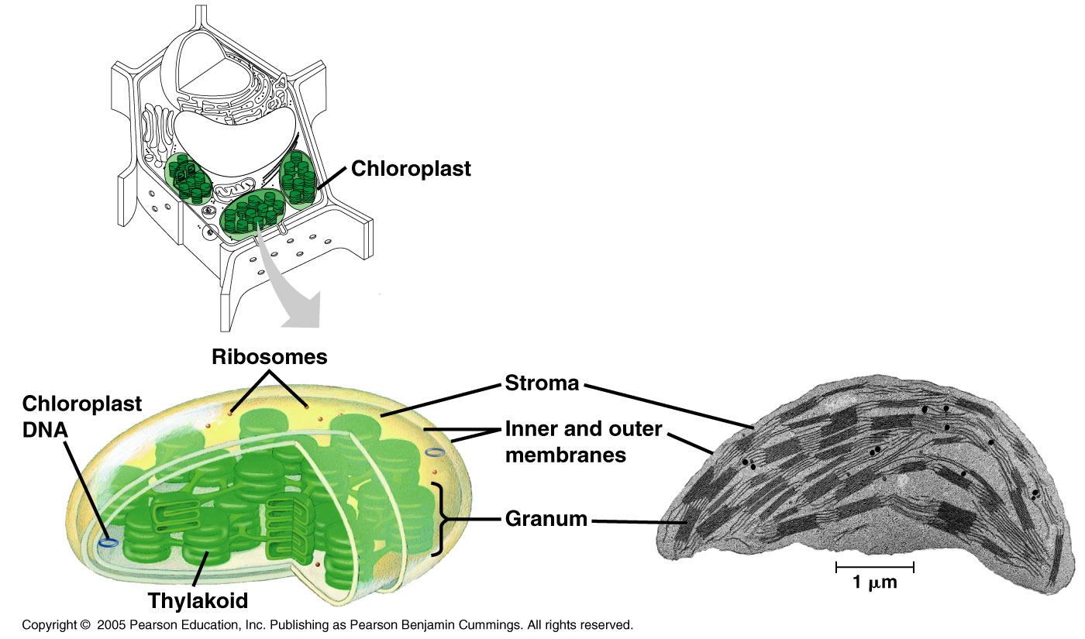
Chloroplasts
Like the mitochondrion, the chloroplast is enclosed by 2 membranes.
  Within the chloroplast is the stroma, the site of the light independent reactions of photosynthesis.
Tiny interconnected stacks of thylakoids are called grana.
  Inside of the thylakoids, the thylakoid space is where the light dependent reactions of photosynthesis take place.

Slide 9
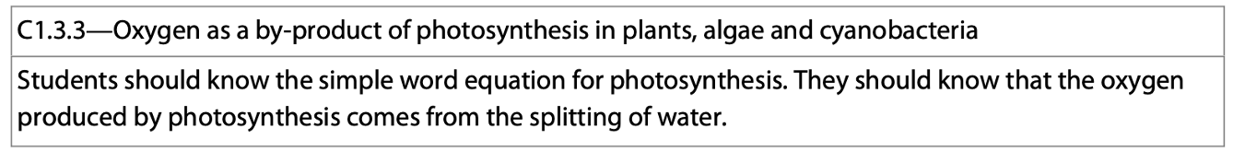
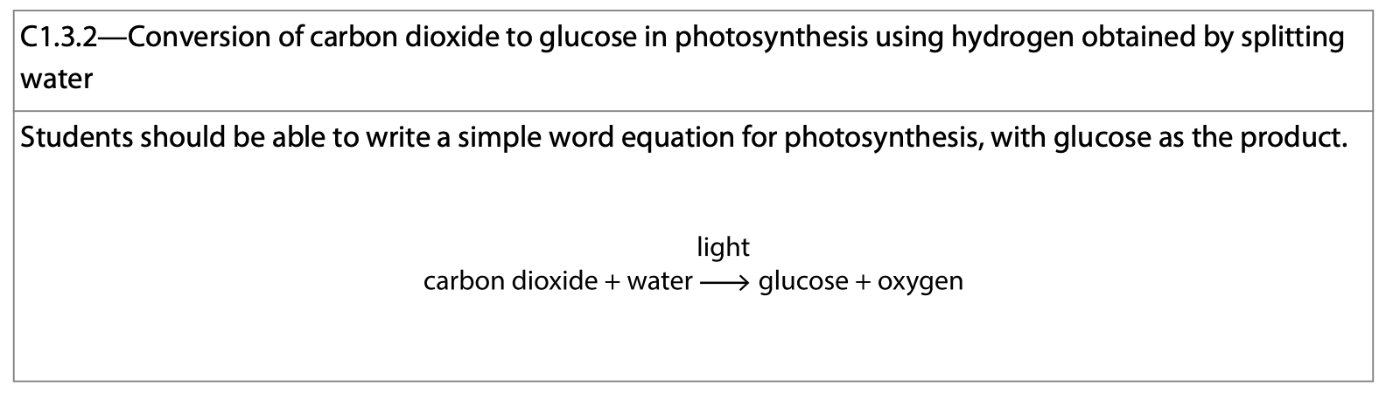
Photosynthesis
In general, photosynthesis is carried out according to the following equation:
    6CO₂ + 12H₂O + light energy —> C₆H₁₂O₆ + 6O₂ + 6H₂O
Which is essentially the reverse of cellular respiration:
C₆H₁₂O₆ + 6O₂ —> 6CO₂ + 6H₂O + energy

Slide 10
What Happens to the Atoms Involved?
In the 1930’s, C.B. van Neil was working with photosynthetic bacteria and showed where the oxygen gas (O2) came from.
  He demonstrated that H₂O was split.
One of the groups of bacterial used H₂S (vs. H₂O) and yellow globules of sulfur were produced as a waste product.

Slide 11
What Happens to the Atoms Involved?
van Neil’s reasoning was that the bacteria used the H atoms from hydrogen sulfide to make sugar and sulfur was a byproduct.
This idea was then generalized to say that all photosynthetic plants require a hydrogen source (which can vary) to make sugar and a byproduct is given off as a result (S, O₂, etc.).

Slide 12
What Happens to the Atoms Involved?
Sulfur Bacteria:
  CO₂ + 2H₂S —> CH₂O + H₂O + 2S
Plants:
  CO₂ + 2H₂O —> CH₂O + H₂O + O₂
General:
  CO₂ + 2H₂X —> CH₂O + H₂O + 2X

Slide 13
What Happens to the Atoms Involved?
As scientists learned more about radioactive tracers and how to use them, they used heavy oxygen (¹⁸O) and followed it through photosynthesis to confirm van Neil’s hypothesis.
They showed:
  That when ¹⁸O was used in the water the plants consumed, the plants would make O₂ with ¹⁸O.
  If CO₂ contained ¹⁸O, then the plant contained ¹⁸O in the carbohydrates and water.

Slide 14
What Happens to the Atoms Involved?
These experiments demonstrate the shuffling of atoms that takes place during photosynthesis. Here, O₂ is the “waste” product of photosynthesis.
Experiment 1: Radiolabeled O,¹⁸O, in water.
  CO₂ + 2H₂O —> CH₂O + H₂O + O₂
Experiment 2: Radiolabeled O,¹⁸O, in carbon dioxide.
  CO₂ + 2H₂O --> CH₂O + H₂O + O₂

Slide 15
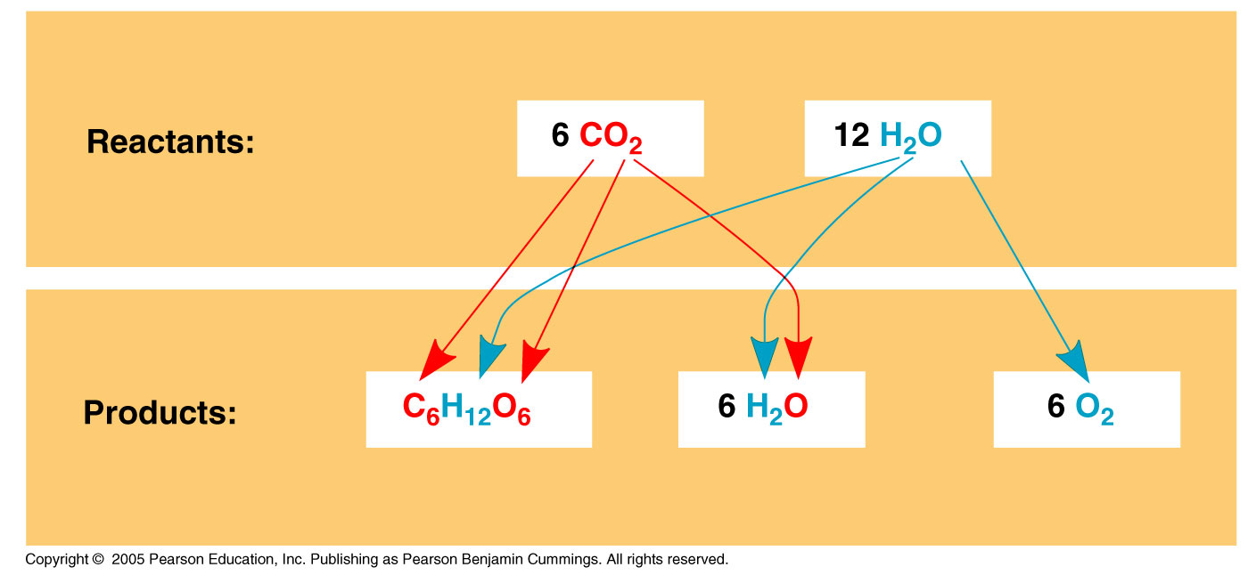
What Happens to the Atoms Involved?
The fate of the atoms involved can be seen here: This is referred to as the photolysis of water.

Slide 16
Photosynthesis and Cellular Respiration
Photosynthesis is essentially the reverse of cellular respiration. During respiration, the electrons released from glucose “fall” down the ETC toward O₂ generating H₂O and CO₂ as waste products.
Energy is harnessed as the electrons “fall” and it is used to create ATP from ADP.

Slide 17
Photosynthesis and Cellular Respiration
In photosynthesis, the direction of electron flow is reversed and water gets split, electrons are transferred to CO₂ along with H⁺ reducing it to sugar.
This process requires energy (is endergonic) which is obtained from sunlight.

Slide 18
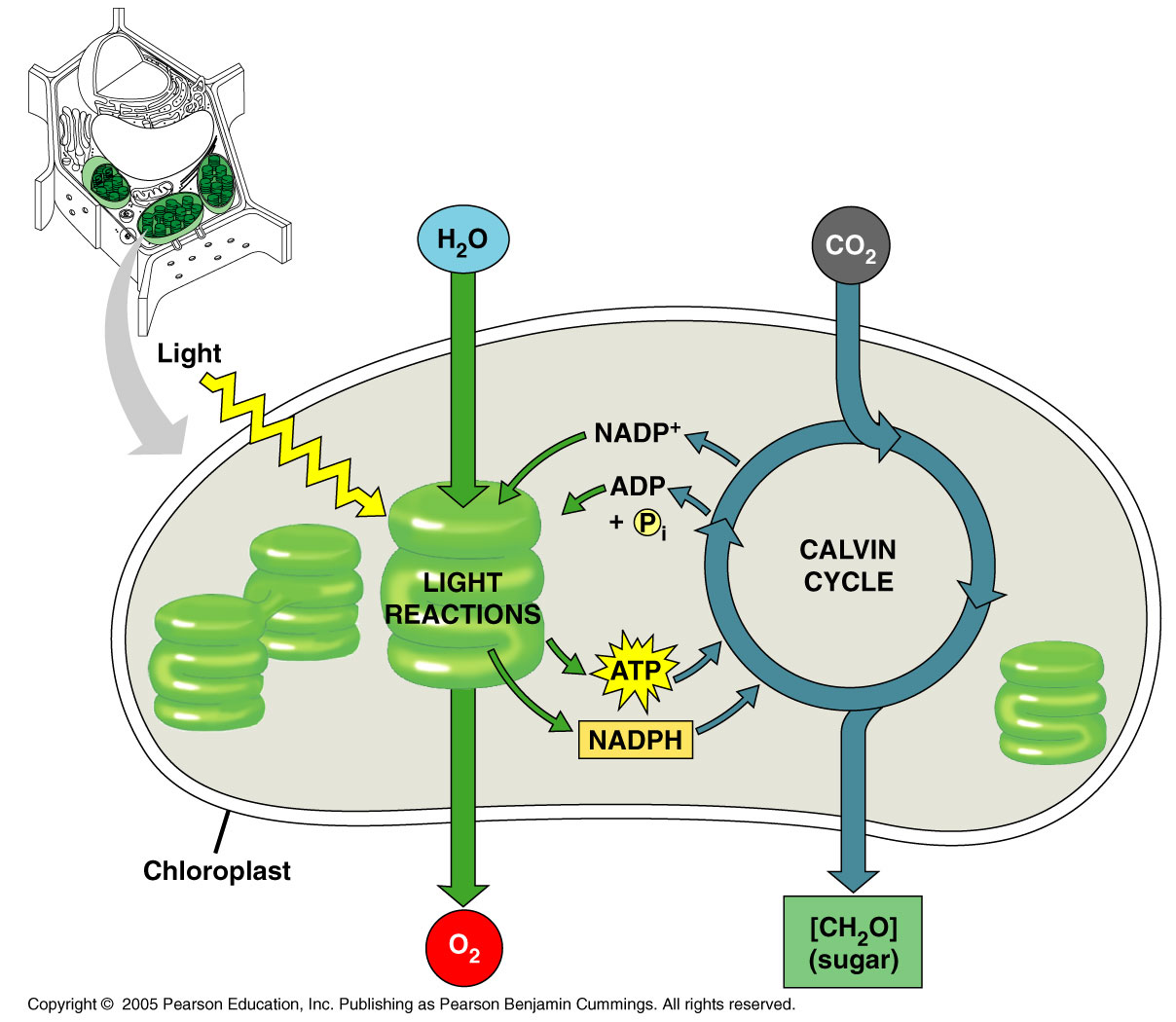

Slide 19
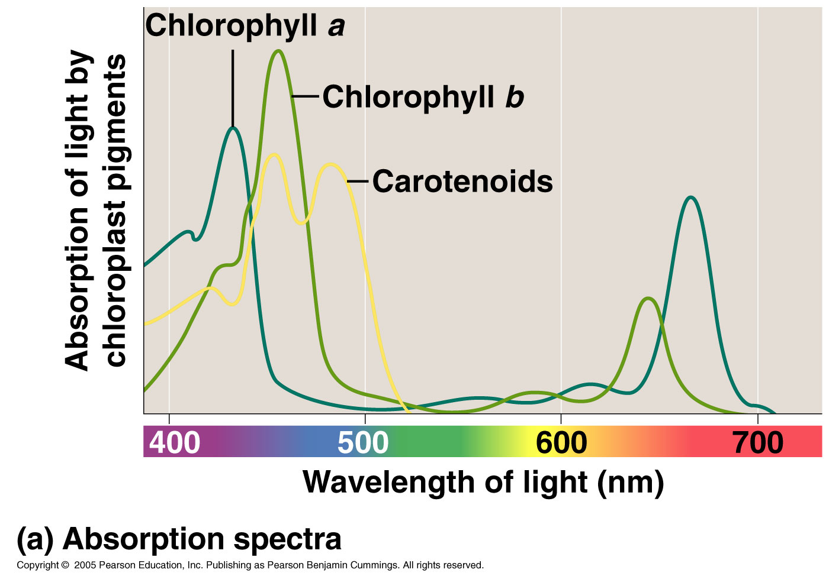
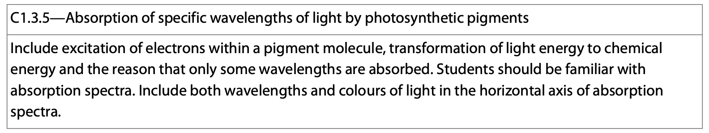
The 3 Main Pigments in Chloroplasts
1. Chlorophyll a- which absorbs violet-blue and red light the best.
2. Chlorophyll b- which absorbs violet-blue and red-orange light the best.
3. Carotenoids absorb violet and blue-green light the best.

Slide 20
Chlorophyll a and Accessory Pigments
Chlorophyll a
  Is the main photosynthetic pigment.
Chlorophyll b and the carotenoids
  These are accessory pigments.
  Chlorophyll b absorbs different wavelengths of light than chlorophyll a
    It broadens the spectrum of useful photosynthetic pigments.
    The accessory pigments also provide photoprotection by dissipating heat that might otherwise damage the plant.

Slide 21
Experiments With Light
These findings are confirmed by the action spectrum prepared for chlorophyll which also shows that green is the least effective color.

Slide 22
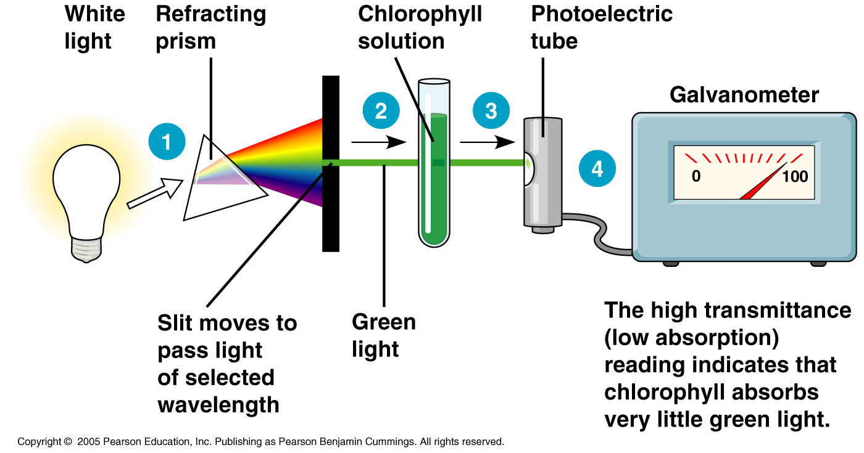

Slide 24
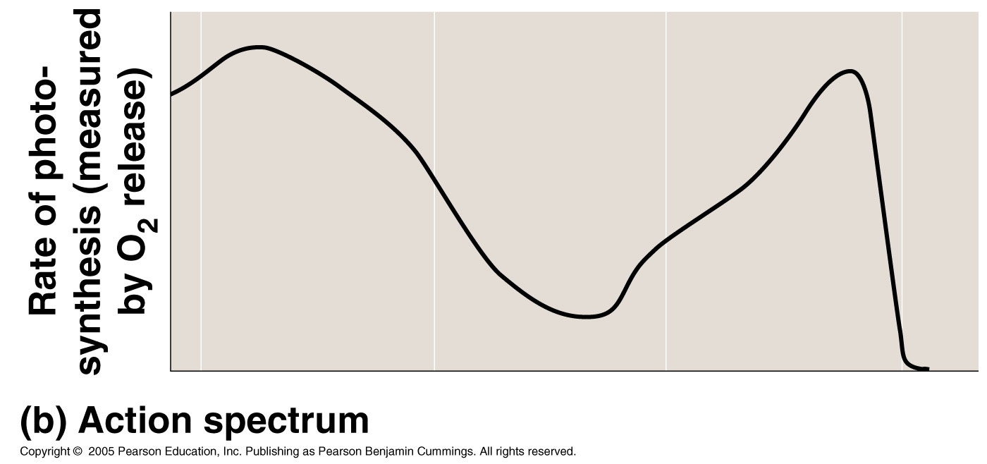

Slide 25
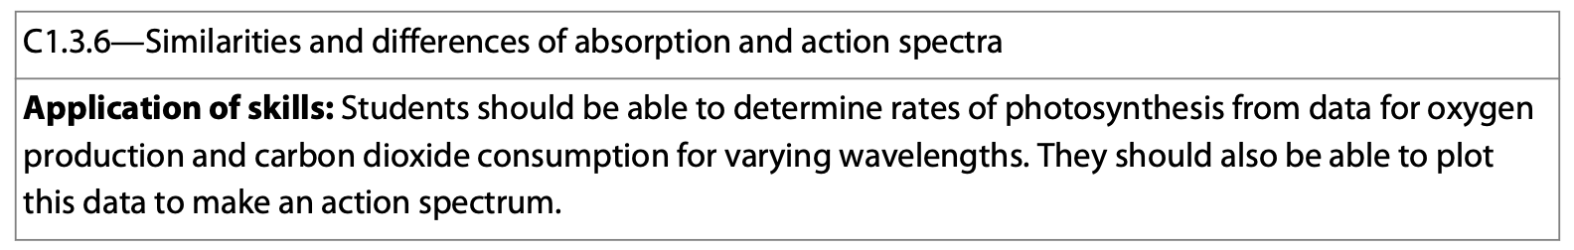
Comparing Oxygen Production and Absorption of Light in Photosynthesis
If you notice, the points at which the O₂ production is the greatest overlap with the points at which light absorption is the greatest.

Slide 26
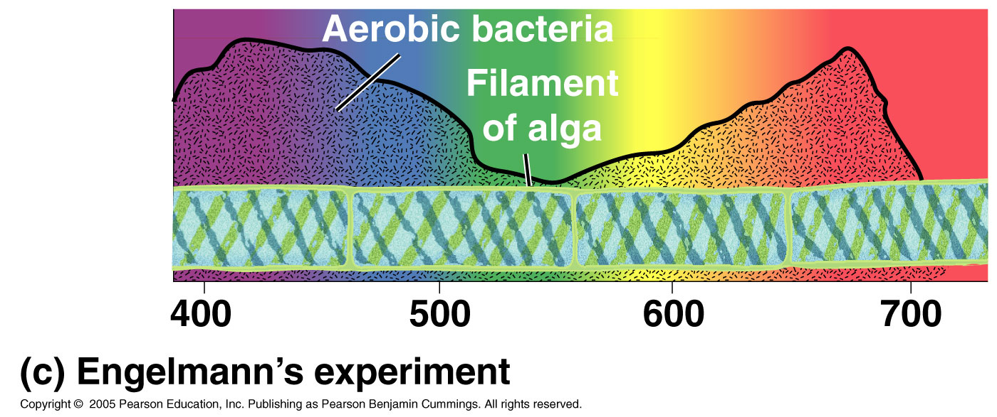
Theodore Englemann
Experimented with aerophilic bacteria and long spiral algae called spirogyra.
Used light to illuminate the specimens after it had been passed through a prism.
Found that bacteria congregated in areas of violet-blue and red light.

Slide 27
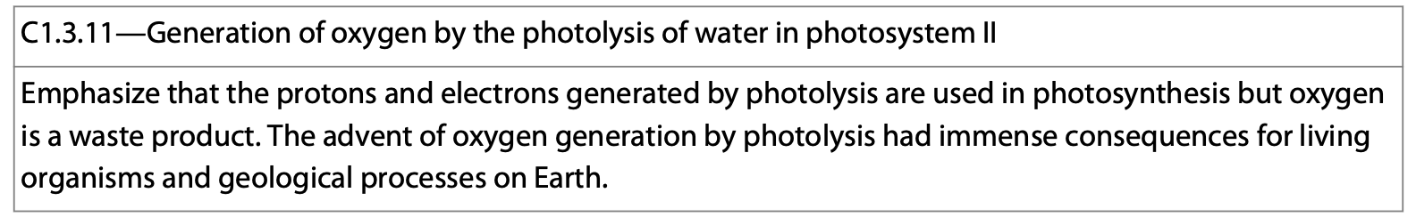
Photosynthesis: The Light-Dependent Reactions
These convert solar energy into chemical energy when light is absorbed by the chlorophyll.
Electrons and hydrogen atoms get transferred from water to NADP⁺. When H₂O is split, O₂ is given off.
The light reactions also generate ATP from ADP from a process called photophosphorylation.
This occurs in the thylakoids.

Slide 28
Photosynthesis: The Calvin Cycle, The Light-Independent Reactions
The Calvin cycle incorporates CO₂ from the air into organic molecules present in the chloroplast via a process called carbon fixation. Here, NADPH and ATP (from the light reactions) convert CO₂ into carbohydrate.
These do take place during the day, but do not need light in order to function.
They occur in the stroma.

Slide 29
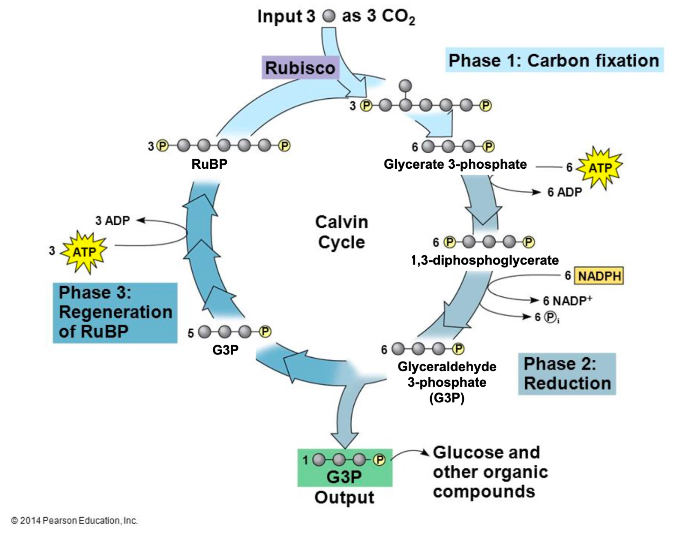
Triose Phosphate

Slide 30
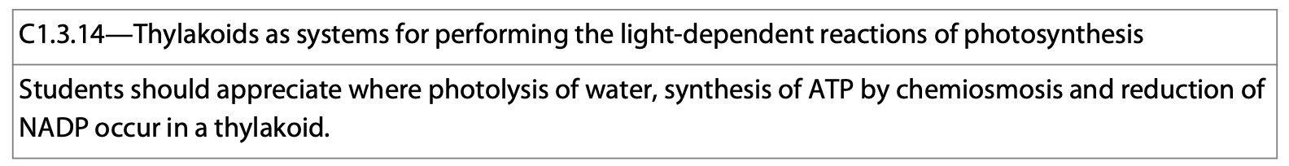
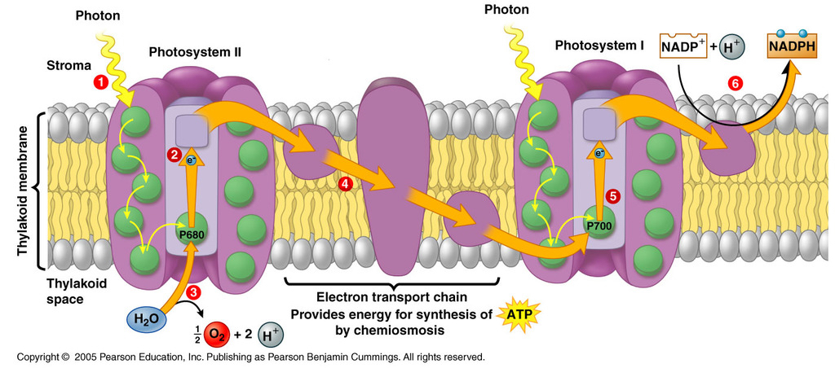
Photosystems
In the thylakoid membrane, chlorophyll molecules are organized with proteins into what are known as photosystems II and I.
These are essentially reaction centers surrounded by light-harvesting complexes which consist of chlorophyll a/b and/or carotenoids bound to proteins.

Slide 31
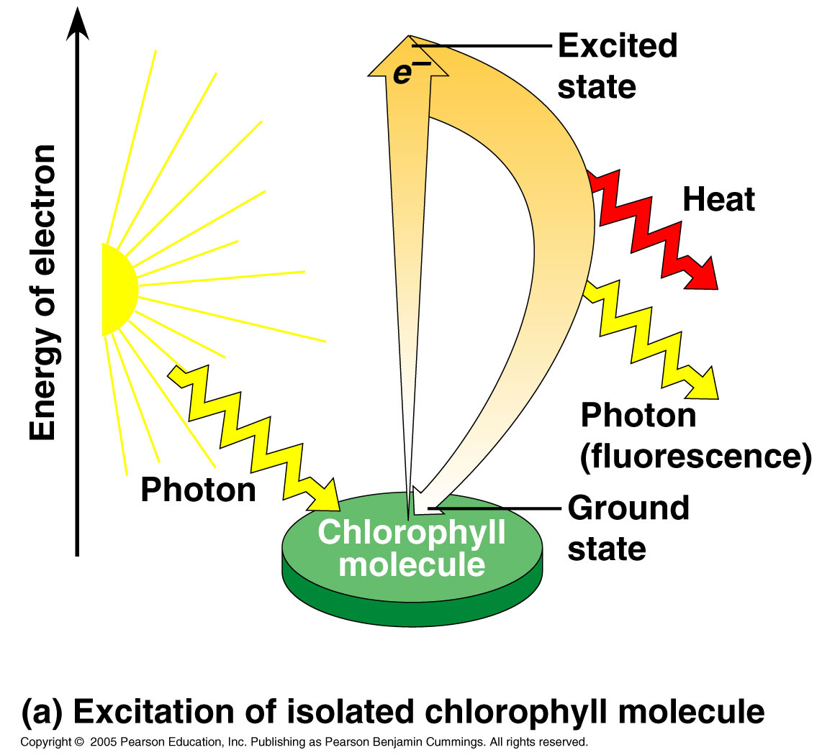
Absorption of Light
When the plant pigments absorb light energy, they funnel it into a reaction center which includes a protein complex with 2 special chlorophyll a molecules and a primary electron acceptor.
The chloroplasts are essentially transferring light energy to electrons that get boosted to a higher energy level

Slide 32
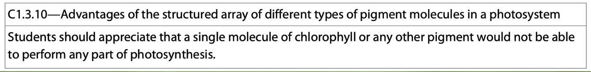
Photosystems II and I
There are two types of photosystems that exist in the thylakoid membrane, photosystem II and photosystem I. They function sequentially and are named in the order of their discovery. Photosystem II actually occurs 1st.

Slide 33
Photosystems II and I
Photosystem II has a P680 reaction center which absorbs light best when it has a frequency of 680nm.
Photosystem I has a P700 reaction center which absorbs light best when it has a frequency of 700nm.

Slide 34
The Light Reactions of Photosynthesis
During the light reactions of photosystems II and I, there are 2 possible routes for electron flow—cyclic and non-cyclic.

Slide 35
Non-Cyclic Electron Flow
Non-cyclic electron flow is the primary route.
In this process, a light harvesting complex captures a packet of light energy and transfers it to a P680 pigment molecule.
When this transfer occurs, an electron is excited to a primary electron acceptor.

Slide 36
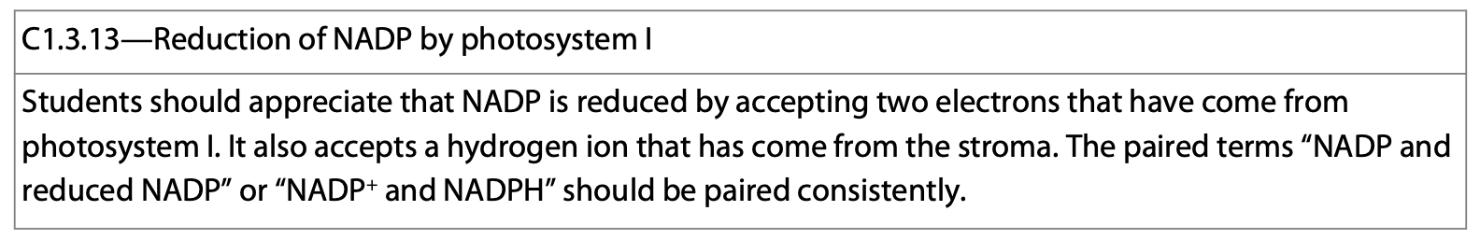
Non-Cyclic Electron Flow
In photosystem I, a light particle is captured by another light harvesting complex and travels to the reaction center where it excites an electron in the P700 pigment molecule. The excited electron is replaced by the one traveling down the ETC from photosystem II.

Slide 37
Non-Cyclic Electron Flow
After the electron is excited from the P700 molecule, it is accepted by a primary electron acceptor and passed to an ETC where it flows down and generates NADPH.
The ATP generated from the photosystem II’s ETC and the NADPH generated from photosystem I’s ETC provide energy and reducing power for the sugar making processes of the Calvin cycle.

Slide 38
Non-Cyclic Electron Flow
In this process, an enzyme splits water, uses the electrons to replace those “lost” during excitation and generates O₂ in the process.
From the primary electron acceptor, the excited electron enters an electron transport chain and generates ATP in route to photosystem I.

Slide 39
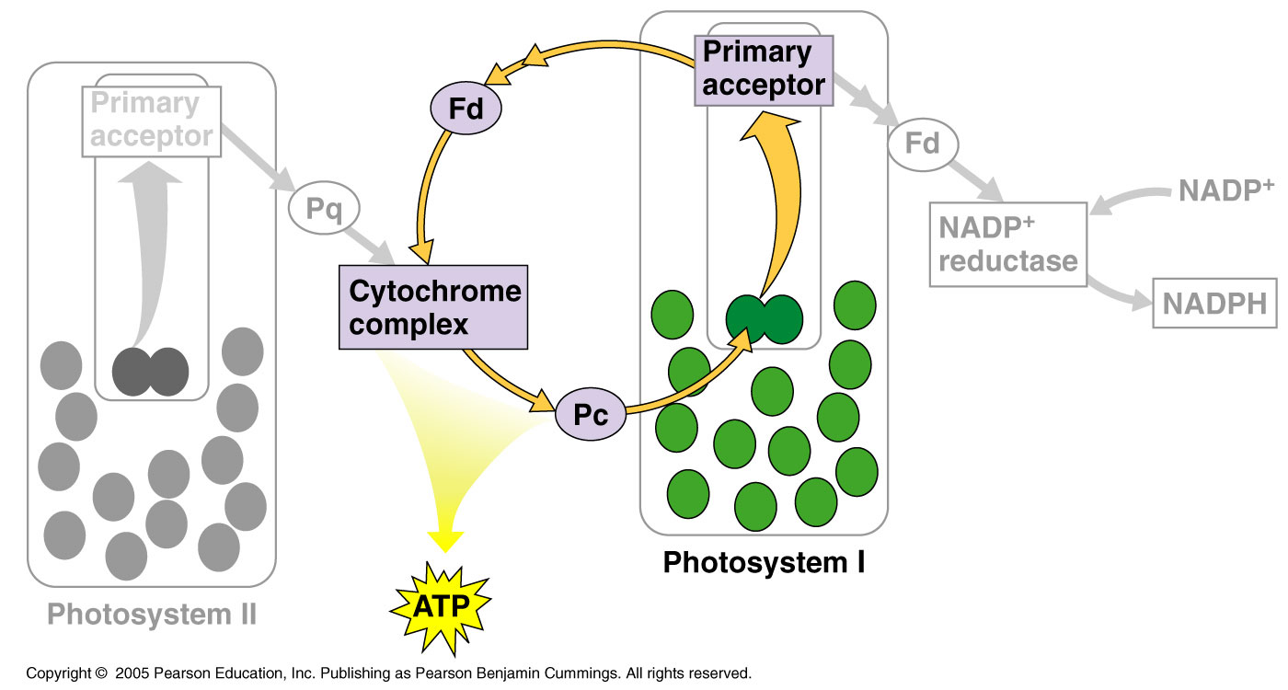
Cyclic Electron Flow
During the process of cyclic electron flow, electrons excited in photosystem I are funneled into the ETC that links photosystem II and photosystem I.
This generates more ATP and is necessary because the Calvin cycle uses more ATP than NADPH.
This mechanism allows ATP production to keep up with demand.

Slide 40
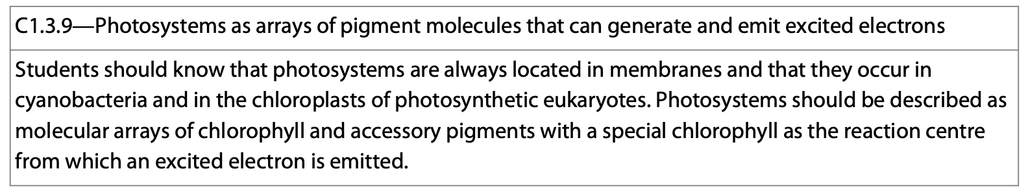
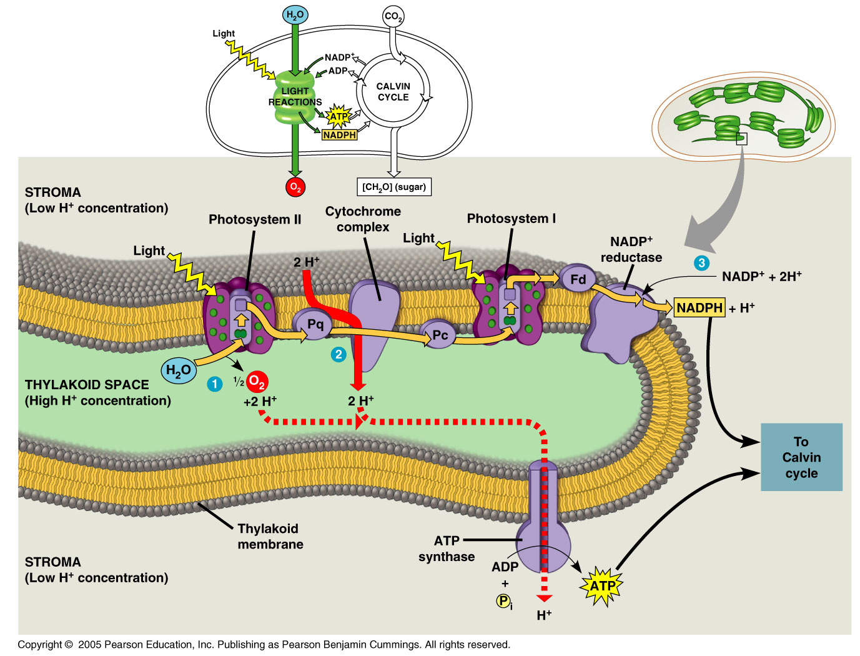
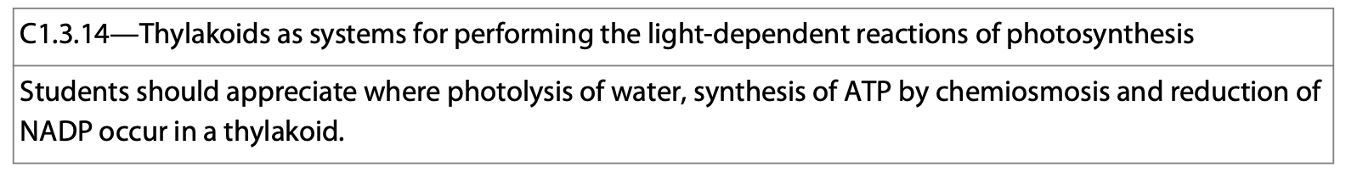

Slide 41
Similarities Between Chloroplasts and Mitochondria
Chloroplasts and mitochondria generate ATP by chemiosmosis. The ETC assembled in the membranes of these 2 organelles pass electrons down the chain and pump H⁺ across a membrane. ATP synthase molecules are built into the same membrane and make use of the potential energy to drive the phosphorylation of ADP to ATP.

Slide 42
Similarities Between Chloroplasts and Mitochondria
Although the mechanisms and proteins between the 2 organelles are very similar, the main difference between the 2 processes is that mitochondria transfer chemical energy from food to ATP/NADH. Chloroplasts transfer energy from light to create ATP and NADPH.

Slide 43
Form Fitting Function: Chloroplasts and Mitochondria
Another main difference that illustrates form fitting function.
  In the mitochondria, H⁺ are pumped to the intermembrane space which powers ATP production as they flow down their gradients back into the matrix.
  In chloroplasts, the process is reversed and H⁺ ions flow from the thylakoid space into the stroma creating ATP for use in the Calvin cycle.

Slide 44
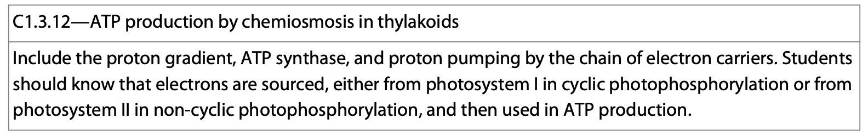
Form Fitting Function: Chloroplasts and Mitochondria
In chloroplasts, H⁺ are pumped from the stroma into the thylakoid space. As the H⁺ diffuse down their gradient back into stroma through ATP synthase, ATP is produced (into the stroma) which is the site of the Calvin cycle (sugar production).

Slide 45
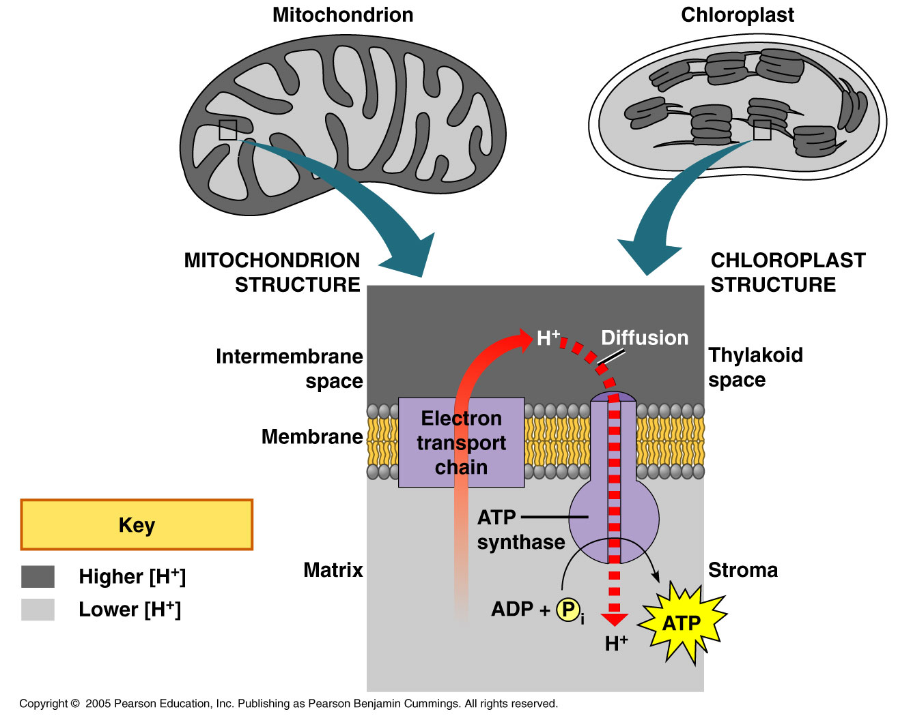

Slide 46
The products of the light dependent reactions power the Calvin-Benson cycle. A lack of CO2 prevents photosystem II from functioning.
  Light reactions occur in the thylakoid space
  The Calvin cycle occurs in the stroma.

Slide 47
The Calvin Cycle
The Calvin cycle can be broken down into three phases:
  1. Carbon fixation.
  2. Reduction.
  3. Regeneration of RuBP (ribulose bisphosphate).

Slide 48
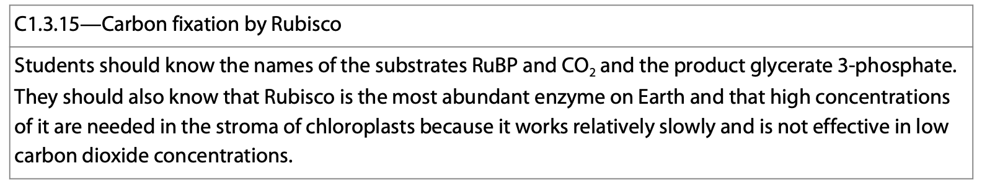
The Calvin Cycle: Carbon Fixation
During carbon fixation, the Calvin cycle incorporates 1 molecule of CO₂ at a time into RuBP, a 5 carbon sugar, the “CO₂ acceptor.”
RuBisCO is the enzyme that catalyzes this first step, ultimately forming glycerate 3-phosphate (3-phosphoglycerate).

Slide 49
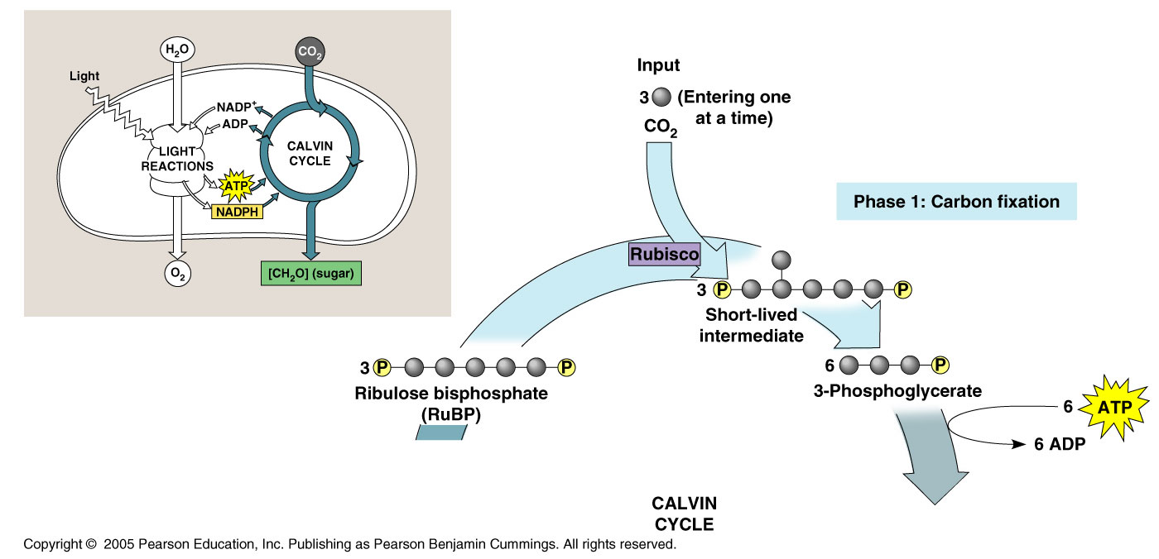
Glycerate 3-phosphate

Slide 50
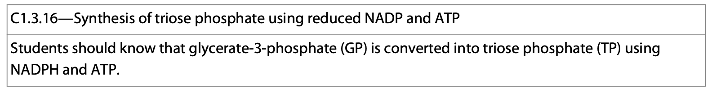
The Calvin Cycle: Reduction
In the reduction phase, glycerate 3-phosphate (3-phosphoglycerate) is reduced by NADPH forming a triose phosphoate.
3CO₂ molecules must enter the cycle to produce one molecule of G3P.

Slide 51
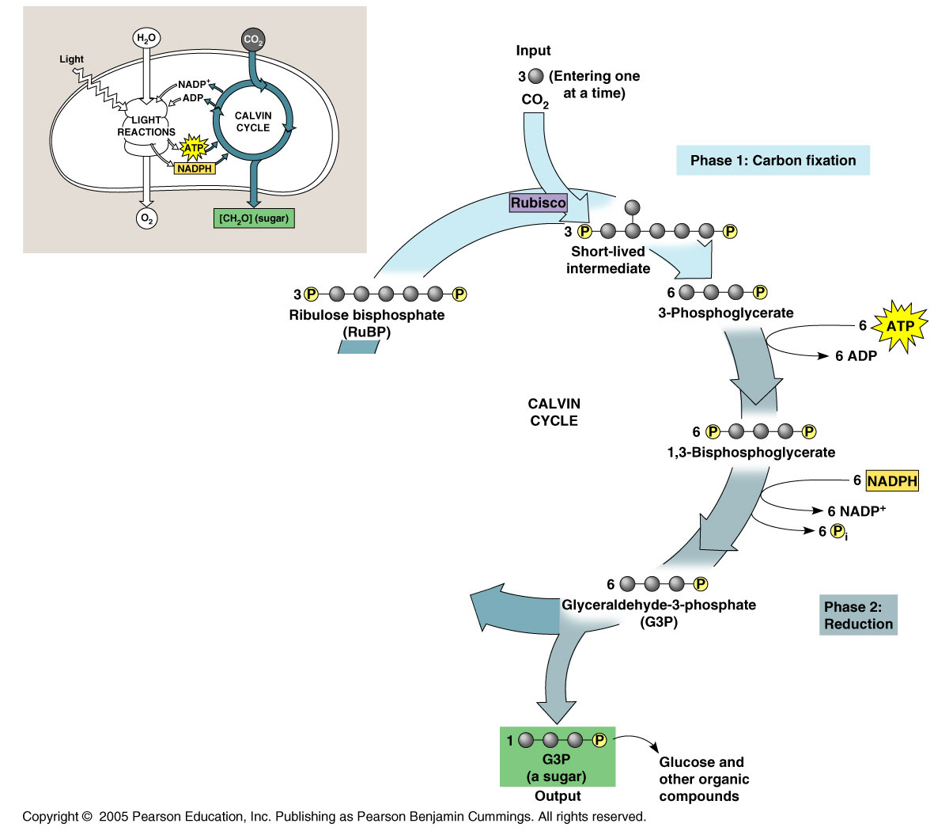
Glycerate 3-phosphate
1,3-diphosphoglycerate
Triose phosphate

Slide 52
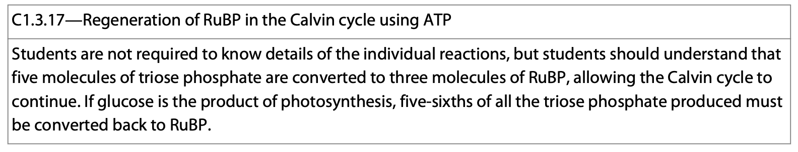
The Calvin Cycle: Regeneration of RuBP
In order for the cycle to repeat, RuBP must be regenerated.
In a complex series of reactions, the remaining triose phosphate (glyceraldehyde 3-phosphate, G3P) gets rearranged (with energy from ATP) and RuBP is reformed.
CO₂ can be accepted again and the cycle repeats.

Slide 53
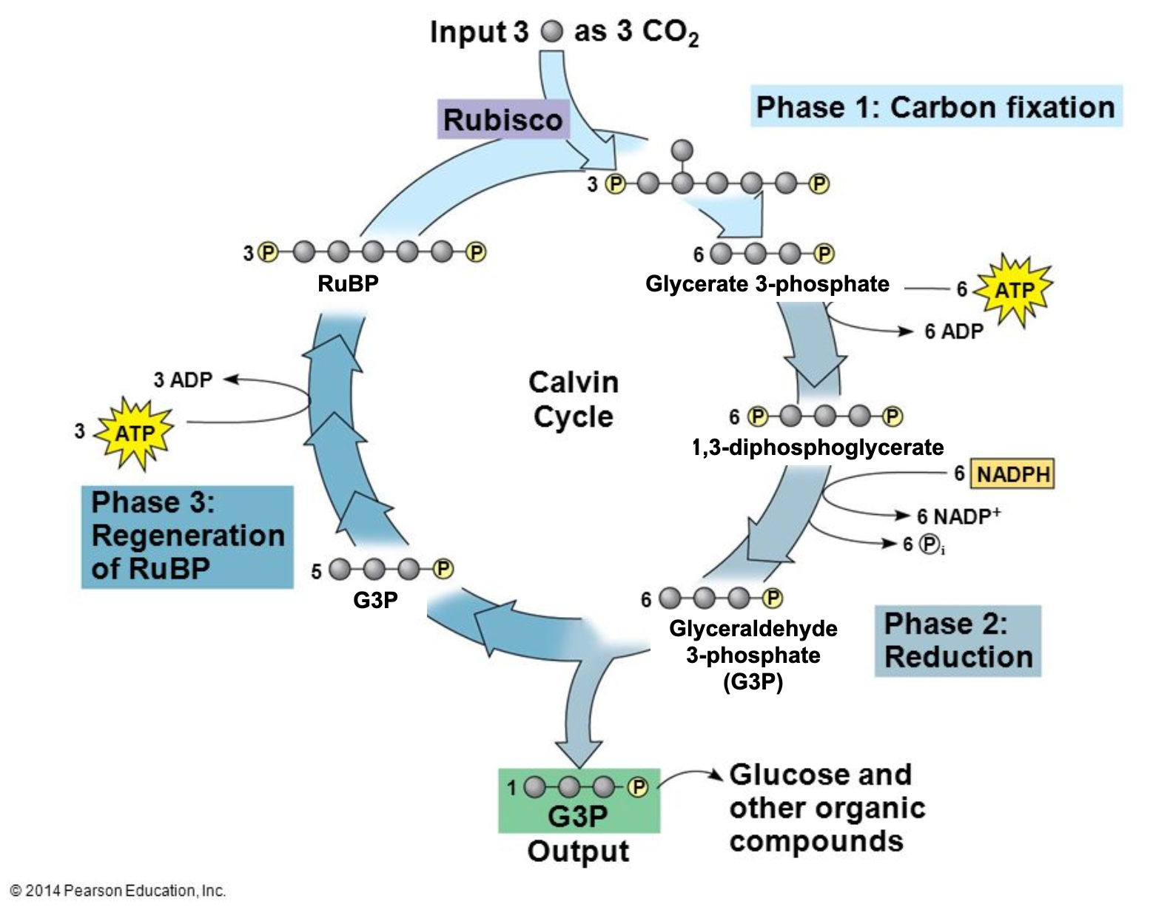
Triose Phosphate
Triose Phosphate

Slide 54
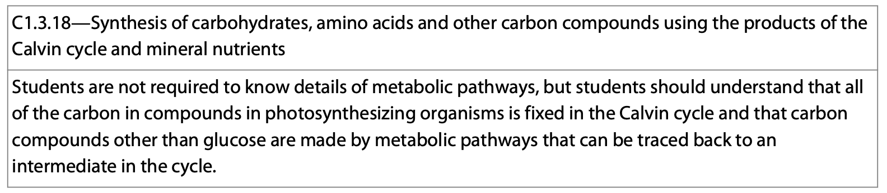
The Calvin Cycle
We know the Calvin Cycle makes sugars for the plant to use.
The Calvin Cycle also responsible for the synthesis of amino acids and other carbon-containing compounds.
It uses intermediate compounds and minerals from the environment to do this.

Slide 55
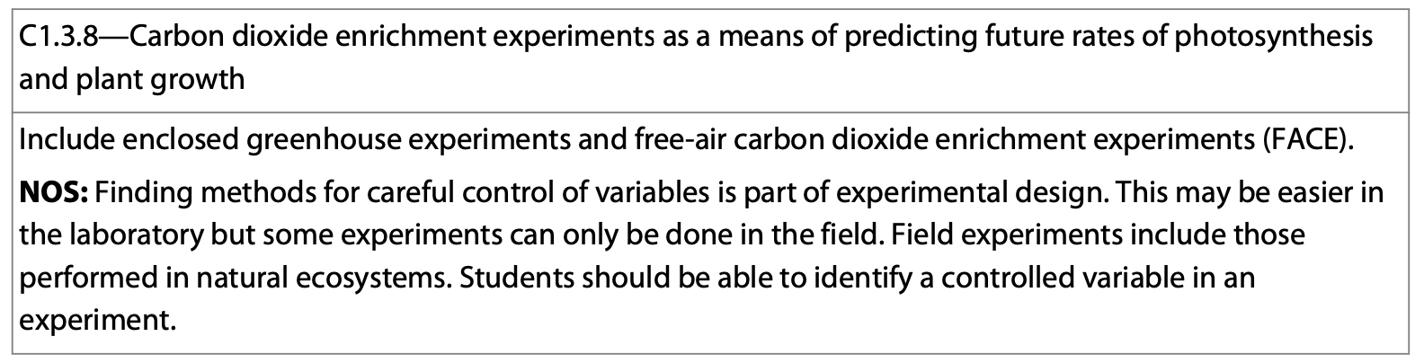
Using Your Device
Explain what a free-air carbon dioxide enrichment experiment is (FACE).
What is the difference between a laboratory experiment and a field experiment?
What is the difference between a controlled variable (constant) and a control?
What are the challenges of field experiments?

