Slide 1
Chapter 8: An Introduction to Metabolism
Essential Idea: Enzymes control the metabolism of the cell.
Essential Idea (HL Only): Metabolic reactions are regulated in response to the cell’s needs.

Slide 2
TOK
Development of some techniques benefits particular human populations more than others. For example, the development of lactose-free milk available in Europe and North America would have greater benefit in Africa/Asia where lactose intolerance is more prevalent. The development of techniques requires financial investment. To what extent should knowledge be shared with regard to techniques developed in one part of the world that are more applicable in another?

Slide 3
TOK
Many metabolic pathways have been described following a series of carefully controlled repeated experiments. To what degree can looking at component parts give us knowledge of the whole?

Slide 4
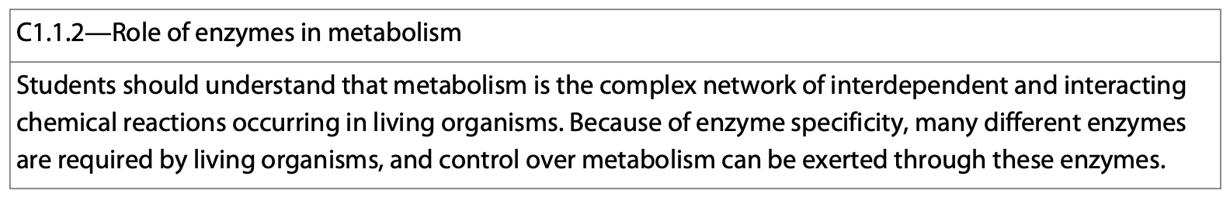
Metabolism
The sum of all chemical reactions that take place in the organism.
It is the way in which a cell manages its material and energy resources.

Slide 5
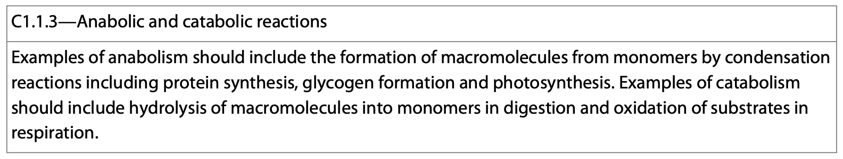
Pathways Within the Cell
Anabolic:
These are the build up pathways that use starting materials to build biologically useful molecules.
Catabolic:
These are the breakdown pathways that use energy stored in the bonds of starting materials to drive the synthesis of energetic molecules.

Slide 6
Anabolic Pathways
Building proteins from amino acids we obtain from eating food.

Slide 7
Catabolic Pathways
Forming ATP from Glucose.
Glucose comes from the food we eat.
ATP is the energy source for the cell.

Slide 8
2 Main Types of Energy:
Potential Energy: The stored energy or the energy of position.
Kinetic Energy: The energy of motion.
  These are ways to describe energy for our purposes.

Slide 9
Chemical Energy
This is a form of potential energy because it is energy that is stored. It is stored in the bonds of the molecule.

Slide 10
Gibbs Free Energy
In terms of the energy in a system, the only thing we are concerned with is the free energy—known as the Gibbs Free Energy.
Gibbs Free Energy is the energy that is available to do work.

Slide 11
Gibbs Free Energy
When ΔG is negative, the reaction is said to be spontaneous and the free energy of the reaction can be used by the cell.
Spontaneous doesn’t necessarily mean that the reaction occurs quickly.

Slide 12
Gibbs Free Energy
When ΔG is positive, the reaction is said to be non-spontaneous and free energy is required by the cell in order for a reaction to go.

Slide 13
Chemical Reactions
Exergonic—release heat, ΔG is negative, and they are said to be spontaneous.
The molecules give off energy as they are broken down.
Endergonic—need heat to go, ΔG is positive, and they are non-spontaneous.
The molecules created by this reaction store energy.

Slide 14
Exergonic Reactions
Consider the breakdown of glucose. Breaking bonds always requires energy.
As an example, consider the metabolism of glucose:
  C6H12O6 + 6O2 —> 6CO2 + 6H2O

Slide 15
Exergonic Reactions
Consider the breakdown of glucose. Breaking bonds always requires energy.
In a glucose molecule there are:
  7 C-H bonds = +414 kJ/mol
  7 C-O bonds = +358 kJ/mol
  5 O-H bonds = +463 kJ/mol
  5 C-C bonds = +346 kJ/mol
  The O2 molecule requires +498 kJ/mol
To break the bonds of the reactants requires +12,437 kJ of energy

Slide 16
Exergonic Reactions
Consider the formation of carbon dioxide and water. Forming bonds always releases energy.
In 6 carbon dioxide molecules there are:
  12 C=O bonds = +498 kJ/mol
In 6 water molecules there are:
  12 O-H bonds = +463 kJ/mol
To form these bonds releases -15,204 kJ of energy.
The energy difference is used to make ATP.

Slide 17
Exergonic Reactions
The difference in the bond enthalpies (∆H) between the breaking down of glucose and the formation of carbon dioxide and water is used to make ATP.
  -15,204 kJ is given off when CO2 and H2O form.
  +12,437 kJ is required to break the bonds of glucose.
The difference is -2,767 kJ. Energy is released when this reaction occurs.

Slide 18
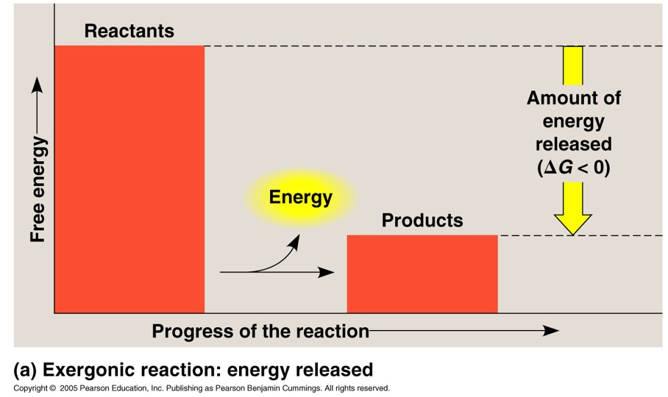
Exergonic Reactions
We say that energy is released from these reactions.
That is, the amount of free energy in the products is less than that of the reactants.

Slide 19
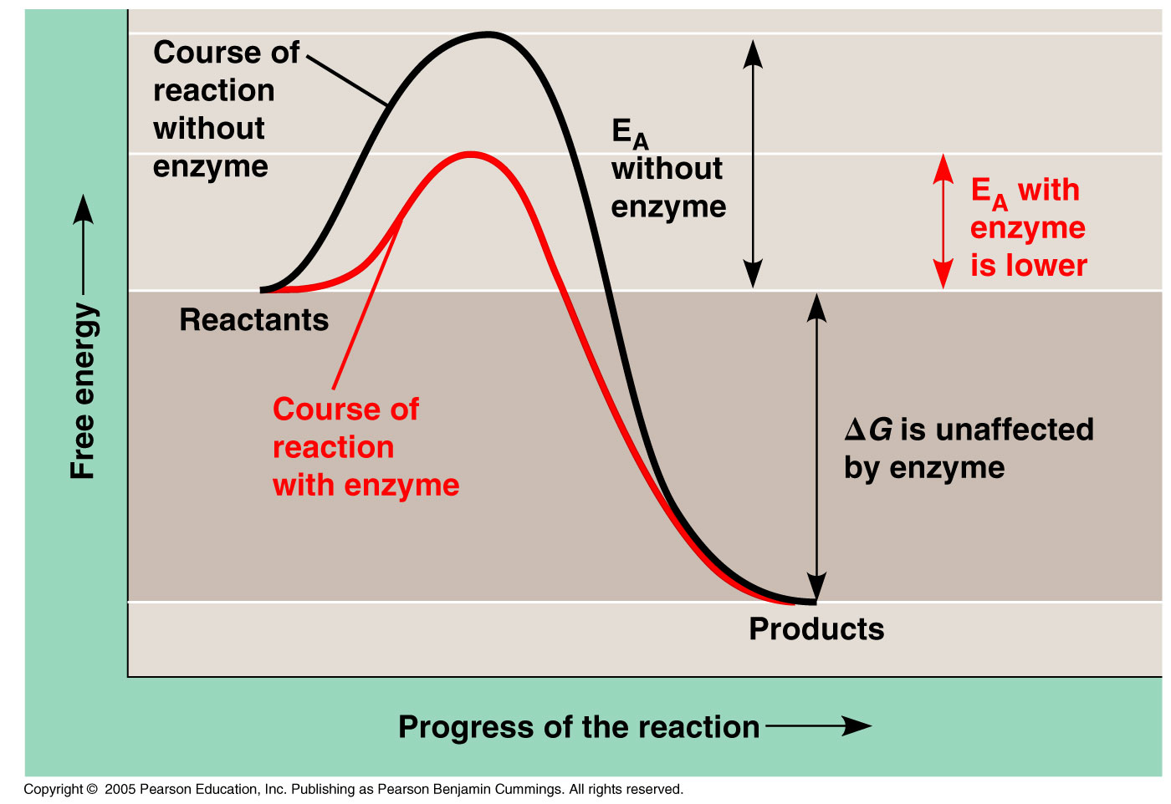

Slide 20
Endergonic Reactions
The opposite is true of energetic reactions.
With the formation of glucose, the reactions would be the opposite of those involving its breakdown.
To form glucose from CO2 and H2O would require an input of 2,767 kJ of energy. This energy comes from the sun.

Slide 21
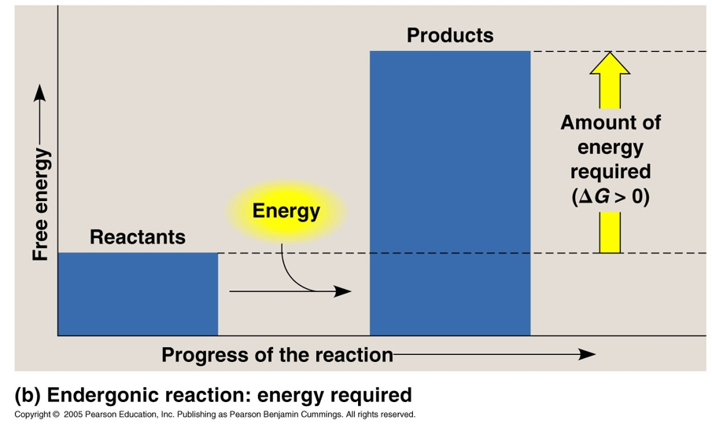
Endergonic Reactions
So with endergonic reactions, we say that energy is absorbed.
That is, the amount of free energy in the products is more than that of the reactants.

Slide 22
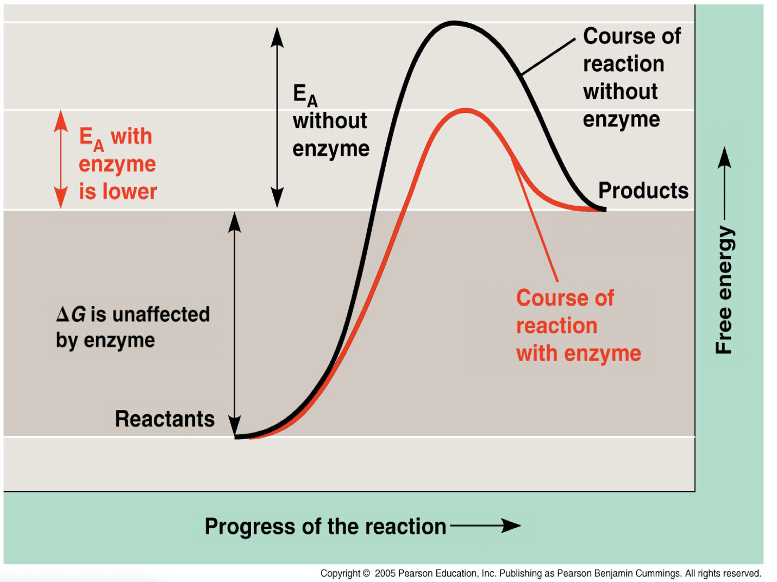

Slide 23
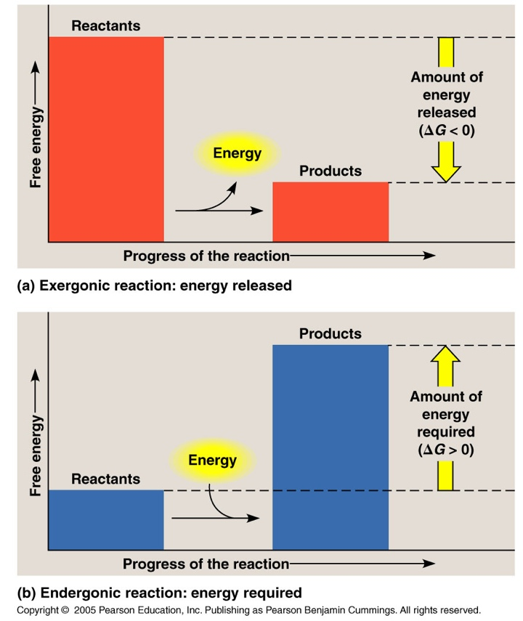
Endergonic and Exergonic Reactions

Slide 24
How does this relate to cells?
Within a cell, exergonic reactions are used to drive endergonic ones.
ATP is an exergonic molecule that supplies energy for chemical reaction within a cell.

Slide 25
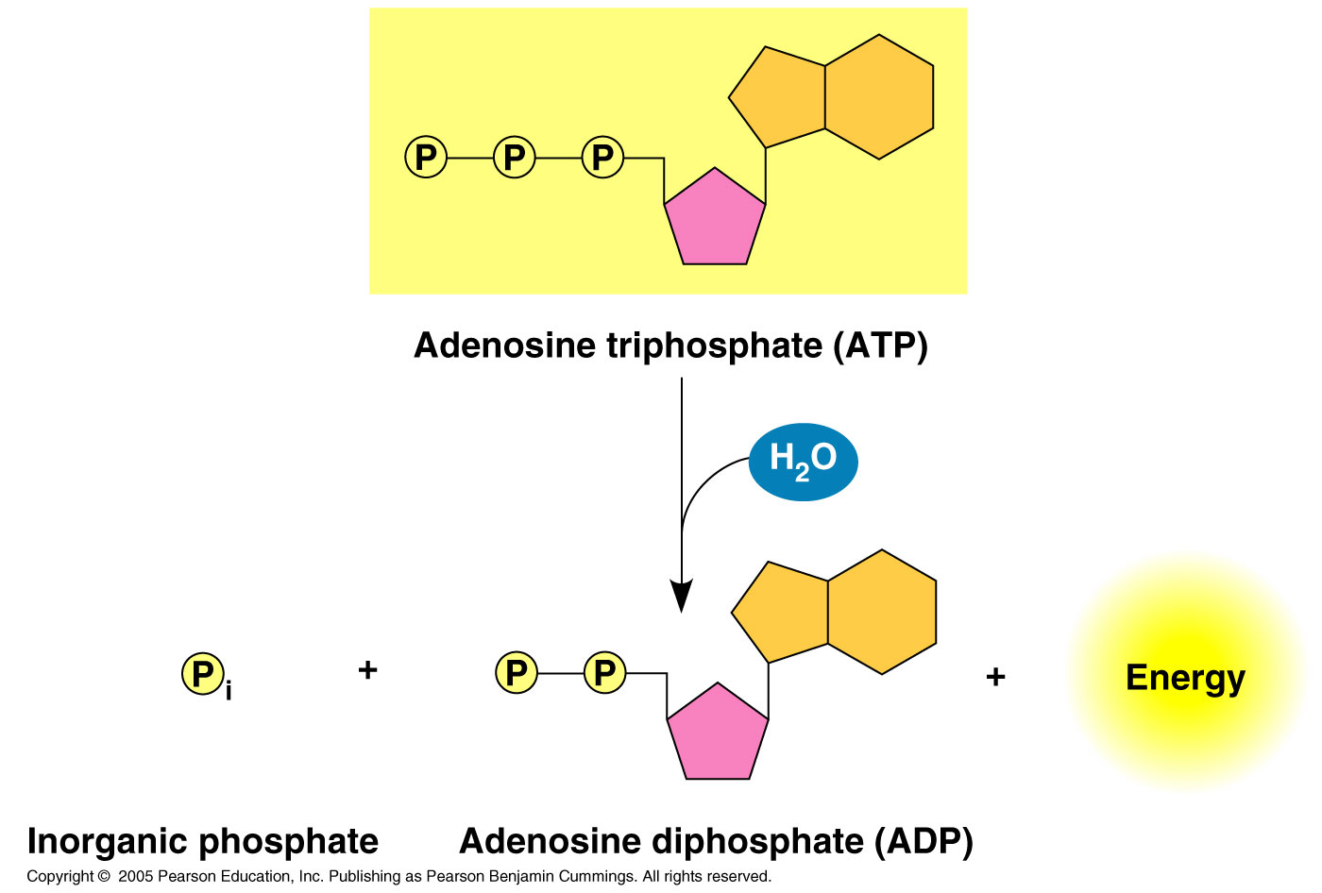
= -7.3 kcal/mol

Slide 26
ATP
When a phosphate bond is broken in the ATP molecule, 7.3kcal of energy is given off and used by the cell to power endergonic reactions.
This process is called coupling.
Coupling is when an endergonic reaction is “coupled” to the breaking of a phosphate bond from ATP.

Slide 27
Example
When the body synthesizes glutamine from glutamic acid and ammonia, energy is required (endergonic). To make the reaction go, it is coupled to the hydrolysis of ATP (which is exergonic).
When the ATP is hydrolyzed, an intermediate is phosphorylated. The intermediate is more reactive and reacts easier and more quickly to give the desired result.

Slide 28
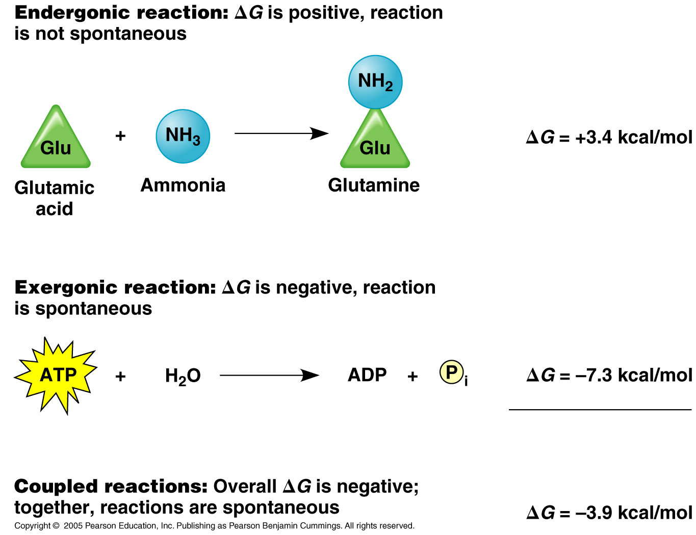

Slide 29
ATP Generation
Just as ATP is used to power cellular processes, it is regenerated from catabolic pathways.
Energy releasing processes such as cellular respiration provide energy for synthesizing ATP.

Slide 30
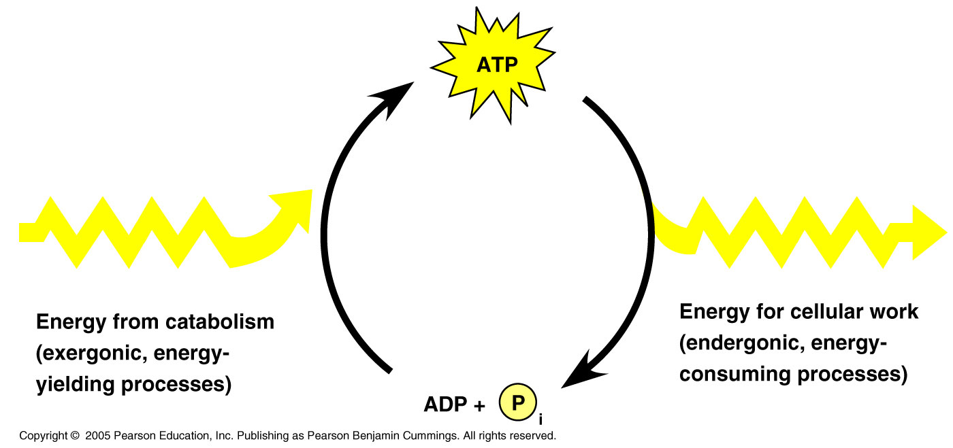

Slide 31
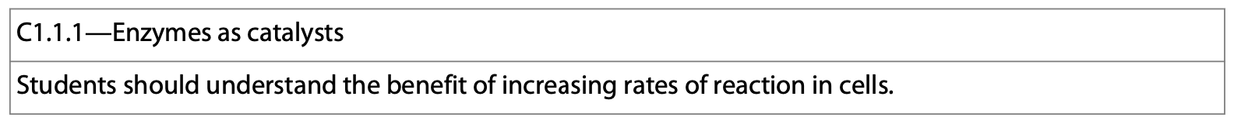
Enzymes
Enzymes are used by the cell to lower the activation energy required for a chemical reaction.
Enzymes are globular proteins.
Some enzymes can be manufactured and packaged (immobilized) for a variety of uses.
The speed up reactions to the degree that will support life.

Slide 32
Immobilized Enzymes
The advantages of enzyme immobilization:
  They can increase the concentration of the enzyme—increases the rate of reaction.
  Immobilized enzymes are easy to separate from a reaction mixture making their recycling easy.
  It is easy to separate them from the reaction and control it.
  This process stabilizes the enzyme, increasing its effectiveness-not as susceptible to breakdown.

Slide 33
Immobilized Enzymes
Immobilized enzymes are attached to a material to restrict their movement.
  Those used in industry are usually immobilized.
Immobilization is achieved by the following:
  Aggregation of enzymes bonded together.
  Attached to surfaces.
  Entrapped in gels—alginate beads-lactase.

Slide 34
Immobilized Enzymes
Enzymes have a wide variety of uses.
  1. Detergents contain proteases and lipases to help clean clothes.
  2. The textile industry uses enzymes to process fibers (make them shiny in some cases).
  3. The brewing industry uses them.
  4. Medicine and biotechnology use them.

Slide 35
Immobilized Enzymes
Enzymes have a wide variety of uses.
  5. They are used in the food industry.
    Pectinase increases juice yield from fruit.
    Rennet is used in cheese production.
  6. Paper production uses enzymes to help with the processing of wood.

Slide 36
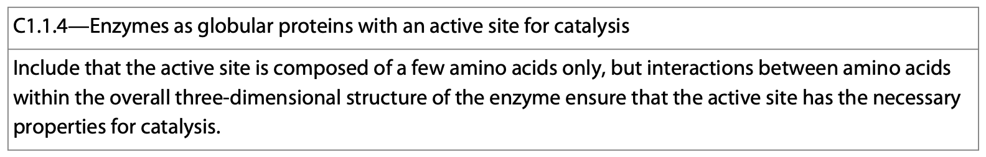
Enzymes
More specifically, within a cell, enzymes are globular proteins that bind to a specific substrate on which the enzyme acts forming an enzyme-substrate complex.

Slide 37
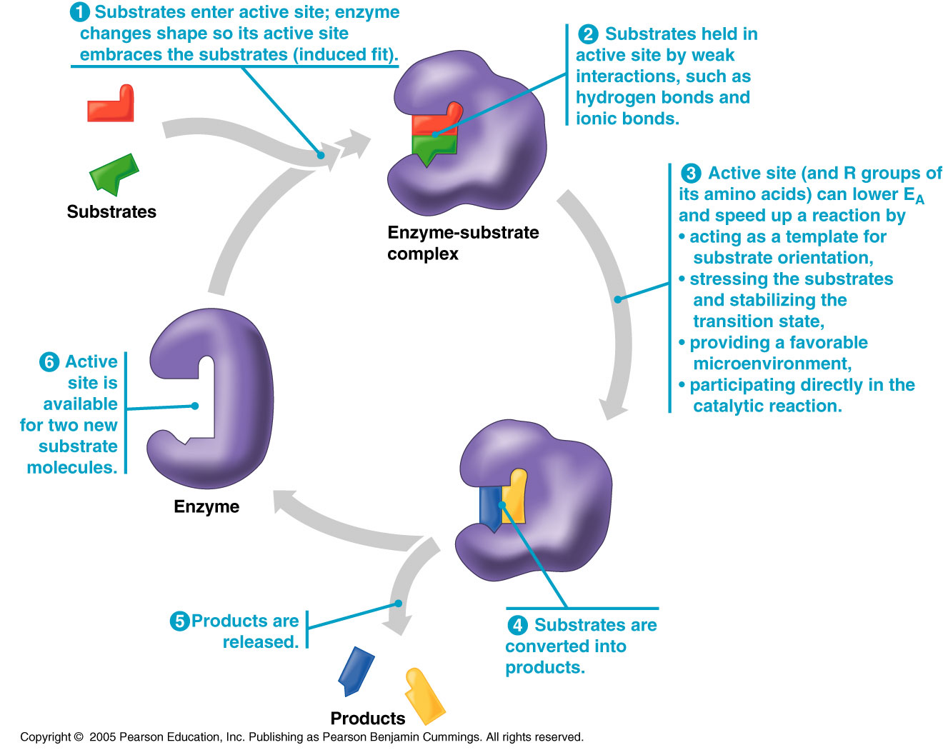

Slide 38
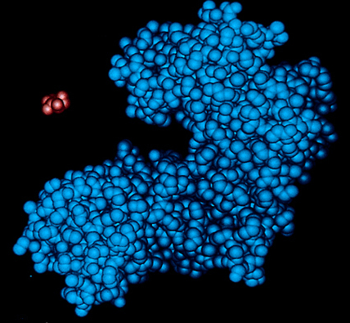
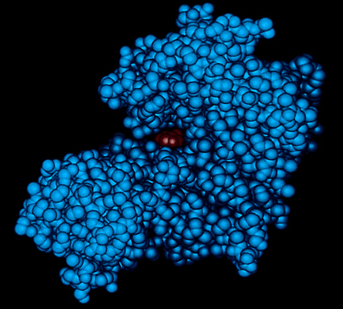
Enzymes
In this example of hexokinase and glucose, the enzyme-substrate complex forms an “induced” (tight) fit between the enzyme and the substrate at the active site.

Slide 39
Enzymes
There is also a “lock and key” model to explain enzyme function.
Here, the substrate fits perfectly into the active site of the enzyme.
https://www.differencebetween.com/difference-between-induced-fit-and-lock-and-key/

Slide 40
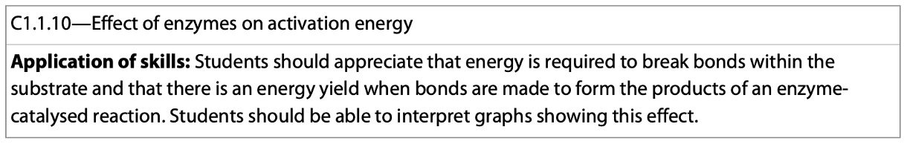
Lowering of the Activation Energy
There are a variety of ways in which an enzyme lowers the activation energy of a reaction.

Slide 42
Lowering of the Activation Energy
1. The active site acts as a mediator that brings things close together so they can react.
2. The substrate molecules can be stretched toward their transition state which stresses bonds that need to be broken during a chemical reaction.

Slide 43
Lowering of the Activation Energy
3. The enzyme may make the microenvironment for a reaction more favorable than normal.
4. The active site may actually participate in the chemical reaction (covalently) and the remaining steps of the reaction restore the enzyme to its beginning conformation enabling it to perform another reaction.

Slide 44
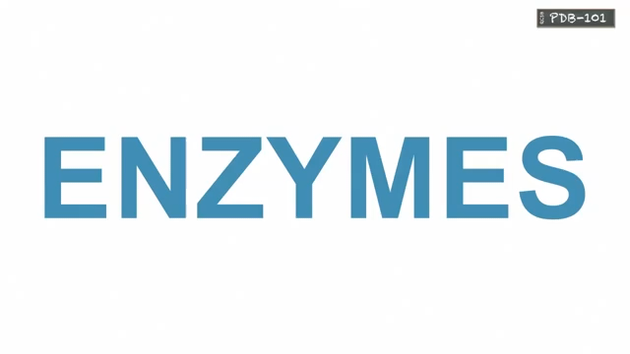

Slide 45
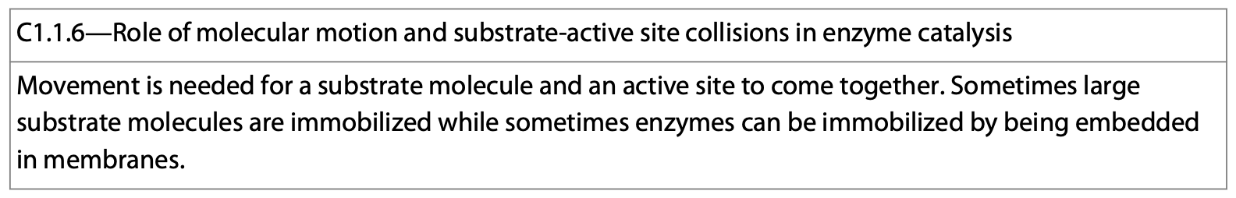
Enzyme Catalysis
Enzyme catalysis involves molecular motion.
Molecular motion contributes to collisions between the enzyme’s active site and substrate molecules.
The result is a chemical reaction between the substrate molecules.

Slide 46
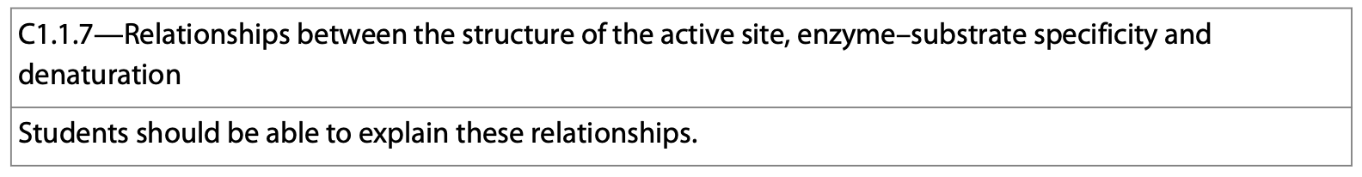
Things which affect enzyme function
Extreme temperature, pH levels, and salt concentration can denature the protein, often affecting the folding of the protein (2° & 3° structure).
Denaturation affects the active site of the protein so that it is no longer active and no longer recognizes its substrates.

Slide 47
Things which affect enzyme function
Cofactors help an enzyme function.
  Often inorganic, metal ions are an example.
Coenzymes which are organic substances also help.
  Often organic, vitamins are an example.
https://courses.lumenlearning.com/boundless-microbiology/chapter/enzymes/

Slide 48
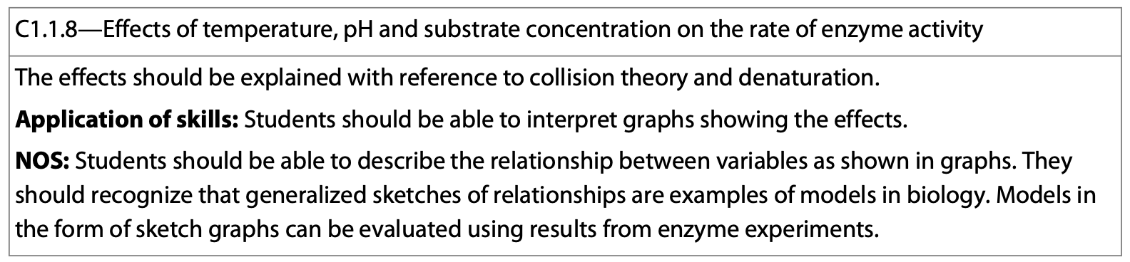
Things which affect enzyme function
Increasing the concentration of substrate increases the rate of the reaction—to a point.
Increasing the concentration of enzyme increases the rate of the reaction—again, to a point.
That point is termed, “saturation.”

Slide 49
Things which affect enzyme function
Inhibitors—slow or stop enzyme activity
  Competitive inhibitors--compete with substrate molecules for the active site of an enzyme.
  Non-competitive inhibitors bind to a spot other than the active site altering the active site slowing a reaction.

Slide 50
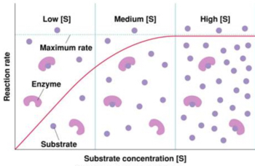
Saturation

Slide 51
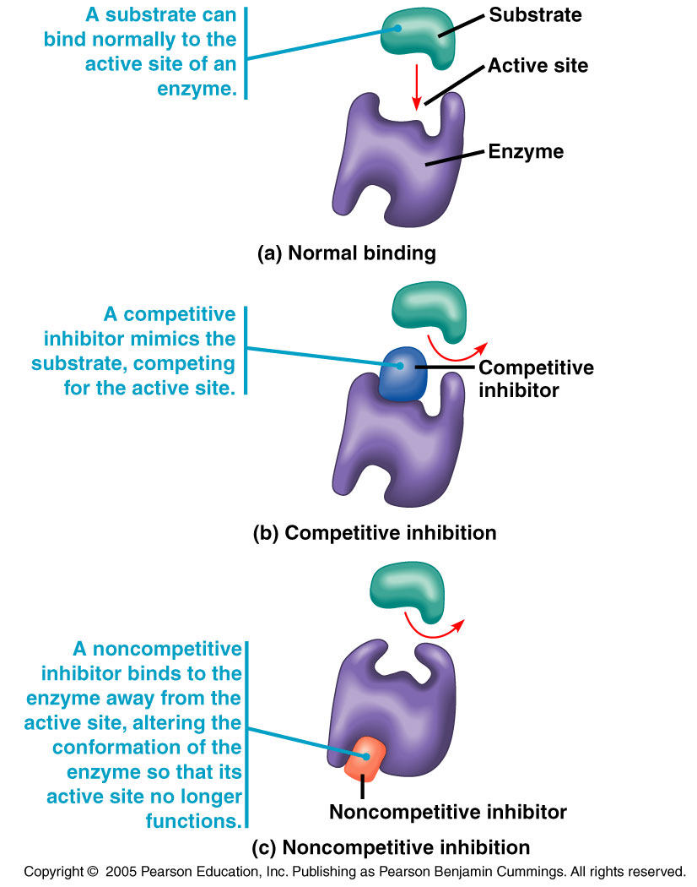
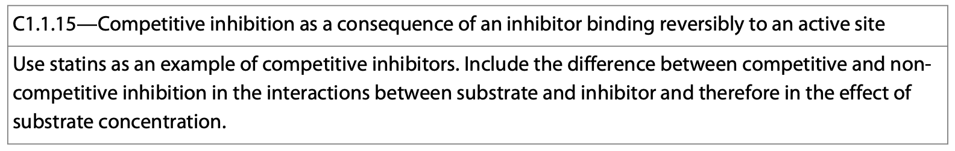
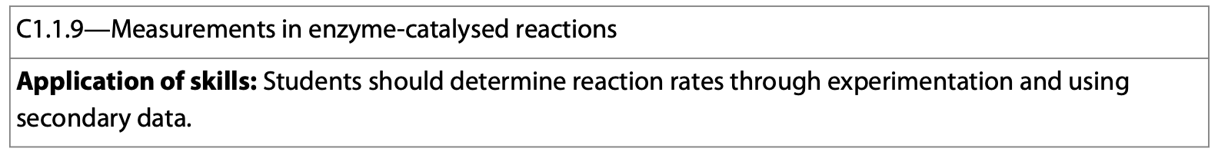

Slide 52
Regulation of Enzyme Activity
Allosteric regulation—occurs when a regulatory molecule binds reversibly to an enzyme changing the active site, slowing or stopping an enzyme’s function.
  Allosterically controlled enzymes often have many subunits.
Allosteric regulation also occurs when a regulatory molecule binds to one subunit on the enzyme affecting the active site on a different subunit.

Slide 53
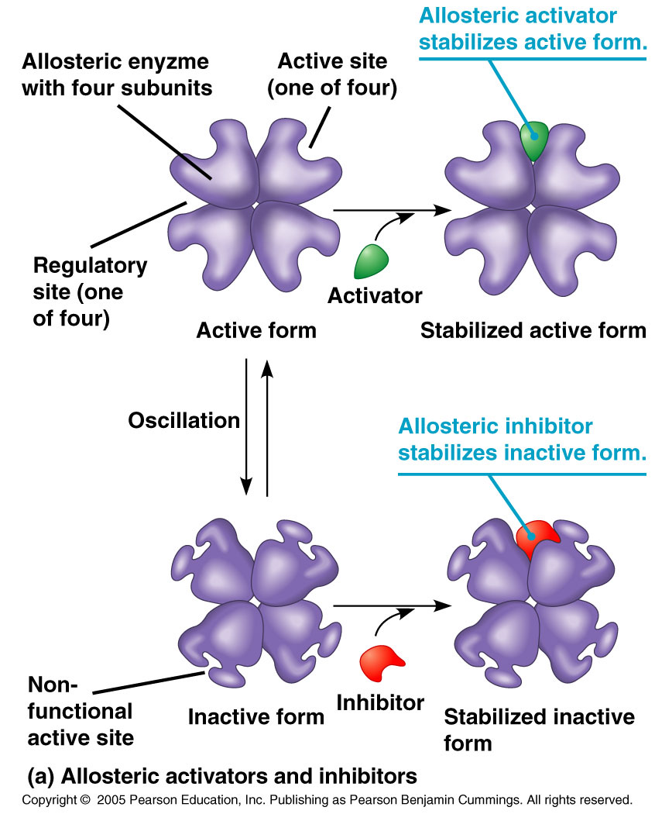
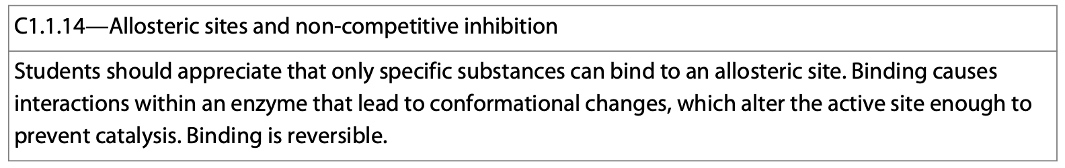

Slide 54
Regulation of Enzyme Activity
Feedback inhibition occurs when a metabolic pathway is switched off at the level of the gene. This occurs when an inhibitory molecule binds to an activator/repressor protein and affects its activity—and gene expression.

Slide 56
Regulation of Enzyme Activity
Feedback inhibition also occurs when a metabolic pathway is switched off by the inhibitory binding of an end product to an enzyme early in the pathway—usually the first one.

Slide 57
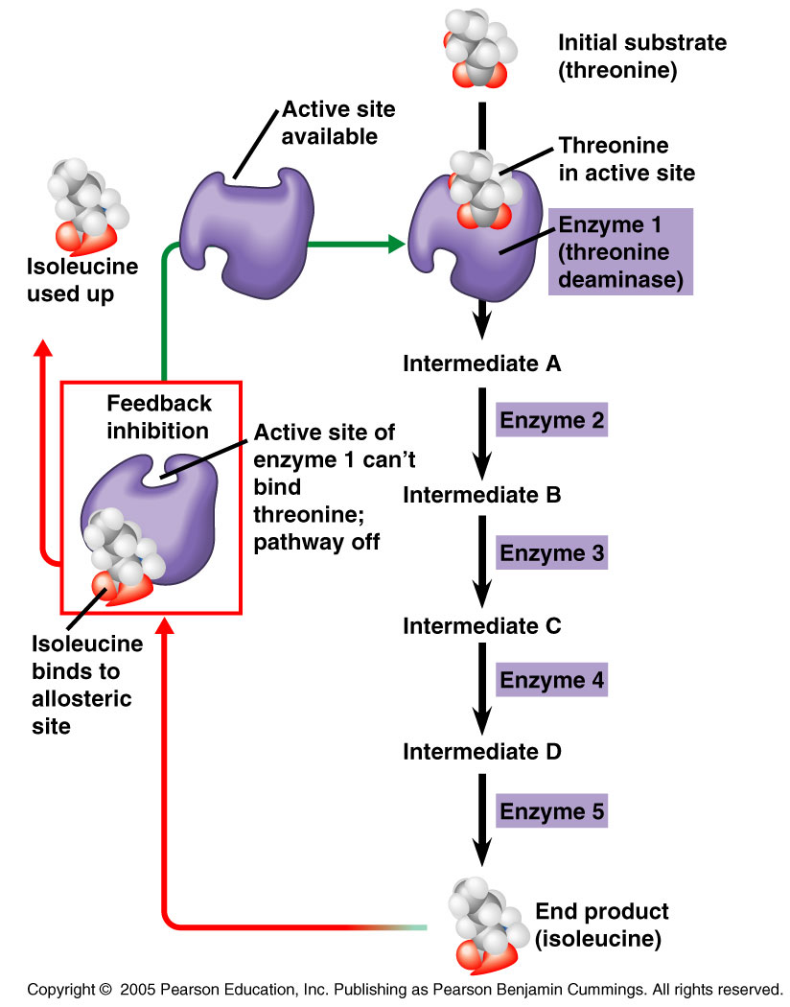

Slide 58
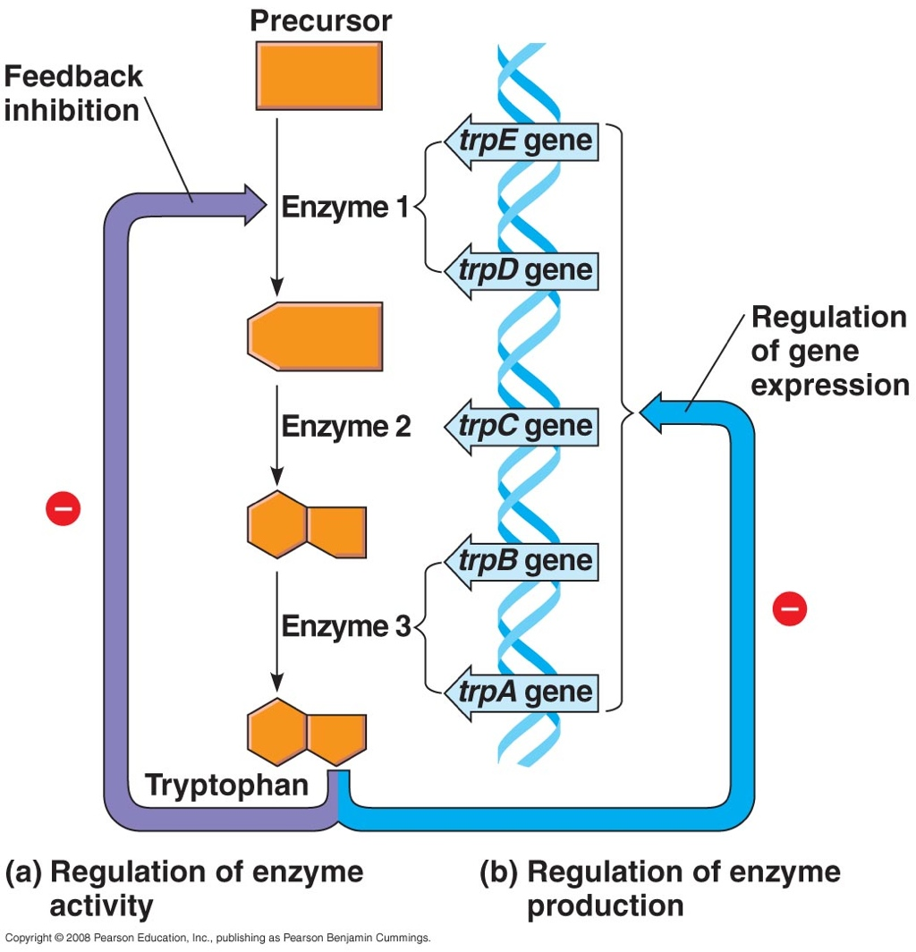
Regulation of Enzyme Activity
Both are ways for the cell to conserve energy.

