Slide 1
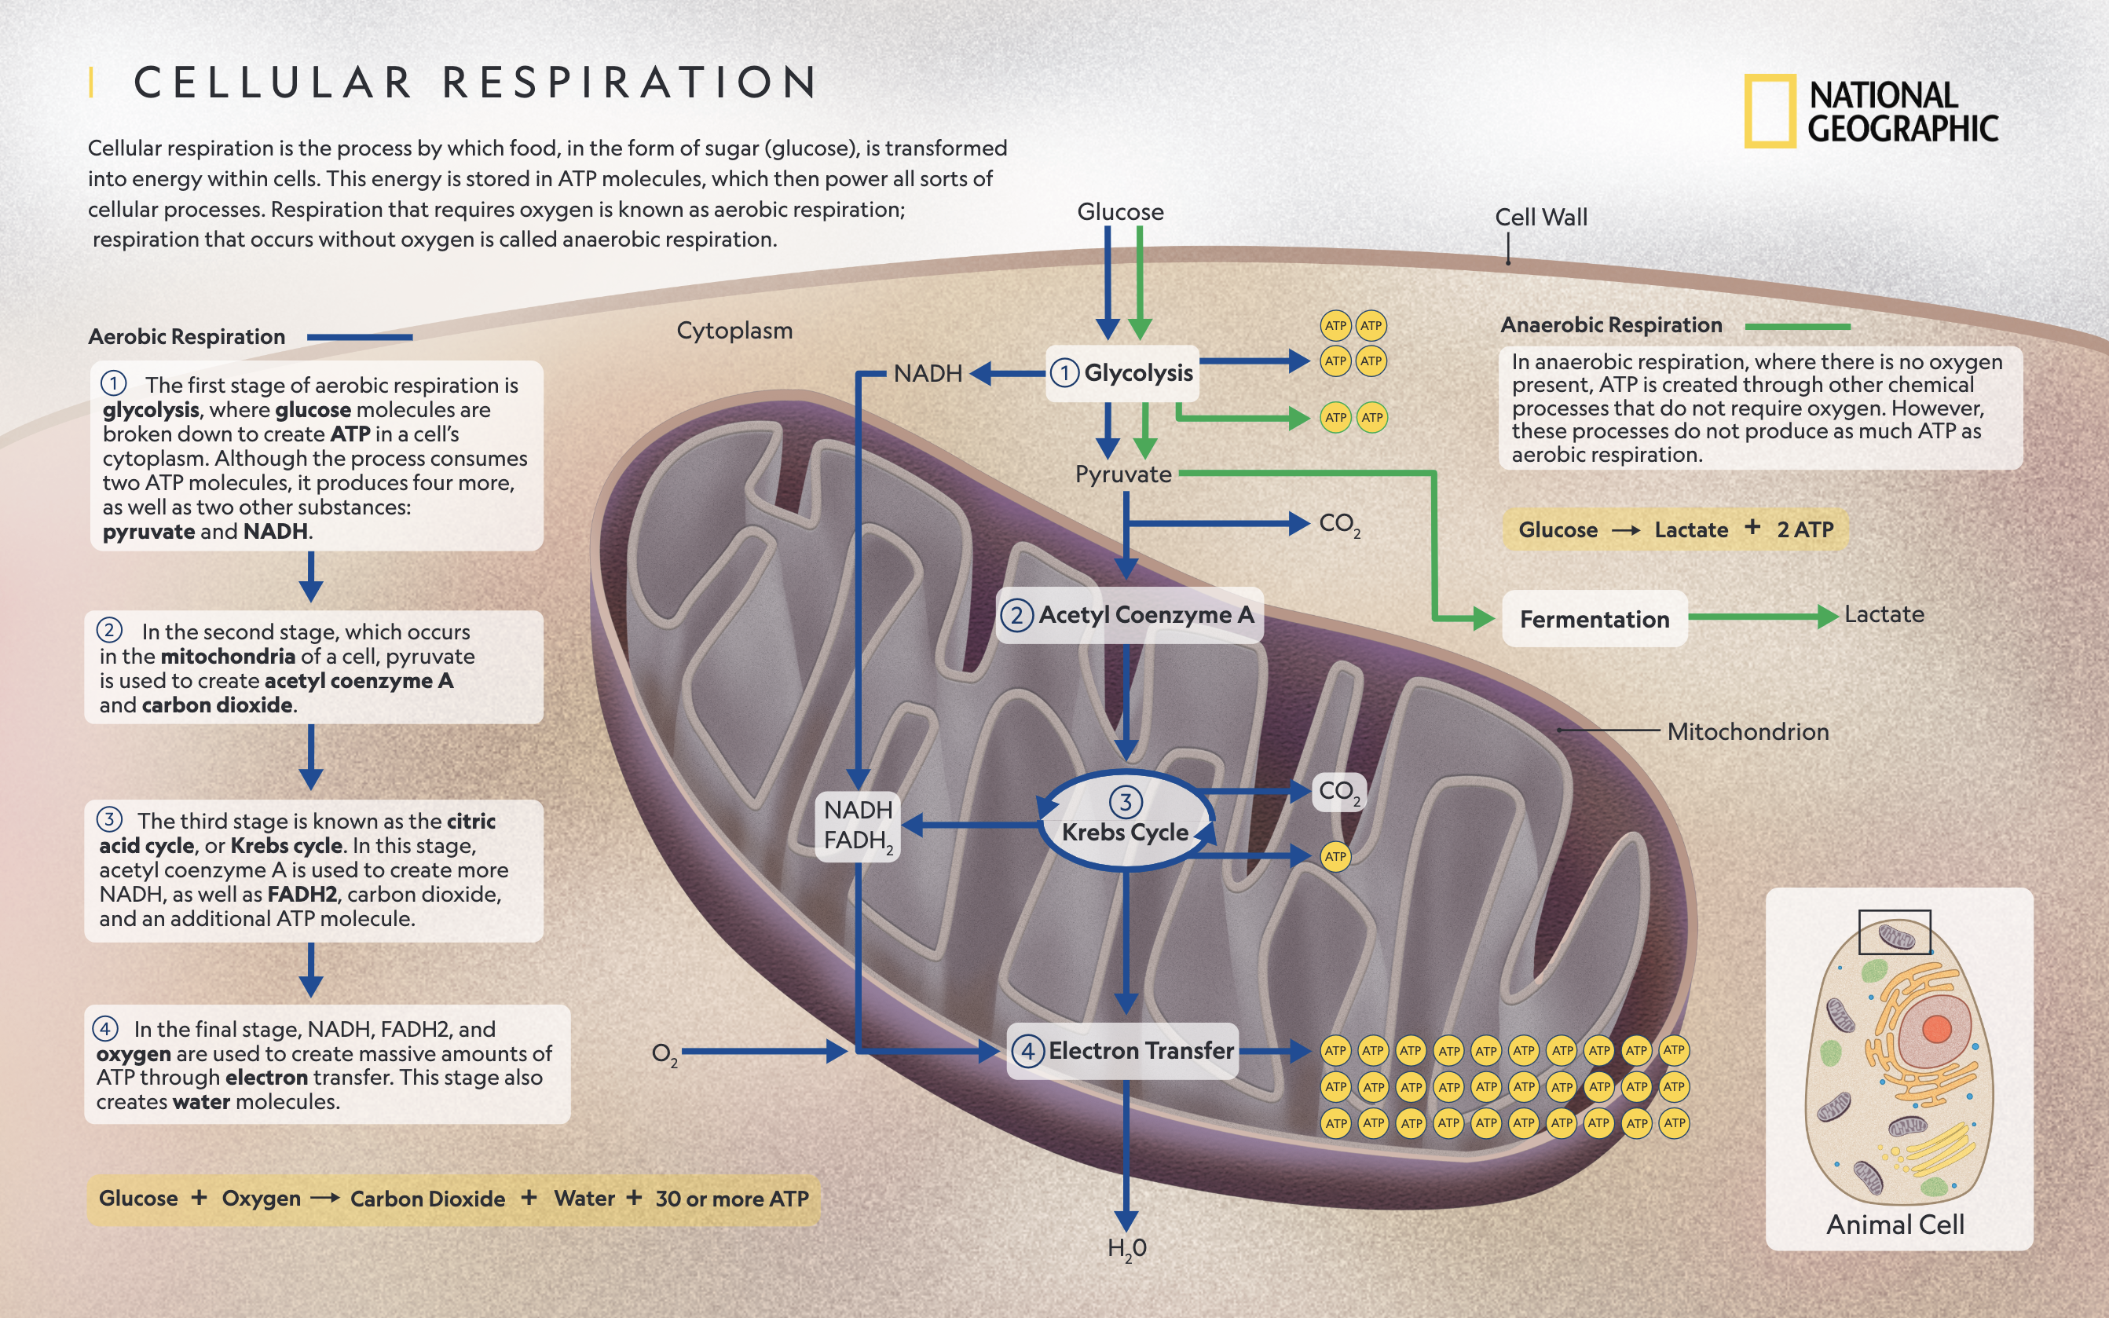
Chapter 9 Cellular Respiration

Slide 2
TOK
Peter Mitchell’s chemiosmotic theory encountered years of opposition before it was finally accepted. For what reasons does falsification not always result in an immediate acceptance of new theories or a paradigm shift?

Slide 3
Essential Idea:
Cell respiration supplies energy for the functions of life.
Energy is converted to a usable form in cell respiration.

Slide 5
Energy Production
This chapter deals with the catabolic pathways that break down organic molecules for the production of ATP.
Whether you are talking about gasoline or sugar, the general equation is:
Organic compound + O₂ —> CO₂ + H₂O + Energy

Slide 6
Cell Respiration
Cellular respiration is the process of oxidizing food molecules into CO2 and H2O.
Glucose, C6H12O6, is a common “food” used in the equation for cellular respiration, but all of the food you eat gets converted into compounds that can be funneled into cellular respiration.
Cellular respiration creates ATP which supplies the energy cells need to carry out their functions.

Slide 8
Energy Transfer
Cell Respiration takes place when the electrons in the reactants are transferred to oxygen.
It does so in very discrete (small) steps causing the phosphorylation to ADP creating ATP.
The ATP (adenosine triphosphate) is immediately available as a source of energy for the cell.

Slide 10
Redox Reactions
Redox reactions involve an oxidation step that occurs when something loses an electron, and a reduction step where a substance gains an electron. Remember, LEO-GER and OIL-RIG

Slide 11
Redox Reactions
Oxygen is a very powerful oxidizing agent because of its electronegativity.
Thus, in redox reactions where electrons are moved closer to oxygen, a lot of chemical energy is given off and is available to do work.
Within the cell during cellular respiration, the energy transfer is used to convert ADP into ATP.

Slide 12
Redox Reactions
Similarities:
  Burning gas in a car liberates energy in the hydrocarbons and powers the car.
  Burning glucose within our cells enables us to do work.
  Cells are much more efficient than other machinery. 40% vs. 15%

Slide 13
Redox Reactions Within the Cell
C₆H₁₂O₆ + 6O₂ + a little bit of energy —> 6C + 12H + 18O —> 6CO₂ + 6H₂O + A lot of Energy (ATP)
The O₂ from respiration oxidizes glucose (O₂ itself becomes reduced forming CO₂ and H₂O (reduced O₂)
Anything with a lot of hydrogen is a good fuel because they fall downhill liberating energy which drives the synthesis of ATP (energy).

Slide 14
Glucose Metabolism
The most efficient way to harness the energy in chemical bonds of a fuel is to do so in small discrete steps.
Glucose and other organic fuels used by the body are broken down in a series of steps that are each catalyzed by a specific enzyme.

Slide 15
Glucose Metabolism
At key points in the process, H atoms are stripped from the intermediates (dehydrogenation) and transferred to the electron carriers, NAD⁺ and FAD creating NADH + H⁺ and FADH2
In a series of steps, NADH and FADH2 transfer electrons to O₂ through the electron transport chain forming water.

Slide 16
Cellular Respiration
The stages of cellular respiration can be summed up as follows:
  1. Glycolysis
  2. The link reaction/pyruvate oxidation
  3. The Citric Acid Cycle
  4. Oxidative Phosphorylation

Slide 18
Glycolysis
Glycolysis is an anaerobic process.
  It doesn’t actually use O₂, thus it isn’t technically considered part of cellular respiration.
Much of the starting material of the citric acid cycle and oxidative phosphorylation comes from glycolysis.

Slide 20
Glycolysis
Glycolysis occurs in the cytosol and breaks down glucose producing 2 ATP, 2 NADH + 2H⁺, 2 pyruvates, and 2 water molecules.
Glycolysis is where the majority of substrate level phosphorylation occurs.
No CO2 is released during glycolysis.

Slide 21
The Junction Between the Citric Acid Cycle and Glycolysis
After glycolysis, most of the energy from glucose is stored in the pyruvate molecules.
When O₂ is present, pyruvate enters the citric acid cycle within the mitochondrion completing the breakdown of glucose.

Slide 22
The Link Between Glycolysis and the Citric Acid Cycle
This is known as the “link reaction,” or pyruvate oxidation.
It is here that pyruvate is converted into acetyl CoA and enters the citric acid cycle where the breakdown of glucose is completed.
In this process, CO₂ is given off and a small amount of ATP is made, and NADH + H⁺ is generated as pyruvate is converted into acetylCoA.

Slide 23
The Citric Acid Cycle
Upon entering the citric acid cycle, the oxidation of acetyl CoA occurs.
In a series of steps, 1 ATP molecule, 3NADH + 3H⁺ and 1FADH₂ are made for each acetyl CoA that enters.

Slide 24
Citric Acid Cycle
Remember, each molecule of glucose produces two molecules of pyruvate, so the cycle actually spins twice for each molecule of glucose that undergoes glycolysis.

Slide 25
NADH and FADH₂ are Reducing Power
NADH and FADH₂ are a source of electrons which are used as reducing power within the mitochondrial matrix.
Oxidative phosphorylation uses NADH and FADH₂ to transfer electrons from one molecule to another in the matrix of the mitochondrion.

Slide 26
Oxidative Phosphorylation
These small “packets” of energy are used to pump hydrogen ions across the cristae to the intermembrane space ultimately driving the synthesis of ATP.

Slide 27
ATP Synthesis
Within the mitochondrial matrix, chemiosmosis and the ETC use the small “packets” of energy to drive the synthesis of ATP.
90% of the ATP generated comes from oxidative phosphorylation.

Slide 28
ATP Synthesis
The remaining 10% of ATP comes from substrate level phosphorylation (glycolysis) and the Krebs cycle where enzymes transfer a phosphate group (PO3²⁻) from a substrate directly to ADP.
The substrate in this case comes from an organic intermediate generated from the breakdown of glucose.

Slide 30
Electron Transport Chain
The NADH and FADH₂ produced by the citric acid cycle carry energy to the cristae of the mitochondria.
The energy from the carriers is used by the electron transport chain to couple electron transport with the movement of H⁺ to the intermembrane space.
The binding of electrons and the free protons to oxygen maintains the hydrogen gradient and generates water.

Slide 31
Oxidative Phosphorylation and the Electron Transport Chain
No ATP is made directly, but the energy transfer is sliced into small amounts which is used to drive hydrogen ions across the membrane.
ATP synthesis occurs via chemiosmosis as the hydrogen ions pass through the ATP synthase molecule.
O2 serves as the terminal electron acceptor for the electron transport chain.

Slide 32
ATP Synthase and Chemiosmosis
The inner part of the mitochondrial membrane contains many copies of a protein complex called ATP synthase.
ATP synthase is the enzyme that actually phosphorylates ADP—making ATP during oxidative phosphorylation.
It makes use of the H⁺ gradient created by the electron transport chain.

Slide 33
Chemiosmosis
The mitochondrial membrane generates and maintains this H⁺ gradient by using the energy releasing flow of electrons to pump H⁺ across the membrane from the matrix to the intermembrane space.
The flow of H⁺ through the ATP synthase drives the synthesis of ATP.

Slide 34
Fermentation
Glycolysis occurs in the cytoplasm of a cell with or without oxygen producing 2 ATPs.
As long as there is a way to regenerate NAD⁺ when O₂ is not available, the cell can keep functioning via glycolysis. (NAD⁺ is the oxidizing agent).
Fermentation is the way the cell continues glycolysis.

Slide 35
Alcohol Fermentation
Yeast
1. CO₂ is released from pyruvate creating acetaldehyde.
2. NADH reduces acetaldehyde to ethanol regenerating NAD⁺.
3. Glycolysis is allowed to continue which produces ATP and keeps the cell alive.

Slide 36
Lactic Acid Fermentation
Muscle
1. Pyruvate is reduced by NADH forming lactate as an end product.
2. Lactate is the ionized form of lactic acid.
3. Glycolysis is allowed to continue producing ATP and pyruvate which keeps the cell alive.

Slide 37
Evolutionary Significance of Glycolysis
The pathways of anaerobic respiration in yeast and humans are essentially the same. The difference is the final product made.

Slide 38
Evolutionary Significance of Glycolysis
1. Ancient prokaryotes likely used glycolysis for energy production before O₂ was present in the atmosphere.
2. Oldest prokaryotic fossil is 3.5 byo, O₂ began accumulating in the atmosphere 2.7 bya.
3. Glycolysis is the most widespread form of energy production indicating it evolved early on.
4. Location in the cytosol indicates it’s very old, older than membrane bound organelles.

Slide 39
Catabolism
Much of what we’ve discussed regarding cellular respiration deals with glucose as the “food,” but this isn’t always the case.
The foods we eat are often high in carbohydrates, proteins and fats.
Many of the carbs get broken down into glucose and other monosaccharides that can be used by cellular respiration.

Slide 40
Protein Catabolism
Proteins are also used as fuel.
First, deamination removes an amino group (excreted in urea), and the intermediates are then fed into glycolysis and the Krebs cycle.

Slide 41
Fat Catabolism
Fats undergo a series of steps producing various intermediates of glycolysis and the Krebs cycle which can then be used as fuel.
Fats get converted to glycerol and fatty acids.
Glycerol gets converted to G-3-P.
β-oxidation converts the fatty acids into 2 carbon fragments that enter the Krebs cycle as acetyl CoA.

Slide 42
=
7 FADH2
7 NADH
8 Acetyl CoA

Slide 43
Anabolic Metabolism
In addition to using food for energy, some of the food we ingest is diverted away from glycolysis and the Krebs cycle and is used for growth and maintenance of the cell. Instead of producing ATP, the body uses it to create building products.

