Slide 1
Chapter 21
B2.3 Cell Specialization (The Zygote, Cell Division & Stem Cells)
Guiding Questions:
What are the roles of stem cells in multicellular organisms?
How are differentiated cells adapted to their specialized functions?
Linking Question:
How do cells become differentiated?
“Embryology is to me by far the strongest single class of facts in favor of change of forms, and not one, I think, of my reviewers has alluded to this.”
-Charles Darwin, 1860

Slide 2
Zygote, Cell Division, & Stem Cells
When the zygote divides, it undergoes 3 major changes:
  1. Cell division
  2. Cell differentiation
  3. Morphogenesis

Slide 3
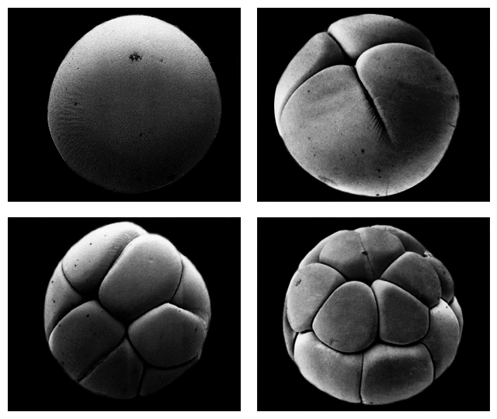
1. Cell Division
Cell division gives rise to numerous cells.

Slide 4
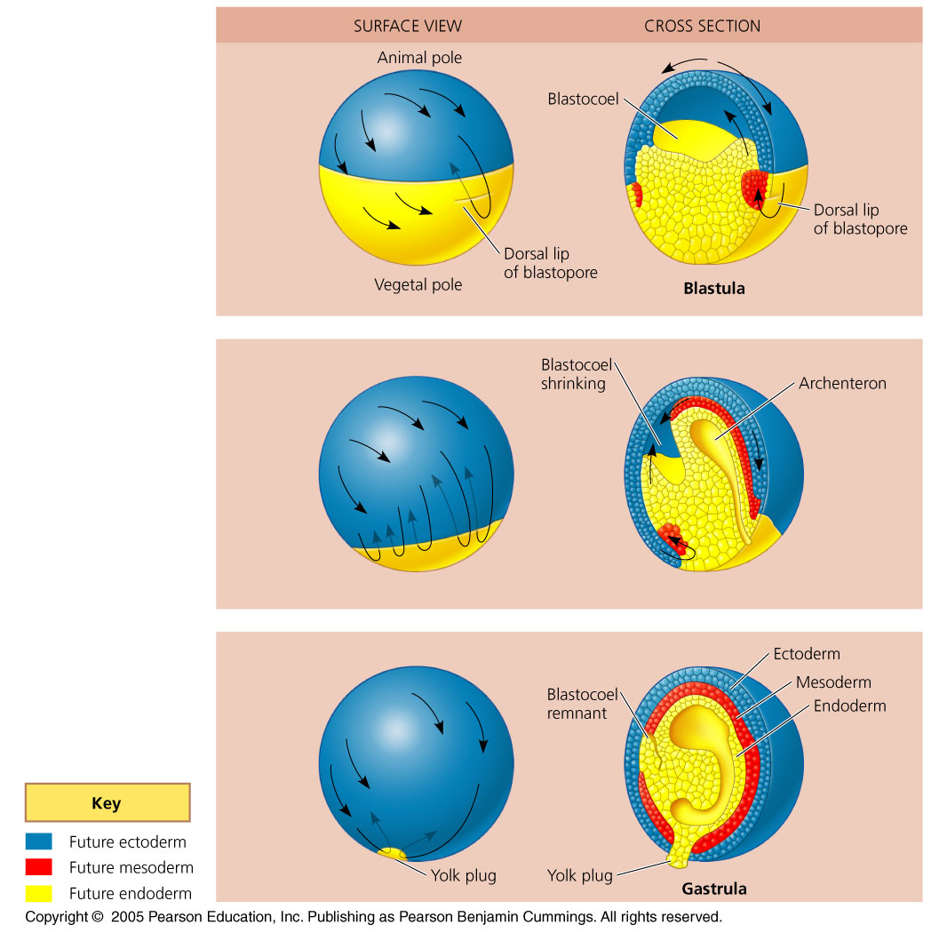
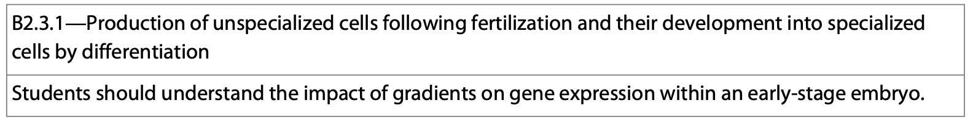
2. Cell Differentiation
Cell differentiation is the process by which cells become specialized in form and function. These cells undergo changes that organize them into tissues and organs.

Slide 5
3. Morphogenesis
As the dividing cells begin to take form, they are undergoing morphogenesis which means the “creation of form.”
Morphogenetic events lay out the development very early on in development as cell division, cell differentiation and morphogenesis overlap.

Slide 6
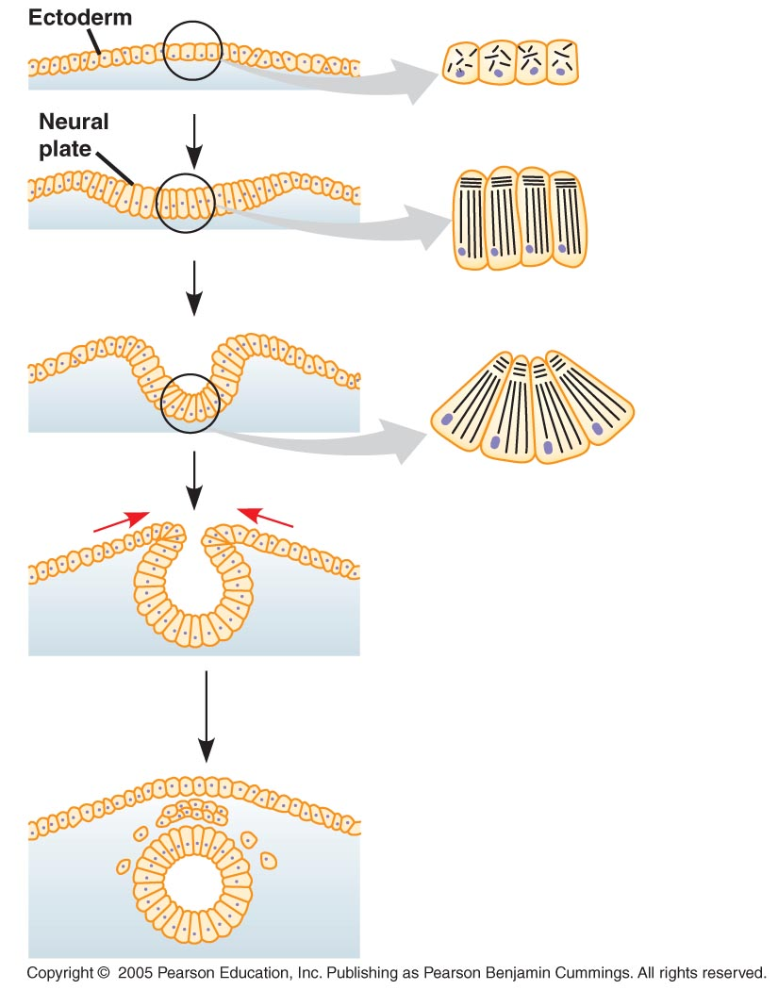
3. Morphogenesis
These morphogenetic events “tell” the organism where the head and tail are, which is the front and back, and what is left and right.
As time progresses, later morphogenetic events will give instructions as to where certain appendages will be located.

Slide 7
Morphogenetic Events
Morphogenetic events, as well as cell division and differentiation, take place in all multicellular organisms.
Morphogenesis differs in 2 major ways in plants and animals:
  1. In animals, movements of cells and tissues are required for the transformation of the early embryo into the characteristic 3D form of the organism.
  2. In plants, morphogenesis and growth in overall size are not limited to embryonic and juvenile periods, they occur throughout the life of the plant.

Slide 8
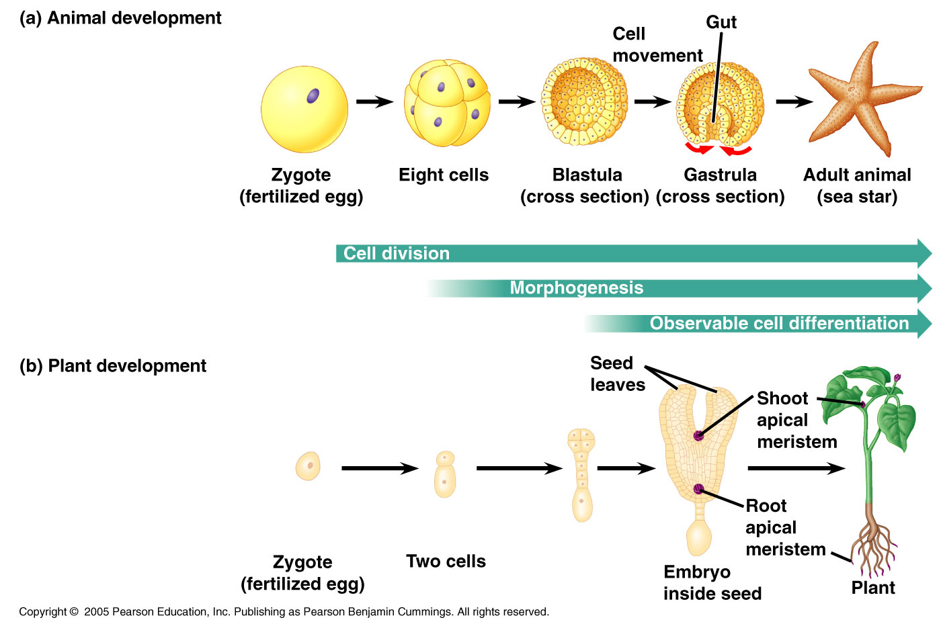

Slide 9
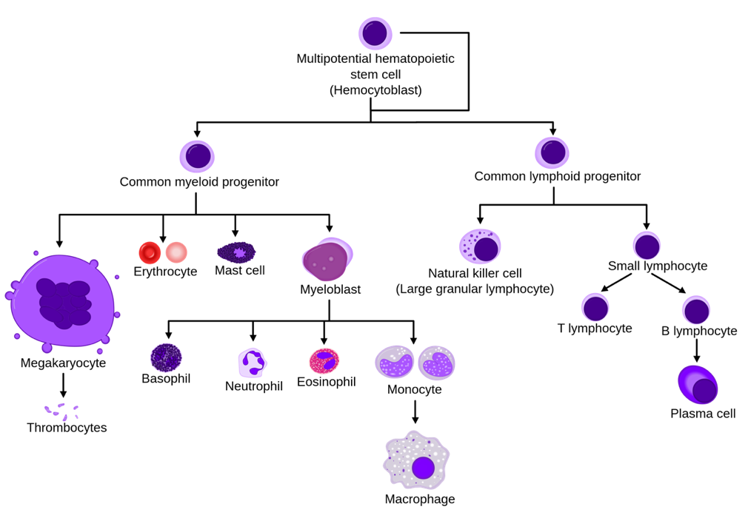
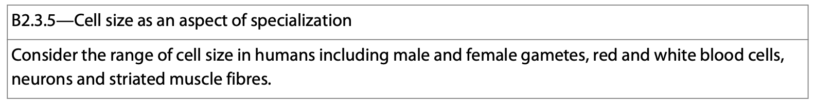

Stem Cells
Stem cells are cells that have the ability to divide endlessly and differentiate along many different pathways.
https://en.wikipedia.org/wiki/Hematopoietic_stem_cell#/media/File:Hematopoiesis_simple.svg

Slide 10
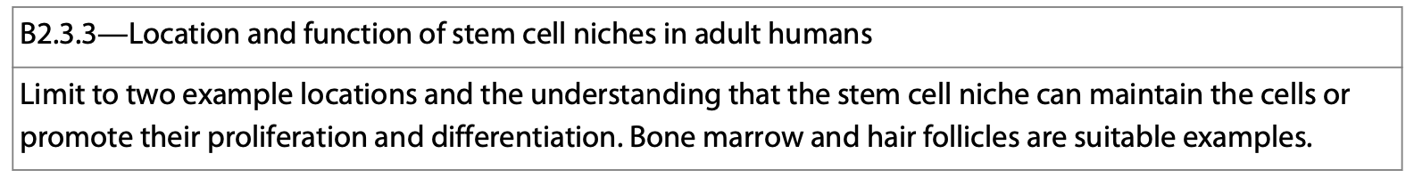
Stem Cells
Stem cells are special human cells with the ability to become a number of different types of cells within the body.
They can give rise to new cells on a regular basis (like with the blood or hair), and sometimes they can be used to repair damaged tissue.

Slide 11
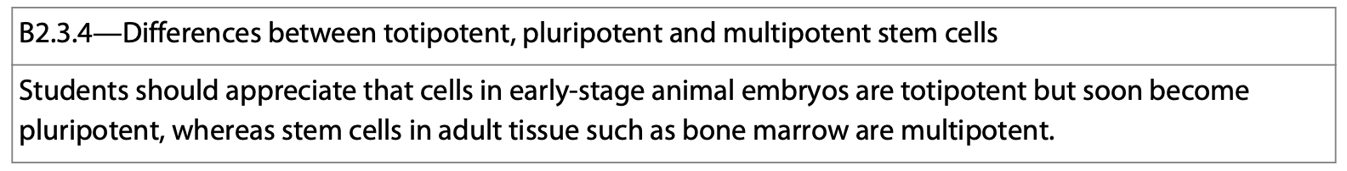
Stem Cells
There are three main types:
  Totipotent
  Pluripotent
  Multipotent

Slide 12
Totipotent Cells
Totipotency is the ability of a single cell to divide and produce all the differentiated cells in an organism.
Totipotent cells are formed as a result of sexual reproduction.
These cells have the ability to give rise to a new individual, as well as any type of cell in the body, as well as extra-embryonic tissue (the placenta).

Slide 13
Pluripotent
In cell biology, the definition of pluripotency refers to a stem cell that has the potential to differentiate into any of the three germ layers: endoderm, mesoderm, or ectoderm.
Pluripotent stem cells can give rise to any fetal or adult cell type. However, alone they cannot develop into a fetal or adult animal because they lack the potential to contribute to extraembryonic tissue, such as the placenta.

Slide 14
Multipotent
Multipotent stem cells have the ability to divide and develop into many different types of specialized cells.
  For instance, stem cells in human blood can give rise to all of the different types of blood cells. Most adult stem cells are multipotent.
https://en.wikipedia.org/wiki/Hematopoietic_stem_cell#/media/File:Hematopoiesis_simple.svg

Slide 15
https://cdn.technologynetworks.com/tn/images/body/cell-potency-hierarchy1527087241886.png

Slide 16
https://www.nature.com/articles/s41576-018-0040-z/figures/1

Slide 17
Stem Cells
The capacity of cells to divide and differentiate along different pathways is necessary in embryonic development. This feature is also what makes stem cells suitable for therapeutic uses.
The use of stem cells, especially embryonic stem cells, has many obvious medical applications.

Slide 18
https://www.sciencedirect.com/topics/medicine-and-dentistry/stem-cell

Slide 19
Animals
The ongoing development in adult animals is normally restricted to the generation of cells that need to be continually replenished: blood cells, hair follicle cells, skin cells and the cells lining the intestine for example.

Slide 20
Reflection
1. Explain the difference between pluripotent, multipotent, and totipotent stem cells.
2. What is morphogenesis?
3. What is a zygote?

Slide 21
Multicellular Organisms
The cells of multicellular organisms come almost entirely from differences in gene expression. Regulatory mechanisms turn certain genes on and off during development.
These regulatory mechanisms are what makes cells different because nearly all cells have the same genetic complement.
Early division of the cells divides up the intracellular contents. These contents are called transcription factors--the combination of which results in the differential gene expression unique to each type of cell.

Slide 22
Multicellular Organisms
Cytoplasmic determinants
Generalized transcription factors
Specific transcription factors

Slide 23
Cell Differentiation
There are 2 major things telling a cell when and how to differentiate:
  1. The “stuff” found within the egg at the time of conception.
  2. The environment in which the embryo develops.

Slide 24
The “Stuff” in the Egg
  The egg cell’s cytoplasm contains RNA and protein molecules encoded by the mother’s DNA.
    mRNA, proteins, organelles, and other substances are scattered unevenly throughout the cytoplasm of an unfertilized egg.
    These maternal substances influence the course of early development called cytoplasmic determinants.

Slide 25
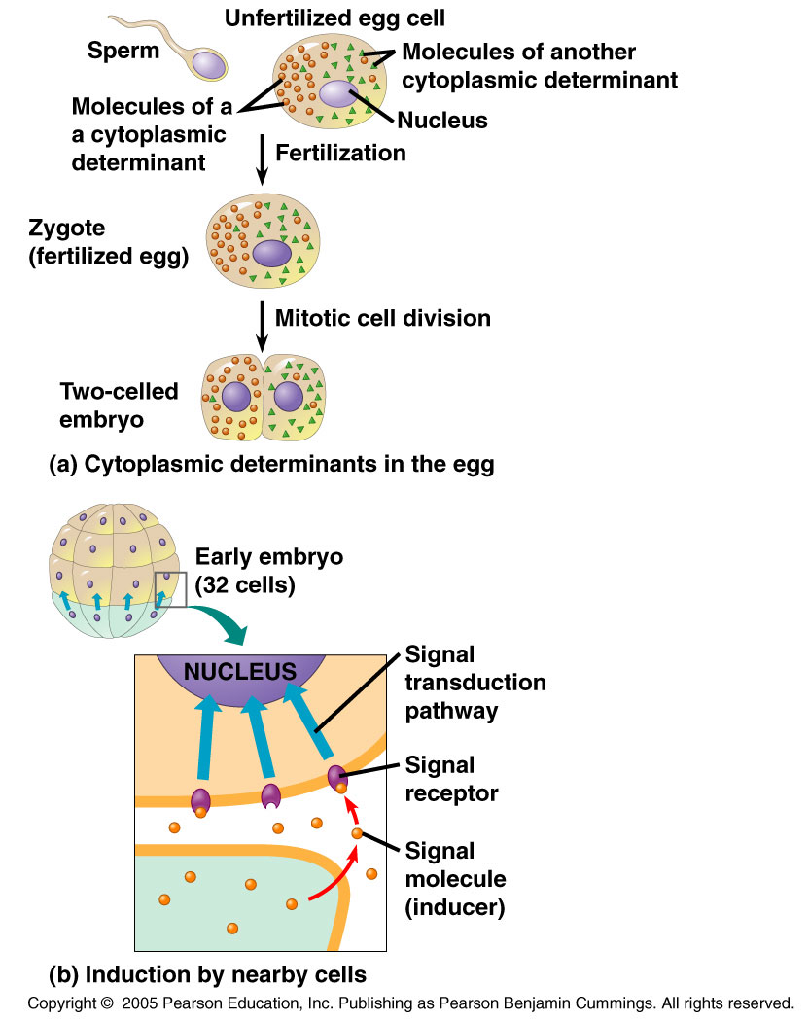
Cytoplasmic Determinants
Following fertilization, mitotic divisions distribute the zygote’s cytoplasm into separate cells.
The nuclei of these cells are subjected to many different cytoplasmic determinants.
What has been received determines the developmental fate of each of the cells.

Slide 26
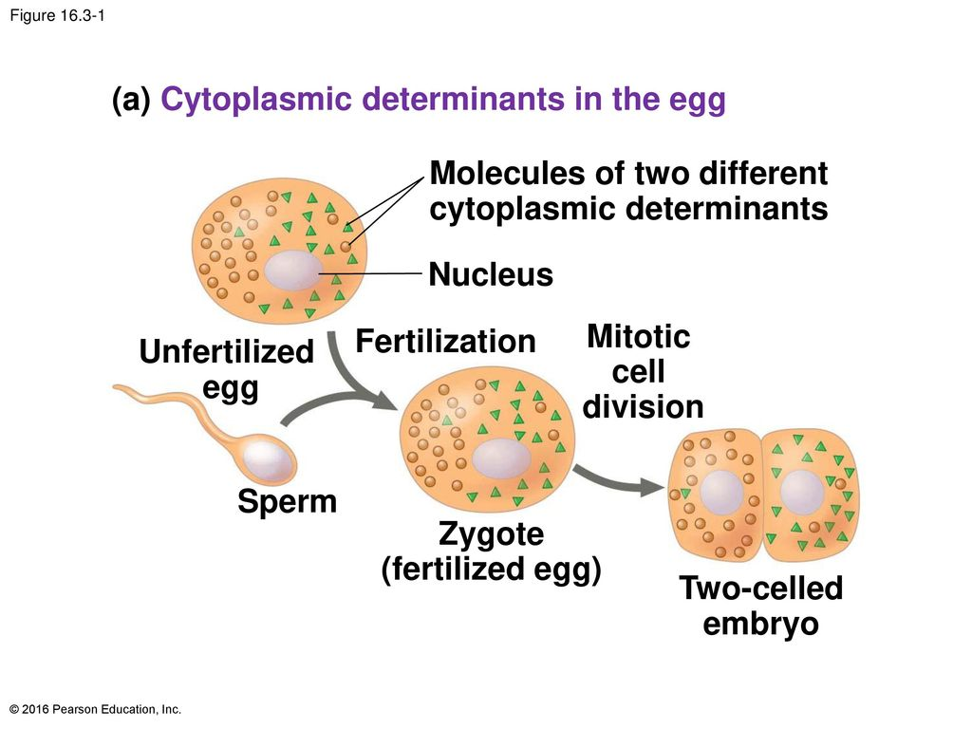
Cytoplasmic Determinants
Cytoplasmic determinants help to create an animal’s 3D arrangement before morphogenesis can shape the animal.

Slide 27
The Environment
The environment in which the embryo develops plays an important factor in outcome of the developing organism.
  The surface contact of cell-to-cell interaction helps to signal development.
  By the process of induction, an embryo’s genes signal the expression of proteins that cause changes in nearby target cells.
  These signals send a cell down a specific developmental pathway--inducing further differentiation of the many specialized cells within the new organism.

Slide 28
The Environment
The transcription factors present in the cell, along with the different types of activators determines which genes get expressed.
  Virtually all cells in the body contain all of the same genes.
  Not all genes are expressed by each cell.
  The genes that are expressed are turned on and off by various combinations of available activators and transcription factors.

Slide 29
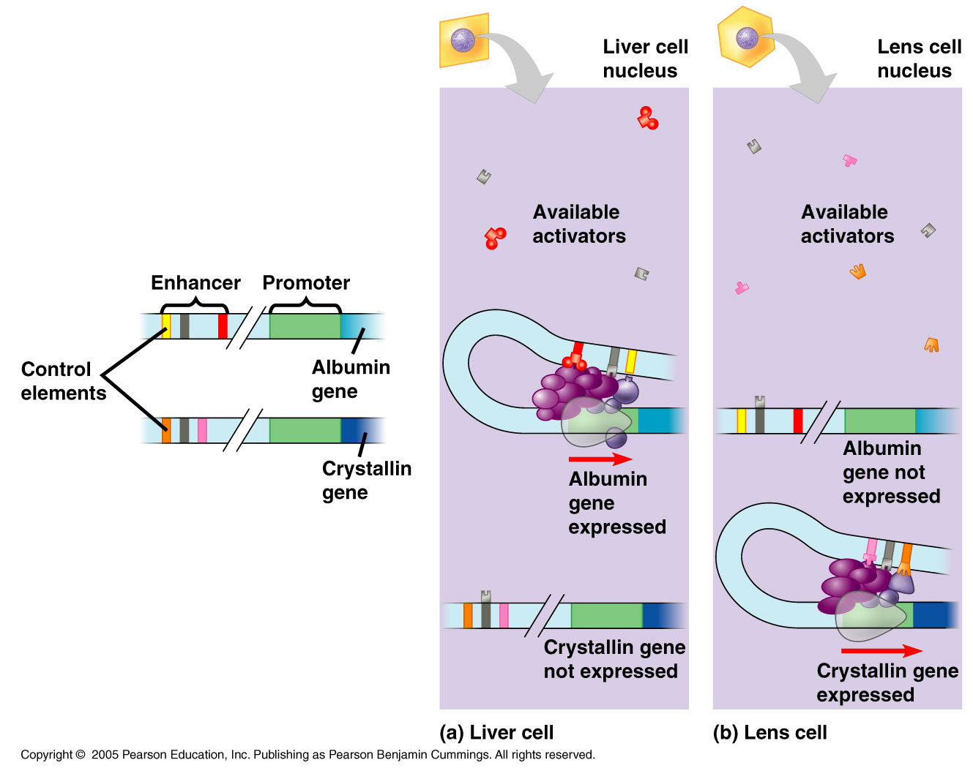

Slide 30
Reflection
1. What is the difference between embryonic and adult stem cells?
2. The differences in the cells of multicellular organisms is almost entirely due to differences in gene expression. Explain.
3. What are cytoplasmic determinants? Where do they come from?
4. What are the two major things that tell a cell how to differentiate?

