Slide 1
Chapter 36
Transport in Vascular Plants: Xylem and Phloem
Guiding Questions:
• How are multicellular organisms adapted to carry out gas exchange?
• What are the similarities and differences in gas exchange between a flowering plant and a mammal?
• What adaptations facilitate transport in animals and plants?
• What are the differences and similarities between transport in animals and plants?
travismulthaupt.com

Slide 2
Solute Movement
The plant’s plasma membrane is selectively permeable.
It regulates the movement solutes in and out of a cell.
  Passive transport
  Active transport
Transport proteins are in the membrane and allow things in and out.
travismulthaupt.com

Slide 3
Active Transport
Proton pumps are the most important active transport proteins in plants.
  ATP is used to pump H⁺ out of the cell.
  Forms a PE gradient
The inside of the cell becomes negative.
The PE energy difference can then be used to do work.
travismulthaupt.com

Slide 4
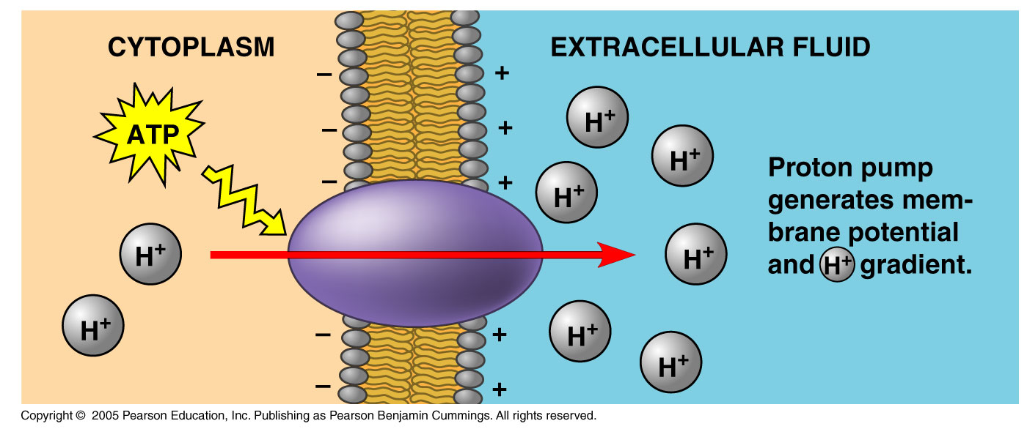
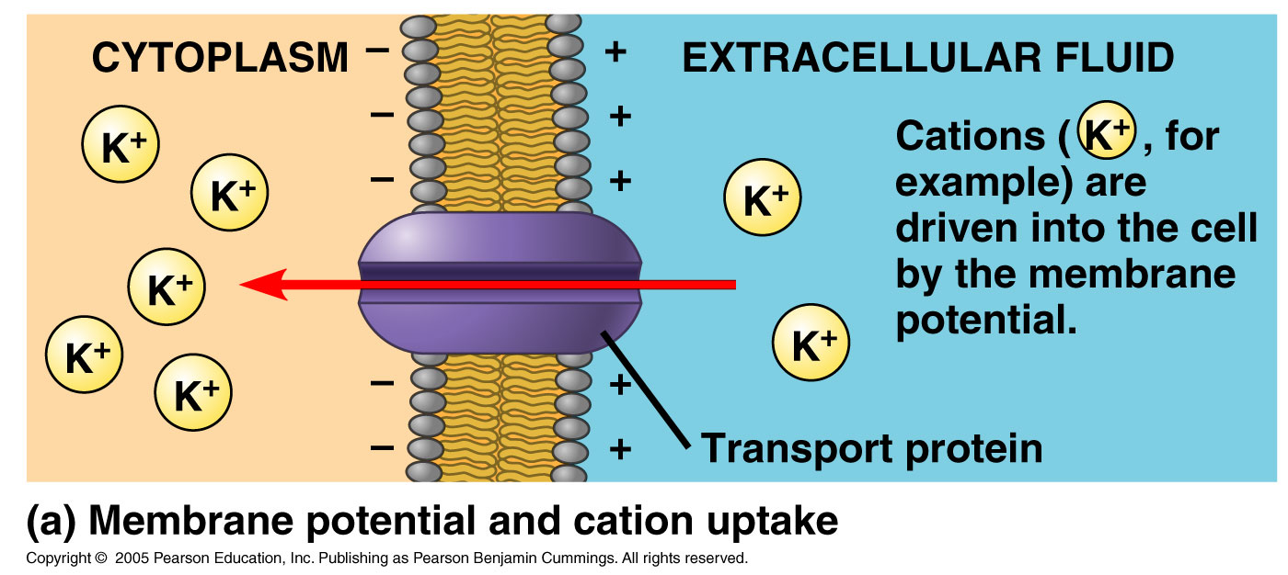
Plant Cells
Plant cells use this H⁺ gradient to drive the transport of solutes.
Root cells use this gradient to take up K⁺.
This lowers water potential allowing water uptake.
travismulthaupt.com

Slide 5
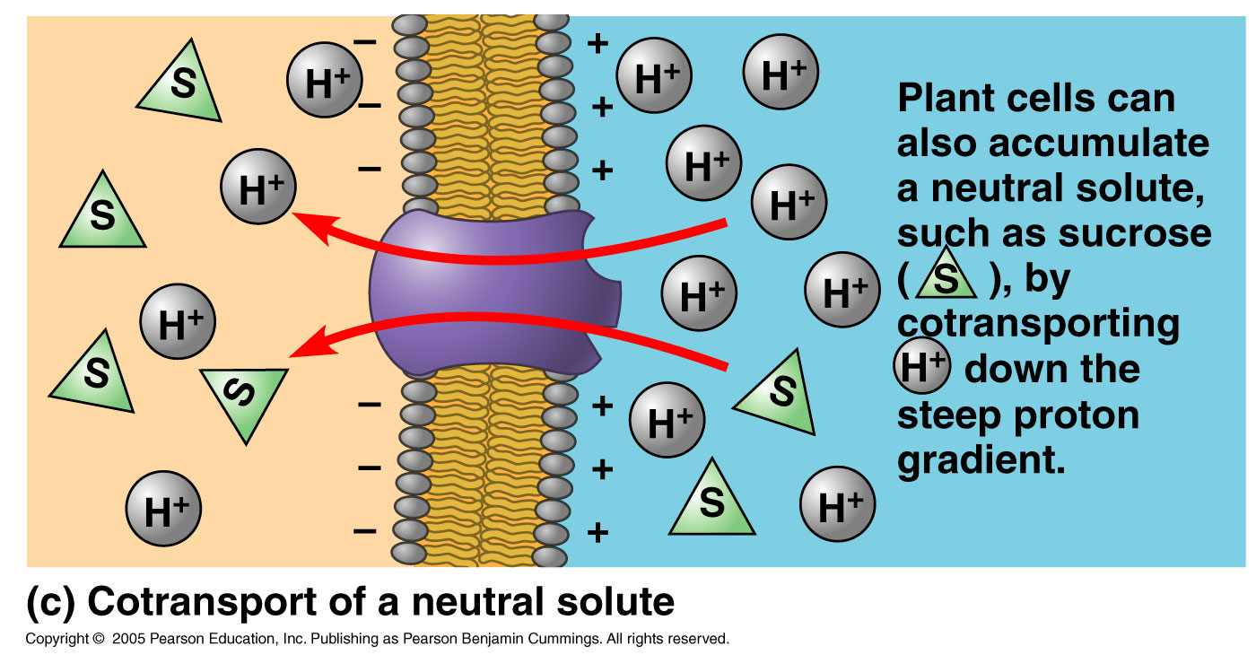
Cotransport
This occurs when the downhill flow of one solute is coupled with the uphill movement of another.
In plants, a membrane potential cotransports sucrose with a H⁺ moving down its gradient through a protein.
travismulthaupt.com

Slide 6
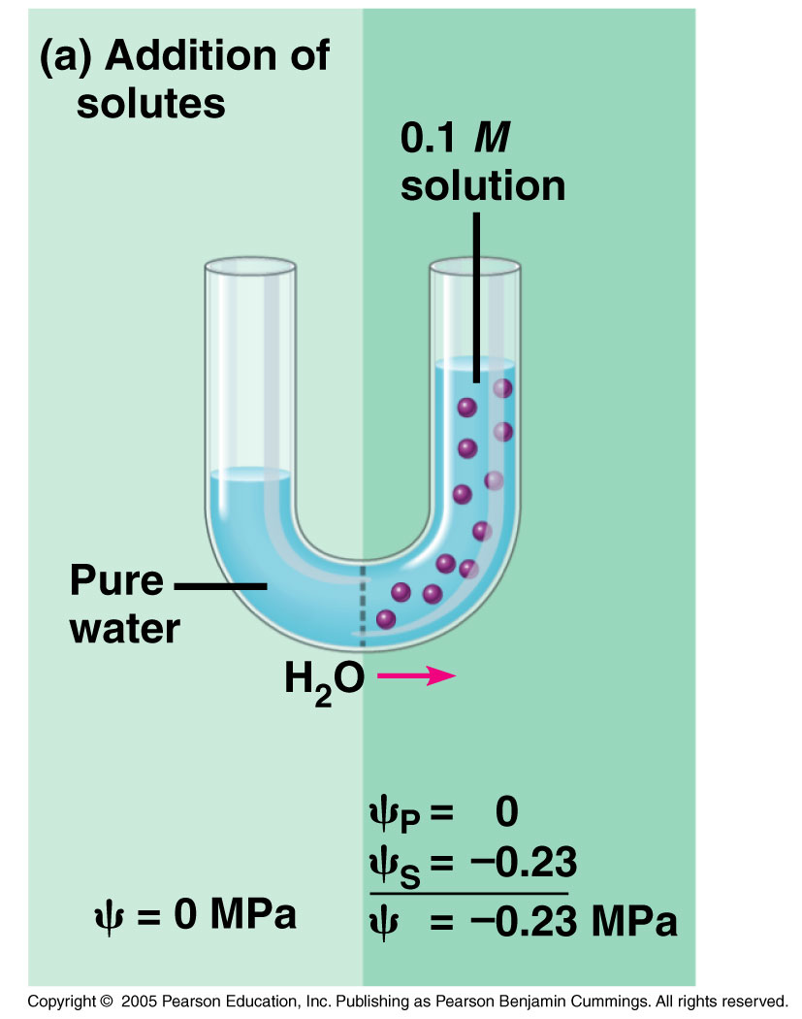
Osmosis
Osmosis is the passive transport of water across a membrane.
It is the uptake or loss of water that plants use to survive.
travismulthaupt.com

Slide 7
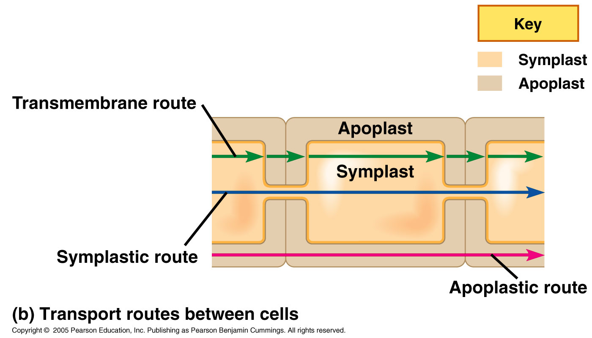
Osmosis
It is the incompressibility of water that allows for its transport along hydrostatic pressure gradients.
travismulthaupt.com

Slide 8
Osmosis
If a cell’s plasma membrane is impermeable to solutes, then knowing the solute concentration of either side of the cell will tell you which direction H₂O will move.
Determining how the water moves involves calculating the potential (which is denoted as Ψ).
travismulthaupt.com

Slide 9
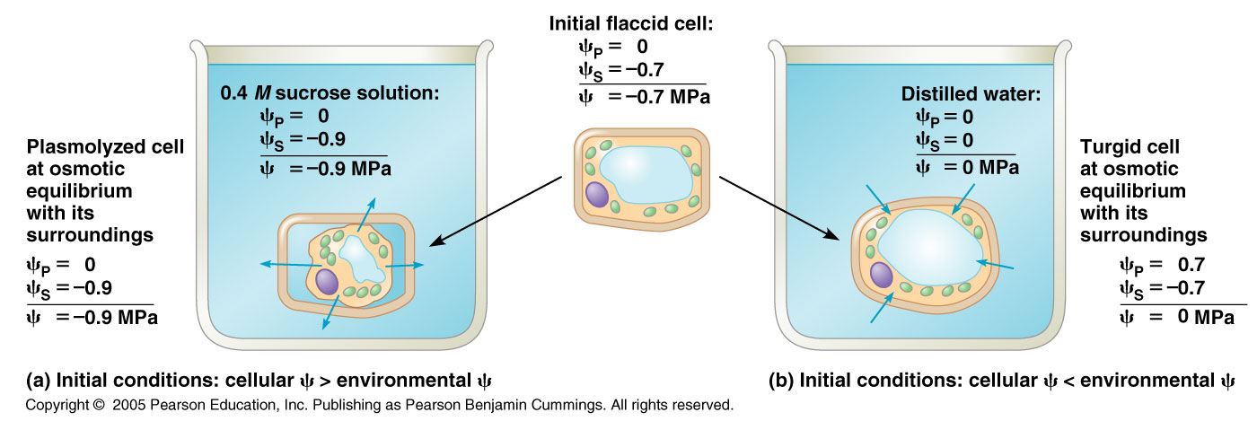
Water Potential
Plants have cell walls, and the solute concentration along with the physical pressure of the cell wall creates water potential.
travismulthaupt.com

Slide 10
Water Potential
Free water (not bound to solutes) moves from regions of high water potential to regions of low water potential.
“Potential” in water is the water’s PE, water’s capacity to do work when it moves from high Ψ to low Ψ.
Ψ is measured in MPa or bar.
travismulthaupt.com

Slide 11
Water Potential
The water potential (Ψ) of pure water in an open container is zero (at sea level).
Pressure and solute concentration affect water potential.
  Ψ = Ψ_{s} + Ψ_{p}
    Ψ_{s} (osmotic potential/solute potential)
    Ψ_{p} (pressure potential)
travismulthaupt.com

Slide 12
Osmotic/Solute Potential
Osmotic potential and solute potential are the same because the dissolved solutes affect the direction of osmosis.
  By definition, Ψ_{s} of pure water is zero.
Adding solutes binds H₂0 molecules and lowers its potential to do work.
  The Ψ_{s} of a solution is always negative.
For example, the Ψ_{s} of a 0.1M sugar solution is negative (-0.23MPa).
travismulthaupt.com

Slide 13
Remember,
High solute concentration
High osmotic pressure (Π).
Low osmotic potential
Hypertonic
travismulthaupt.com

Slide 14
Pressure Potential
Pressure potential (Ψ_{p}) is the physical pressure on a solution.
Ψ_{p} can be positive or negative relative to atmospheric pressure.
The Ψ_{p} of pure water at atmospheric pressure is 0.
travismulthaupt.com

Slide 15
Water Uptake and Ψ_{p}
In a flaccid cell, Ψ_{p} = 0.
If we put the cell into a hypertonic environment, the cell will plasmolyze, Ψ = a negative number.
travismulthaupt.com

Slide 16
Water Uptake and Ψ_{p}
If we put the flaccid cell (Ψ_{p} = 0) into a hypotonic environment, the cell will become turgid, and Ψ_{p} will increase.
Eventually, Ψ = 0. (Ψ_{s} + Ψ_{p} =0)
travismulthaupt.com

Slide 17
Transpiration
Transpiration is the loss of water from the plant through stomata in the leaf.
It is a natural consequence of gas exchange.
The plant needs CO₂ for photosynthesis and O₂ for respiration.
The exchange of these gases leads to water loss.
travismulthaupt.com

Slide 18
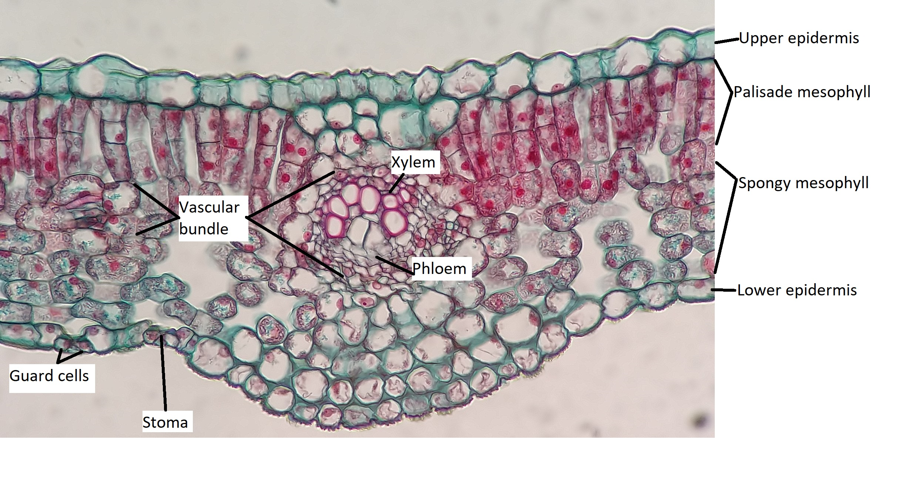
Leaf Anatomy
https://bio.libretexts.org/Courses/Norco_College/BIO_5%3A_General_Botany_%28Friedrich_Finnern%29/05%3A_Leaves/5.02%3A_Internal_Leaf_Structure
The insides of the leaf are specialized for function:
  Upper side of leaves contain a lot of cells with chloroplasts.
  The underside has a large internal surface area.
  These spaces increase the surface area 10-30x.
travismulthaupt.com

Slide 19
Leaf Anatomy
This large internal surface area increases the evaporative loss of water from the plant.
Stomata and guard cells help to balance this loss with photosynthetic requirements.
travismulthaupt.com

Slide 20
Transpiration and Evaporation
Hot, windy, sunny days are when we see the most transpiration.
Evaporative water loss, even when the stomata are closed, can cause plants to wilt.
A benefit to evaporative water loss is that it helps the leaf to stay cool.
travismulthaupt.com

Slide 21
Stomata
The stomata of plants open and close due to changes in the environment.
Guard cells are the sentries that regulate the opening and closing of the stomata.
travismulthaupt.com

Slide 22
Guard Cells
As the guard cells become flaccid or turgid, they close and open respectively.
When they become flaccid, such as during hot/dry periods, there isn’t much water in the plant.
Allowing water out would be a detriment to the plant.
Thus, they remain closed.
travismulthaupt.com

Slide 23
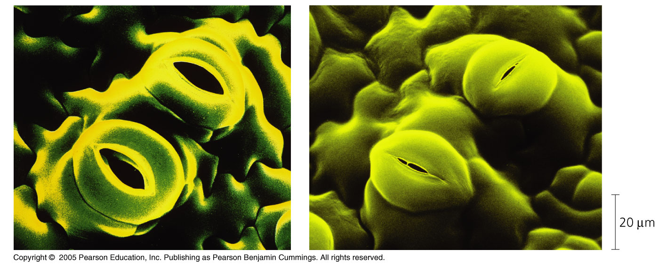
Guard Cells
When the plant becomes turgid, the guard cells swell and they open.
travismulthaupt.com

Slide 24
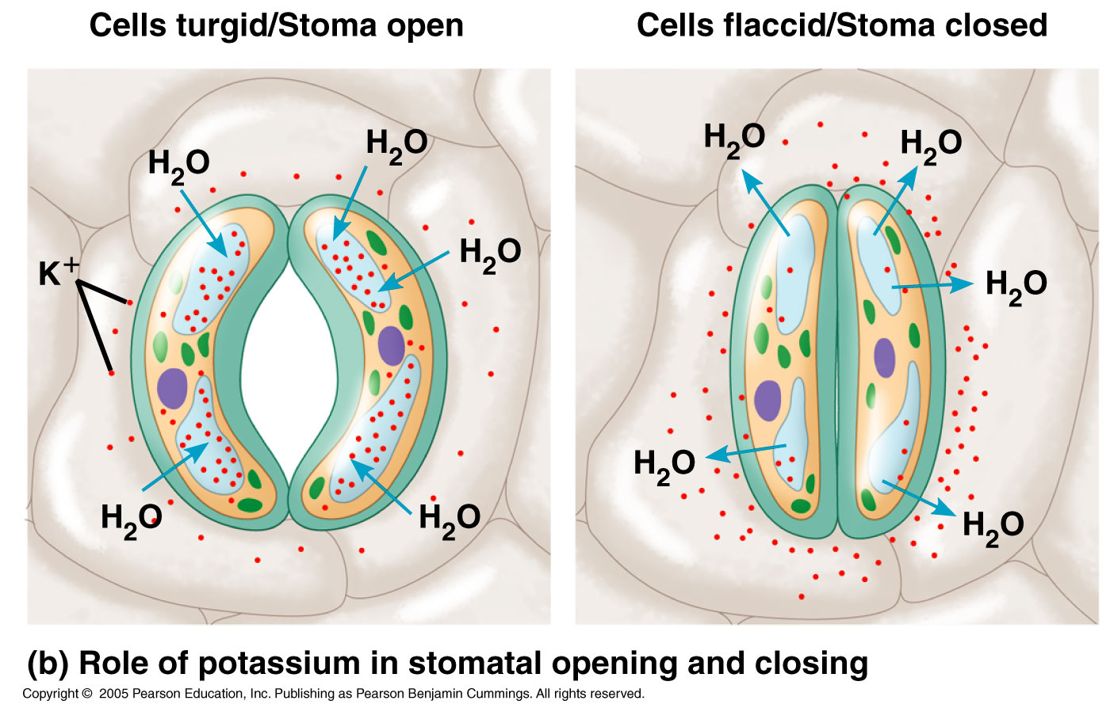
Guard Cells
Changing the turgor pressure of the guard cells is due largely to the uptake and loss of K⁺ ions.
Increasing and decreasing the K⁺ concentration within the cell lowers and raises the water potential of a cell.
travismulthaupt.com

Slide 25
Guard Cells
Having a lot of water in the plant allows transpiration and photosynthesis to occur without causing damage to the plant. This causes the water to move.
travismulthaupt.com

Slide 26
Guard Cells
Active transport is responsible for the movement of K⁺ ions.
Pumping H⁺ out of the cell drives K⁺ into the cell.
Sunlight powers the ATP driven proton pumps. This promotes the uptake of K⁺, lowering the water potential.
Water moves from high to low potential causing the guard cells to swell and open.
travismulthaupt.com

Slide 27
3 Cues to Stomatal Opening
1. Light
2. CO₂ levels
3. Circadian rhythm
travismulthaupt.com

Slide 28
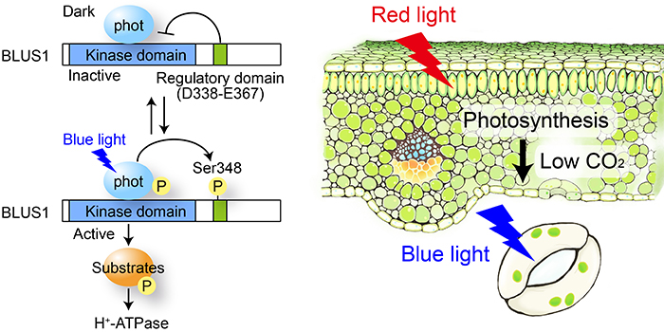
1. Light
Light receptors stimulate the activation of ATP-powered proton pumps and promotes the uptake of K⁺ which opens the stomata.
https://plantae.org/how-blue-and-red-light-synergistically-drive-stomatal-opening/
travismulthaupt.com

Slide 29
2. CO₂ Level
Low levels of CO₂ are also responsible for stomatal opening.
When CO₂ levels drop, the plant senses this and it triggers a cell signaling pathway to stimulate stomata to open and let more in.
travismulthaupt.com

Slide 30
3. Circadian Rhythm
Circadian rhythm also tells the stomata when to open and close.
travismulthaupt.com

Slide 31
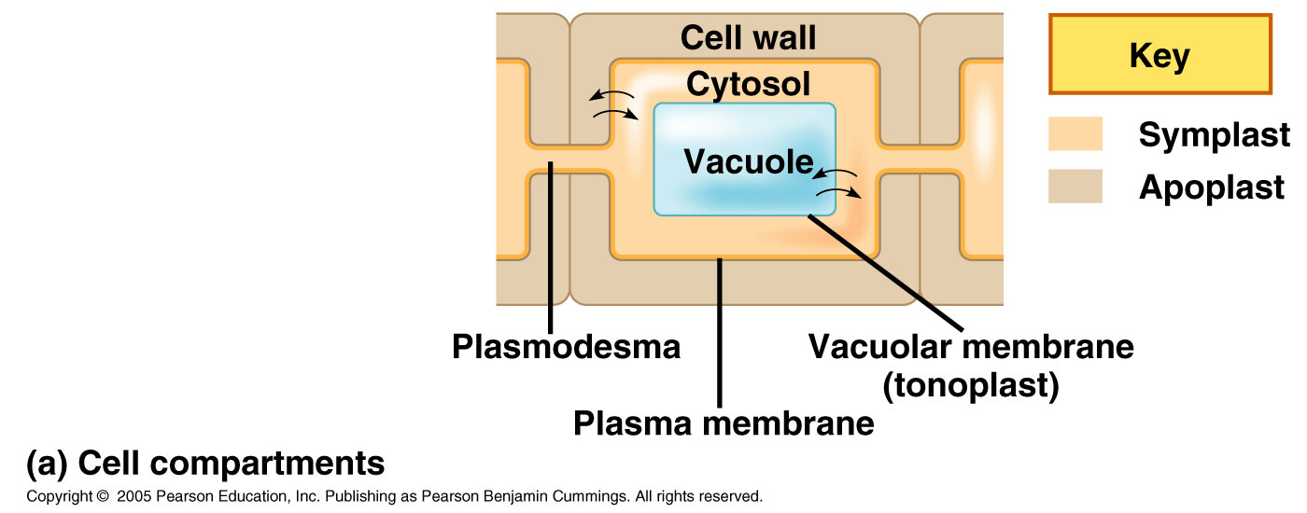
How Does this Apply?
There are three available routes for water and solute movement with a cell:
1. Substances move in and out across the plasma membrane.
travismulthaupt.com

Slide 32
How Does this Apply?
2. After entering a cell, solutes and water can move throughout the symplast via the plasmodesmata.
3. Short distance movement can work along the apoplast.
travismulthaupt.com

Slide 33
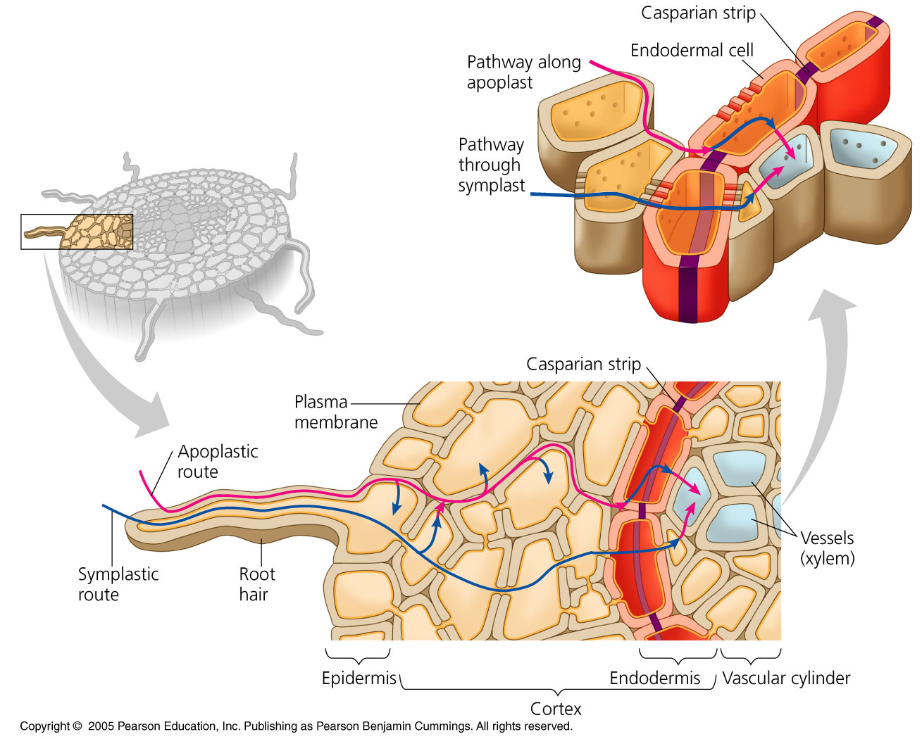
travismulthaupt.com

Slide 34
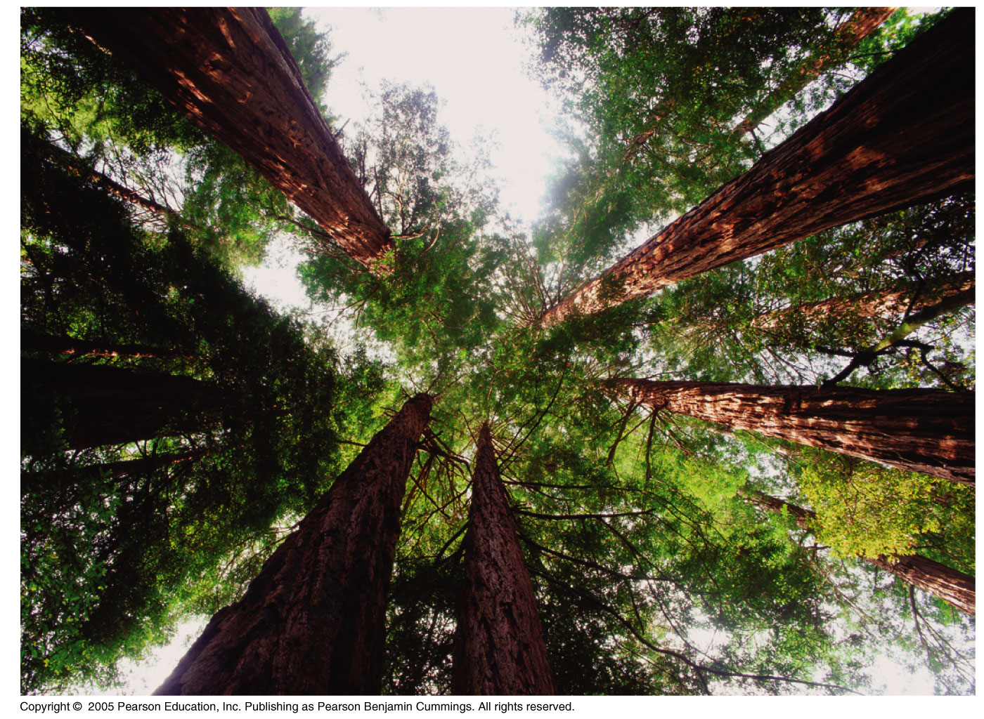
How Does this Apply?
Bulk flow is good for short distance travel.
For long distance travel, pressure is needed.
travismulthaupt.com

Slide 35
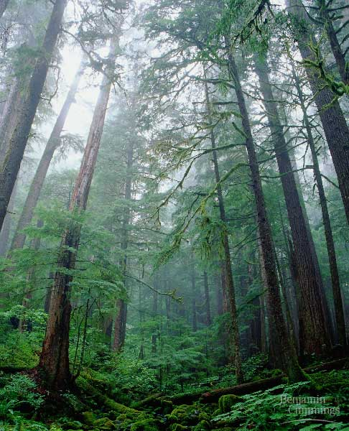
Xylem
Negative pressure drives long distance transport.
travismulthaupt.com

Slide 36
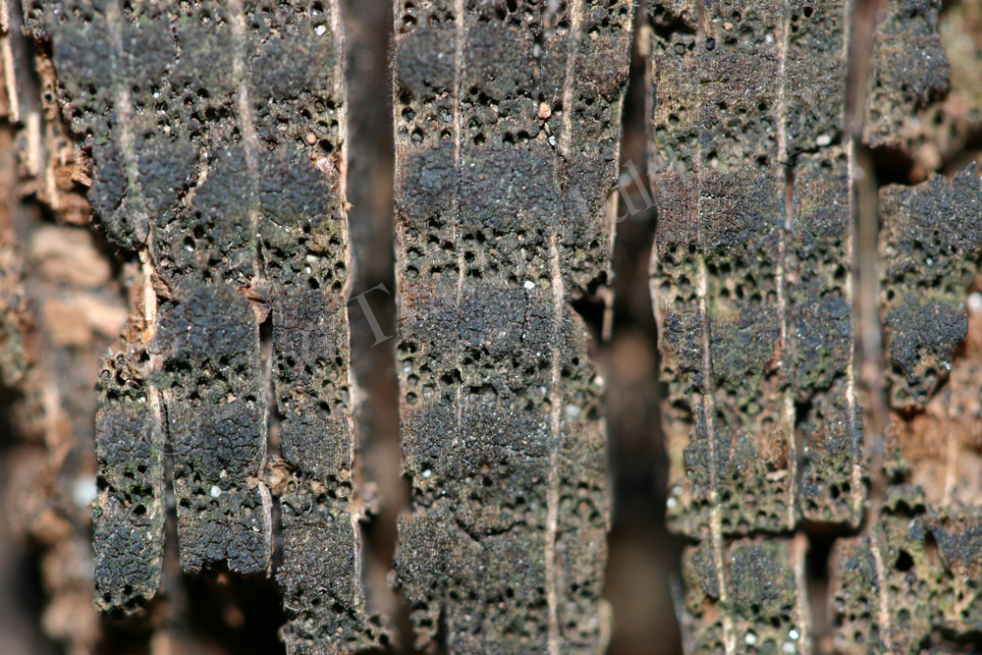
Xylem
Xylem conveys water and dissolved minerals upward from roots to shoots.

Slide 37
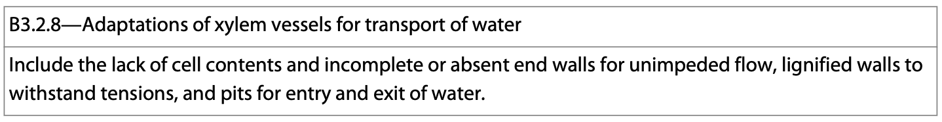
Xylem
The two types of water conducting cells of xylem.
  A. Tracheids
  B. Vessel Elements:
These are dead at functional maturity.
Xylem has many modifications including incomplete end walls, lignification, and pits.

Slide 38
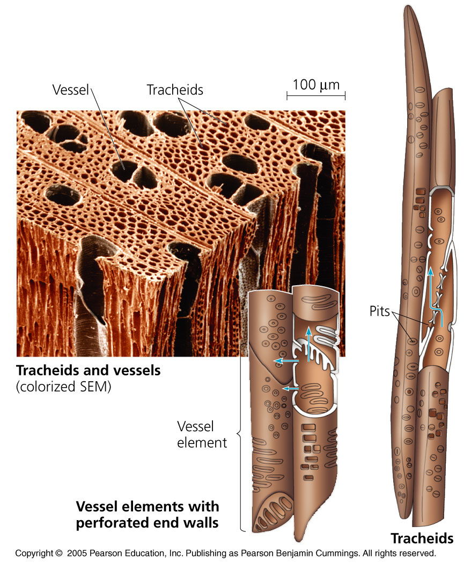
Tracheids
Tracheids are found in the xylem of all vascular plants.
Most angiosperms, a few gymnosperms, and a few seedless vascular plants have vessels.

Slide 39
Tracheids
When the cell dies, a non-living conduit remains through which water flows.
The secondary cell walls contain lignin.

Slide 40
Vessel Elements
Vessel elements are usually wider, shorter and thinner than tracheids.
They are relatively long micropipes and are aligned end to end.

Slide 41
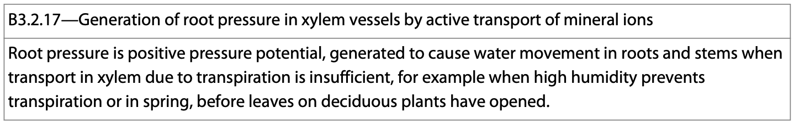
Xylem
In the roots of plants, active transport results in the movement of potassium (K⁺) and other ions into the cells.
This lowers the water potential and water moves in by osmosis generating root pressure.
This plays a role in water movement in certain environmental conditions.

Slide 42
Phloem
Phloem transports organic nutrients from where they are made (source) to where they are needed/stored (sink).

Slide 43
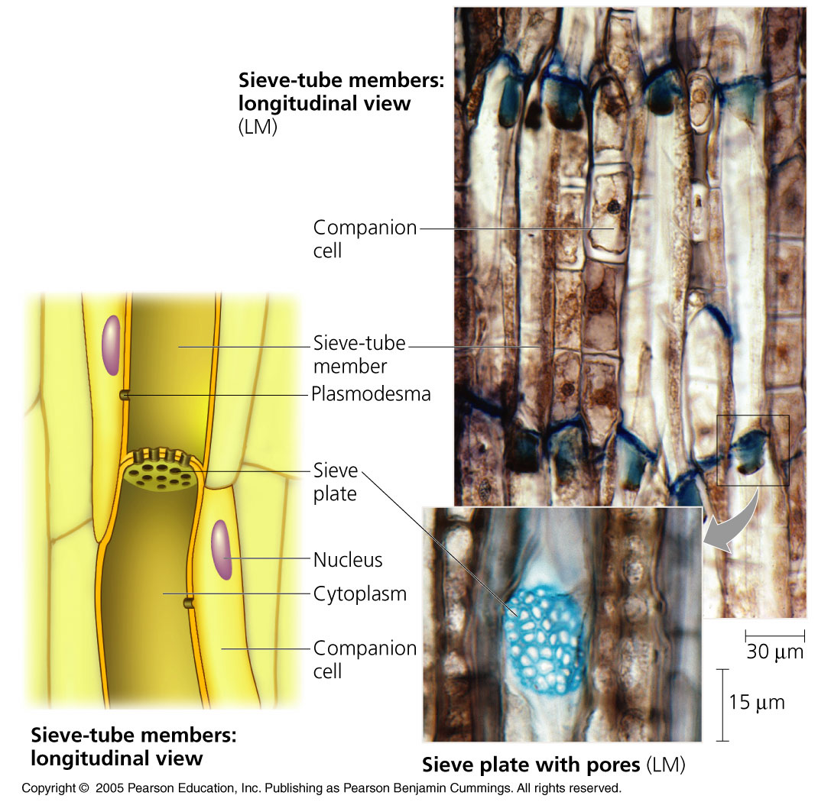
B. Phloem and Sieve Tubes
The sugar conducting cells of phloem are alive at maturity.
The sugar and other organic nutrients flows through sieve tubes.

Slide 44
B. Phloem and Sieve Tubes
The end walls of sieve tubes have sieve plates which have pores that allow fluid to move from tube to tube throughout the plant.
*More on this in a moment.

Slide 45
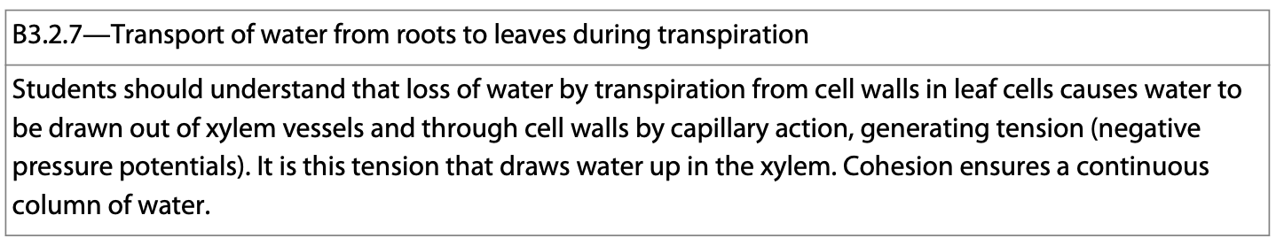
Transpiration
Due to transpiration, water loss reduces the pressure in leaf xylem.
This creates tension that “pulls” the xylem upward from the roots.
Active transport pumps ions into the roots of plant cells.
This lowers the water potential of the cells and draws water into the cells.
travismulthaupt.com

Slide 46
Transpiration
Drawing water in acts to increase the water pressure within the cells and this pushes the water upward.
The water can only be pushed upward so far, and cannot keep pace with transpiration.
To meet the needs of the plant, pressure is needed.
travismulthaupt.com

Slide 47
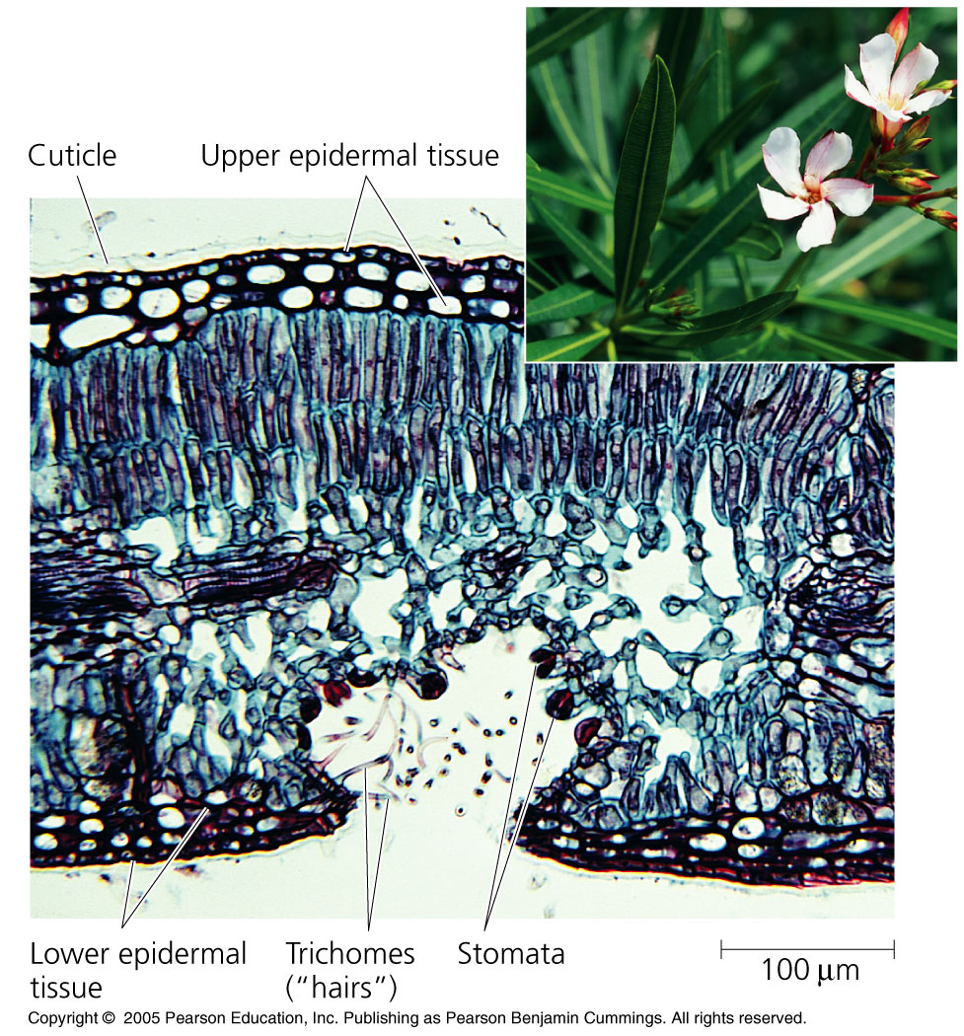
Transpiration
When the sun rises and the stomata open, the increase in the amount of water lost acts to pull water upward from below.
travismulthaupt.com

Slide 48
Transpiration
The spaces in the spongy mesophyll are saturated with water vapor--a high water potential.
Generally, the air outside of the plant cell is much drier, and has a lower water potential.
Recall that water moves from a high water potential to a low water potential.
Thus, water moves out.
travismulthaupt.com

Slide 49
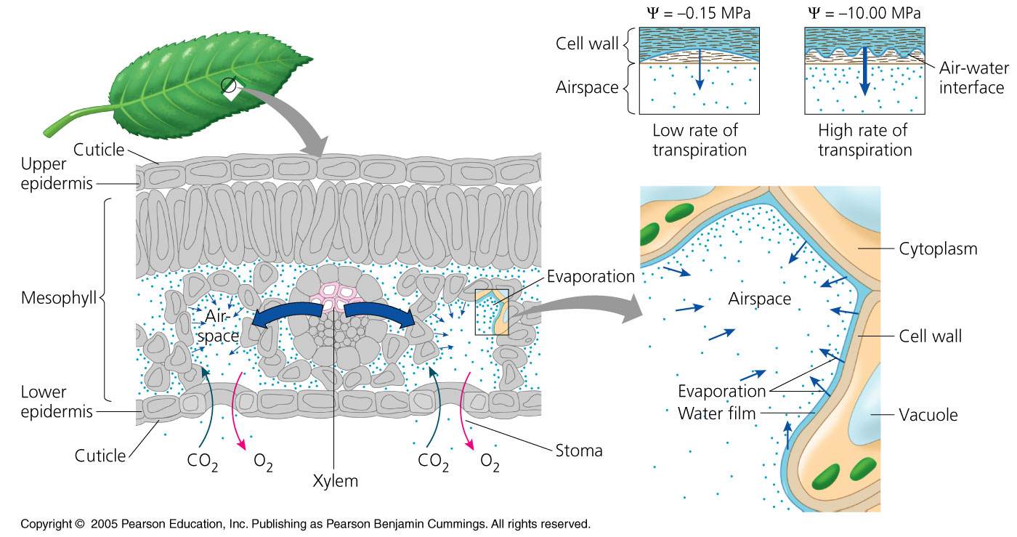
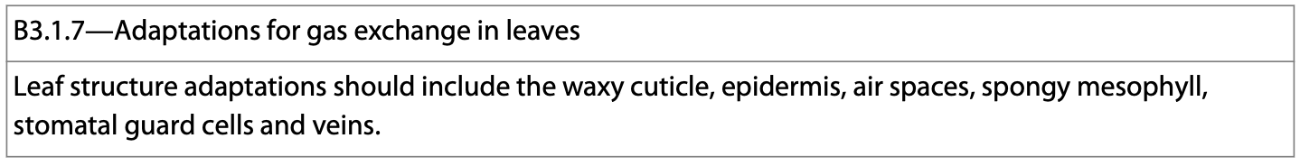
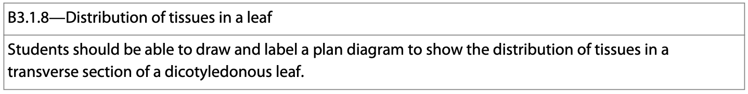
travismulthaupt.com

Slide 50
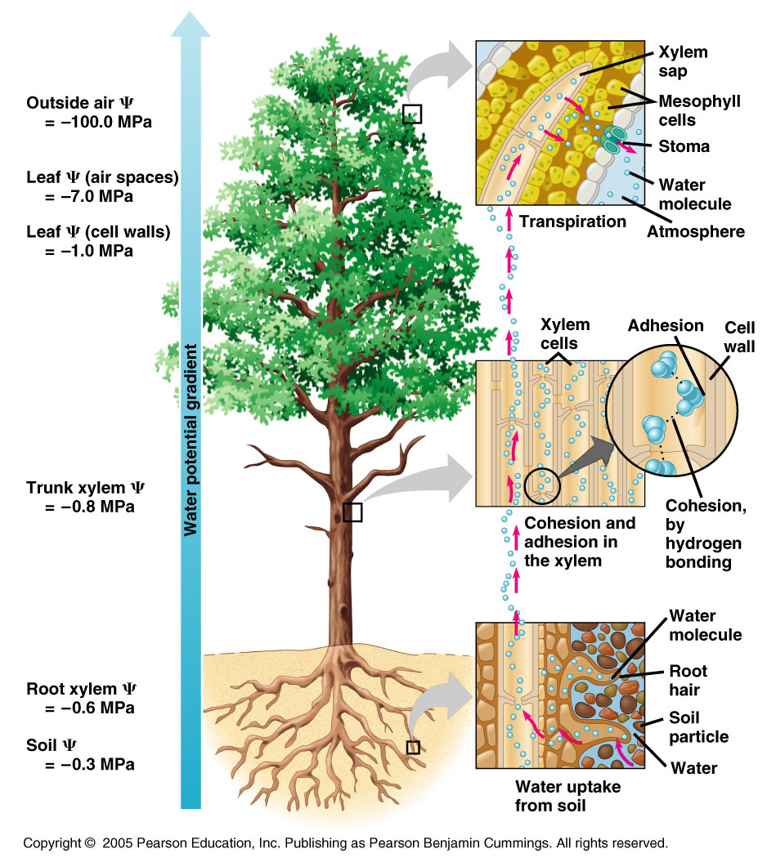
Transpiration
As the water exits the leaf, more is pulled up from below.
Put another way, the negative water potential of the leaves acts to pull water up from below.
travismulthaupt.com

Slide 51
Transpiration
The cohesive properties of water (hydrogen bonding) assists in the process.
The water gets pulled up the plant without separating.
travismulthaupt.com

Slide 52
Transpiration
The adhesive properties of water along with evaporation generate tension forces in leaf cell walls.
travismulthaupt.com

Slide 53
Transpiration
As the water evaporates from the mesophyll, more water is drawn through the pores in the leaf cell walls from the nearest xylem generating tension.
travismulthaupt.com

Slide 54
Transpiration
The xylem pipes’ walls are stiff, but somewhat flexible.
The tension created by the water as it is pulled up the tree on a hot day pulls the xylem pipes inward.
This can be measured.
The thick secondary cell walls of the xylem prevents collapse.
travismulthaupt.com

Slide 55
Transpiration
Xylem channels stop functioning when:
  When the xylem channels break
  The xylem channels freeze
  An air pocket gets in them.
They do, however, provide support for the plant.
On hot days, xylem can move 75cm/min.
About the speed of a second hand moving around a school clock.
travismulthaupt.com

Slide 56
Phloem
Phloem contains the sugar (organic compounds) plants make during photosynthesis.
Phloem can flow in many directions.
It always flows from source to sink.
travismulthaupt.com

Slide 57
Phloem
The primary sugar source is usually the leaf, which is where photosynthesis occurs.
The sink is what stores the sugar and usually receives it from the nearest source.
  Roots, fruits, vegetables, stems.
Storage organs are either a source or a sink, depending on the season.
travismulthaupt.com

Slide 58
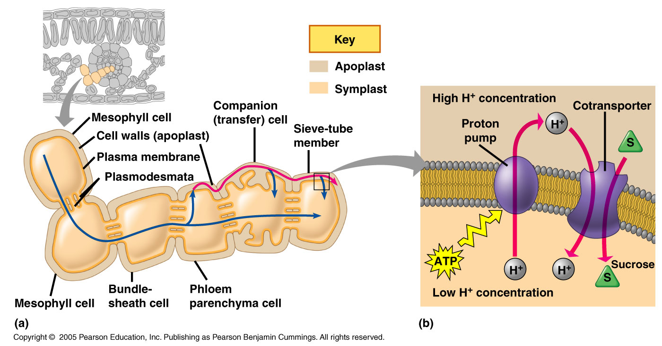
Sugar Transport
Sugar transport is sometimes achieved by loading it into sieve tube members.
Sometimes it is transported through the symplast via the plasmodesmata.
travismulthaupt.com

Slide 59
Sugar Transport
Other times, the sugar goes through the apoplastic pathway.
In either case, the sugar ends up in the sieve-tube member.
travismulthaupt.com

Slide 60
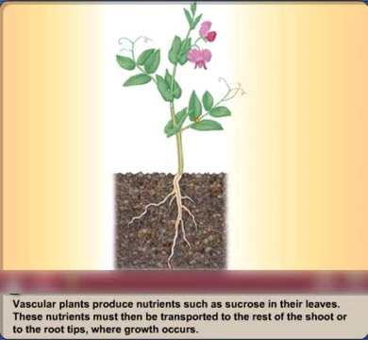
Companion Cells
Sieve tubes have companion cells that help to load sugars into sieve tube members.

Slide 61
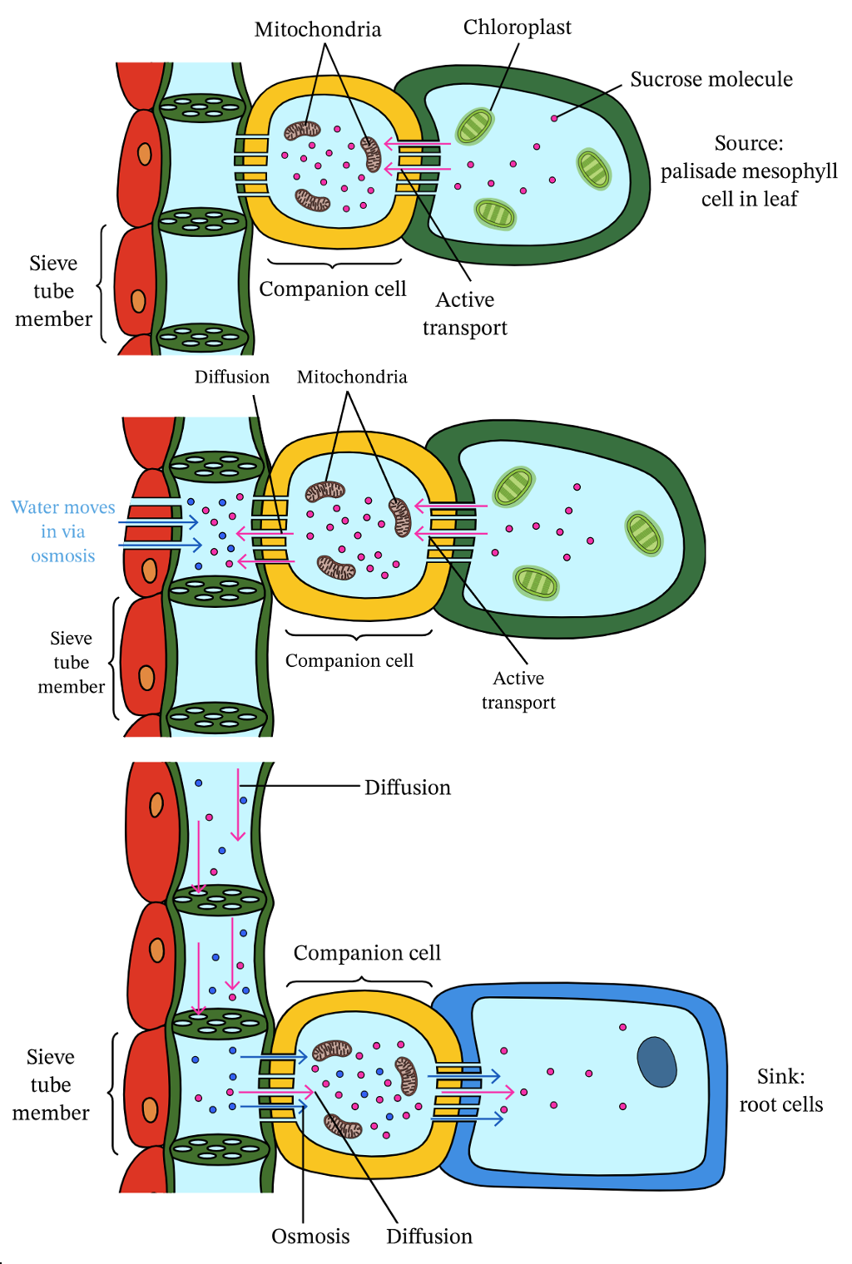
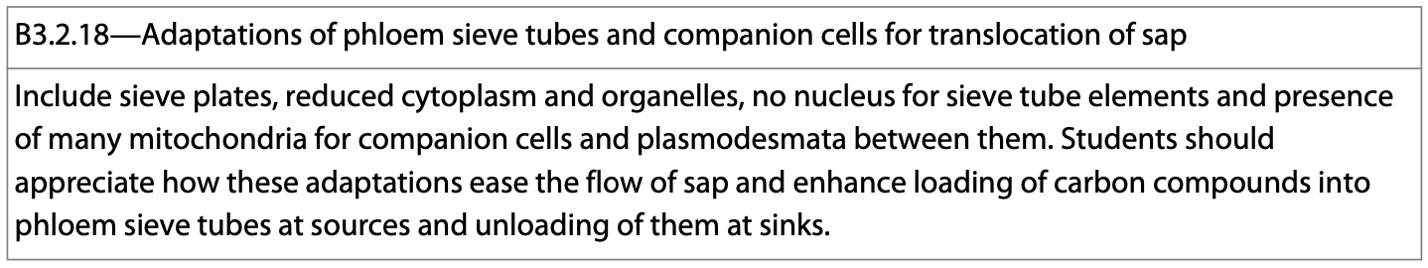
Companion Cells
Companion cells have many adaptations that allow them to do their jobs.
*Many mitochondria to power the active uptake of sugar through the co-transporter protein.
https://www.nagwa.com/en/explainers/923102368193/
travismulthaupt.com

Slide 62
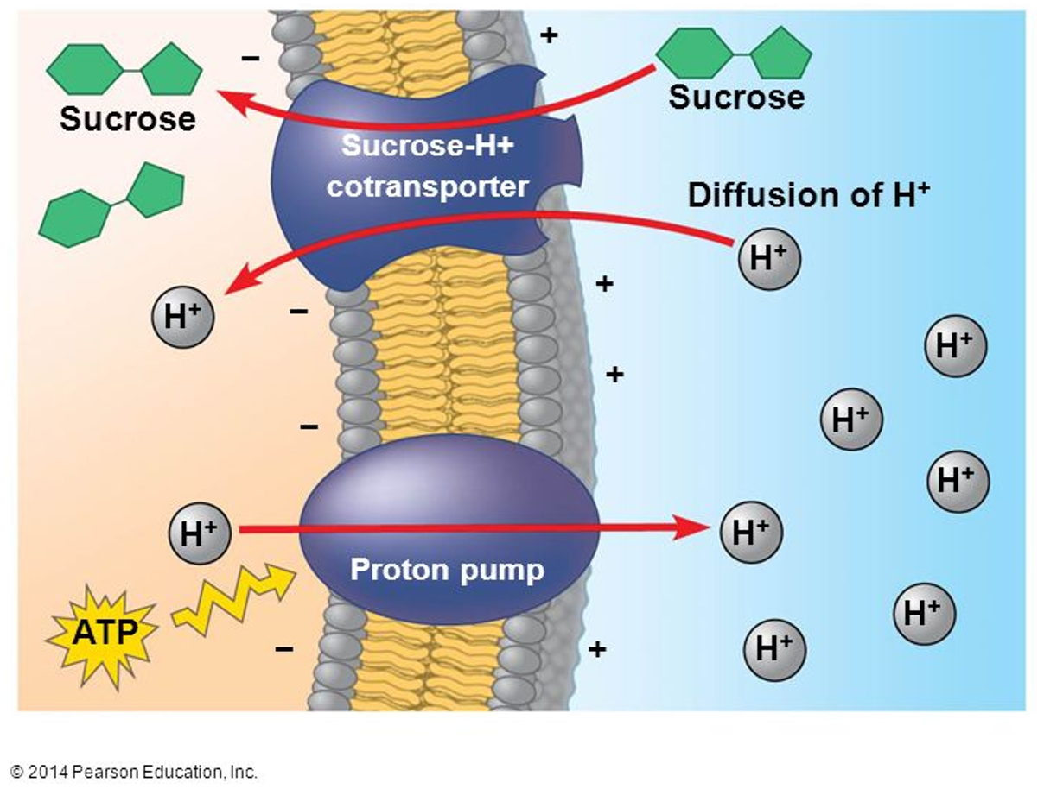
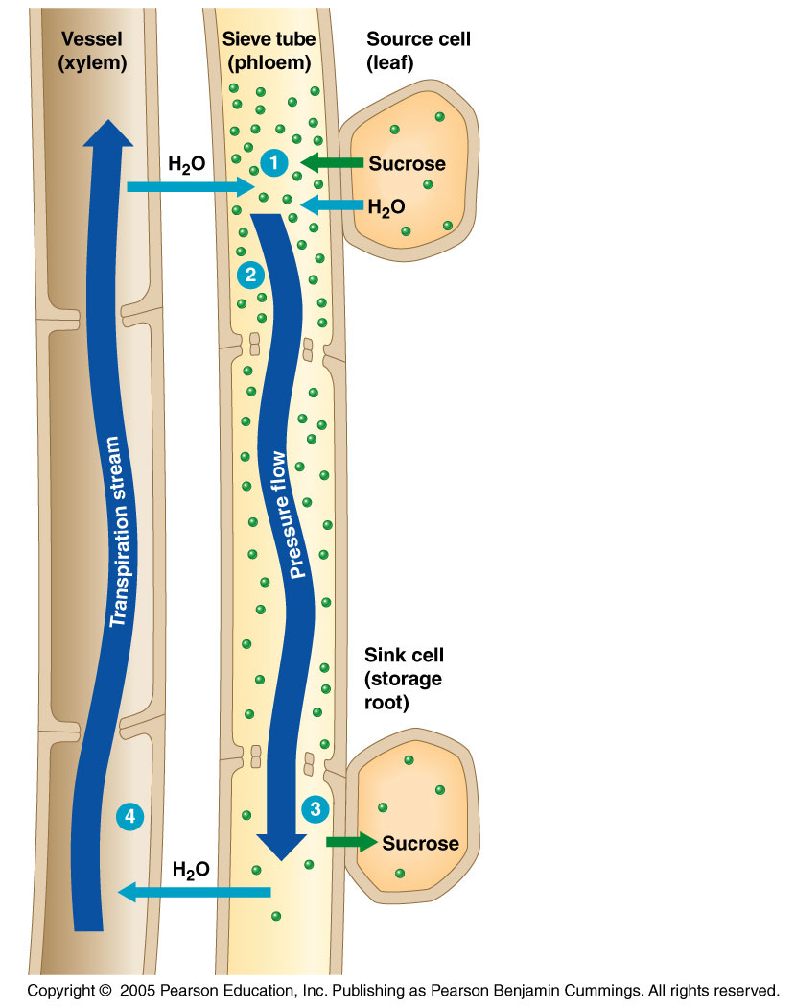
Sugar Loading
Sugar loading often requires an active transport mechanism because of the high concentration of sugar in the sieve tube member.
Simple diffusion won’t work, so a co-transport mechanism is used.
The mesophyll at the source has a lower concentration of sugar.
travismulthaupt.com

Slide 63
In Phloem
Loading the sugar creates high pressure and forces the sap into the opposite end of the cell as water is taken up from the xylem by osmosis.
travismulthaupt.com

Slide 64
Sugar Unloading
At the sink, the sugar content is relatively low compared to the fluid in the sieve tube member.
This is due to the various active transport mechanisms that result in the movement of sugar from the sieve tube member to the sink.
travismulthaupt.com

Slide 65
Sugar Unloading
The sugar gets used as an energy source by the growing, metabolizing sink cells, or it is converted to insoluble starch.
Water follows by osmosis.
travismulthaupt.com

Slide 66
Phloem Movement
The movement of phloem is fast and occurs as a result of positive pressure.
The increased concentration of sugar in the sieve tube member causes water to move into the tube.
This pushes the fluid to the sink.
travismulthaupt.com

Slide 67
Phloem Movement
At the sink, the sugar is unloaded and the xylem now has a higher solute concentration.
Thus, water moves into the xylem and is cycled back up the plant.
travismulthaupt.com

