Slide 1
Essential Idea
Reproduction in flowering plants is influenced by the biotic and abiotic environment.

Slide 2
Chapter 38
Plants
travismulthaupt.com

Slide 3
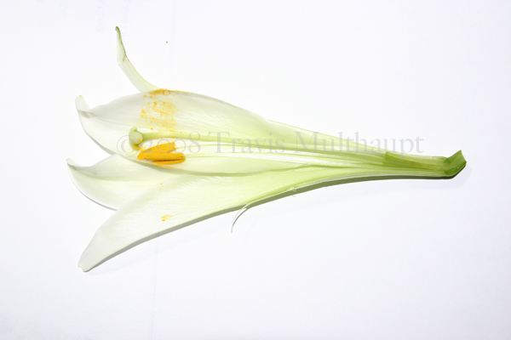
Flowers
Flowers are the reproductive shoots of the angiosperm sporophyte.
Floral organs are the sepals, petals, stamens and carpels.

Slide 4
Flowering
Flowering involves a change in gene expression at the shoot apex.
This change in gene expression happens when meristems in the shoot apex produce flowers instead of leaves.

Slide 5
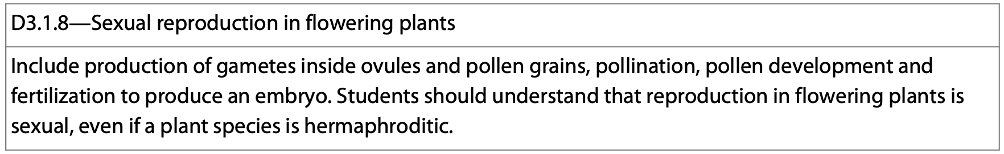
Flowers
Flowers are the sexual structures of plants.
Meiosis produces gametes inside of pollen and ovum.
Reproduction in flowering plants is a form of sexual reproduction.

Slide 6
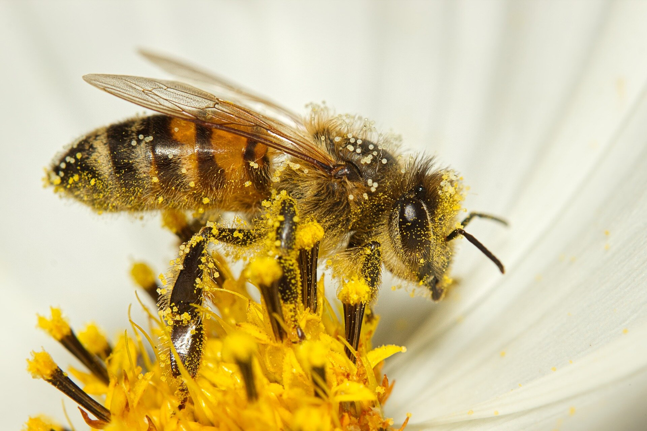
Pollination
Pollinators are attracted to the plants by scents given off by plants.
The nectar in plants serve as a food source for pollinators.
When the pollinators are getting the nectar, they are picking up pollen and transferring it from one plant to another.
https://phys.org/news/2023-05-pollen-bumble-bees-climate.html

Slide 7
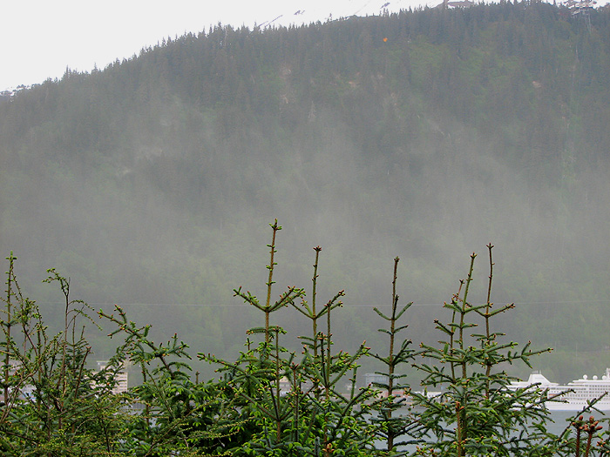
Pollination
Pollination often occurs when pollen is transferred by the wind and/or animals.
Animals such as birds, bats and insects are the main sources of pollination.
https://westjuneau.com/WordPress/2010/06/02/spruce-pollen-blowing-in-the-wind/

Slide 8
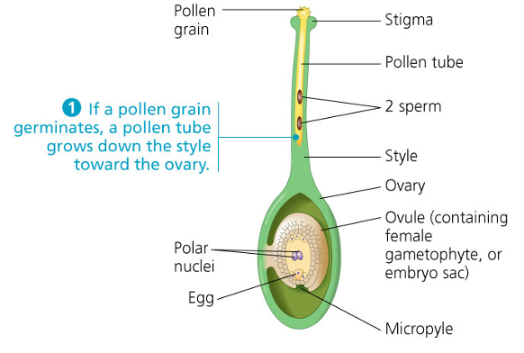
Pollination
Pollination is the first step in the chain of events which leads to fertilization.
It occurs when pollen from the stamen of one plant lands on the stigma of another plant.

Slide 9
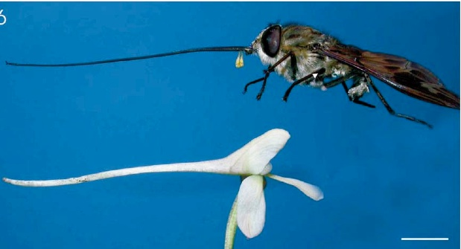
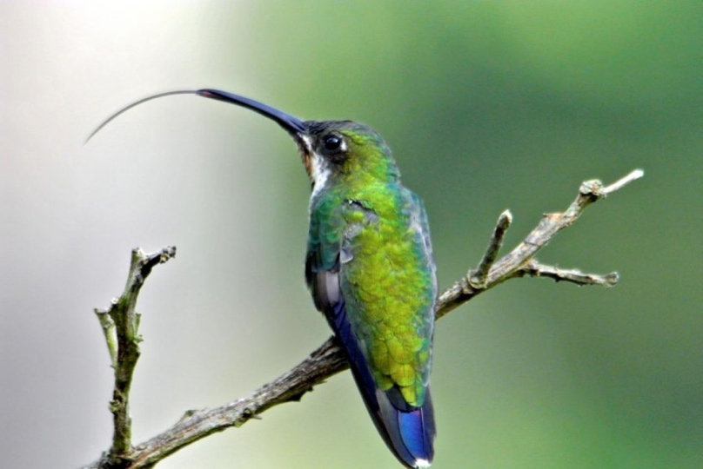
Pollination
Through the course of time, plants and pollinators have developed a mutualistic relationship where both of them benefit.
https://www.emaze.com/@AOZZTWOT/Presentation-Name
http://www.sciencedaily.com/releases/2015/08/150819103650.htm

Slide 10
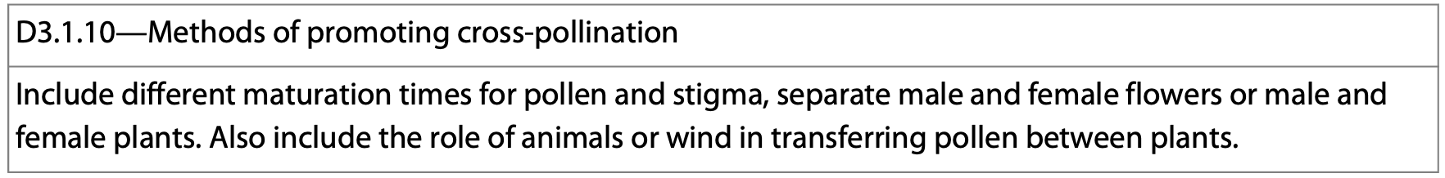
Pollination
Ideally plants don’t self-fertilize.
This ensures variety and a good mix of genes for future generations of plants.
Pollen and stigma often develop at slightly different times which promotes cross-pollination and lowers the chances of self-pollination.

Slide 11
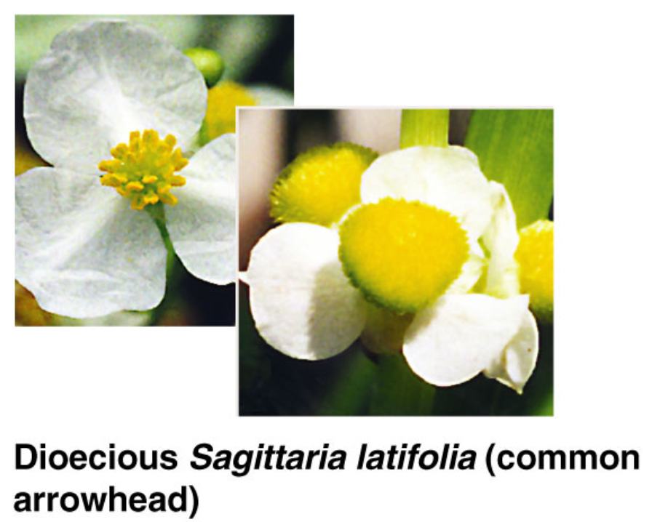
Mechanisms Preventing Self-Fertilization
Dioecious species can’t self-fertilize because they are either stamenate or capellate.
There are male plants and female plants.

Slide 12
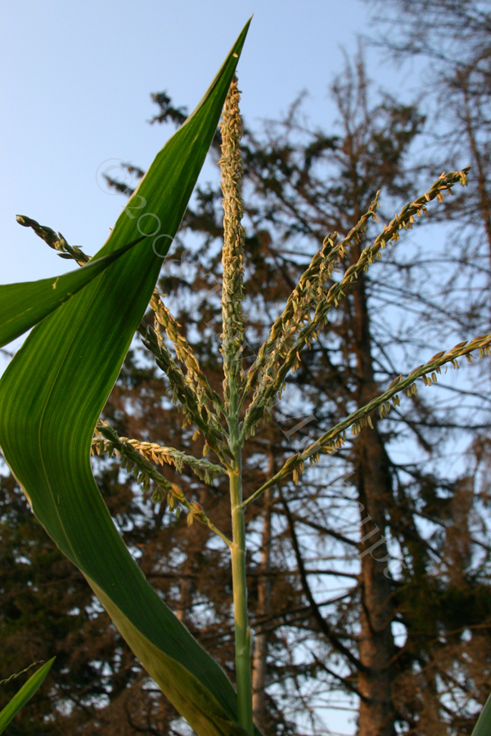
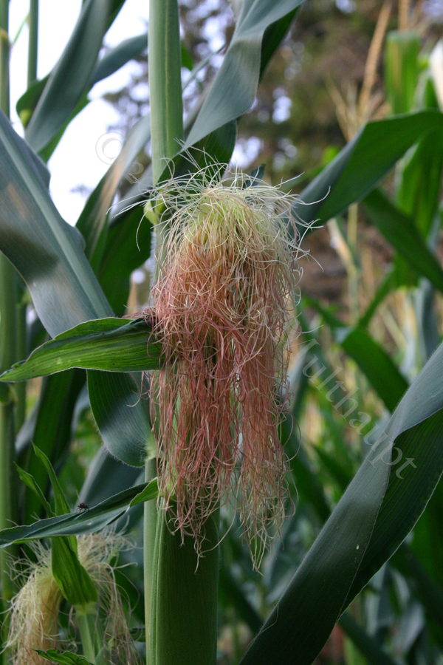
Mechanisms Preventing Self-Fertilization
Monoecious plants often have floral organs that develop at different times.
Male and female parts are on the same plant.

Slide 13
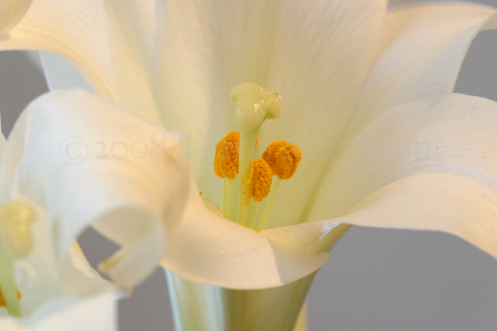
Mechanisms Preventing Self-Fertilization
Some flowers arrange floral parts so plants can’t self-fertilize.
Here the stigma is above the stamen.

Slide 14
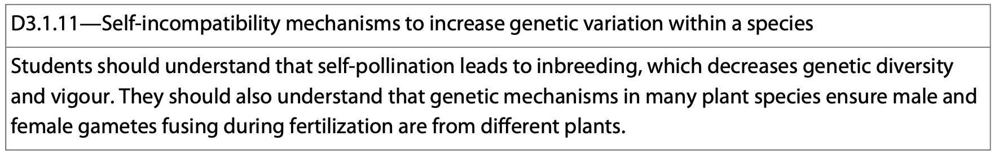
Mechanisms Preventing Self-Fertilization
The most common mechanism is self-incompatibility.
An individual rejects its own pollen and that of its close relatives.
There are biochemical blocks prevent pollen development.

Slide 15
Fertilization
Fertilization occurs after pollination.
During this process, once a pollen grain lands on the stigma of a plant, a pollen tube grows down the carpel.
The male gametes travel through this pollen tube and eventually make their way to the egg.

Slide 16
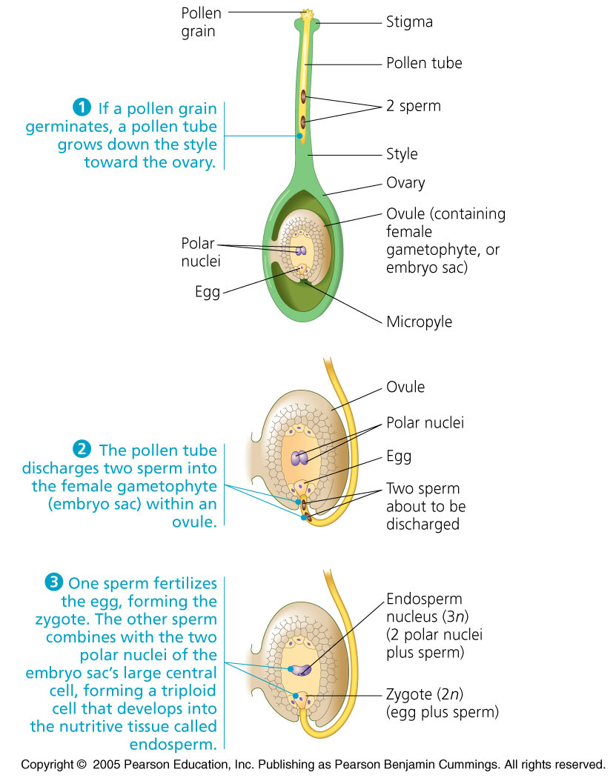
Double Fertilization
Double fertilization is unique to angiosperms.
One sperm fertilizes the egg.
The second sperm fertilizes the polar nuclei forming a triploid (3n) nucleus in the center of the large, central cell of the embryo sac.
This large cell gives rise to the endosperm—the food storing tissue of the seed.

Slide 17
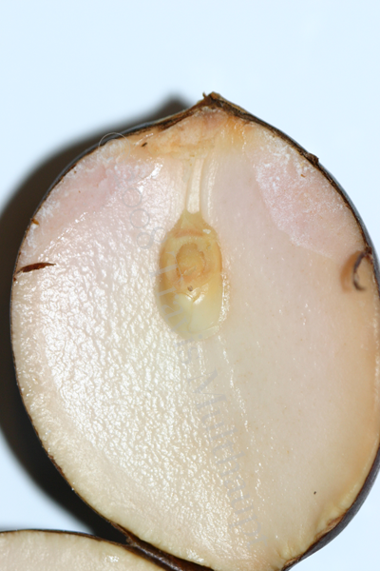
Double Fertilization
Double fertilization is an evolutionary mechanism that ensures the development of the endosperm only occurs in ovules when the egg has been fertilized.
This helps the plant prevent wasting resources.

Slide 18
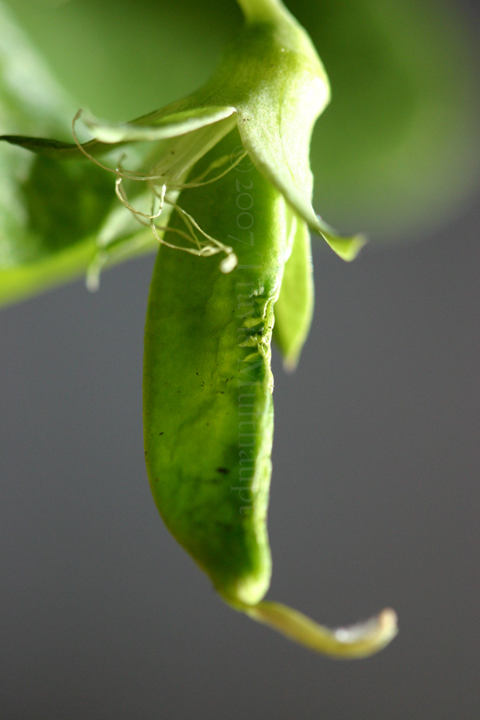
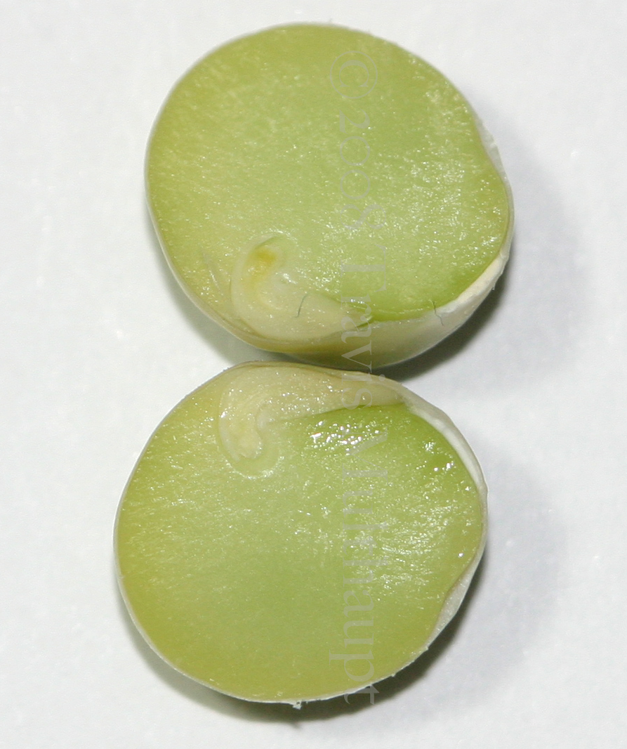
Double Fertilization
After double fertilization:
  Each ovule develops into a seed.
  The ovary develops into the fruit that encloses the seed.
The triploid nucleus divides forming a multi-nucleated supercell.

Slide 19
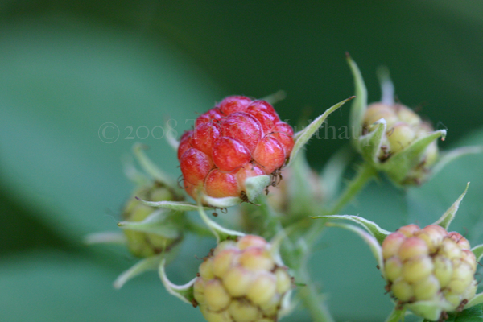
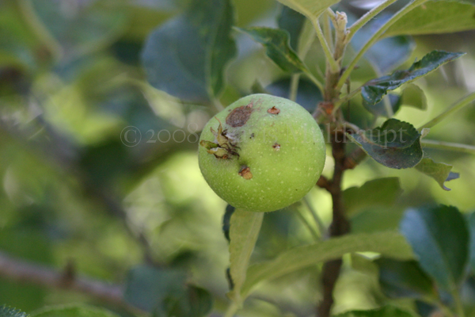
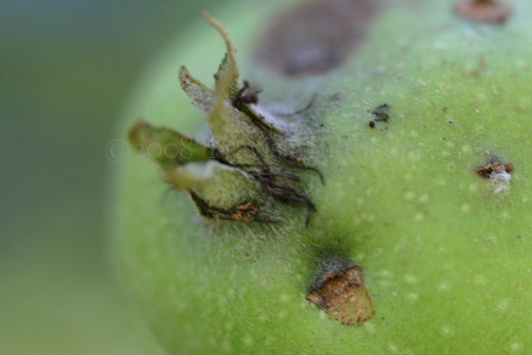
Fruit Development
Once fertilization occurs and a zygote is formed.
The zygote gives rise to an embryo which grows inside the ovule that contains the developing seed.
The entire ovary develops into a fruit containing one or more seeds.

Slide 20
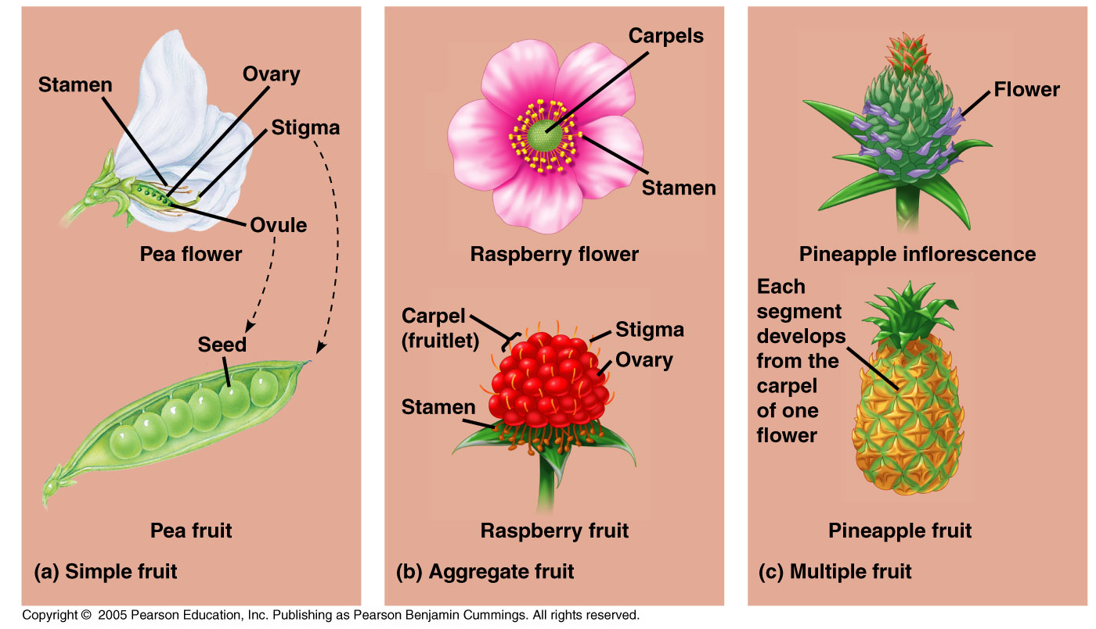
Fruit Development
While the seeds are developing, the walls of the ovary are developing into a fruit.
The pericarp is the thickened walls of the ovary.

Slide 21
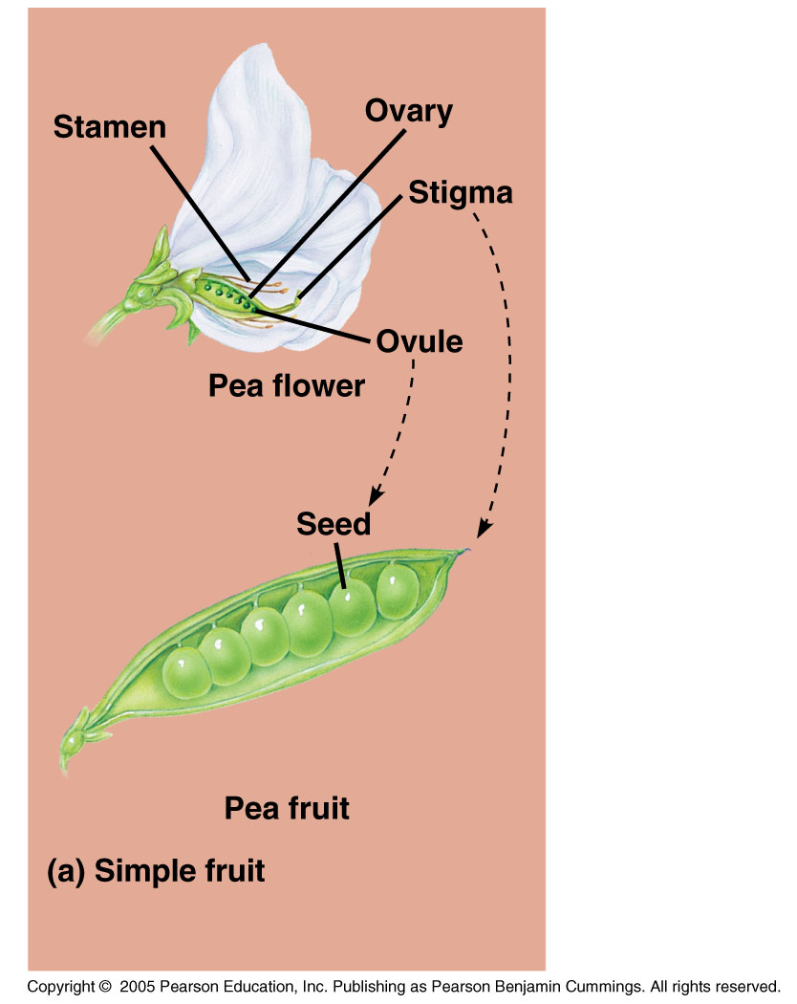
Fruits
Simple fruits-derived from a single carpel or several fused carpels.
  Examples: peas, peach, nut.

Slide 22
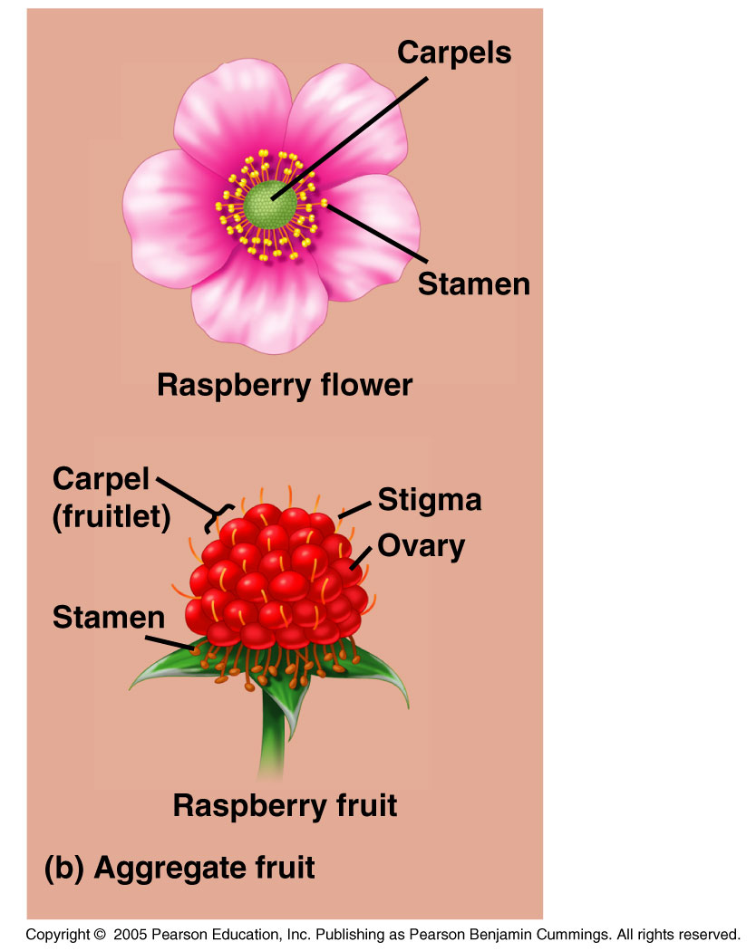
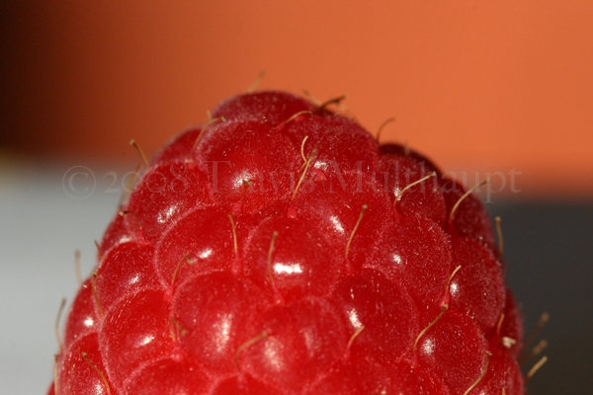
Fruits
Aggregate fruits result from a single flower that has more than one separate carpel. Each carpel has an egg, and each one grows a small fruit.
  Example: raspberry.

Slide 23
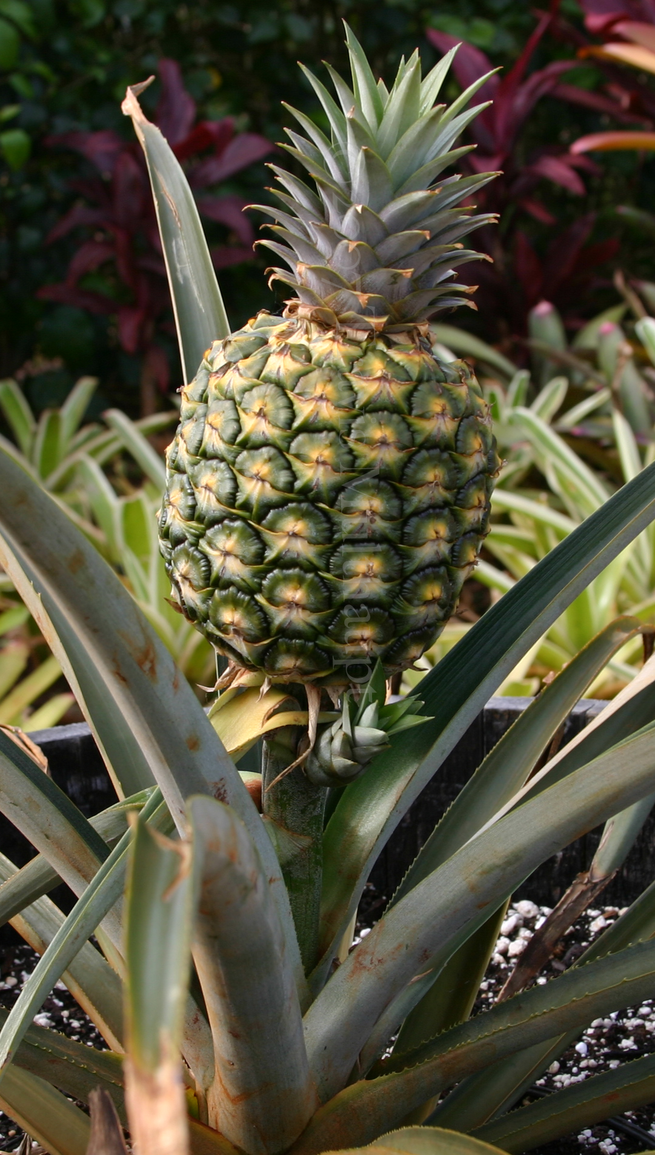
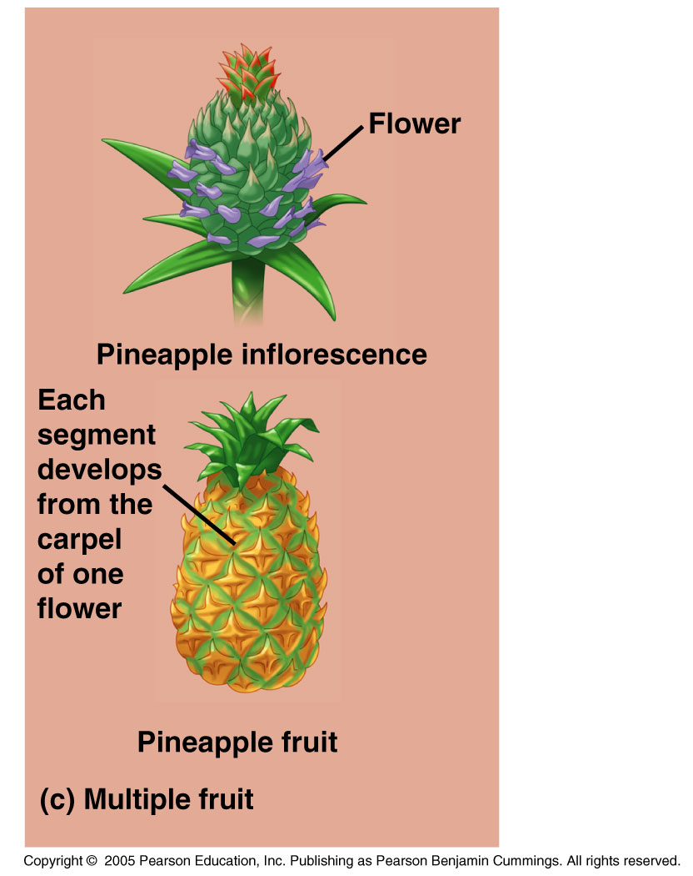
Fruits
Multiple fruits develop from inflorescence. A group of flowers tightly clustered together.
When the walls of the ovaries thicken, they fuse together forming the fruit.
  Example: pineapple.

Slide 24
Fruits
Fruit usually ripens around the time seeds complete their development.
  Example: Peaches
Some fruits ripen, and then age and dry out.
  Example: Soybeans
http://www.google.com/search?q=soybeans&hl=en&prmd=imvnsu&source=lnms&tbm=isch&ei=ll7qTqGpKqXr0gG72v21CQ&sa=X&oi=mode_link&ct=mode&cd=2&sqi=2&ved=0CCoQ_AUoAQ&biw=1238&bih=819

Slide 25
Seed Maturation and Development
As a seed matures, it prepares for dormancy.
To break the dormancy, the seed must find optimal conditions.

Slide 26
Seed Production
The chances that a seedling will survive and produce offspring is very low.
This is why many plants produce so many seeds.
This is also why so many plants use asexual reproduction.

Slide 27
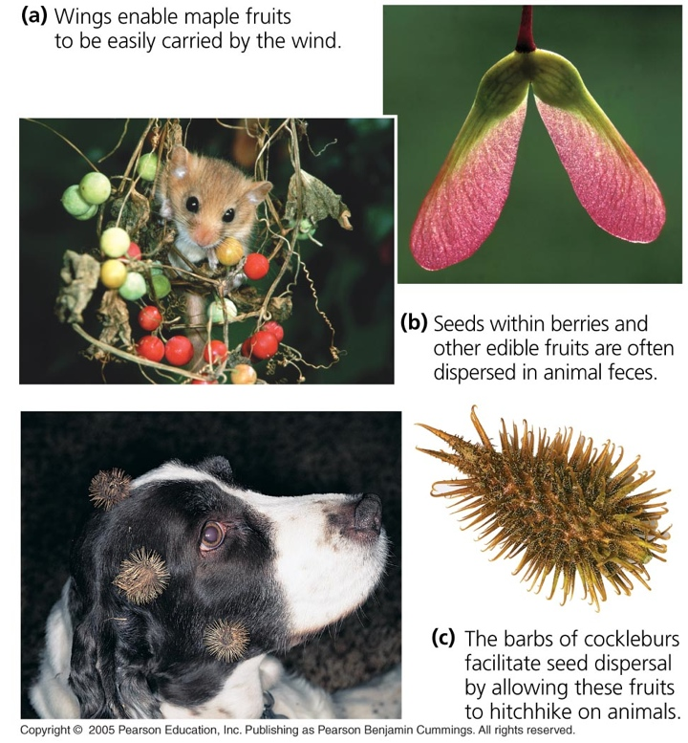
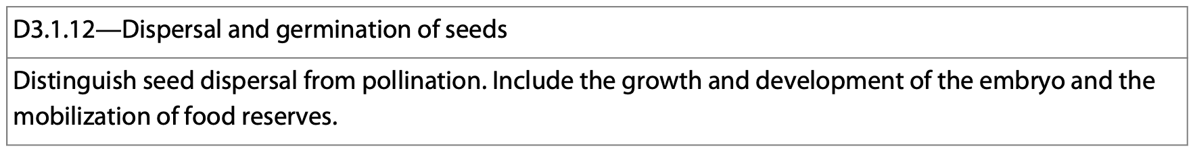
Seed Dispersal
Once seeds have been produced, there are a variety of mechanisms by which they are dispersed.
Wind and animals play a major role in seed dispersal.

