Slide 1

Chapter 39
Plant Responses to Internal and External Signals

Slide 2
Response to Stimuli
Plants are sensitive to a wide range of stimuli.
They elicit a cellular response using a signal transduction pathway.

Slide 3
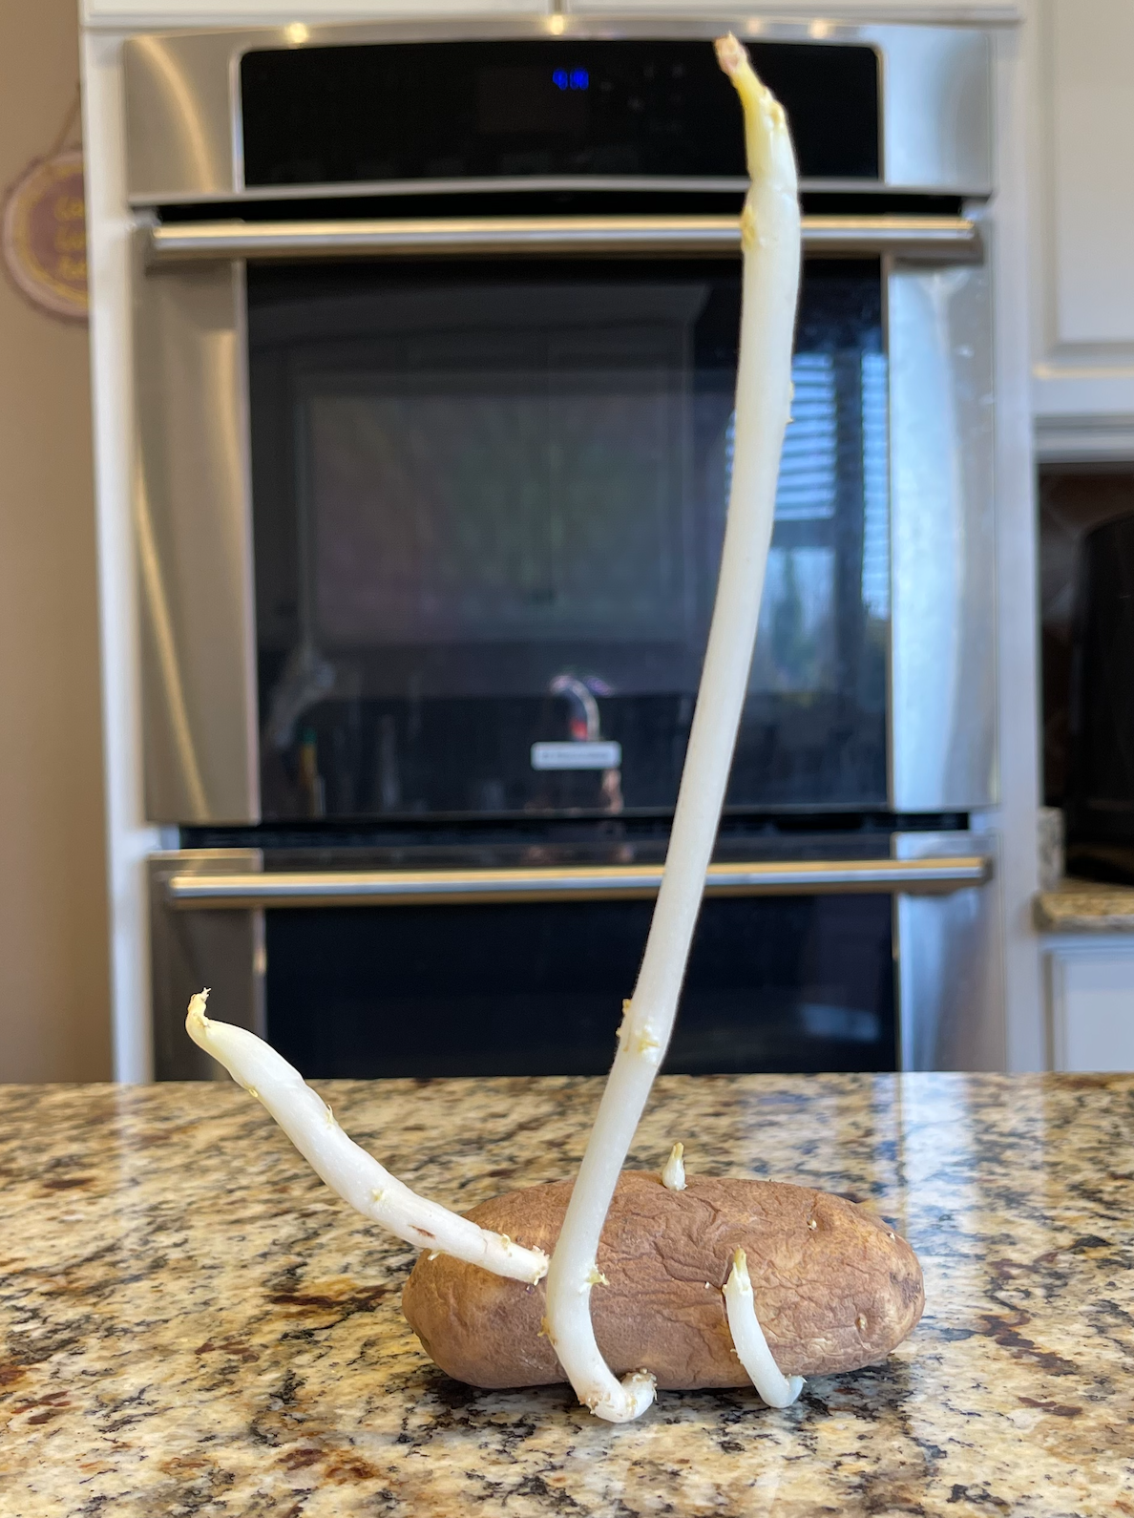
Response to Stimuli
Consider a forgotten potato in the cupboard.
  They eyes of the potato (axillary buds) sprout shoots that are suited to their function. They are pale and lack broad green leaves, and they lack elongated roots.

Slide 4
Etiolation
These adaptations for growing in the dark are called etiolation.
The “stimulus” for growth is complete darkness.
The plant uses all energy for elongation of the stem in search of light so the leaves can open after reaching the surface.

Slide 5
Etiolation
During etiolation, there is no evaporative loss of water.
Leaves would be a hindrance to the shoot passing through the soil.
There’s no need for chlorophyll—there’s no light.

Slide 6
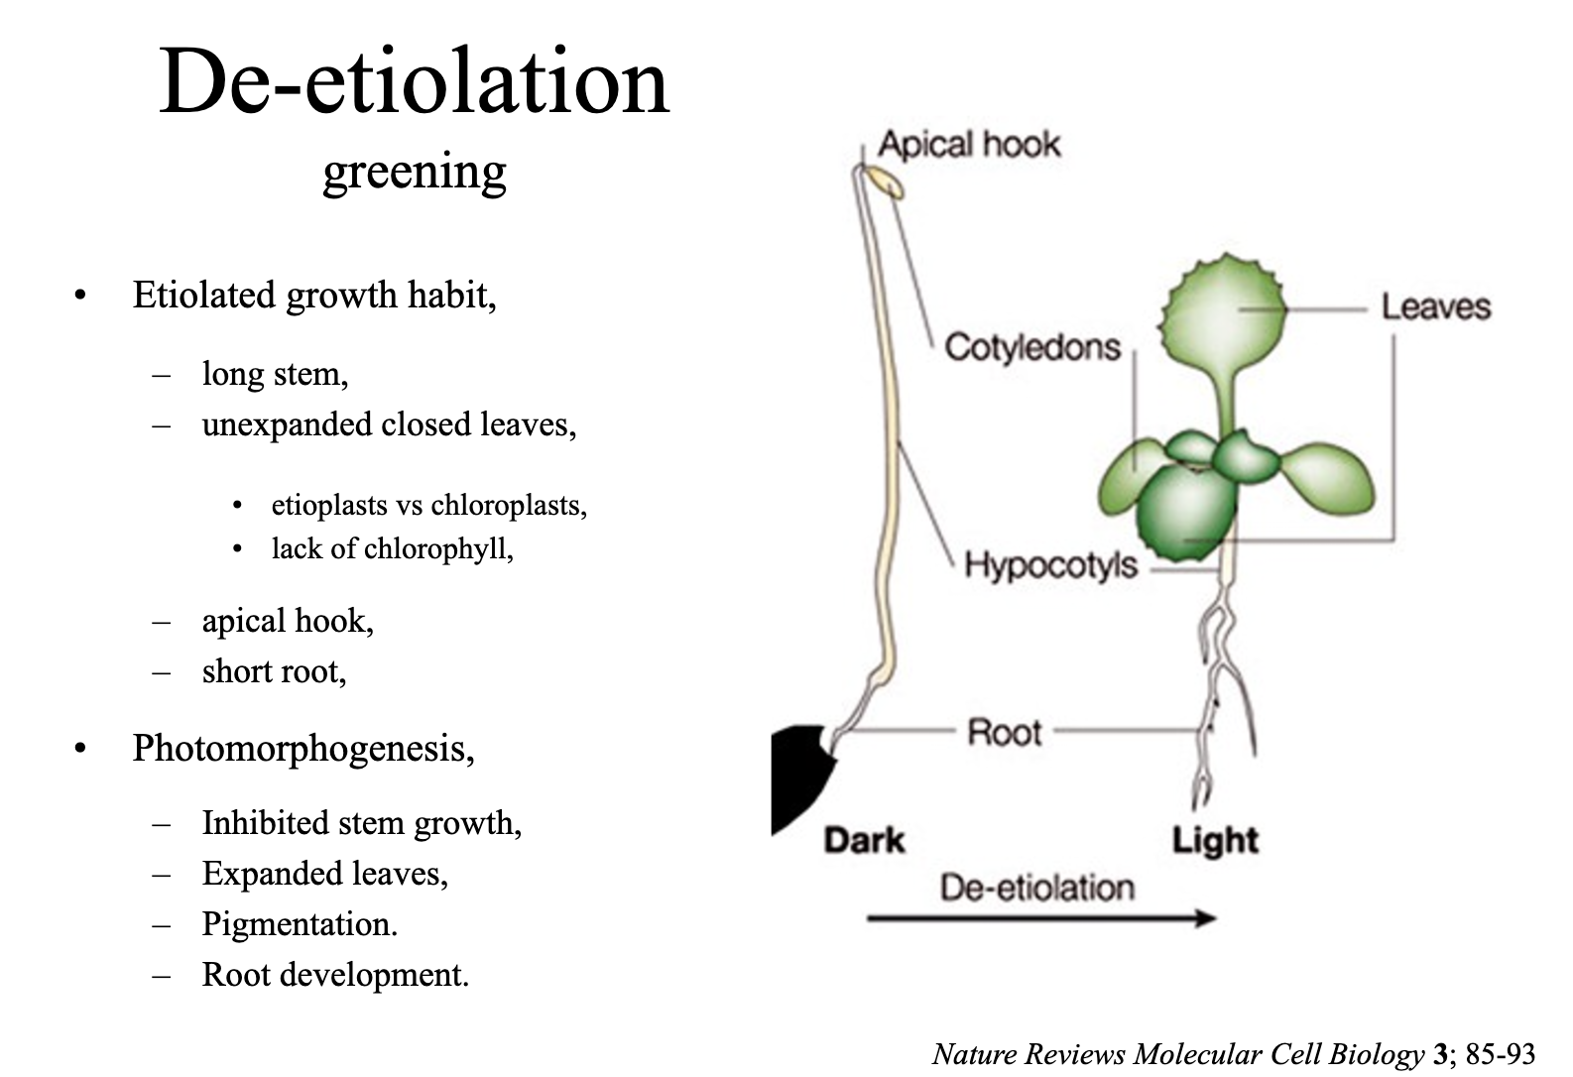

Slide 7
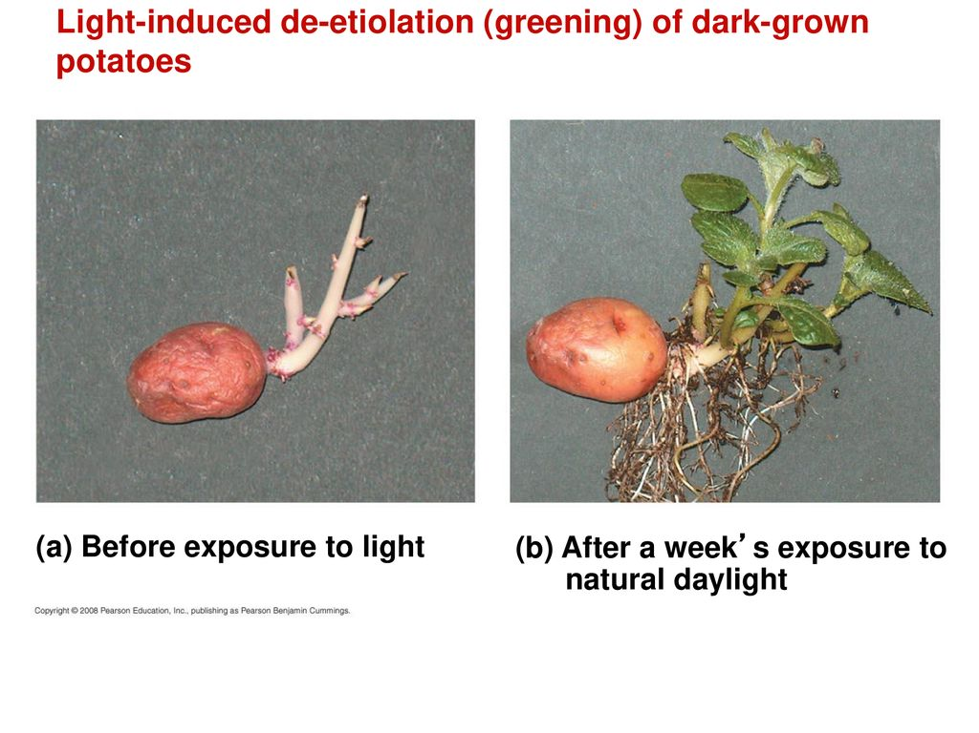
De-etiolation
When the shoot hits the light, de-etiolation occurs.
Leaves now expand.
Elongation of the stem slows.
Roots elongate.

Slide 8
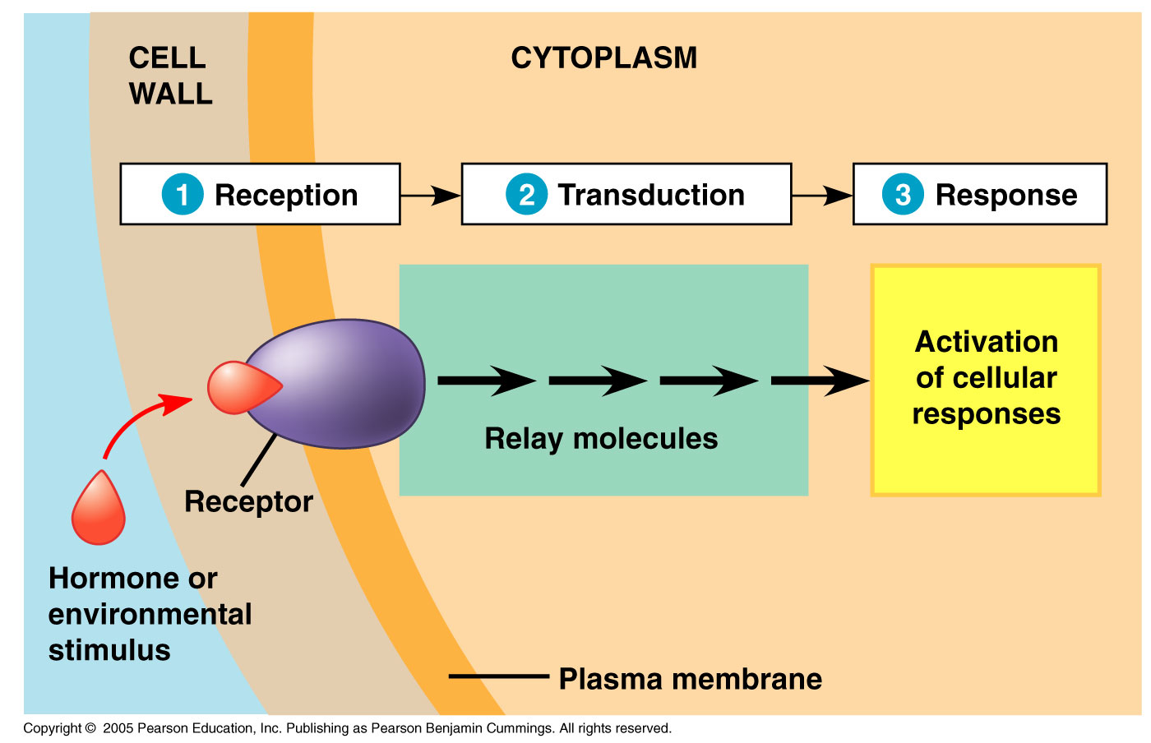
Signal Reception
Signals are detected by receptors.
Proteins change in response to the stimulus.

Slide 9
Signal Transduction
Second messengers are small, internally produced, non-protein chemicals.
They are made in response to an external signal binding to a receptor.
Their job is to transfer and amplify signals to the other proteins causing a cellular response.

Slide 10
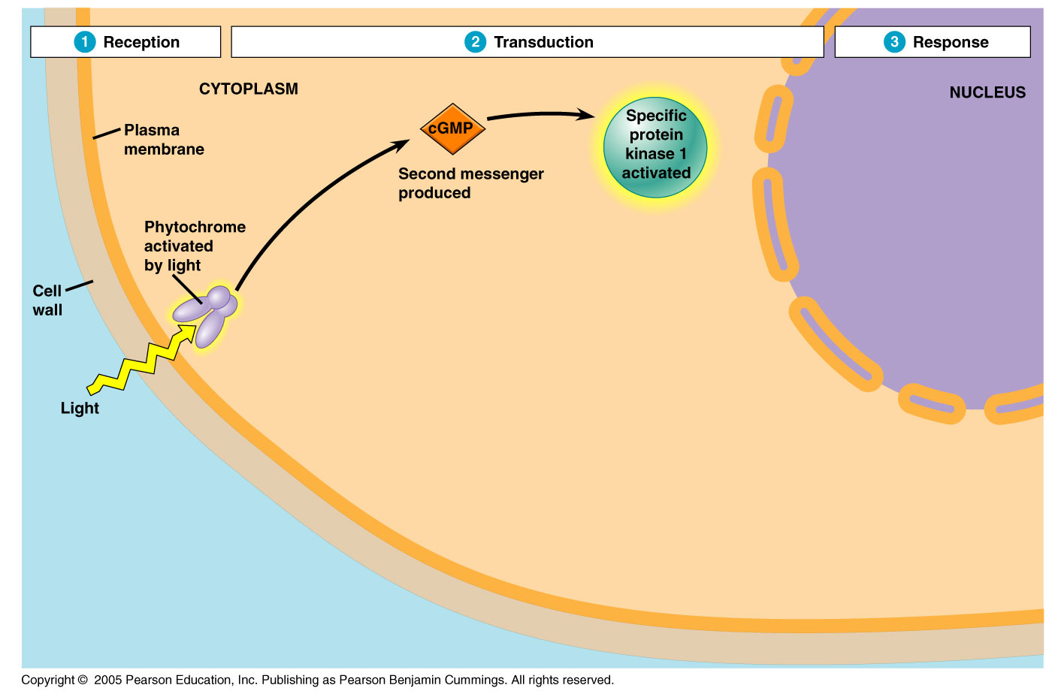

Slide 11
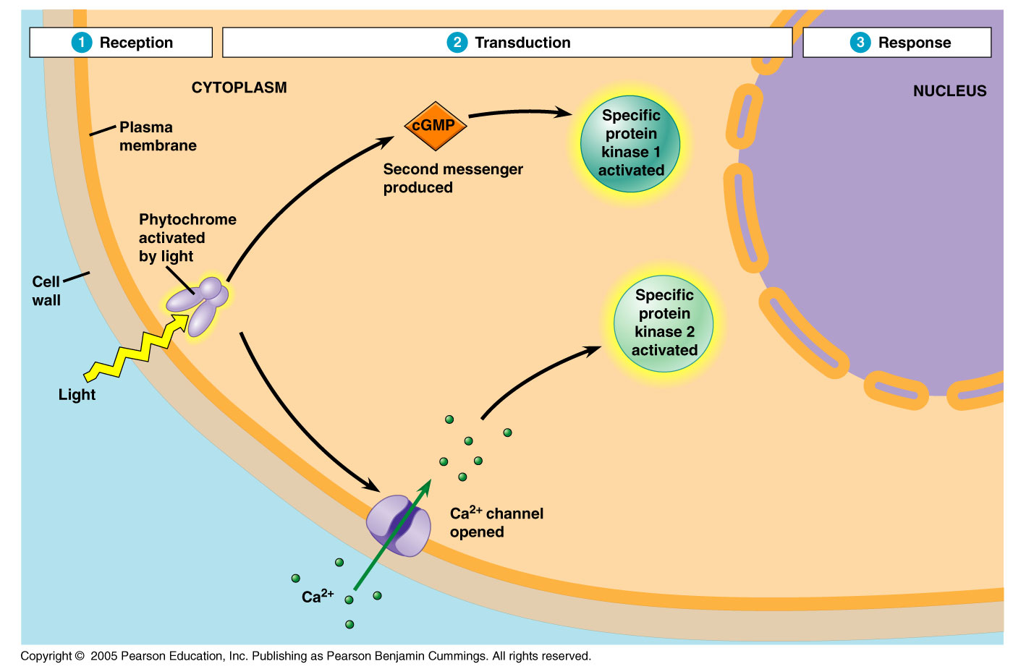

Slide 12
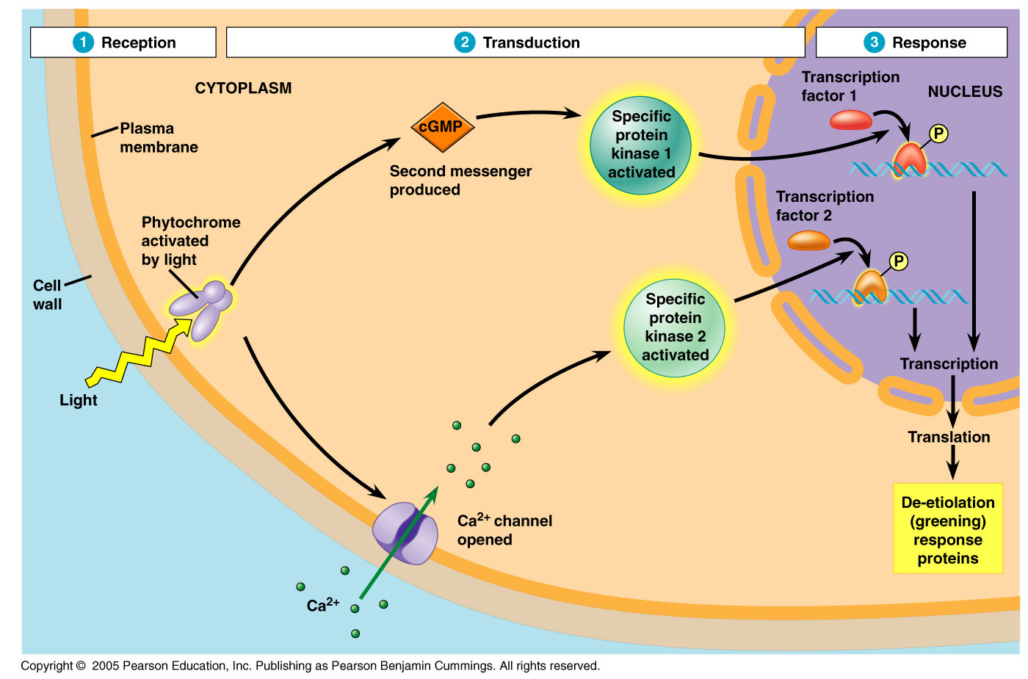

Slide 13
Response
Signal transduction leads to one or more cellular pathways being regulated.
Usually, this leads to an increase in the activity of certain enzymes which have stimulatory or inhibitory effects.

Slide 14
Signal Pathways
Signal pathways lead to both a turning on and off of genes.
For example, putting a potato back into the cupboard activates many phosphatases which dephosphorylate specific proteins and switch off certain pathways.

Slide 15
The Idea of Signal Pathways
Classic experiments studying grass seedlings uncovered the notion of chemical messengers.
The movement of a plant shoot toward or away from a stimulus is called tropism.
The hormone pathway.

Slide 16
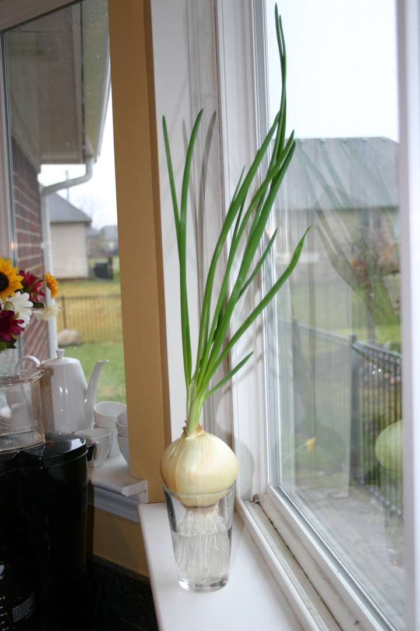
Signal Pathways and Grass Seedlings
Positive phototropism is the process that directs plants toward sunlight for photosynthesis.
  Grass shoots kept in the dark will grow straight up.
  So will those illuminated equally on all sides.

Slide 17
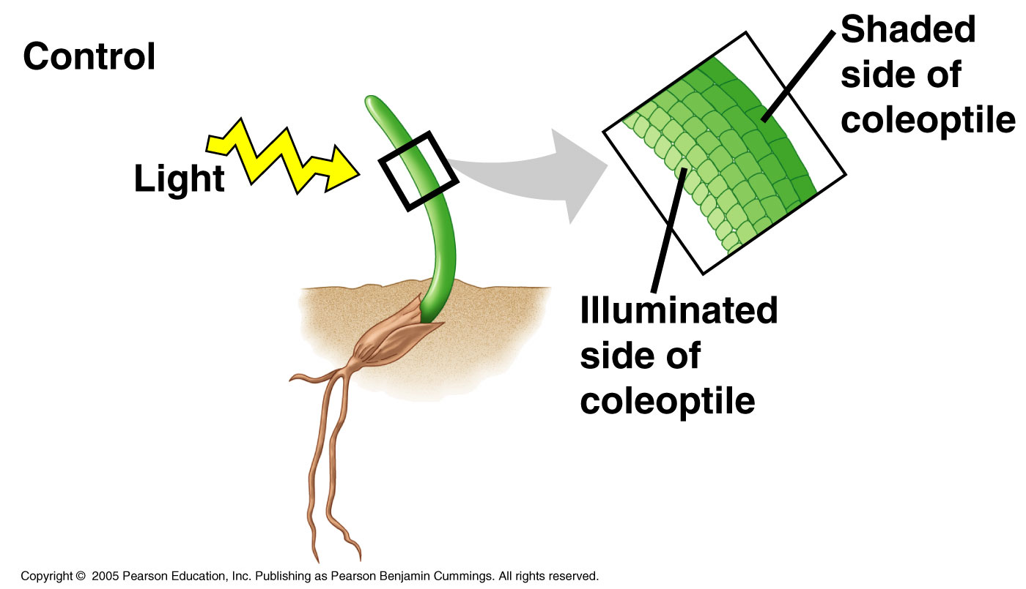
Signal Pathways and Grass Seedlings
If illuminated from only one side, the plant will grow toward the stimulus.
This results from differential growth on the opposite side of the stimulus.

Slide 18
The Darwins’ Experiments
Observations:
  Plants will only bend toward the light source if the coleoptile is present—no tip, no curve.
  Covering the tip with an opaque cap prevents curving.
  Covering the tip with a transparent cap or placing a cover below the tip—curving.
Notes:
Charles and his son Francis did this work.

Slide 19
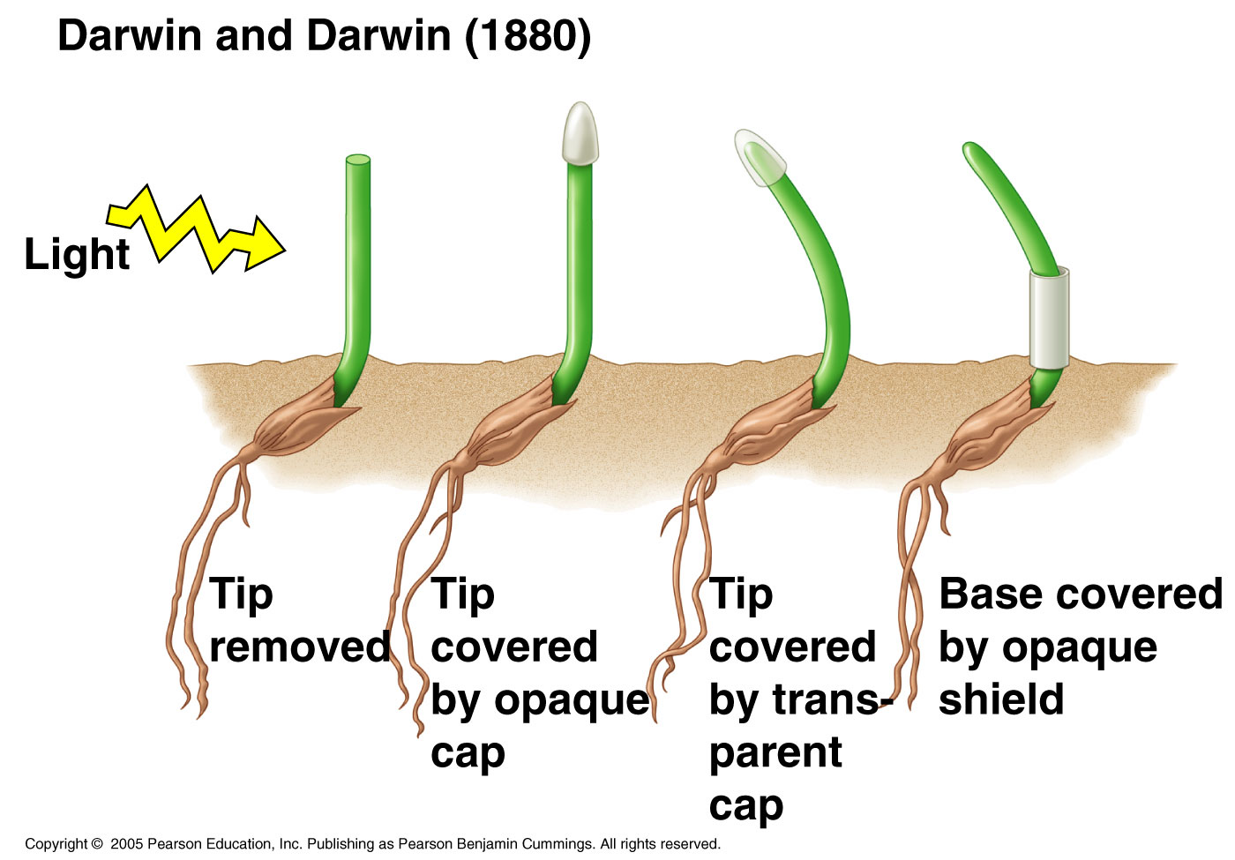

Slide 20
The Darwins’ Experiments
Their conclusions:
  The tip of the coleoptile is responsible for curvature.
  Also, the curvature of the plant was actually the result of differential growth some distance below the coleoptile.
  Some signal must be responsible for elongation of the coleoptile.

Slide 21
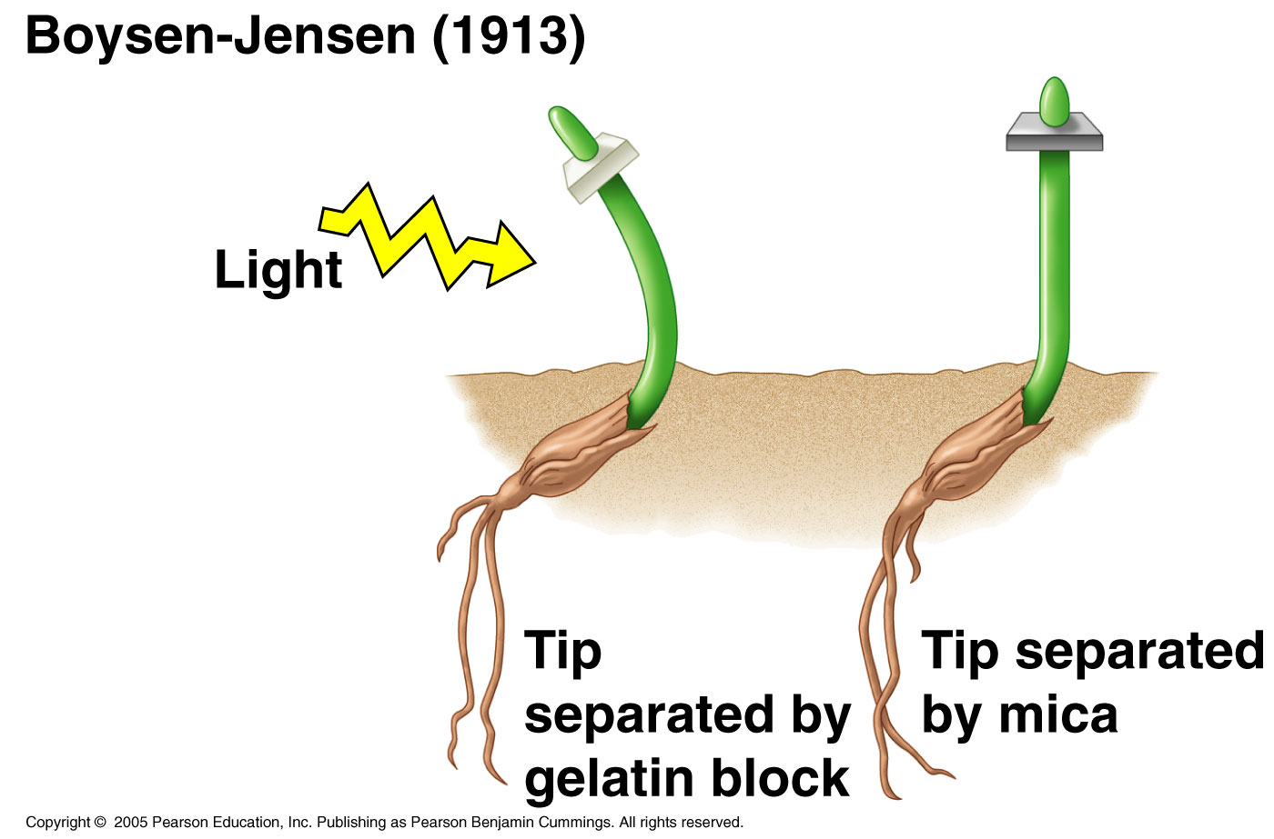
Peter Boysen-Jensen
A few decades later:
  Boysen-Jensen separated the tip of the coleoptile with a block of gelatin.
  The cells still showed the normal growth response.

Slide 22
Peter Boysen-Jensen
Using mica, there was no response.

Slide 23
Frits Went
Went was a Dutchman who modified Boysen-Jensen’s experiment to extract the chemical messenger.
He removed the coleoptile tip and placed it on an agar block.
If the messenger could diffuse into the block, then it could be substituted for the tip resulting in normal growth.

Slide 24
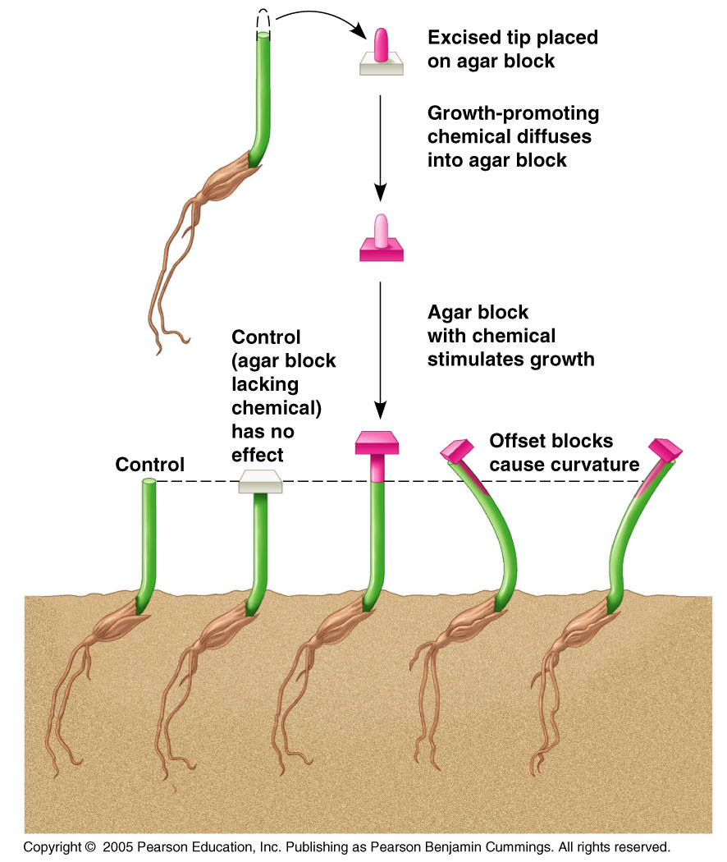
Frits Went
Results:
  Decapitated coleoptile—no growth.
  Decapitated coleoptile + agar only—no growth.
  Decapitated coleoptile + agar with hormones—growth.

Slide 25
Frits Went
Also, placing the block on one side of the coleoptile or the other caused unequal growth on the side containing the block causing curvature in the opposite direction.

Slide 26
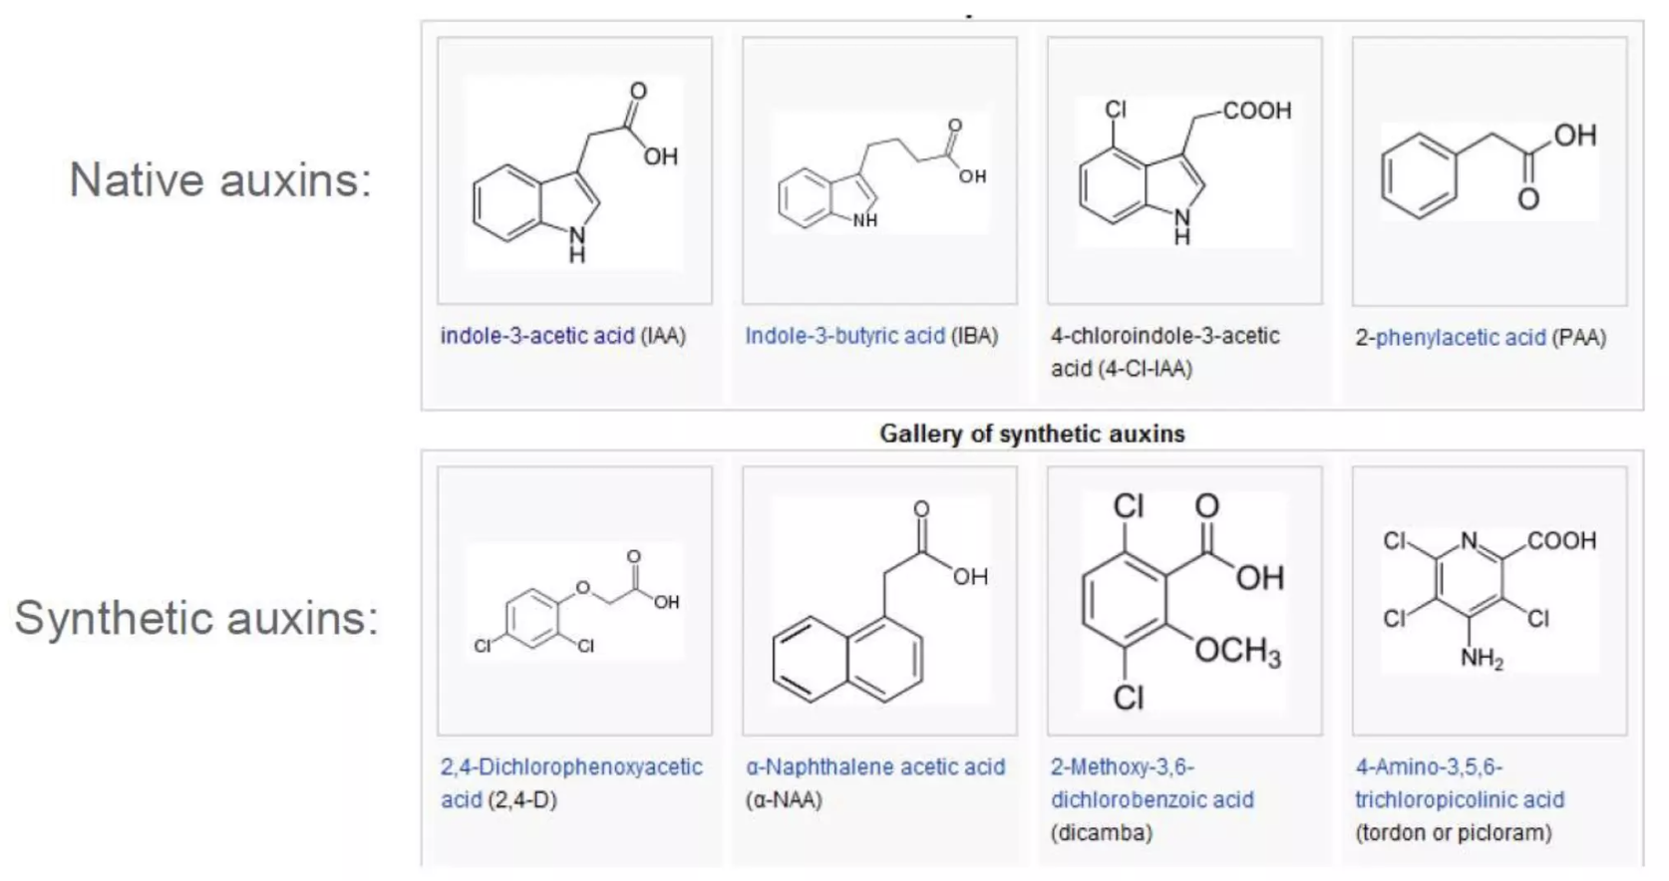
Went’s Conclusions:
The plants curved due to the higher concentration of a growth promoting chemical on the dark side of the plant.
Went named this hormone auxin—“to grow.”

Slide 27
Went’s Model
This model doesn’t necessarily occur in all plants.
There is still an unequal distribution of auxin in a plant causing curvature.
Some plants show an increase in growth inhibitors on the light side of the plant.

Slide 28
Plant Hormones
There are many different classes of plant hormones.
They all have different effects on plants.
Most are produced in very small amounts and often have profound effects on the plant.
The hormones often act to alter gene expression.

Slide 29
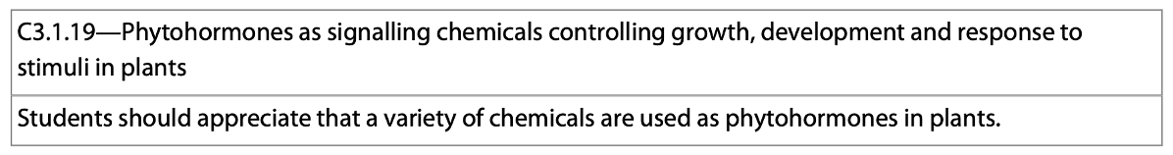
3 Common Plant Hormones—Phytohormones
Auxins-stimulate growth. They’re produced in the embryo, growth tissue, and meristematic tissue.
Gibberellins—produced in the apical meristems of buds, roots, young leaves and embryos.
Ethylene—promotes ripening. Opposes auxin.

Slide 30
Light
Light is an important environmental factor in the growth and development of plants—it stimulates the production of auxins.
Photomorphogenesis is the effect of light on plant morphology.

Slide 31
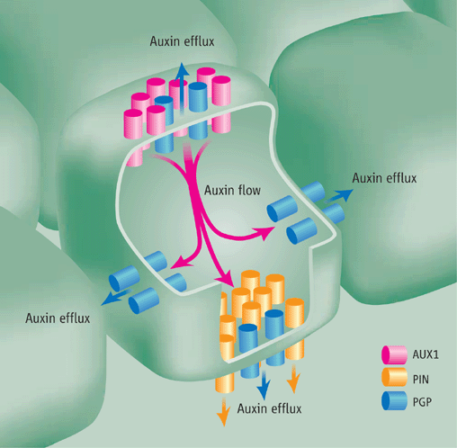
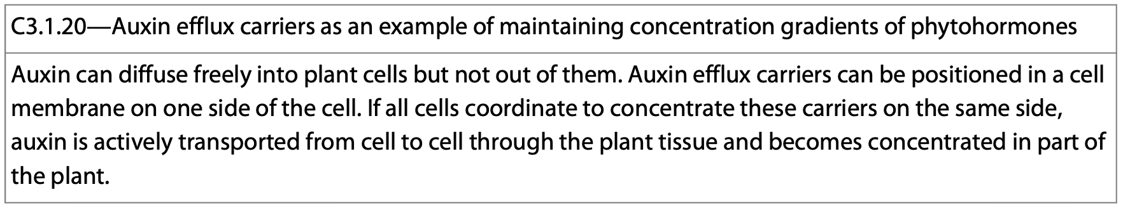
Auxin Efflux Carriers
Auxin efflux carriers are proteins that pump auxin out of cells.
They’re located on the cell membrane.
https://www.science.org/cms/10.1126/science.1127659/asset/73580b9c-7d33-46c7-9e1a-a54076360146/assets/graphic/858-1.gif

Slide 32
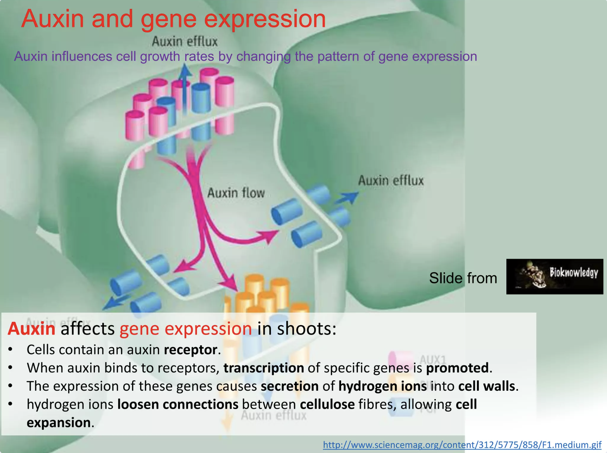

Slide 33
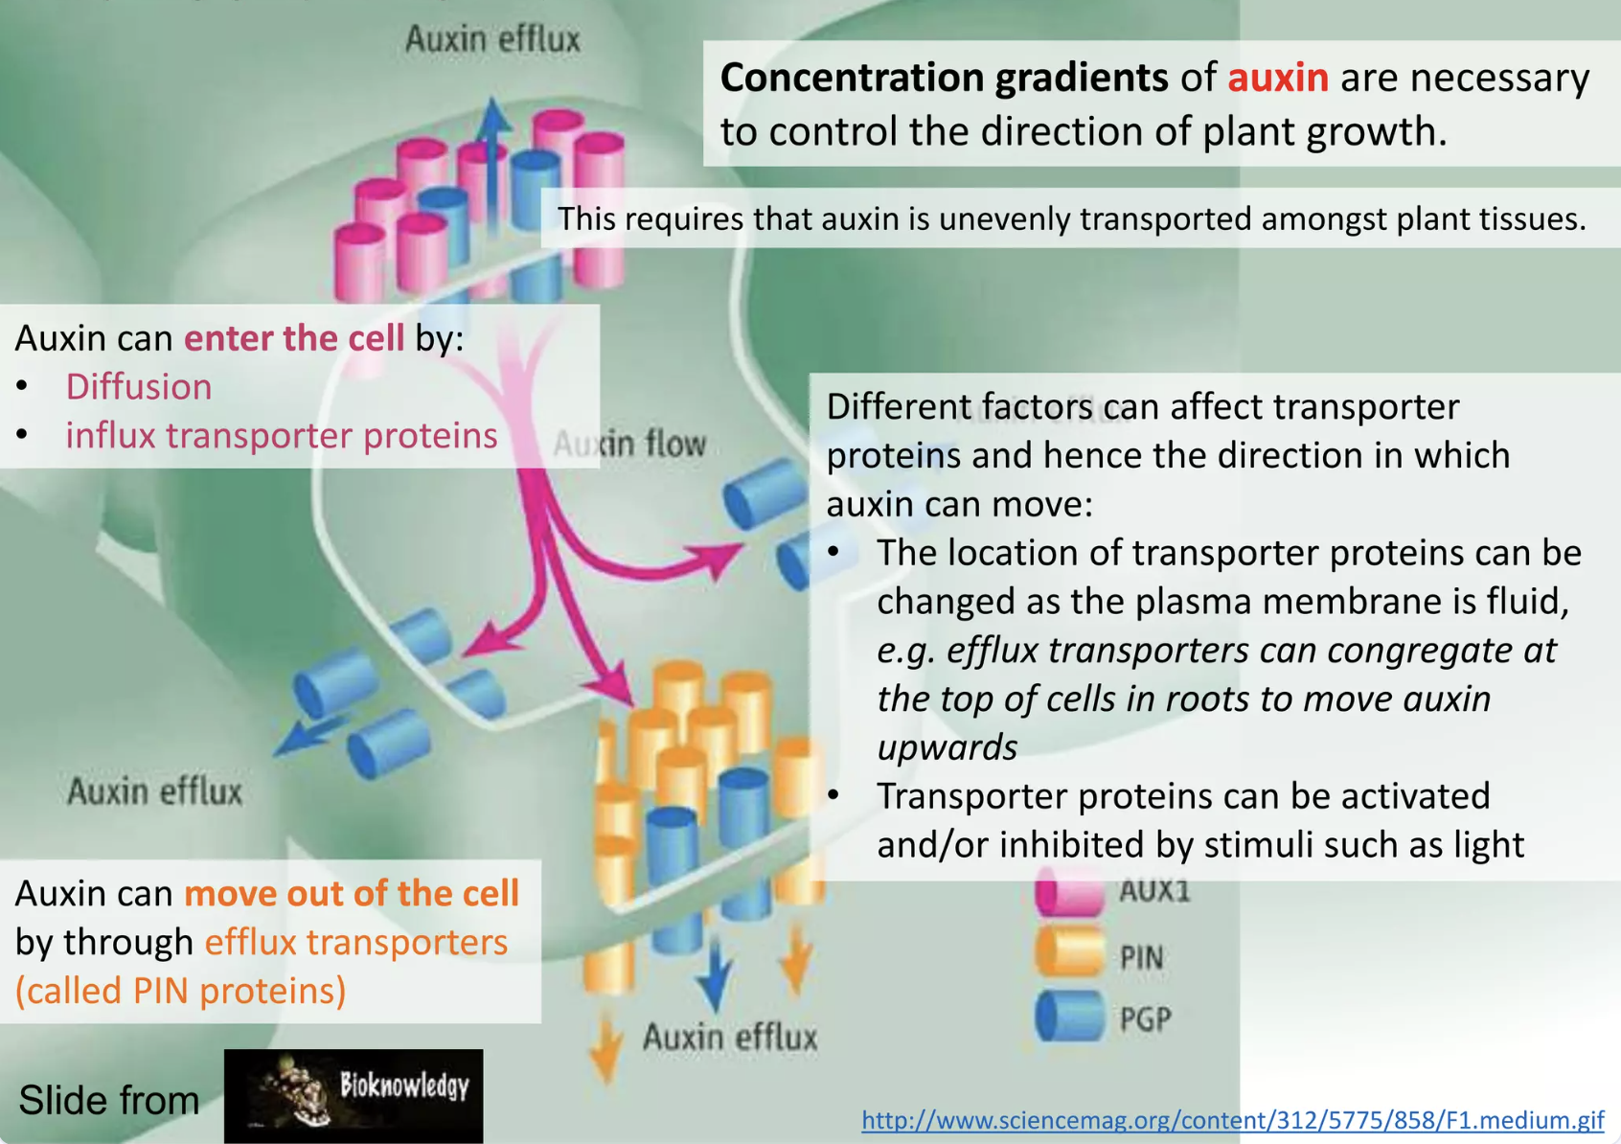

Slide 34
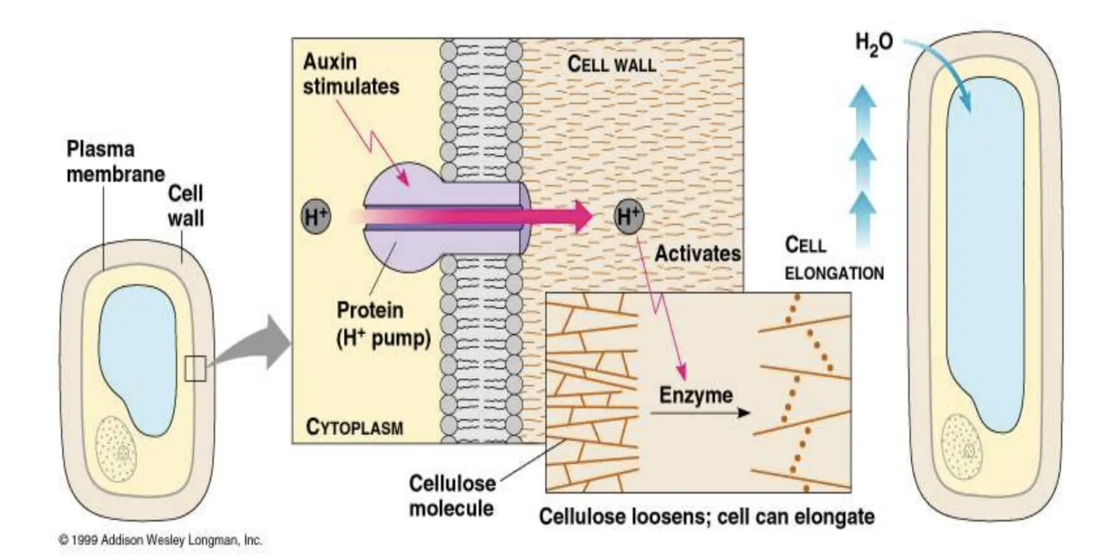
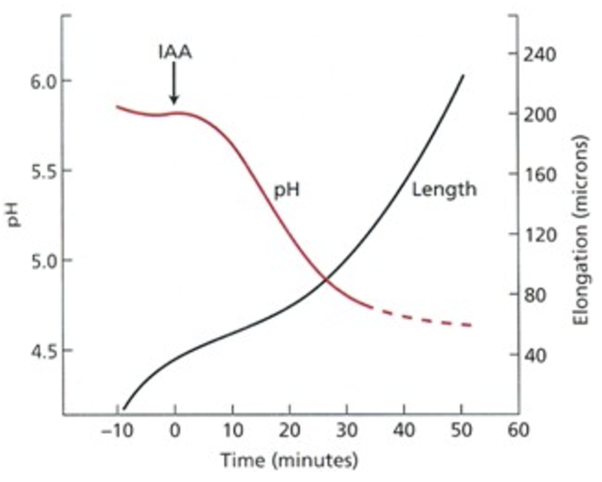
Auxin Response—Acid Growth Hypothesis
The presence of auxin promotes cell expansion.
Auxin activates the H⁺-ATPase pump. This actively pumps H⁺ into the cell wall.
https://slideplayer.com/slide/4992674/

Slide 35
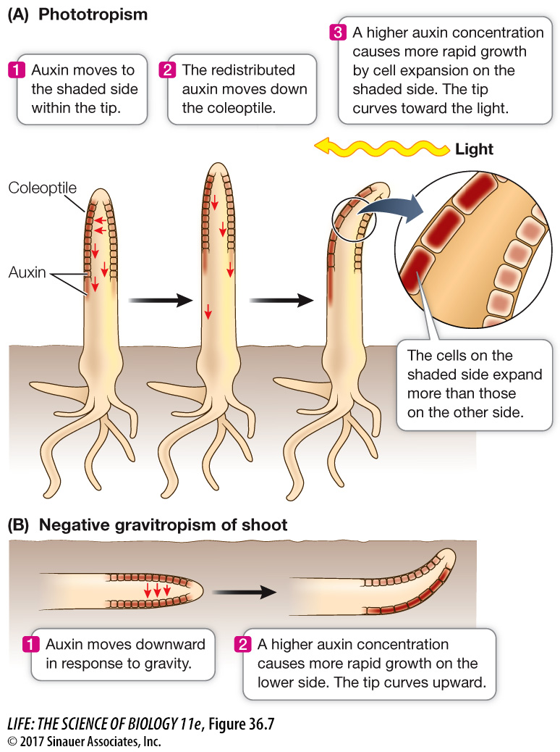
Auxin Response—Acid Growth Hypothesis
The movement of auxin results in differentiated growth.
Here’s how:
https://digfir-published.macmillanusa.com/life11e/life11e_ch36_10.html

Slide 36
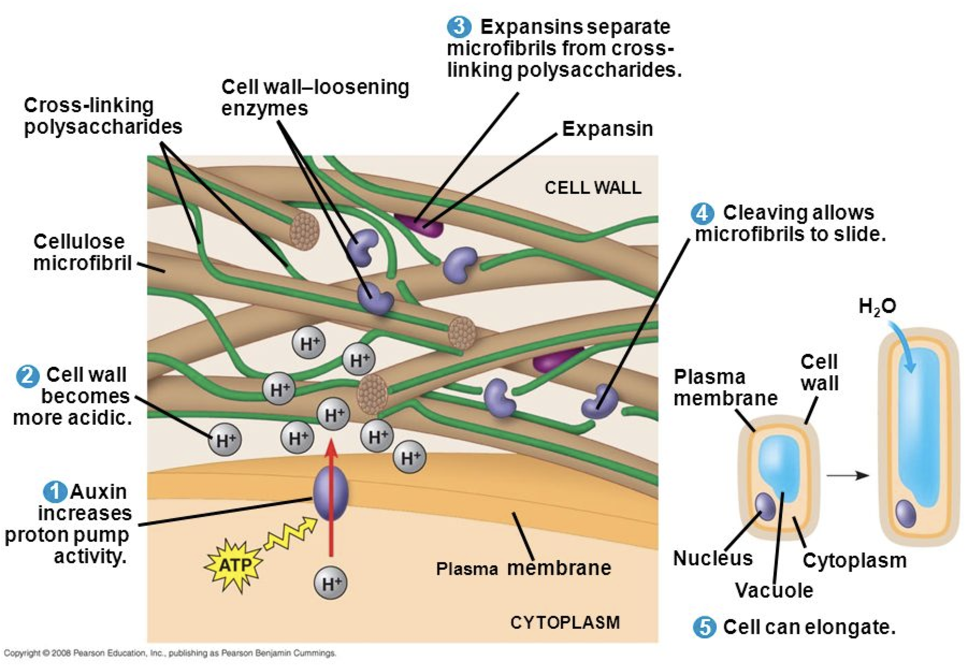
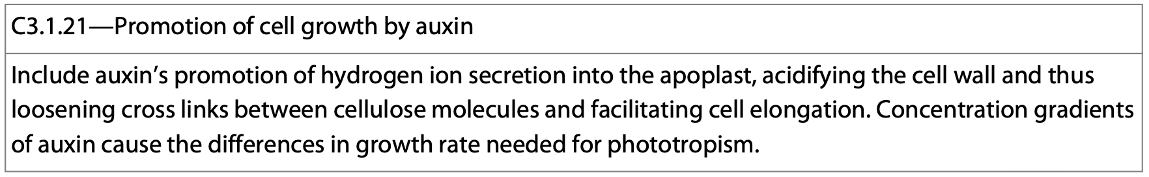
Auxin Response—Acid Growth Hypothesis
The influx of H⁺ loosens the existing cell wall. Auxin promotes the biosynthesis of new cell wall polysaccharides.

Slide 37
Auxin Response—Acid Growth Hypothesis
The acidic environment makes for an optimum pH for the expansin enzymes to function.
This breaks the H-bonds between cellulose molecules.
The efflux of H⁺ ions from the cell into the cell wall changes the membrane potential causing an influx of ions.

Slide 38
Auxin Response—Acid Growth Hypothesis
The influx of ions into the cell lowers the water potential, and water flows in by osmosis.
The increased turgor pressure elongates the cell resulting in growth.

Slide 39
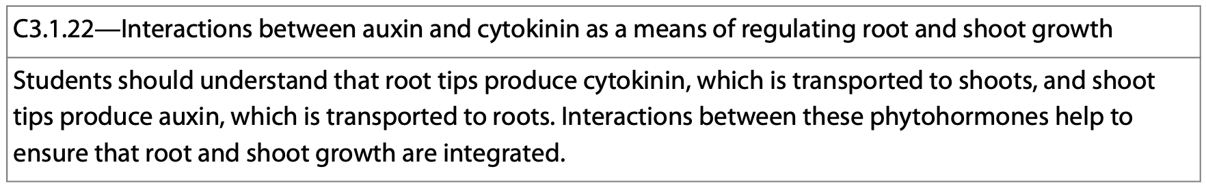
Auxin-Cytokinin Synergy
Auxin and cytokinin work together to control the growth of roots and shoots.
  Shoot tips produce auxin.
  Root tips produce cytokinin.

Slide 40
Auxin-Cytokinin Synergy
Auxin travels downward to the roots and promotes root elongation via the acid-growth hypothesis.
The cytokinin produced by the root tips moves upwards through the xylem and regulates transport of auxin-controlling growth.

Slide 41
Auxin-Cytokinin Synergy
Cytokinin can interfere with auxin uptake and control root growth.
Auxin production interferes with the effects of cytokinin.
These two phytohormones are antagonists of each other.

Slide 42
Auxin-Cytokinin Synergy
A high auxin-to-cytokinin ratio promotes apical dominance.
A high cytokinin-to-auxin ratio prevents elongation and growth of roots.
The levels of these hormones are coordinated to control the growth of roots and shoots.

Slide 43
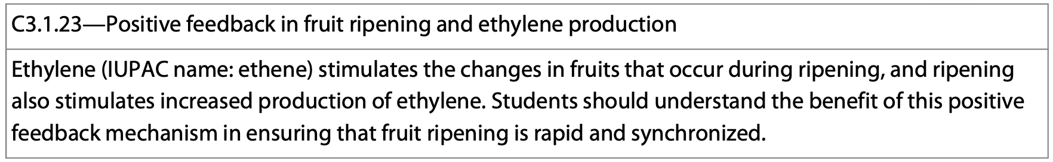
Fruit Ripening
Ethylene is a gas produced by many different fruits and vegetables as they ripen.
It promotes further ripening using positive feedback.

Slide 44
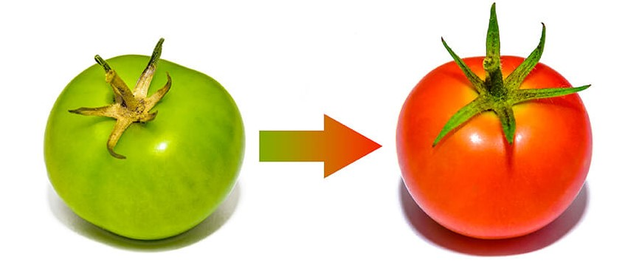
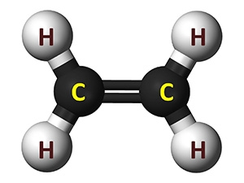
Fruit Ripening
As fruits ripen, they begin producing ethylene.
As more ethylene is produced, it stimulates enzymes which produce more ethylene.
https://www.markon.com/get-inspired/culinary-trends/understanding-ethylene/
https://www.postharvest.net.au/postharvest-fundamentals/atmosphere/ethylene/

Slide 45
Ripening Cascade
Positive feedback fuels the ripening cascade.
As fruits begin production of ethylene, it stimulates more production leading to the changes in fruit color, texture, aroma, and flavor.

