Slide 1

Prokaryotic and Eukaryotic gene Regulation
Chapter 18

Slide 2
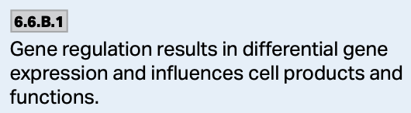
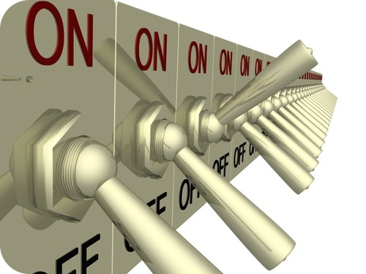
Gene Regulation
Gene regulation is the turning on or off of genes.
There are many ways a cell can do this—increasing or decreasing transcription, translation, or breaking down proteins that are no longer needed.
Internal and external signals trigger changes in gene expression.
https://slideplayer.com/slide/3581702/12/images/44/Promoter+Activators+Gene+DNA+Enhancer.jpg

Slide 3
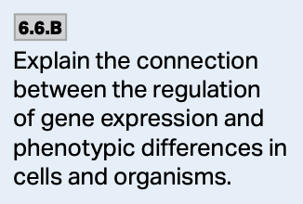
Gene Regulation—Why?
It is a way to conserve energy and resources.
There is no need to make a protein when it is not needed.
The expression of the genes also influences phenotype.
https://slideplayer.com/slide/3581702/12/images/44/Promoter+Activators+Gene+DNA+Enhancer.jpg

Slide 4
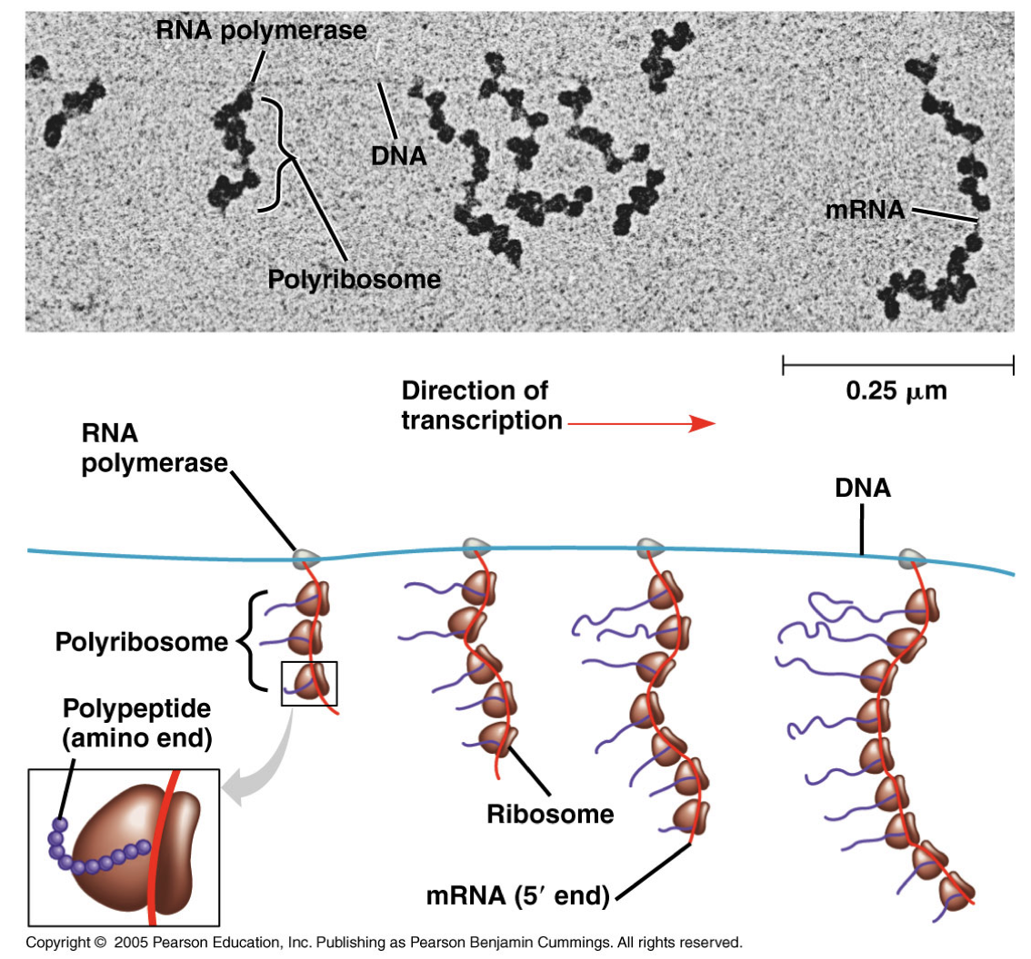
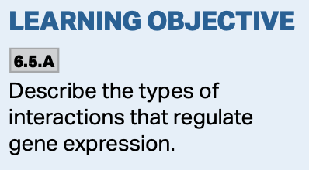
Prokaryotic Gene Regulation
Recall transcription and translation occur at the same time in prokaryotes.
Gene regulation in bacteria is almost entirely due to the control of transcription—via the operon.

Slide 5
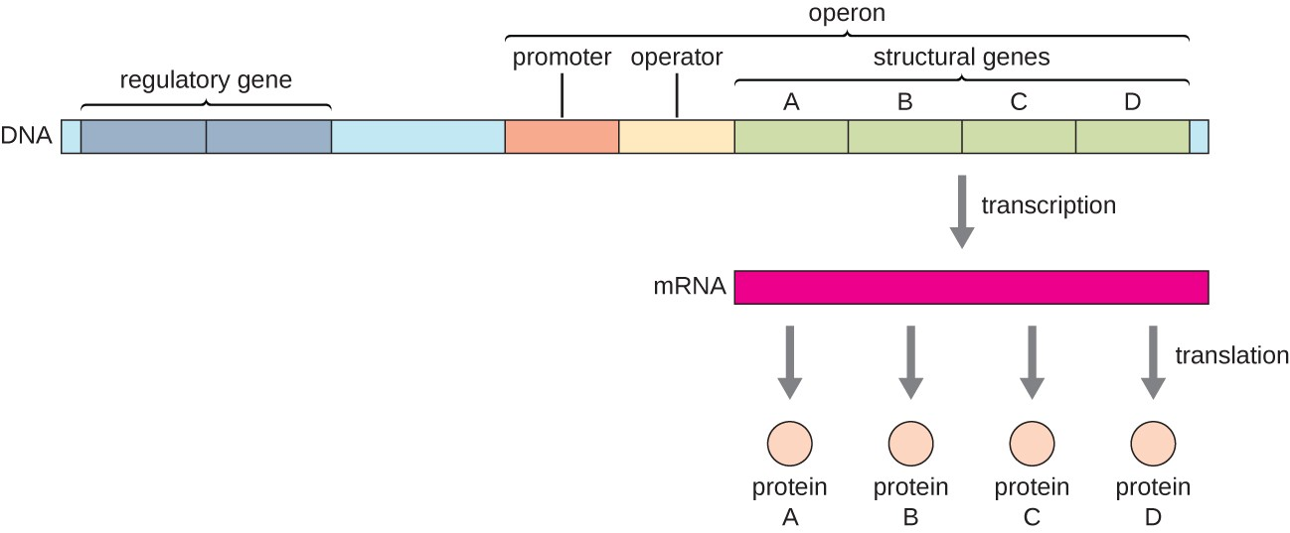
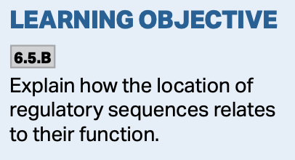
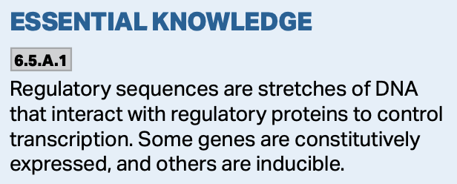
Prokaryotic Gene Regulation—Operons
The operon is the functional unit of gene expression in bacteria.
It consists of a promoter, an operator, and the genes to be expressed.
The operon is under the control of a regulatory protein coded for by a regulatory gene.
https://courses.lumenlearning.com/wm-biology1/chapter/prokaryotic-gene-regulation/

Slide 6
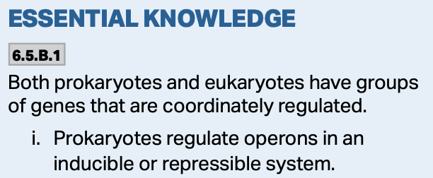
Prokaryotic Gene Regulation—Operons
Operons can be inducible or repressible.
  Inducible operons are always off, but can be turned on.
    The lac operon is an inducible operon.
    The repressor molecule is made in the active form and readily binds to the operator keeping the operon off until needed.
  Repressible operons are always on, but can be turned off.
    The trp operon is a repressible operon.
    The repressor molecule is made in the inactive form and will not bind to the operator until the end product’s concentration is high enough.

Slide 7
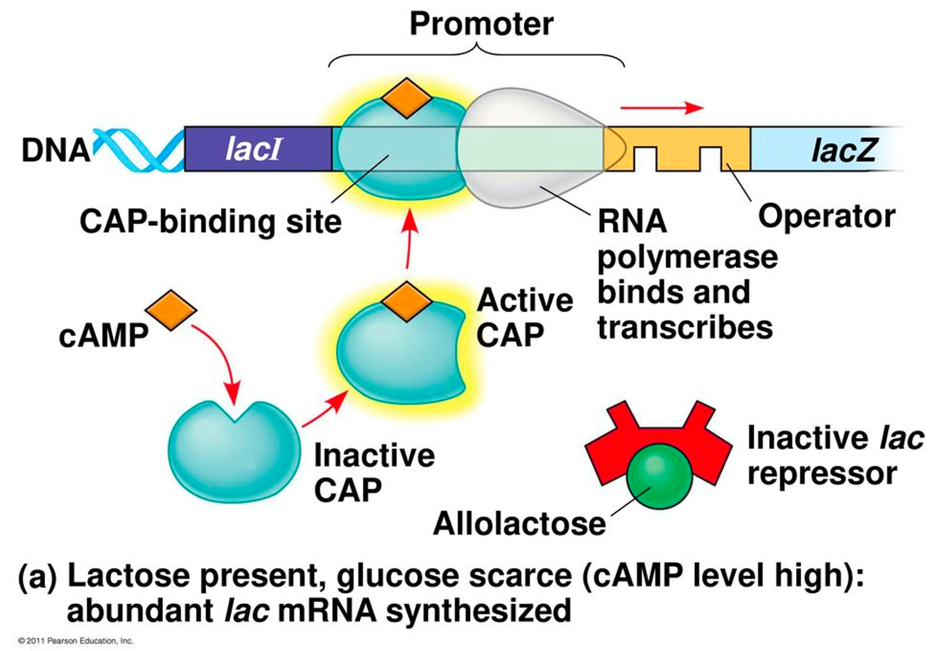
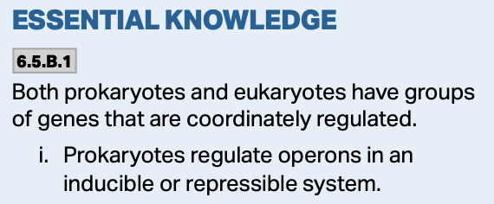
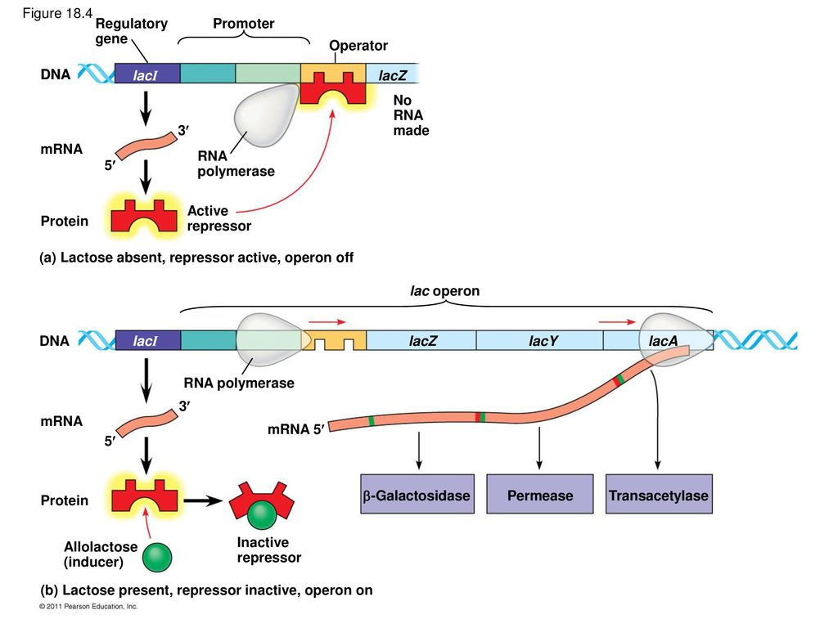
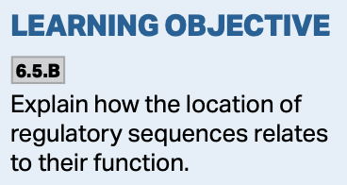
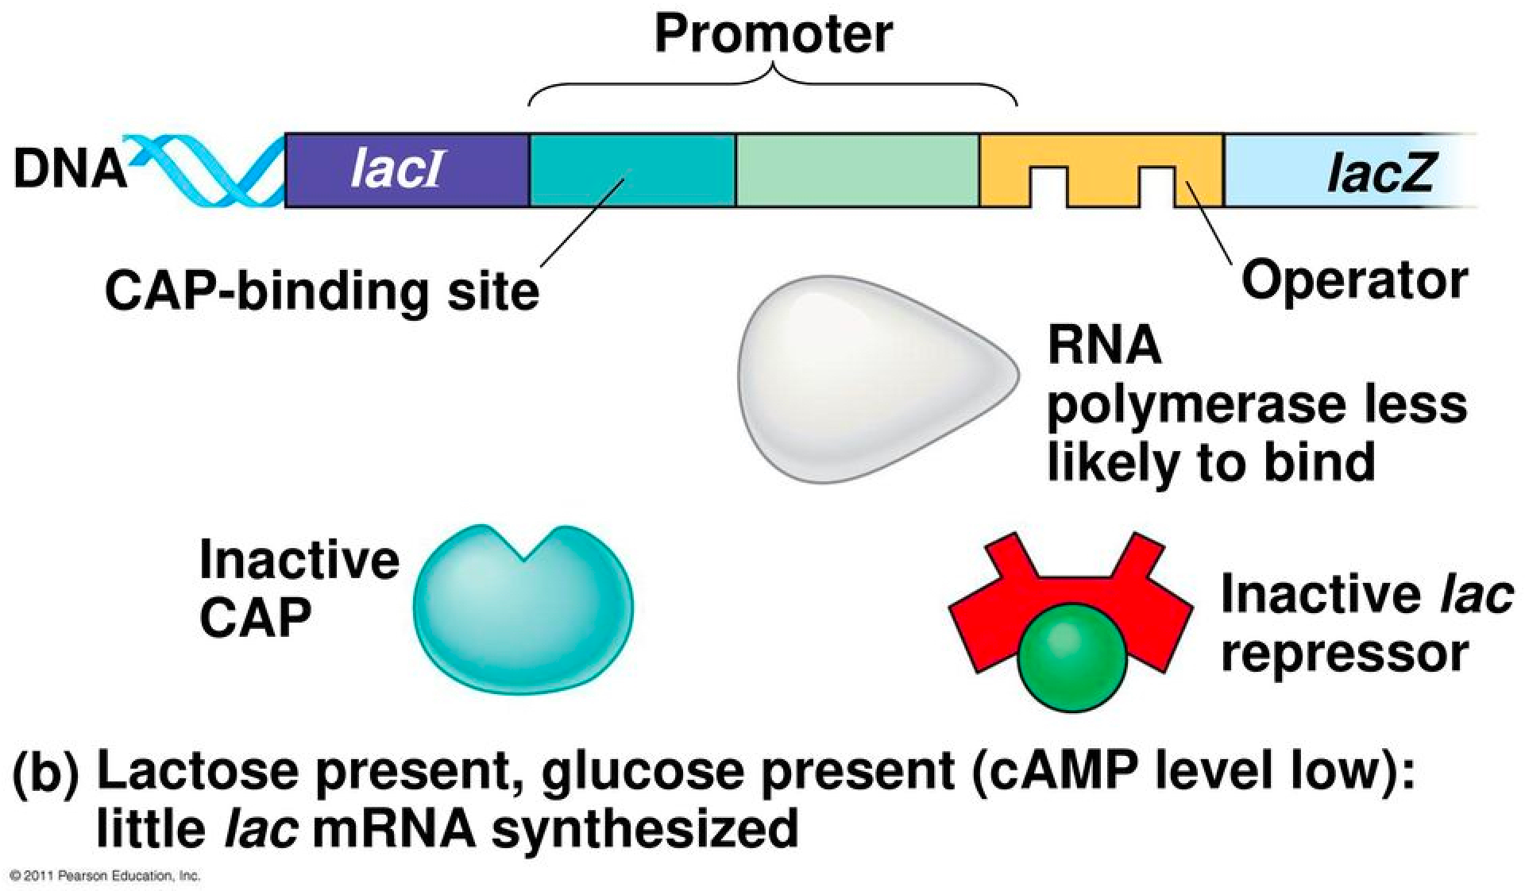
Prokaryotic Gene Regulation—The lac Operon An Inducible Operon

Slide 8
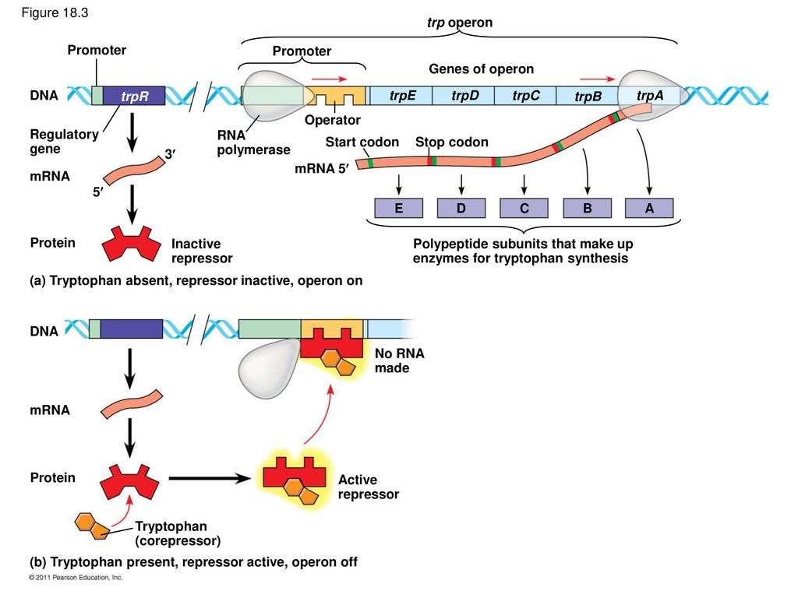
Prokaryotic Gene Regulation—The trp Operon A Repressible Operon

Slide 9
Eukaryotic Gene Regulation
Eukaryotic gene regulation can take many forms to control the production of protein.
  1. Access to the genes
  2. Pre-transcriptional Control
  3. Post-transcriptional Modifications
  4. Pre-translational Control
  5. Post-translational Modifications

Slide 10
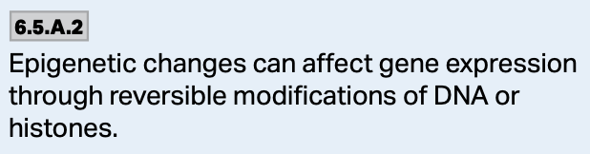
Eukaryotic Gene Regulation—1. Access to Genes
DNA packaging/unpackaging and modification are ways in which gene regulation occurs by providing access to the genes.
  Methylation of DNA and histones.
  Acetylation of histones.
https://s3-us-west-2.amazonaws.com/courses-images/wp-content/uploads/sites/1087/2016/12/12233132/Figure_16_03_03.jpg

Slide 11
Chromatin Structure
Chromatin is the mixture of DNA and proteins, and its structure also impacts transcription.
  DNA is wrapped around histone proteins into structures called nucleosomes.
  The presence of these structures presents a major obstacle for the transcription of genes.
https://media.springernature.com/original/springer-static/image/chp%3A10.1007%2F978-3-319-59786-7_12/MediaObjects/339698_1_En_12_Fig2a_HTML.gif

Slide 12
Chromatin Structure
Nonhistone chromosomal proteins and nucleosome remodeling factors facilitate binding of transcription factors to chromatin by altering the nucleosome structure.
Core histones have two domains, one domain binds with the DNA and also interacts with other histones.
The second domain extends outside of the nucleosome and can be modified.
https://schoolbag.info/chemistry/mcat_biochemistry/mcat_biochemistry.files/image171.jpg

Slide 13
Chromatin Structure—Acetylation
Acetylation of the histone reduces the net positive charge, causing it to loosen its grip on the DNA, and changes its interaction with other proteins.
Histone acetylation also facilitates binding of transcription factors to nucleosomal DNA, thereby increasing the accessibility of chromatin to DNA-binding proteins.
https://i1.wp.com/s3-us-west-2.amazonaws.com/courses-images/wp-content/uploads/sites/1842/2017/05/26155238/figure-16-03-02.png?resize=586%2C453&ssl=1

Slide 14
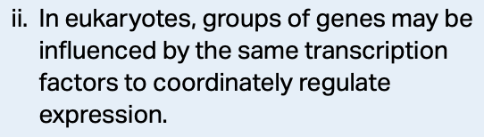
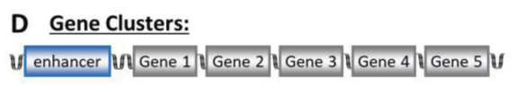
Chromatin Structure—Acetylation
The decondensed nucleosomal chromatin structure allows the RNA polymerase to transcribe through the nucleosome template—expressing the genes.
Some genes are clustered together so that when when one is made available, they all become available for transcription/translation.
https://pmc.ncbi.nlm.nih.gov/articles/PMC8678166/pdf/nihms-1726561.pdf
https://www.researchgate.net/publication/270917749/figure/fig1/AS:650042629165101@1531993648278/Function-of-chromatin-remodeling-complexes-A-Native-chromatin-may-conceal-key.png

Slide 15
Chromatin Structure—Methylation
When methyl groups are added to the DNA and/or histones, transcriptional activity of genes is reduced.
Methylation prevents transcription of the genes with the help of a protein that binds to the methylated DNA keeping it tightly wound and preventing transcription.
https://science.sciencemag.org/content/sci/294/5549/2113/F1.medium.gif?width=800&height=600&carousel=1

Slide 16
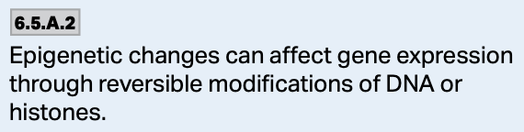
The Effect of Chromatin Structure on Gene Expression—A summary
Methylation of DNA and/or histones reduces gene expression.
Acetylation of histones increases gene expression.
https://d1yboe6750e2cu.cloudfront.net/i/e5d36563c4ed8550453dec299c9d80c3a115e400

Slide 17
Eukaryotic Gene Regulation—2. Pre-Transcriptional Control
The primary means of gene regulation is through the control of the initiation of transcription.
In multicellular organisms, the combined actions of many different regulatory proteins achieves this regulation.
Many of these proteins bind to regulatory sequences to change the activity of RNA polymerase.
https://doctorlib.info/physiology/medical/medical.files/image081.jpg

Slide 18


Slide 19
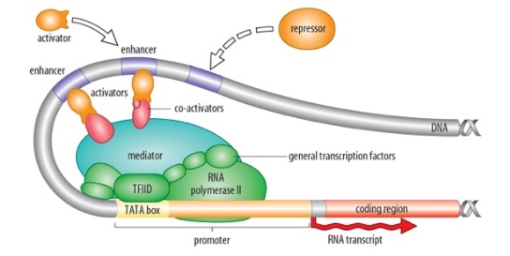
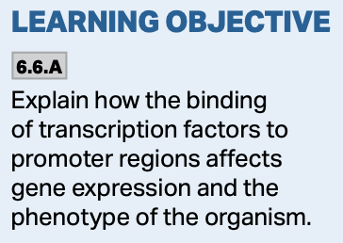
RNA Polymerase II Relies on Promoters and Enhancers
Promoters such as the TATA box and other types of Initiator Sequences allow general transcription factors to bind.
These are associated with the transcription initiation complex that allow transcription to begin.
https://image.slidesharecdn.com/281lec23eukaryoticregulation1-150820154631-lva1-app6892/95/281-lec23-eukaryoticregulation1-7-638.jpg?cb=1440085766

Slide 20
RNA Polymerase II Relies on Promoters and Enhancers
Enhancers bind transcription factors that regulate RNA polymerase.
DNA looping allows transcription factors bound to a distant enhancer to interact with RNA polymerase or general transcription factors at the promoter.
https://image.slidesharecdn.com/281lec23eukaryoticregulation1-150820154631-lva1-app6892/95/281-lec23-eukaryoticregulation1-7-638.jpg?cb=1440085766

Slide 21
RNA Polymerase II Relies on Promoters and Enhancers
Enhancers usually contain multiple functional sequence elements that bind transcriptional regulatory proteins.
All of these things work together to regulate gene expression.
https://www.mdpi.com/cells/cells-08-01281/article_deploy/html/images/cells-08-01281-g003.png

Slide 22
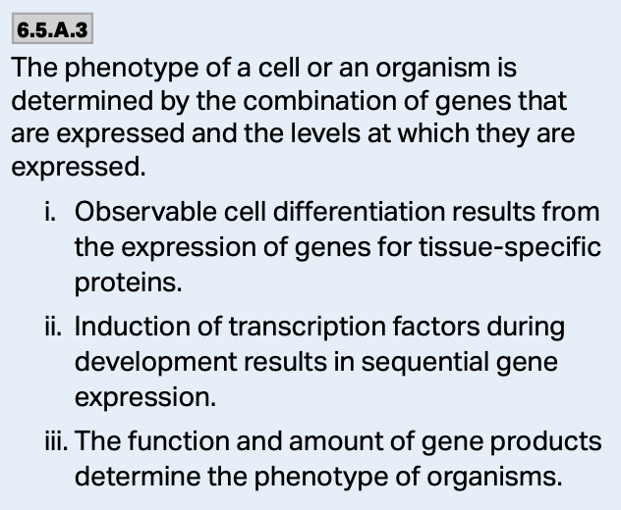
Transcriptional Regulatory Proteins
When specific transcriptional regulatory proteins bind to enhancers, gene expression can be controlled.
Cellular response to hormones and growth factors works this way too—their binding has an effect on gene expression.
https://compbio.pbworks.com/f/regnet3.jpg

Slide 23
Transcriptional Regulatory Proteins
When specific transcriptional regulatory proteins bind to enhancers, gene expression can be controlled.
Cellular response to hormones and growth factors works this way too—their binding has an effect on gene expression.
https://www.google.com/url?sa=i&url=https%3A%2F%2Fmedium.com%2F%40thanradayawichai%2Fcampbell-16-nucleic-acids-and-inheritance-4315304f7651&psig=AOvVaw3E0mZHN2NYJB8S7i9lNXrJ&ust=1607707945973000&source=images&cd=vfe&ved=0CAIQjRxqFwoTCIjJopn5w-0CFQAAAAAdAAAAABAT

Slide 24
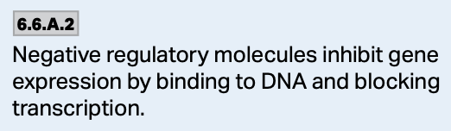
Transcriptional Repressors—2. Pre-Transcriptional Control
In some cases, the repressors have the same, or very similar DNA binding domains as the activators, but lack the activation domain.
Thus, when these proteins bind to a promoter or enhancer, they block the binding of the activator, thereby blocking transcription.
https://www.ncbi.nlm.nih.gov/books/NBK9904/bin/ch6f30.jpg

Slide 25
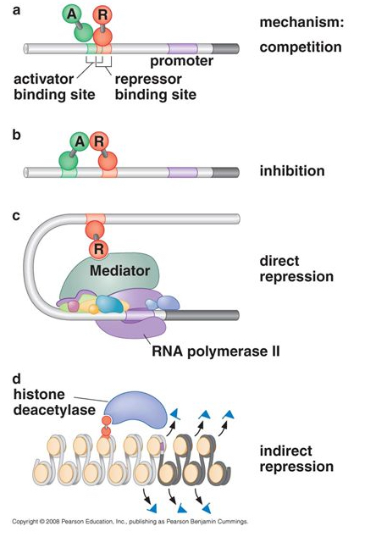
Transcriptional Repressors—2. Pre-Transcriptional Control
Repressors are also responsible for regulating gene expression.
They often bind to DNA and inhibit transcription, but some can interfere with binding of other transcription factors.
https://images.slideplayer.com/12/3515089/slides/slide_33.jpg

Slide 26
Transcriptional Repressors—2. Pre-Transcriptional Control
Many repressors also contain domains that inhibit transcription through protein-protein interactions, while some interact with general transcription factors to prevent the transcription machinery from setting up and transcribing the gene.
Repression can also occur as a result to changes in histone proteins.

Slide 27
Transcriptional Activators
Transcriptional activators are proteins that increase the transcription of a gene or genes.
These proteins often bind to enhancer regions of DNA.
They function to help the transcription machinery come together to transcribe the gene into mRNA.
https://slideplayer.com/slide/3581702/12/images/44/Promoter+Activators+Gene+DNA+Enhancer.jpg

Slide 28
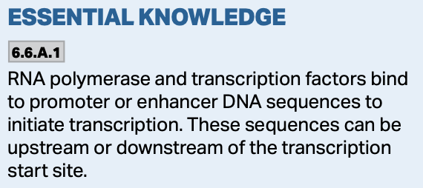
Transcriptional Activators
Transcriptional activators bind to regulatory DNA sequences and stimulate transcription.
https://www.mun.ca/biology/desmid/brian/BIOL2060/BIOL2060-23/23_22.jpg

Slide 29
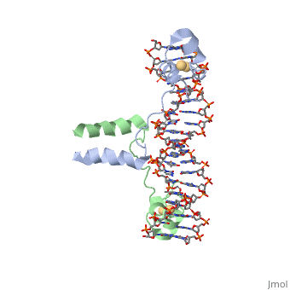
Transcriptional Activators
Transcriptional activators have two domains:
  One that binds to the DNA
  The other domain interacts with the transcriptional machinery.
https://proteopedia.org/wiki/images/f/f3/1d66.gif https://proteopedia.org/wiki/images/f/f3/1d66.gif

Slide 30
Transcriptional Activators
The DNA binding domain anchors the transcription factor to the proper site on the DNA.
The activation domain works independently to stimulate transcription by interacting with other proteins.
https://www.pnas.org/content/pnas/109/6/1949/F4.large.jpg

Slide 31
Transcriptional Activators—Zinc Fingers
Many of the DNA binding domains are related to one another.
  Zinc finger domains have cysteine and histidine repeats that complex with zinc ions and fold into looped structures that bind DNA called zinc fingers.
  These are common with steroid hormone receptors that regulate transcription in response to things like estrogen and testosterone.
https://slideplayer.com/slide/5707370/18/images/53/The+hormone+receptors+have+a+highly+conserved+DNA+binding+domain+with+two+zinc+fingers.jpg

Slide 32
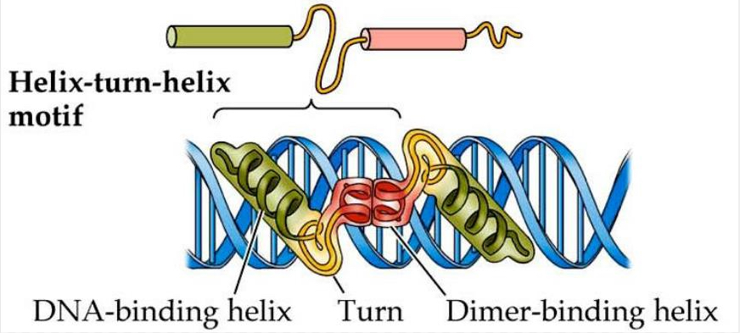
Transcriptional Activators—Helix-Turn-Helix
The helix-turn-helix motif has three or four helixes. One helix makes most of the contact with the DNA, while the others act to stabilize the interaction.
  These are common to homeodomain proteins that regulate development.
  Homeoboxes encode DNA binding domains called homeodomains that interact with transcription factors.
https://image2.slideserve.com/5328077/slide37-l.jpg

Slide 33
Transcriptional Activators
Leucine Zipper
The leucine zipper is a part of the protein that facilitates binding to the DNA.
  Its job is to stabilize the structure.
  In general, leucine zippers are a class of proteins that bind to DNA at specific sites within the promoters of genes.
  When these proteins bind to the DNA, transcription is stimulated and the gene gets expressed.
https://d3i71xaburhd42.cloudfront.net/9490ca6a3cae5c2a71bfd8184e72a274d58cf32f/3-Figure2-1.png

Slide 34
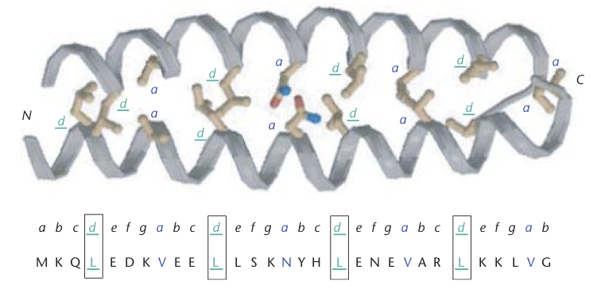
Transcriptional Activators—Leucine Zipper
Leucine zipper proteins contain 4 or 5 leucine residues spaced at intervals of 7 amino acids apart which results in an alpha-helical shape allowing the dimerization of the two proteins which make up the structure.
http://www.acsu.buffalo.edu/~koudelka/leucine.pdf

Slide 35
Transcriptional Activators—Leucine Zipper
The leucine residues interact with the hydrophobic protein subunits to stabilize the structure.
There is also a portion of these proteins that contain basic residues that form ionic bonds with the DNA at specific spots to regulate gene expression.
  Leucine zipper proteins are common for regulating development.
https://lh3.googleusercontent.com/proxy/qhMsvPJbPYg-WZboknMLgvvy9J6b3Cxh1NCM_1jNNJerm2x9aei7Eg4vWrWSSWDuidfby7YFxgOfir7otlg

Slide 36
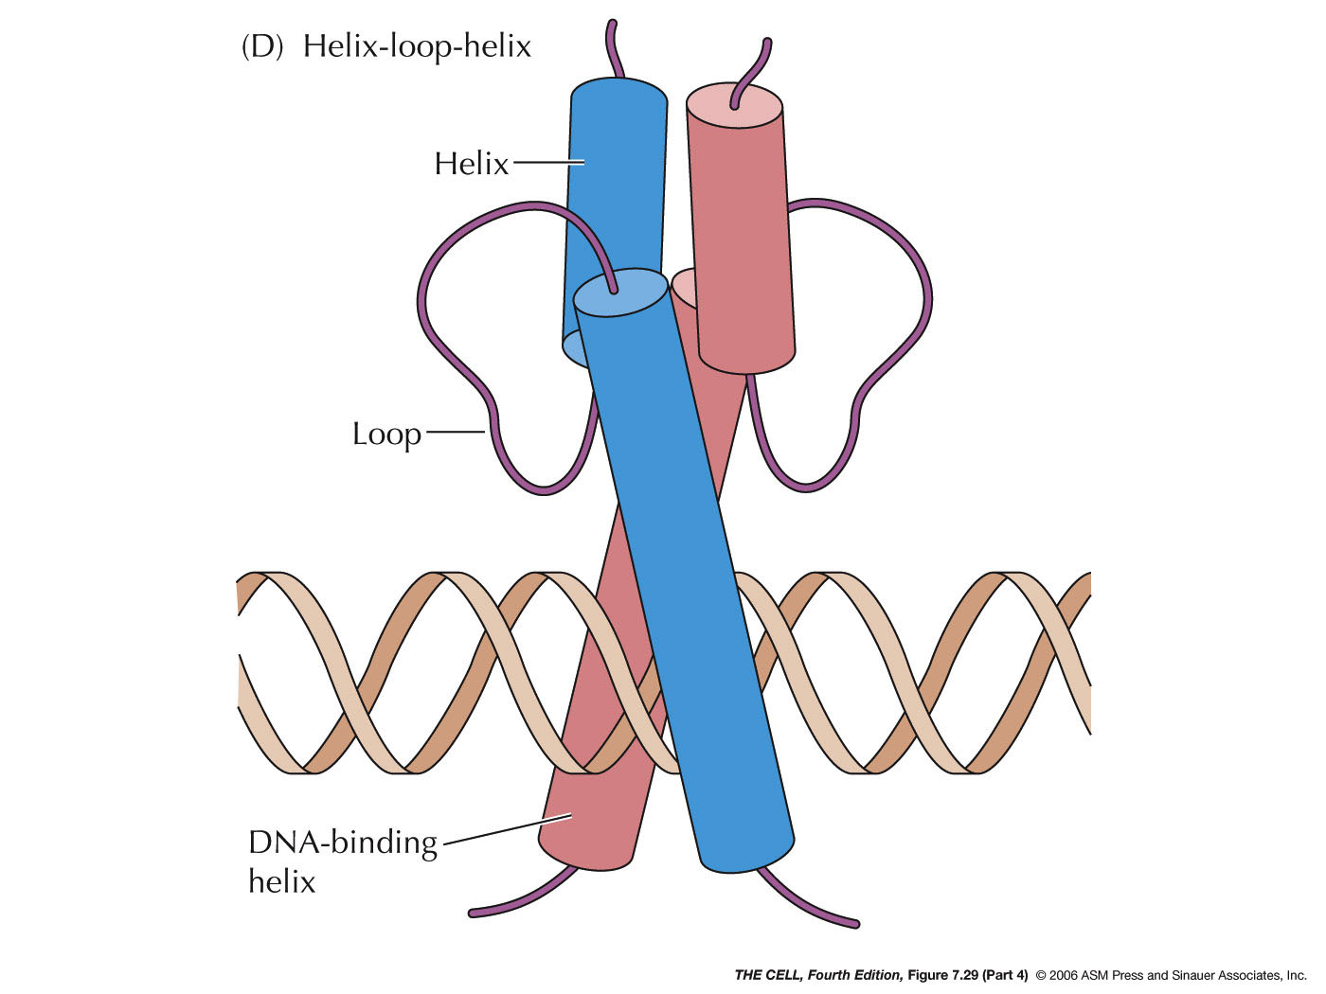
Transcriptional Activators—Helix-Loop-Helix
Helix-loop-helix is a protein structural motif similar to that of the leucine zipper, and is involved in regulating gene transcription.
Like the leucine zipper, these structures consist of two alpha helices connected by a loop.
One helix is small and facilitates binding to the other helix. The second helix is larger and has a DNA binding domain.
http://faculty.samford.edu/~djohnso2/44962w/405/07/f07-29-4.jpg

Slide 37
Transcriptional Activators—Helix-Loop-Helix & Leucine Zipper
Helix-loop-helix and leucine zippers can interact with each other to broaden the number of combinations of regulatory proteins that can be made.
https://d3i71xaburhd42.cloudfront.net/8507b096082ada1b1e5bdb711c74a49d30f8216f/18-Figure1-1.png

Slide 38
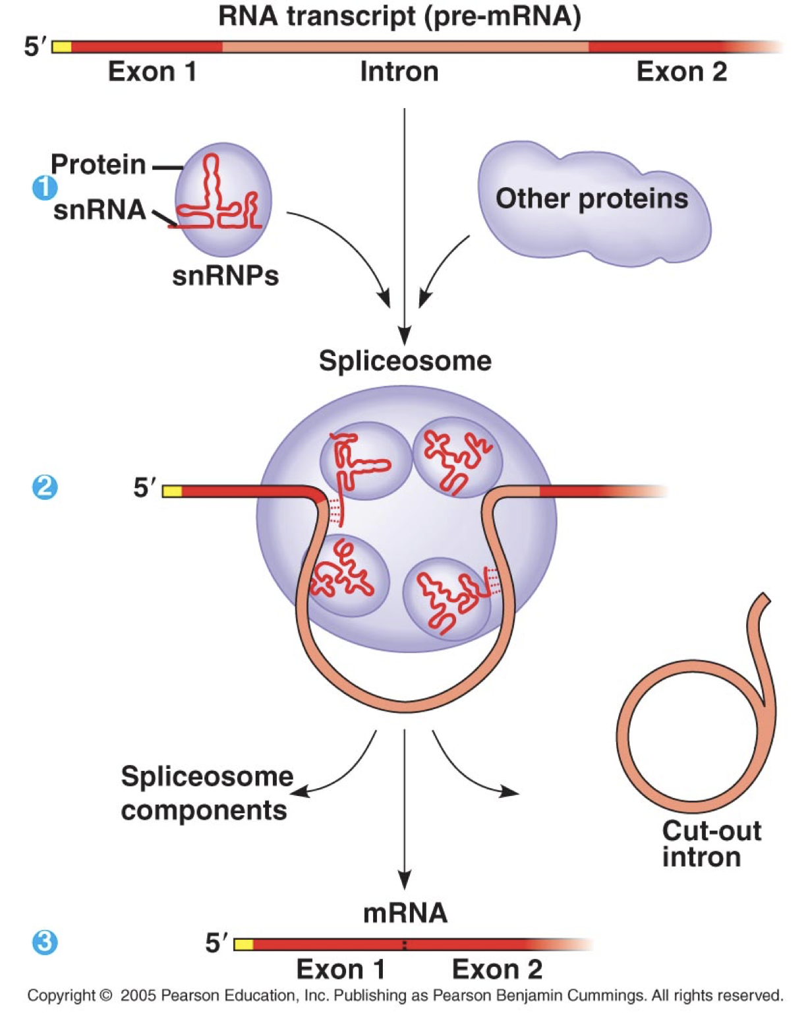
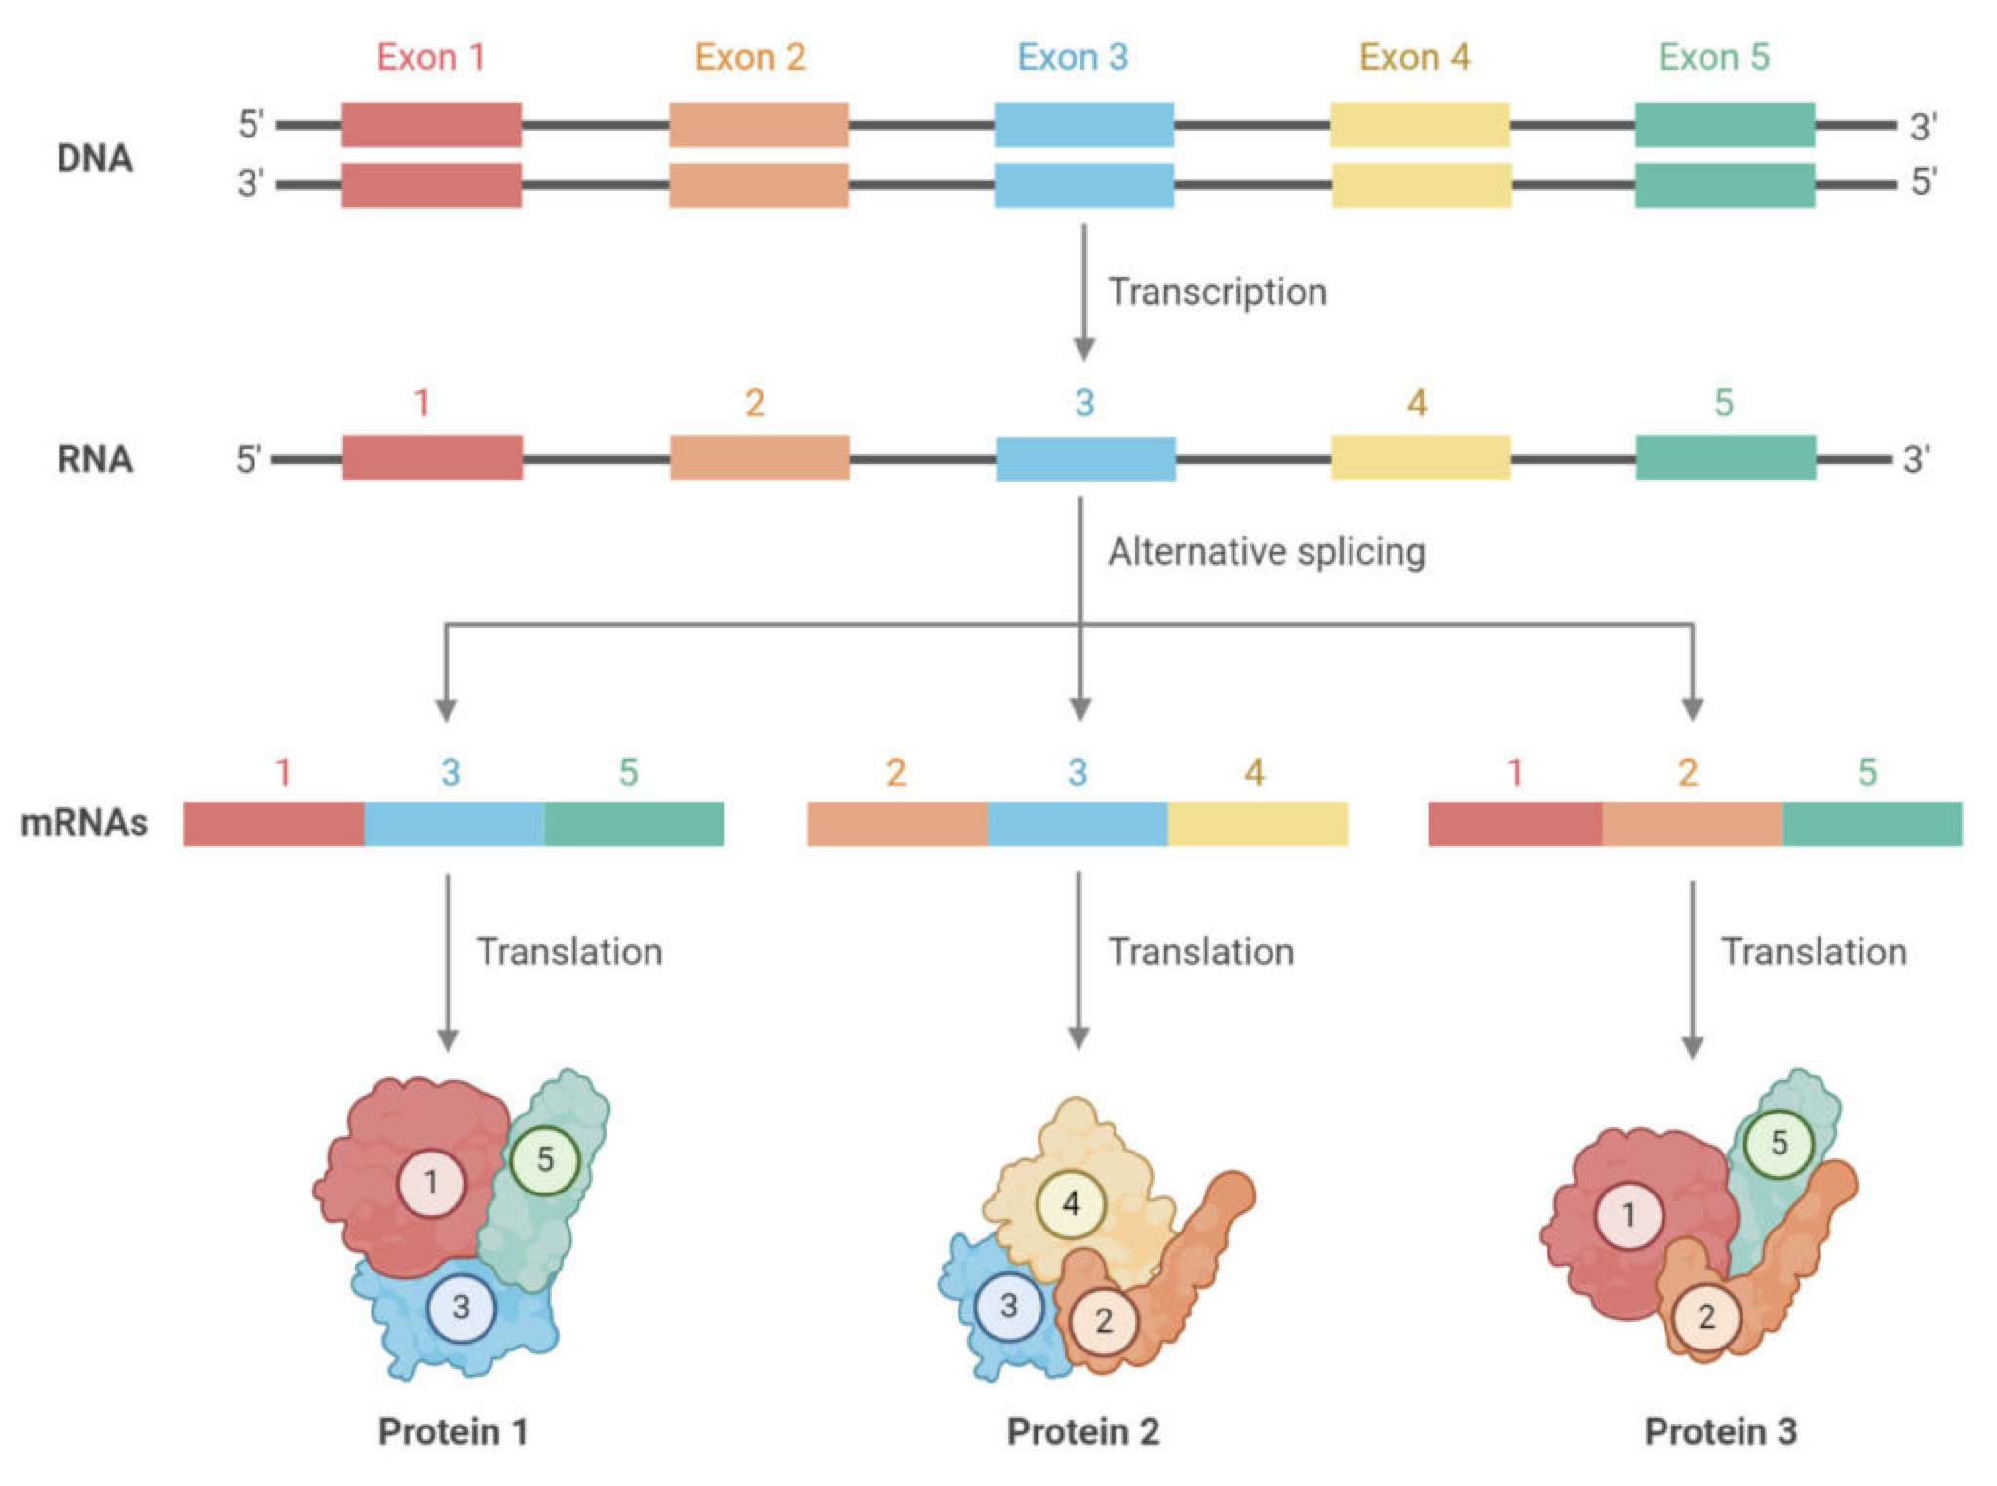
3. Post-Transcriptional Modifications
The RNA processing that we discussed in the last chapter whereby the pre-mRNA is the introns spliced out and the exons spliced together to produce a mature mRNA molecule is post-transcriptional modification.
https://microbenotes.com/wp-content/uploads/2020/10/Alternative-Splicing-1024x762.jpeg

Slide 39
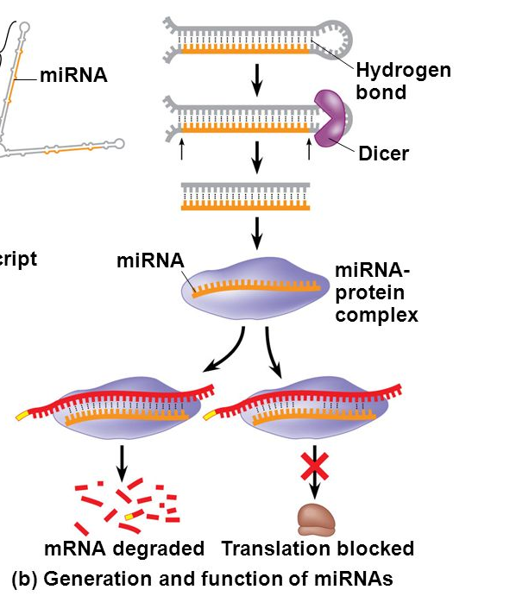
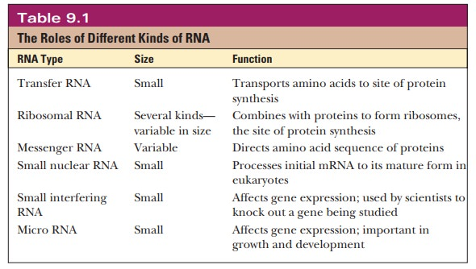
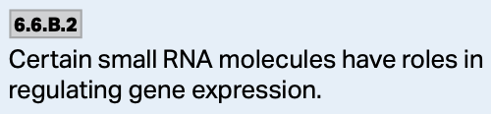
4. Pre-Translational Control–small RNA Molecules
There are many thousands of different types of RNA that are used to regulate translation AFTER the mRNA has been transcribed and processed.
Regardless of the type of RNA, the main idea is this:
  The target mRNA molecules can be degraded.
  Translation of the target mRNA is stopped.

Slide 40
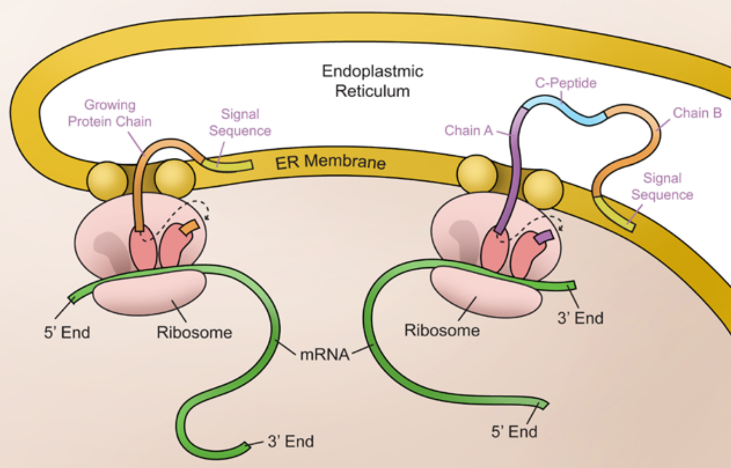
5. Post-Translational Modifications
There are different forms of post-translational modification.
For example, the removal of the signal peptide and the C-protein portion of the beta-globin protein after the initial translation has occurred makes the final, functional beta-globin molecule.

Slide 41
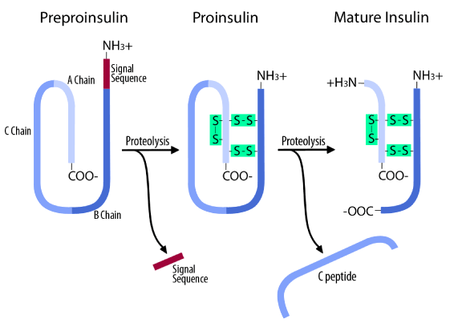
5. Post-Translational Modifications
In the process of insulin production, the signal sequence directs the ribosome to the ER.
In the ER, the signal sequence is cleaved off after translation of preproinsulin is complete forming proinsulin.
The proinsulin then has the C-peptide removed in the Golgi apparatus forming the active insulin molecule which is secreted from the beta cell.

Slide 42
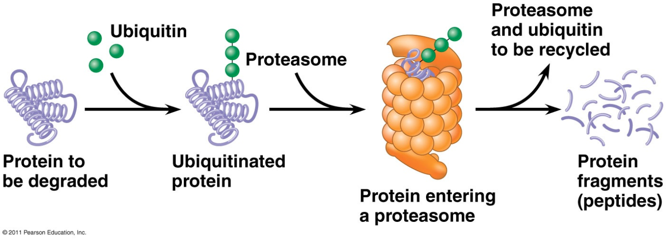
5. Post-Translational Modifications
There are different forms of post-translational modification.
For example, some proteins that are no longer needed are tagged by ubiquitin protein and then transported to a proteasome where they are hydrolyzed and their components are recycled.

Slide 43
Eukaryotic Gene Regulation—A Summary
Eukaryotic gene regulation is a complex process involving a number of different events that involve proteins and the DNA.
Some proteins bind directly to the DNA and either stimulate or repress transcription.
Other modifications to the proteins that help organize the DNA can influence the cell’s ability to express the genes.
The DNA itself can be modified in ways that affect gene expression.

