Slide 1
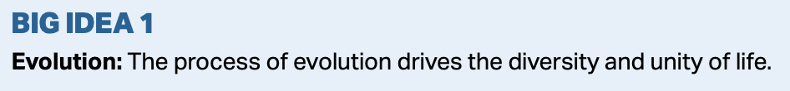
Chapter 23
The Evolution of Populations
“Evolution is indeed a matter of chance, but in the random lottery of mutations, some numbers and combinations better meet the imperatives of ecological necessity, and they arise and are selected for repeatedly.”
                --Sean B. Carroll

Slide 2
Essential Idea
The diversity of life has evolved and continues to evolve by natural selection.

Slide 3
A Common Misconception
Many people think individuals evolve—not true.
Populations evolve because of natural selection acting on each individual within a given population.
Those individuals better fit to survive are more likely to reproduce and pass on genes that will benefit future generations.

Slide 4
Microevolution
Evolution on a small scale.
The change in the genetic make up of a population from generation to generation—mutation, migration, selection, genetic drift.

Slide 5
Darwin’s “Problem”
There were many limitations of science in Darwin’s time.
  He did not have a good explanation for how such heritable variations that were required for natural selection appeared in a population.
  Nor did he have an explanation for how they were transmitted from organisms to their offspring.

Slide 6
Recall the Blending Hypothesis:
The blending hypothesis was what people used to explain why offspring look like both parents.
Darwin and others realized this was wrong because it would eliminate variation within a population that was required for natural selection.
Ironically, shortly after Darwin published Origin, Gregor Mendel published his paper on genetics.

Slide 7

Mendel’s Pea Experiments
Mendel’s paper went unnoticed for nearly 50 years.
In the early 20th century, scientists uncovered the work of Mendel, and its relationship to Darwin’s ideas was profound.

Slide 8
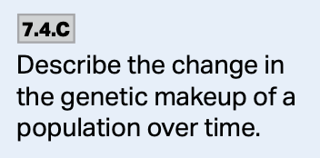
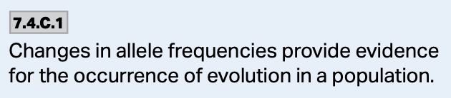
Population Genetics
Scientists’ analysis of the parallels between Darwin and Mendel were melded into what is known as population genetics—the study of how populations change over time.

Slide 9
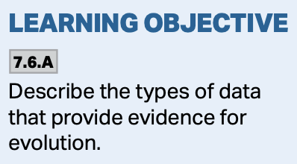
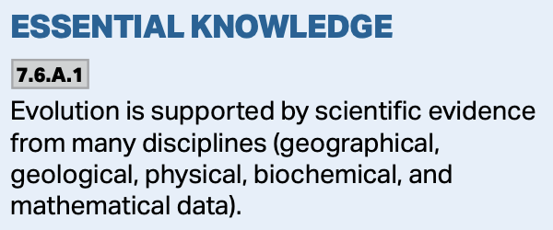
The Modern Synthesis
As more was learned about Darwin and Mendel, the Modern Synthesis was developed. It is a comprehensive theory of evolution that incorporates many fields of science.
  Math
  Natural history
  Geology
  Genetics
  Etc.

Slide 10
Populations
Populations are groups of individuals that can breed with one another and are localized in certain regions.
Some populations are isolated from others.
Still others can easily mix with like members of a population.

Slide 11
Populations
Within a population, all of the genes are called the gene pool and it consists of all alleles at a given locus.
If only one allele exists in a population, it is said to be fixed and all individuals are homozygous.
If more than one allele exists, then individuals are either homozygous or heterozygous.

Slide 12
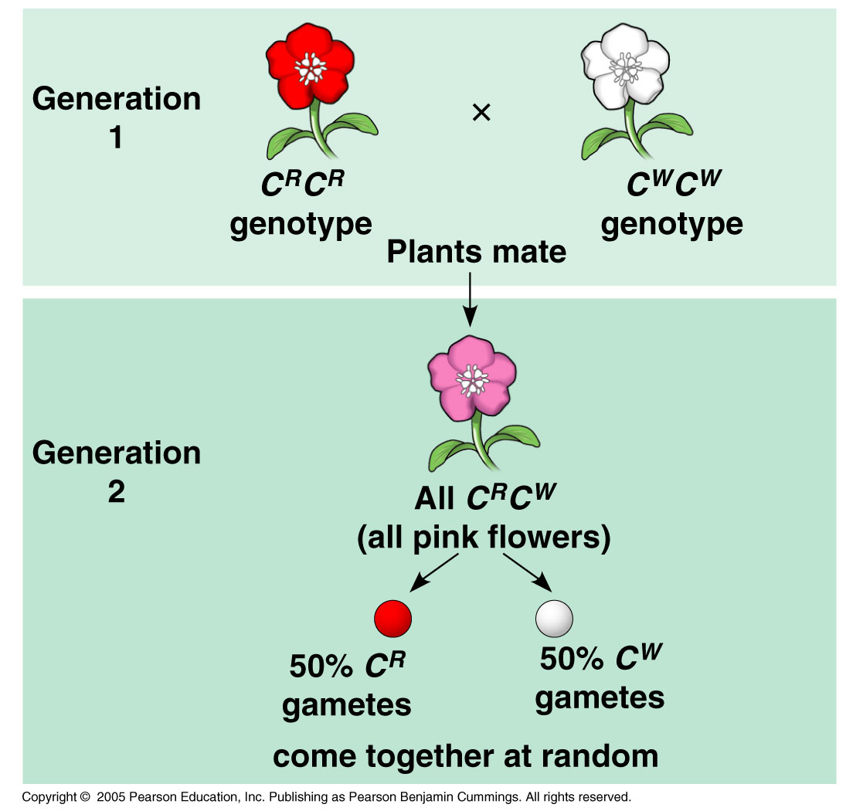
Allele Frequency
Consider a population of 500 with 2 alleles, C^{R} and C^{W}
C^{R}C^{R} gives Red
C^{W}C^{W} gives White
C^{R}C^{W} gives Pink

Slide 13
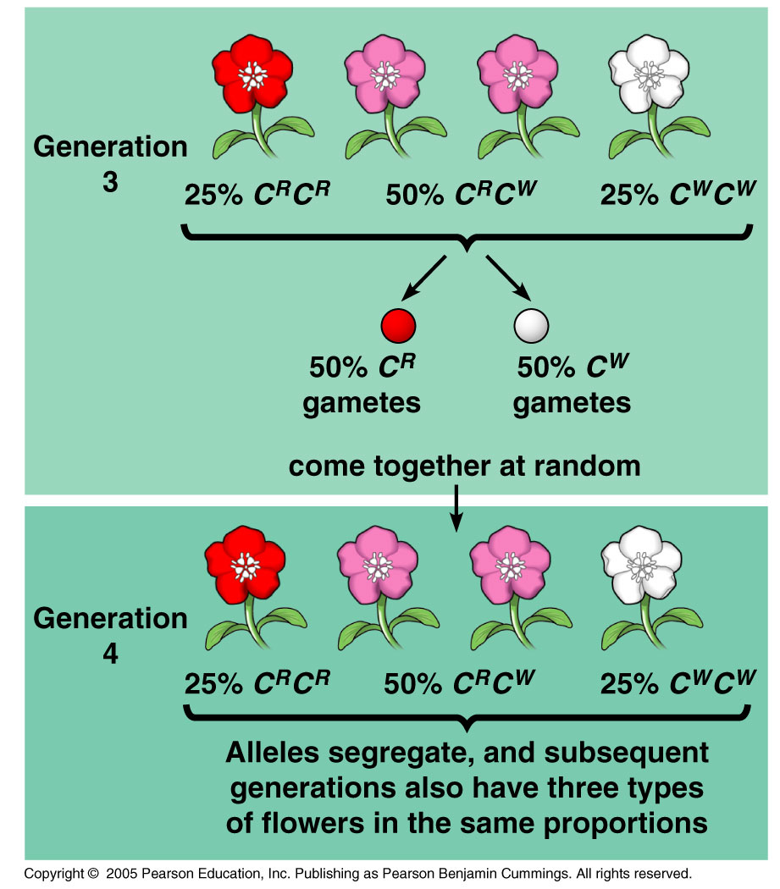
Allele Frequency
Our Population Breakdown:
  320 red, C^{R}C^{R}
  160 Pink, C^{R}C^{W}
  20 White, C^{W}C^{W}
These numbers suggest a blending hypothesis
Why can’t we use blending?

Slide 14
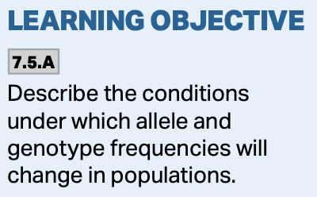
The Hardy-Weinberg Theorem
This theorem examines how allele frequencies change over time when only segregation and independent assortment are working on the alleles.
  It looks at the properties of a non-evolving gene pool—in the absence of natural selection.
  The theorem states that the frequencies of the alleles will remain constant in a population when it is not evolving.

Slide 15
The Hardy-Weinberg Theorem
It helps us to understand long-term evolutionary change—that is, how the preservation of genetic variation gives the opportunity for natural selection to occur.
There are 5 conditions that must be met in order for a population to be in H-W equilibrium.

Slide 16
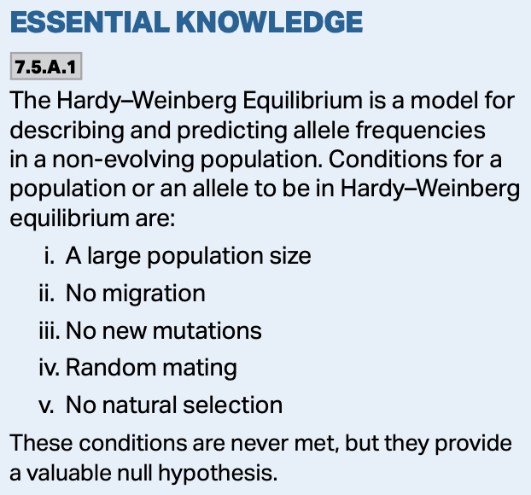
5 Reasons Hardy-Weinberg Doesn’t Hold True:
Departure from any/all of these 5 conditions results in evolution:
  1. Extremely large (infinite) population size.
  2. No gene flow.
  3. No mutations.
  4. Random mating.
  5. No natural selection.

Slide 17
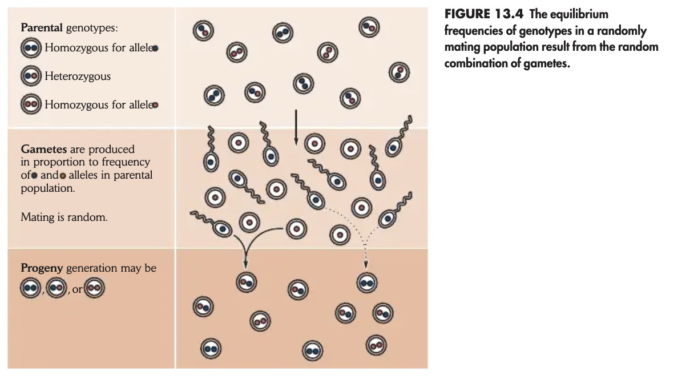
The Hardy-Weinberg Theorem
In other words, sexual reproduction alone will not change the frequency of the alleles in a non-evolving population.
https://www.academia.edu/15092278/Ricklefs_The_Economy_of_Nature_6th_txtbk

Slide 18
The Hardy-Weinberg Theorem
The allele frequencies and genotype frequencies will remain the same from generation to generation unless any or all of the five conditions are violated.
https://www.academia.edu/15092278/Ricklefs_The_Economy_of_Nature_6th_txtbk

Slide 19
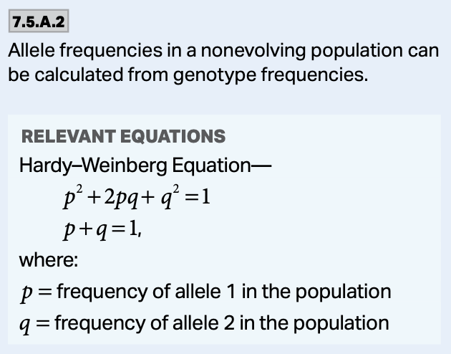
Hardy-Weinberg Frequency
In our population, there are 1000 copies of alleles (500 individuals, 2 copies each).
  800 of them are C^{R}
  200 of them are C^{W}
When we have 2 alleles, by convention we represent them as p and q.
  p = C^{R} = 800/1000 = 0.8 or 80%
  q = C^{W} = 200/1000 = 0.2 or 20%

Slide 20
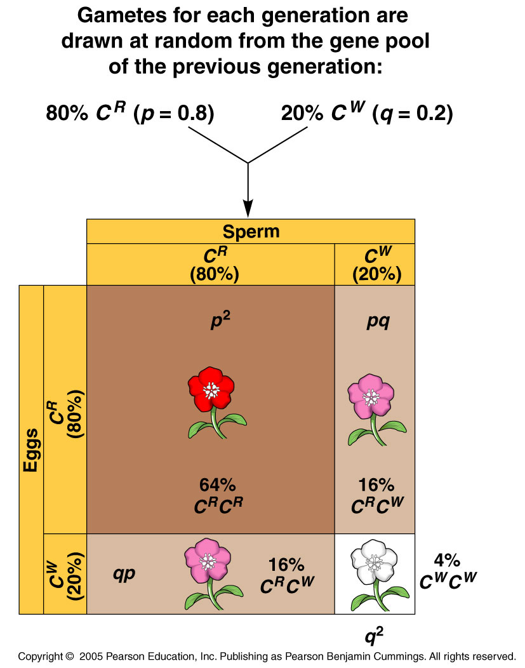
The Hardy-Weinberg Theorem
To determine the probabilities in our wild-flower example:
The chance of C^{R}C^{R} is:
  p • p = p² = 0.8 • 0.8 = 0.64 64%
The chance of C^{R}C^{W} is:
  p • q = 2pq = 0.8 • 0.2 = 0.32 32%
The chance of C^{W}C^{W} is:
  q • q = q² = 0.2 • 0.2 = 0.04 4%

Slide 21
The Hardy-Weinberg Equation
The Hardy-Weinberg Equation becomes: p² + 2pq +q² = 1
Again, with a non-evolving gene pool, the frequencies of alleles will remain constant if mating is random.
  You can think of it like a deck of cards, no matter how many times you shuffle them, the types of cards and the chances that you will receive them don’t change.

Slide 22
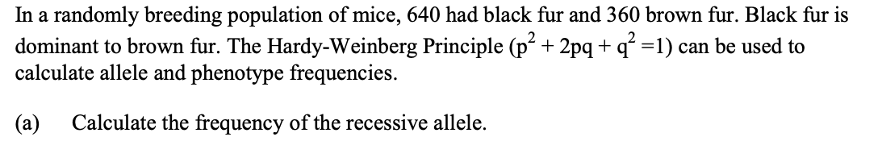


Slide 23
0.6 / 60%
Dominant allele is 0.4 / p2 represents the number / p2 = 0.16,
160
(ECF is okay)

Slide 24
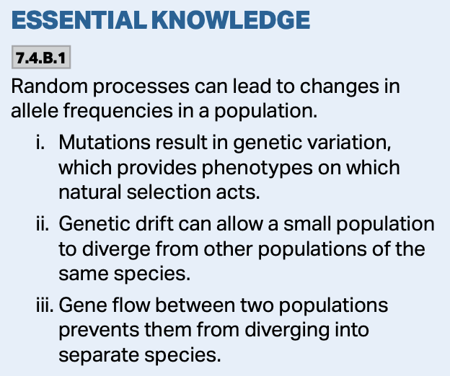
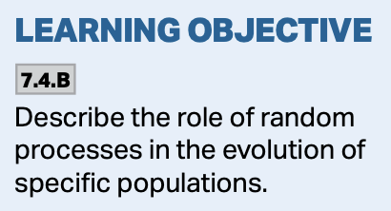
Changing Allele Frequencies
Allele frequencies can be altered, and this plays a role in evolution:
  1. Mutation
  2. Natural selection
  3. Gene flow
  4. Genetic drift

Slide 25
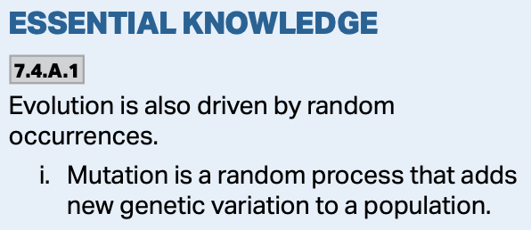
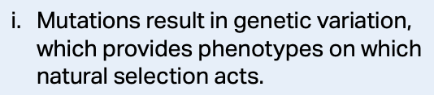
1. Mutation and Sexual Recombination
These provide variety within gene pools.
Mutations are changes in the nucleotide sequences that give rise to new genes and new alleles.
Most mutations occur in somatic cells and are never passed on.
Only a small percentage of gametes ever get into the populations, so any mutation occurring in the gametes likely won’t get passed on.

Slide 26
1. Mutation and Sexual Recombination
Mutation rates in general are low. Large organisms with long generation times have lower mutation rates.
  For example: Plants and animals with long generation times are relatively large and have a much lower frequency of mutations than do bacteria and viruses.

Slide 27
1. Mutation and Sexual Recombination
Sexual recombination is a major source of variation within a population from a generation-to-generation time scale.
https://www.slideteam.net/0714-genetic-recombination-medical-images-for-powerpoint.html

Slide 28
2. Natural Selection
When organisms have traits/adaptations that make them better suited for survival and reproduction, they are said to be more fit.
  Fitness is a measure of reproductive success.
Adaptations are characteristics that make an individual suited to its environment and way of life.
  The ability to adapt is genetically controlled.

Slide 29
2. Natural Selection
Death and survival changes the allele frequencies within a population.
Natural selection only occurs when there is variation among members of the same species.

Slide 30
2. Natural Selection
Species tend to produce more offspring than the environment can support.
Those individuals better adapted tend to survive and produce more offspring while those less well adapted tend to die and produce fewer offspring over time.

Slide 31
2. Natural Selection
Those individuals that have reproductive success pass the characteristics on to their offspring.

Slide 32
2. Natural Selection
Thus, natural selection will increase the frequency of those characteristics that make individuals better adapted while decreasing the frequency of other characteristics making them less well adapted—leading to changes within the species.

Slide 33
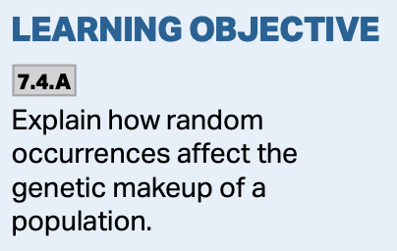
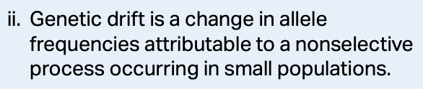
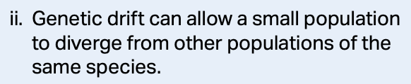
3. Genetic Drift
Genetic drift is the unexpected change in allele frequency and loss of genetic variation due to random changes in fecundity, mortality, and inheritance of genes.
https://www.youtube.com/watch/ALS7UO6F1Zs

Slide 34
3. Genetic Drift
There are two situations which increase the likelihood of genetic drift having a large impact on a population:
  A. The bottleneck effect
  B. The founder effect

Slide 35
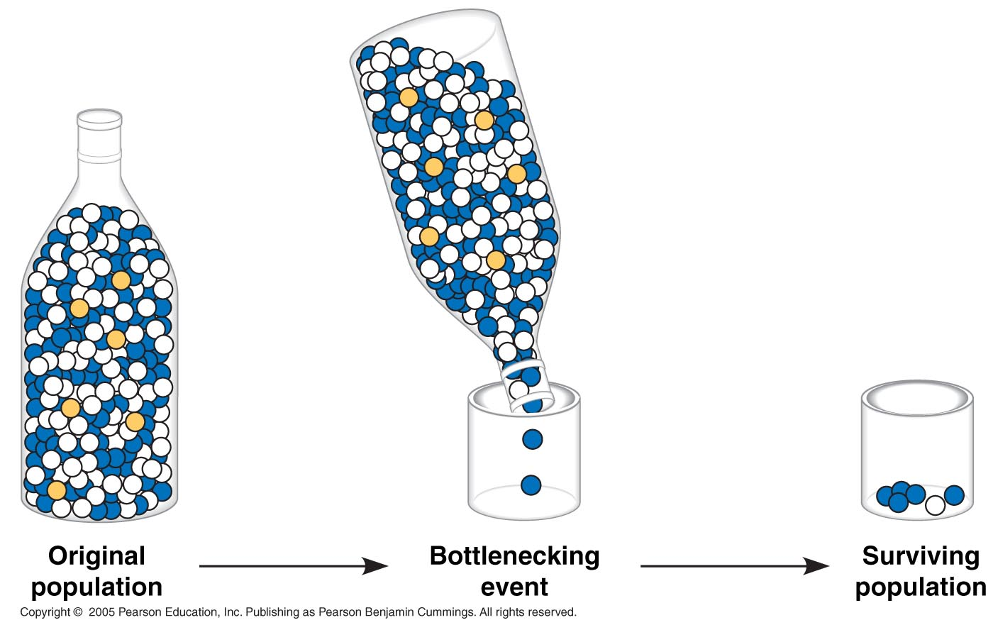
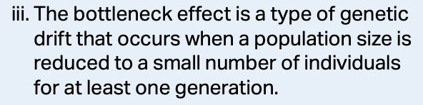
A. The Bottleneck Effect
The Bottleneck Effect describes a sudden change in the environment which drastically alters a population.
It can have a profound impact on the genetic makeup of the population.

Slide 36
A. The Bottleneck Effect
A bottleneck event can change the population in a way that the survivors no longer represent the diversity of the original population. It can occur when as few as 10 individuals survive the selection event.
The survivors are said to have gone through a “bottleneck.”

Slide 37
B. The Founder Effect
The Founder Effect occurs when a few organisms become isolated from a large population and establish a new population.
The new population’s gene pool is not reflective of the old population, we say a “founder event” has occurred.

Slide 38
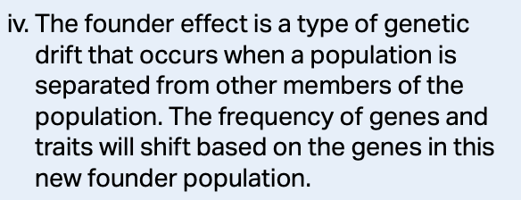
B. The Founder Effect
The founders of the new population pass through an isolation bottleneck.
The population’s gene pool has altered allele frequencies compared to the original population.

Slide 39
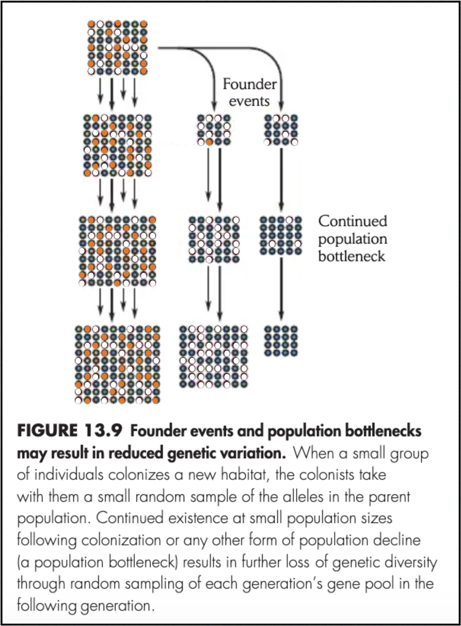
B. The Founder Effect
Founder events and population bottlenecks often result in reduced genetic variation.
https://www.academia.edu/15092278/Ricklefs_The_Economy_of_Nature_6th_txtbk

Slide 40
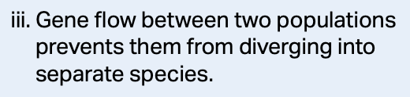
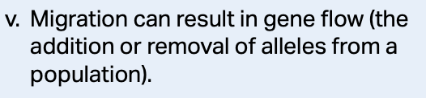
3. Gene Flow
Gene flow occurs when populations gain or lose alleles as organisms come and go within a population (migration).
Gene flow tends to reduce genetic differences between populations.
It can offset genetic changes that occur through mutation, drift, and selection.

Slide 41
Variation
Variation refers to heritable differences within a population, and it is the raw material upon which natural selection acts.
Only the genetic component of variation can have evolutionary consequences as a result of natural selection.

Slide 42
Variation
Variation within a population is described as either discrete or quantitative:
  Discrete characters-an either-or basis and is determined from a single locus.
  Quantitative characters-come from 2 or more loci that determine the phenotype.

Slide 43
Variation
Variation can arise from mutation, meiosis, and the process of sexual reproduction between individuals in a species.
This variation is what natural selection operates on.

Slide 44
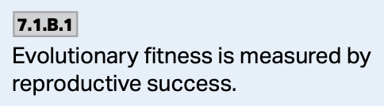
Fitness
Fitness is the adaptive advantage of an organism which allows it to make a genetic contribution to the gene pool of the next generation.
In other words, the reproductive success of an organism.

Slide 45
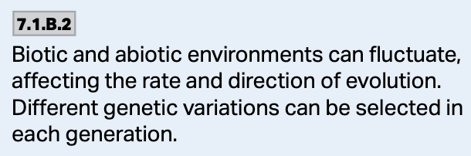
Biotic vs Abiotic
The biotic environment.
The abiotic environment.
The changing environment can have an impact on the variation that exists within a population.

Slide 46
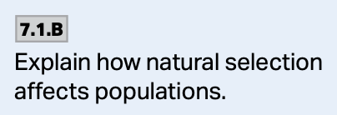
Modes of Selection
Natural selection alters the frequency distribution of heritable traits within a population in three ways:
  1. Directional selection.
  2. Disruptive selection.
  3. Stabilizing selection.

Slide 47
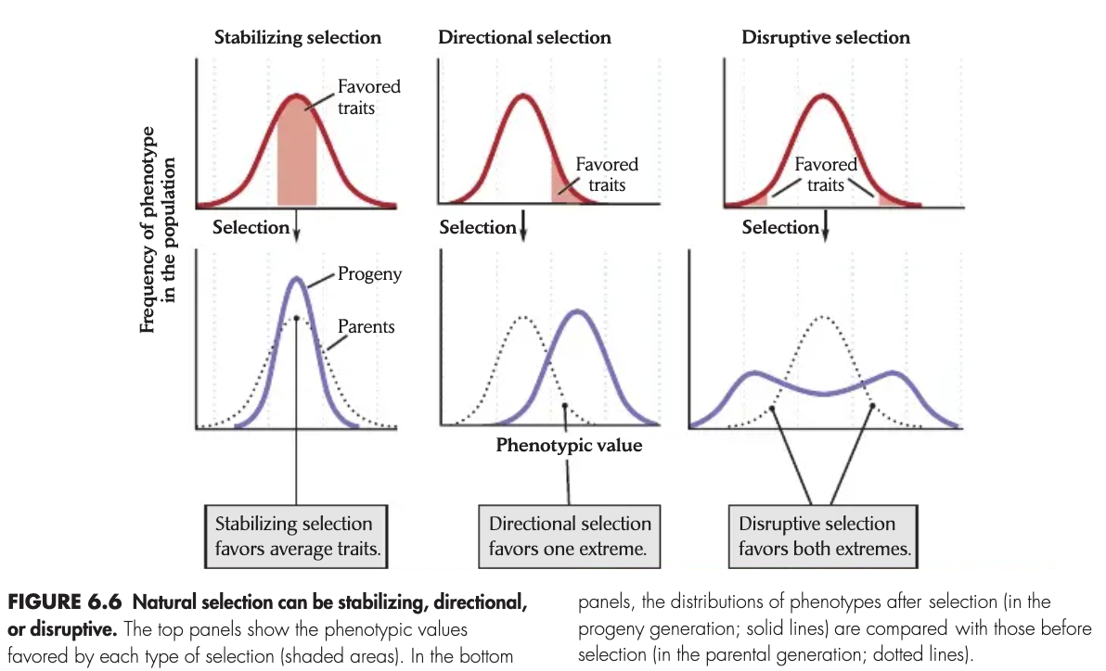
Directional Selection
This is most common when a population’s environment changes or when members of a population migrate to a new habitat with different environmental conditions.
https://www.academia.edu/15092278/Ricklefs_The_Economy_of_Nature_6th_txtbk

Slide 48
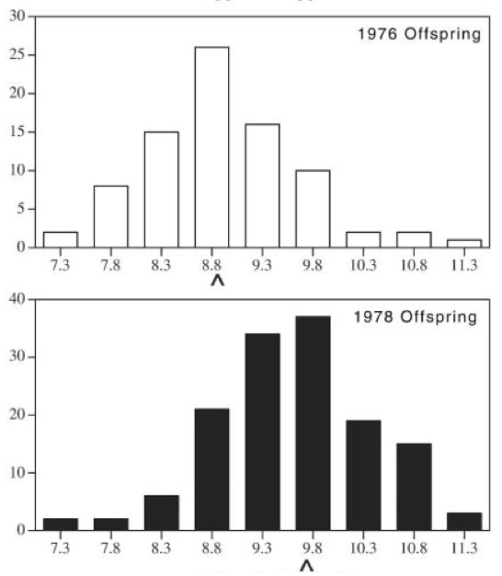
Directional Selection
This is most common when a population’s environment changes or when members of a population migrate to a new habitat with different environmental conditions.
https://www.biointeractive.org/sites/default/files/iow-dp-Finch_Offspring_Image.jpg

Slide 49
Disruptive Selection
This occurs when conditions favor individuals in both extremes over those of normal average phenotypes. It can be important in the early stages of speciation.
https://www.academia.edu/15092278/Ricklefs_The_Economy_of_Nature_6th_txtbk

Slide 50
Stabilizing Selection
Acts against extreme phenotypes, it favors the intermediates. It reduces variation and maintains the status quo of a given phenotype.
https://www.academia.edu/15092278/Ricklefs_The_Economy_of_Nature_6th_txtbk

Slide 51
Selection, In General
Regardless of the mode of selection, selection works to favor certain heritable traits through differential success.

