Slide 1
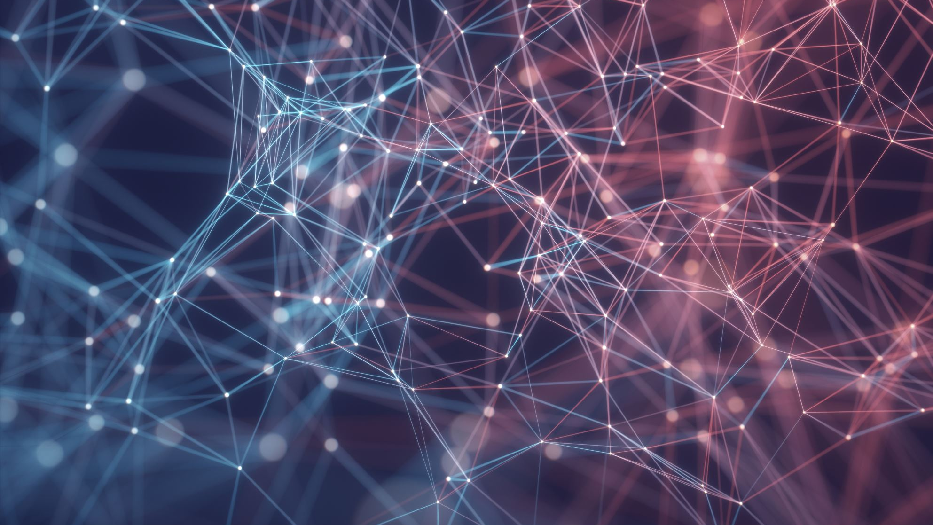
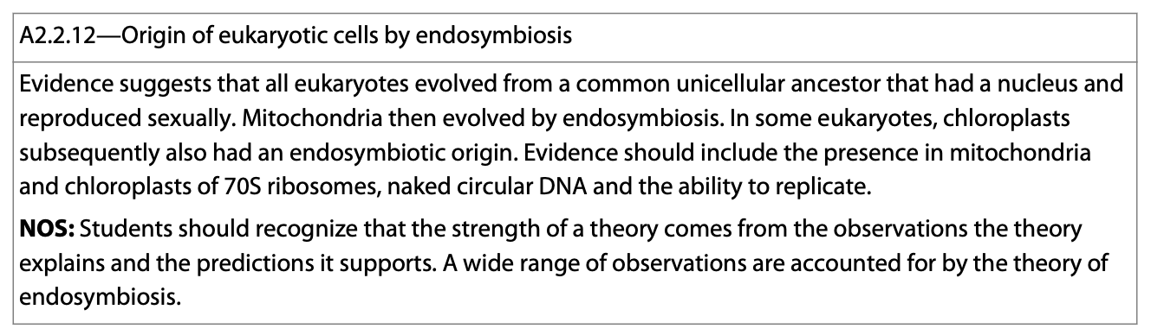
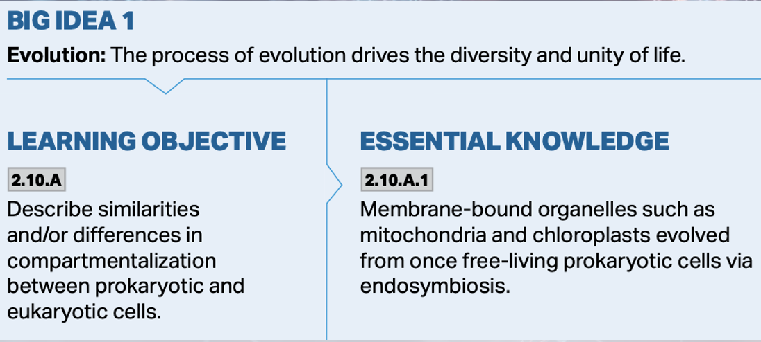
Endosymbiotic Theory

Slide 2
Symbiosis
Symbiosis is predicated on two main concepts in biology:
  1. The most fundamental division in the living world is between prokaryotes and eukaryotes.
https://sites.google.com/site/laurelbiology/cells/prokaryotes-vs-eukaryotes

Slide 3
Symbiosis
  2. Some parts of eukaryotic cells resulted directly from the formation of permanent associations between organisms of different species.
    Cilia
    Mitochondria
    Photosynthetic plastids
  All of these organisms were once free-living bacteria and were all acquired symbiotically by different species of bacteria.
https://bodell.mtchs.org/OnlineBio/BIOCD/text/chapter17/17images/17-18.gif

Slide 4
Requirement for Symbiosis
The symbiotic relationship must be strong.
The integrated symbionts must have an advantage over the free-living alternative.
Traits present in the relationship must be lacking in each of the individuals entering the symbiosis.
  For example: Bacteria-plant symbiosis—neither can fix nitrogen on its own.

Slide 5
Requirement for Symbiosis
Any symbiont that originated as a free-living microbe must have had all of the minimal requirements for living on its own.
  DNA synthesis
  Nucleotide-coded triplet protein synthesis
  mRNA synthesis
  Membrane synthesis
  Food degradation for energy.

Slide 6
Requirement for Symbiosis
If an organelle originated as a free-living microbe, its nucleic acid must exist somewhere in the host cell at every stage of the host’s life cycle.
The growth rate of both symbionts must be about equal.
Redundancy of traits is lost.
Endosymbionts must contain at least one copy of the endosymbiont genome; often many copies are passed along.
https://bodell.mtchs.org/OnlineBio/BIOCD/text/chapter17/17images/17-18.gif

Slide 7
Requirement for Endosymbiosis
Evolution often obscures the identity of the original partners in a symbiosis.
Symbioses can form and then later dissolve.
  The stability of the symbiosis is a function of time, and the intensity of the selective pressure.

Slide 8
Mitochondrial Origin
Mitochondria developed efficient, oxygen-respiring capabilities while they were still free-living bacteria.
They developed the ability to exist in an environment where oxygen was accumulating.
https://cdn.kastatic.org/ka-perseus-images/60525a4db267bd0681f00c2a9f78b7ad40ed1acb.png

Slide 9
Plastid Origin
Plastids derived from independent, photosynthetic bacteria after the formation of mitochondria.
https://cdn.kastatic.org/ka-perseus-images/60525a4db267bd0681f00c2a9f78b7ad40ed1acb.png

Slide 10
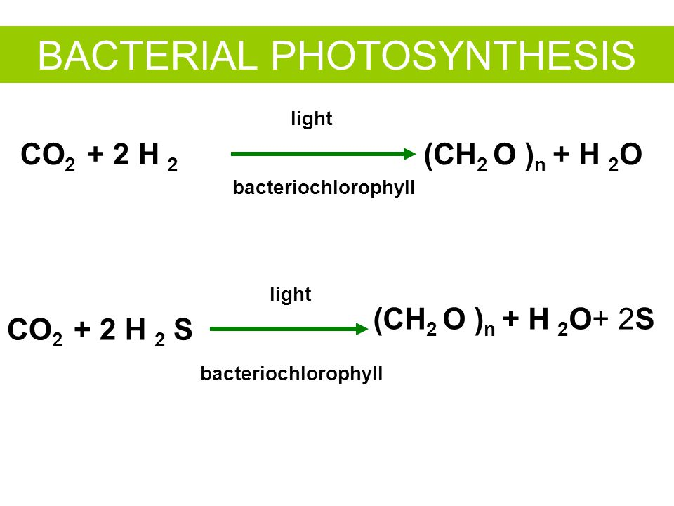
Photosynthesis
Photosynthesis evolved first in anaerobic bacteria in the absence of molecular oxygen very early in the history of life.
The type of photosynthesis that releases gaseous oxygen evolved later.
Oxygen respiring organisms evolved after photosynthetically produced oxygen was available to them.
https://slideplayer.com/slide/3376521/12/images/76/BACTERIAL+PHOTOSYNTHESIS.jpg

Slide 11
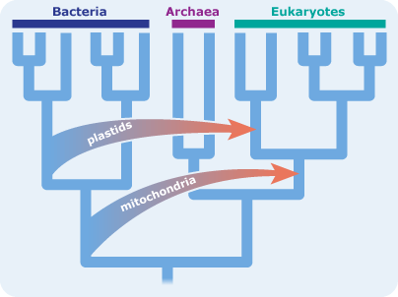
Serial Endosymbiosis
The likely order of evolution of these organelles is believed to be:
  Oxygen respiration
  Eukaryotic photosynthesis
https://undsci.berkeley.edu/cells-within-cells-an-extraordinary-claim-with-extraordinary-evidence/

Slide 12
The First Eukaryotes
The nucleocytoplasmic part (nucleus and cytoplasm together) of cells evolved independently of the organelles and was the first thing to form.
  It’s the largest and least specialized entity.
  The ancestors of this organelle could withstand high temperatures and acidic conditions.
  A special class of proteins (histones) evolved to protect the DNA.
https://i.ytimg.com/vi/DcDhL95PaRU/maxresdefault.jpg
https://our.oasis.unc.edu/public_html/hhmi/hhmi-ft_learning_modules/2011/proteinsmodule/images/dnacondensing.jpg

Slide 13
The First Eukaryotes
The integration of all these features led to the first eukaryotes—new organisms with a greater level of complexity.
  The first eukaryote was anaerobic, heterotrophic, and fed on pre-formed organic molecules.
https://image.slidesharecdn.com/18-1222112645058708-9/95/18-116-728.jpg?cb=1222303583

Slide 14
The First Eukaryotes
Eukaryotes were derived from symbioses between extremely different kinds of prokaryotes.
  Nucleocytoplasm from a thermoacidophilic Archaea.
  Then mitochondria from aerobic respiring eubacteria.
  Followed by plastids from cyanobacteria.

Slide 15
Early Eukaryotes
Early eukaryotes:
  They were wall-less microbes
  They could ferment organic molecules into 3-carbon compounds by glycolysis.
  Archaebacteria are believed to have become the nucleocytoplasm-the skeletons for the eukaryotic cells.
  Were microaerophilic—could tolerate the less than 20% O₂ concentration of the atmosphere.

Slide 16
Steps to Becoming Eukaryotic
Step 1: Symbiotic acquisition of motility. In other words, the organism could move.
  Increased swimming rates.
  These motility systems were likely arrays of proteins in the 9 x 2 arrangement characteristic of today’s cilia and flagella.
  The spirochetes formed symbioses that gave rise motility and the mitotic apparatus.

Slide 17
Steps to Becoming Eukaryotic
Step 2: acquisition of mitochondria.
  The primitive eukaryotic cells then acquired the respiring bacteria that would become mitochondria.
  The protomitochondria were O₂-respiring, rod-shaped organisms related to purple bacteria.
  They oxidized fermentation products completely to CO₂ and H₂O.

Slide 18
Steps to Becoming Eukaryotic
The association likely began through predation of smaller bacteria.
Reproduction of these symbionts inside the nucleocytoplasm led to selection against their cell wall, and against duplicate pathways—the elimination of redundancy.

Slide 19
Steps to Becoming Eukaryotic
Early in the symbiotic relationship, protomitochondria increased the surface area of their membranes for redox reactions.
Natural selection led to the differentiation of cristae.
This culminated in the formation of a more modern looking mitochondrion.
The predatory cell became more tolerant of the increasing amount of oxygen in the atmosphere.

Slide 20
The Earliest Autotrophs
The earliest autotrophs were likely anaerobic methanogens.
  They could use atmospheric CO₂ and H₂.
  They differed from other bacteria in their rRNA.
  They cannot tolerate atmospheric O₂.
  They were bacterial cells, not eukaryotes.
https://image2.slideserve.com/5166805/autotrophic-evolution-evolved-very-early-in-prokaryotic-history-l.jpg

Slide 21
The Evolution of Photosynthesis
Photosynthesis evolved in early prokaryotes.
  These chemosynthetic bacteria used H₂, H₂S, and/or small organic compounds as reducing agents.
  They absorbed sunlight with bacterial chlorophyll.
  They converted CO₂ into organic compounds.
  No oxygen gas (O₂) was created by these early organisms.
https://images.slideplayer.com/29/9441542/slides/slide_4.jpg

Slide 22
The Evolution of Photosynthesis
Their descendants are still found in anaerobic environments.
  2H₂X + CO₂ →(light)→ CH₂O + 2X + H₂O
Descendants of these bacteria were photosynthetic and produced O₂ as a waste product.
  2H₂O + CO₂ →(light)→ CH₂O + O₂ + H₂O
They arose as a result of mutations in photosynthetic sulfur bacteria.
These were cyanobacteria.
https://slideplayer.com/slide/4659518/15/images/18/Bloom+of+Purple+Sulfur+Bacteria%2C+Sulfide+Spring%2C+Madison%2C+WI.jpg
https://scitechdaily.com/images/dye-based-nanotubes-can-help-harvest-light%E2%80%99s-energy.jpg

Slide 23
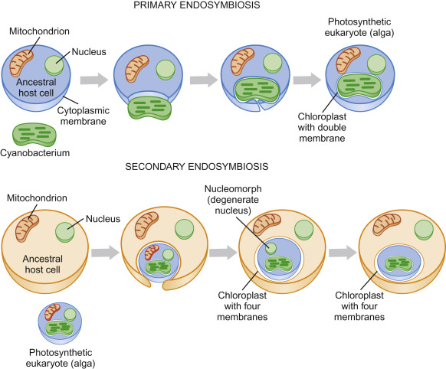
Cyanobacteria
The cyanobacteria are believed to have given rise to plastids of algae and plant cells.
O₂ tolerance is believed to have evolved first in photosynthetic organisms.
These organisms were able to tolerate and then use O₂ because they had mitochondria.
https://ars.els-cdn.com/content/image/3-s2.0-B9780123785947000263-f26-23-9780123785947.jpg

Slide 24
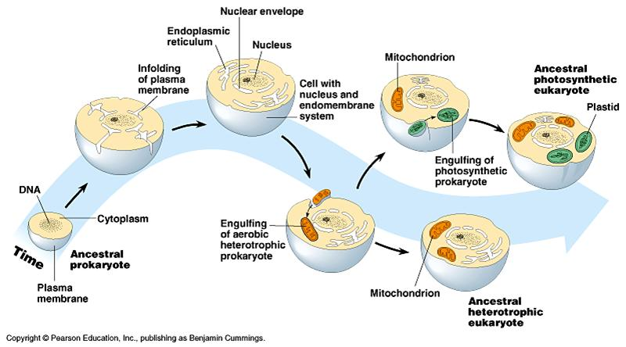
Eukaryotic Cells
As natural selection optimized the process of mitosis and meiosis, various kinds of photosynthetic prokaryotes became associated with more than one kind of heterotrophic protist.
These microbial photosynthesizers were ingested, but not digested.
The vast majority of eukaryotes evolved directly from heterotrophic microbes that never acquired photosynthesis.
https://schoolworkhelper.net/endosymbiosis-evidence-evolution/

Slide 25
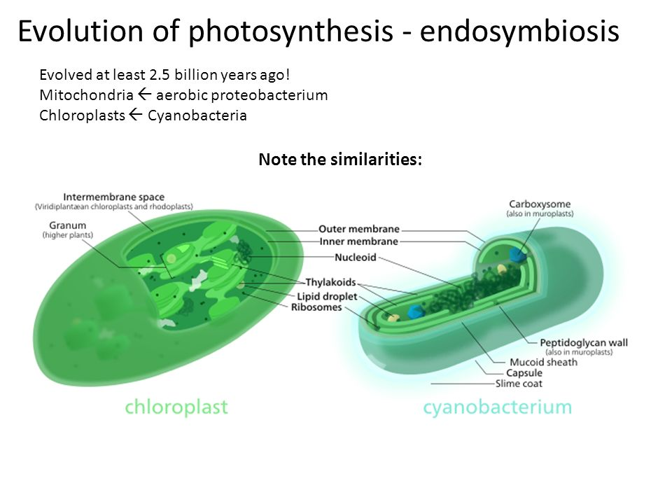
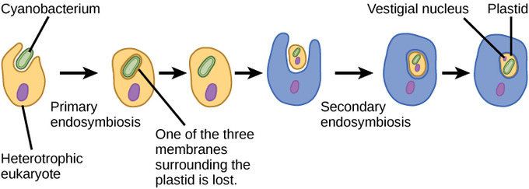
Secondary Endosymbiosis
Secondary endosymbiosis is just another form of endosymbiosis.
It occurs after the original endosymbiotic event and produces organelles like chloroplasts that have a double outer membrane.
https://images.slideplayer.com/27/9022854/slides/slide_7.jpg
https://bio.libretexts.org/Bookshelves/Introductory_and_General_Biology/Book%3A_General_Biology_(Boundless)/23%3A_Protists/23.01%3A_Eukaryotic_Origins/23.1E%3A_The_Evolution_of_Plastids

