Slide 1
Chapter 44
Osmoregulation and Excretion
Guiding Questions: How are constant internal conditions maintained in humans?
What are the benefits to organisms of maintaining constant internal conditions?

Slide 2
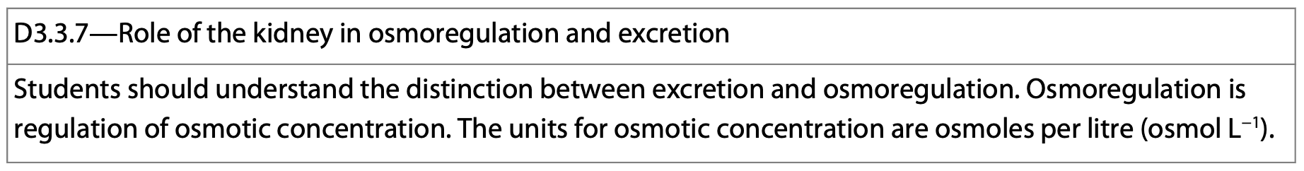
Osmoregulation & Excretion
Osmoregulation is the process by which animals regulate solute concentrations and balance the gain and loss of water.
Excretion is how animals get rid of nitrogen containing waste products.

Slide 3
Some Important Terms
Isoosmotic-a situation where there is no net flow of water in or out of a cell.
Hypoosmotic-solutions are more dilute and contain more water.
Hyperosmotic-solutions have a large concentration of solutes.

Slide 4
Osmoregulation
Osmoregulation requires the expenditure energy to conform to their surroundings.
Typically, about 5% of resting metabolic energy is used for osmoregulation.
Some animals use up to 30% in very salty environments.

Slide 5
Osmoregulation
The ultimate goal of osmoregulation is to maintain the composition of cellular cytoplasm.
Most animals do this by maintaining and managing the internal body fluid.

Slide 6
Specialized Epithelium
Impermeable tight junctions join these cells.
Most animals have specialized transport epithelia joined into extensive tubular networks.
These networks have extensive surface area and work to move solutes in controlled amounts in specific directions.
They are connected to the outside of the body by an opening.

Slide 7
Waste Elimination
Most of the metabolic wastes produced by an animal get dissolved in water before they are eliminated.
They also get converted to something less toxic at a metabolic cost.
Products of protein breakdown are the most important items which need to be eliminated.

Slide 8
Waste Elimination
NH₃ is the most toxic, and very soluble in water.
As a result of nitrogen metabolism, animals need lots of water.

Slide 9
Waste Elimination
To get around the toxicity of ammonia and the lack of copious amounts of water, terrestrial animals convert nitrogenous waste products to urea.
Urea is less toxic than ammonia.
Less water is needed to move higher concentrations.
NH₃ + CO₂ —> CO(NH₂)₂ (urea)

Slide 10
Waste Elimination
The circulatory system carries the waste to the kidneys where it is excreted.
The main disadvantage is that it requires a lot of metabolic energy to convert ammonia to urea.

Slide 11
Physiological Adaptations
There are a variety of excretory systems that produce urine and they all involve several steps:
1. Body fluid is collected
2. Filtration through a selectively permeable membrane.
3. Formation of filtrate.
4. Selective reabsorption of resources: sugars, amino acids.
5. Nonessential solutes are left in the fluid.

Slide 12
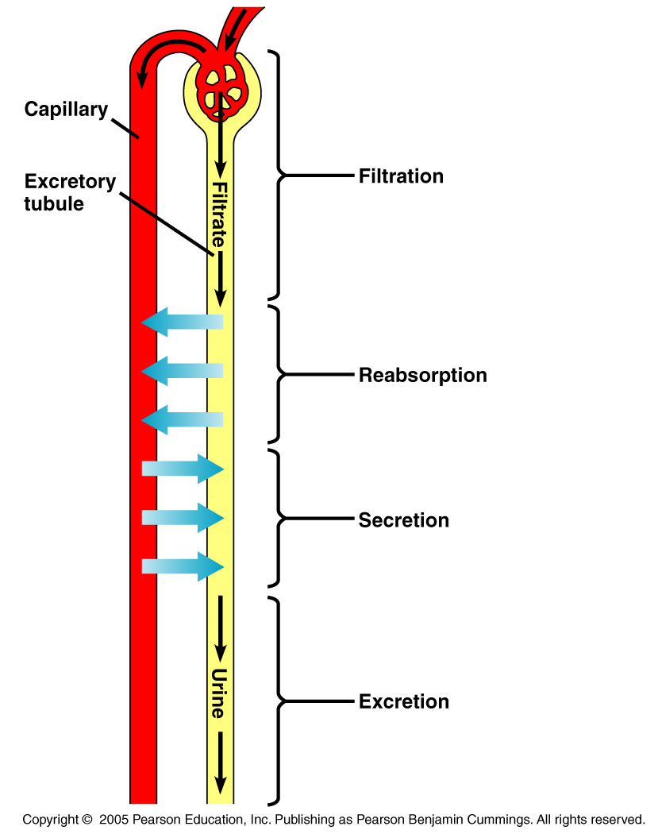
Excretory Systems
Excretory systems are all built using the same basic functions:
A network of tubules provide a large surface area for the exchange of water, solutes, and wastes.

Slide 13
Vertebrate Kidneys
Vertebrate kidneys function in osmoregulation and excretion.
They contain numerous tubules arranged in a highly organized manner.
A dense network of capillaries is also associated with the ducts and tubules that carry urine out of the kidney-and the body.

Slide 14
Kidney
The renal artery supplies the kidney with blood; the renal vein drains it.
The composition of blood in the renal artery is different from that of the renal vein.
Urine exits the kidney through the ureter.
These drain to the urinary bladder.
The urine exits through the urethra.
http://www.ivy-rose.co.uk/Topics/Urinary/UrinarySystem_cIvyRose.jpg

Slide 15
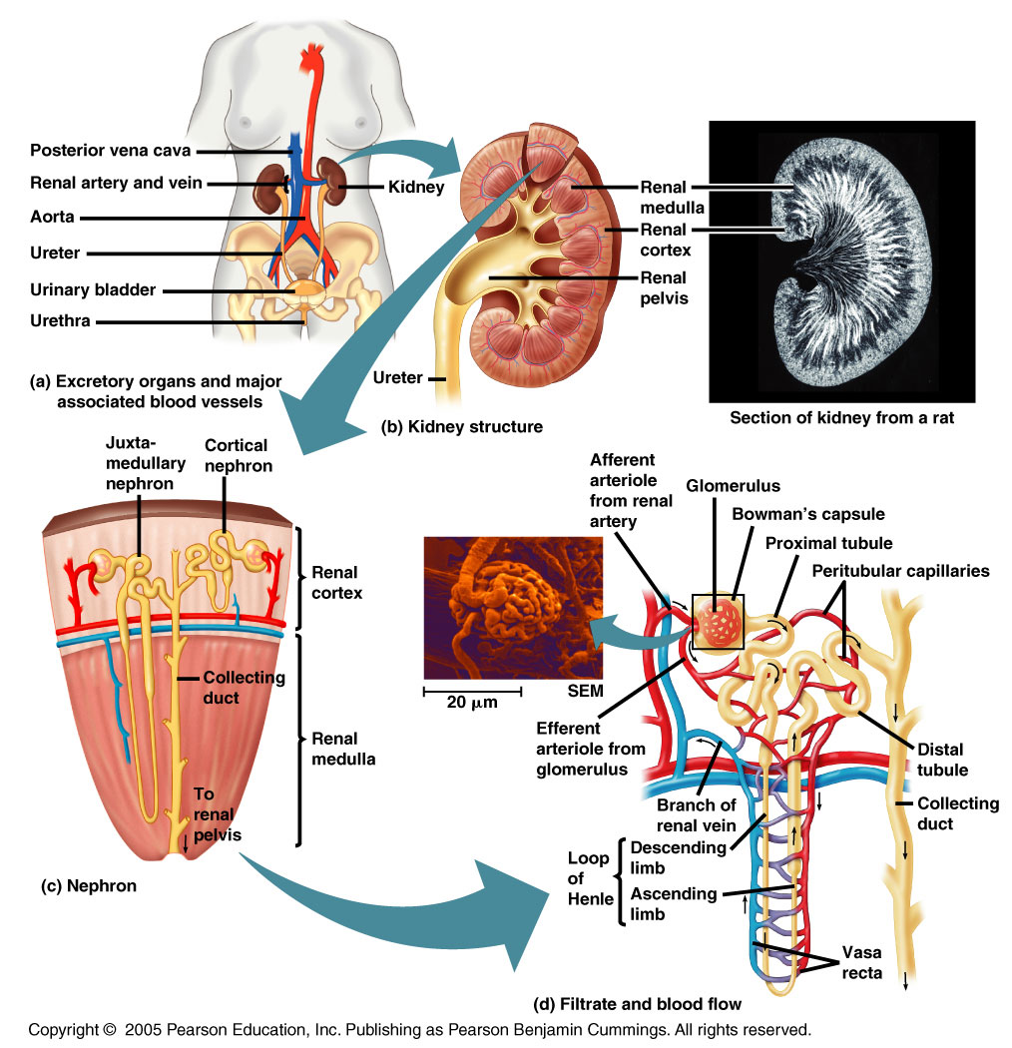
travismulthaupt.com

Slide 16
Mammalian Kidney
It is broken into two parts:
1. The inner medulla
2. The outer cortex
Both regions are packed with excretory tubules and blood vessels.
http://www.ivy-rose.co.uk/

Slide 17
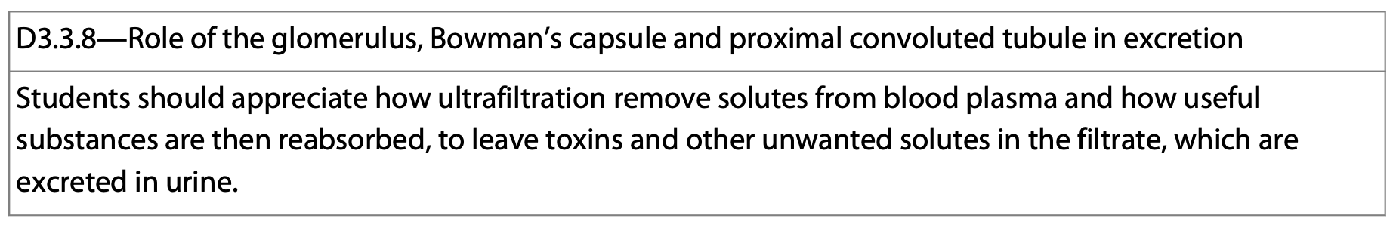
Mammalian Kidney
The nephron is the functional unit.
One end contains a ball of capillaries called the glomerulus.
The blind end of the tubule is a cup-shaped swelling called Bowman’s capsule which surrounds the glomerulus.
http://courses.washington.edu/hubio562/diabeticNephropathy/normalGlom.html
http://www.lab.anhb.uwa.edu.au/mb140/CorePages/Urinary/Images/kidneydiagram.jpg

Slide 18
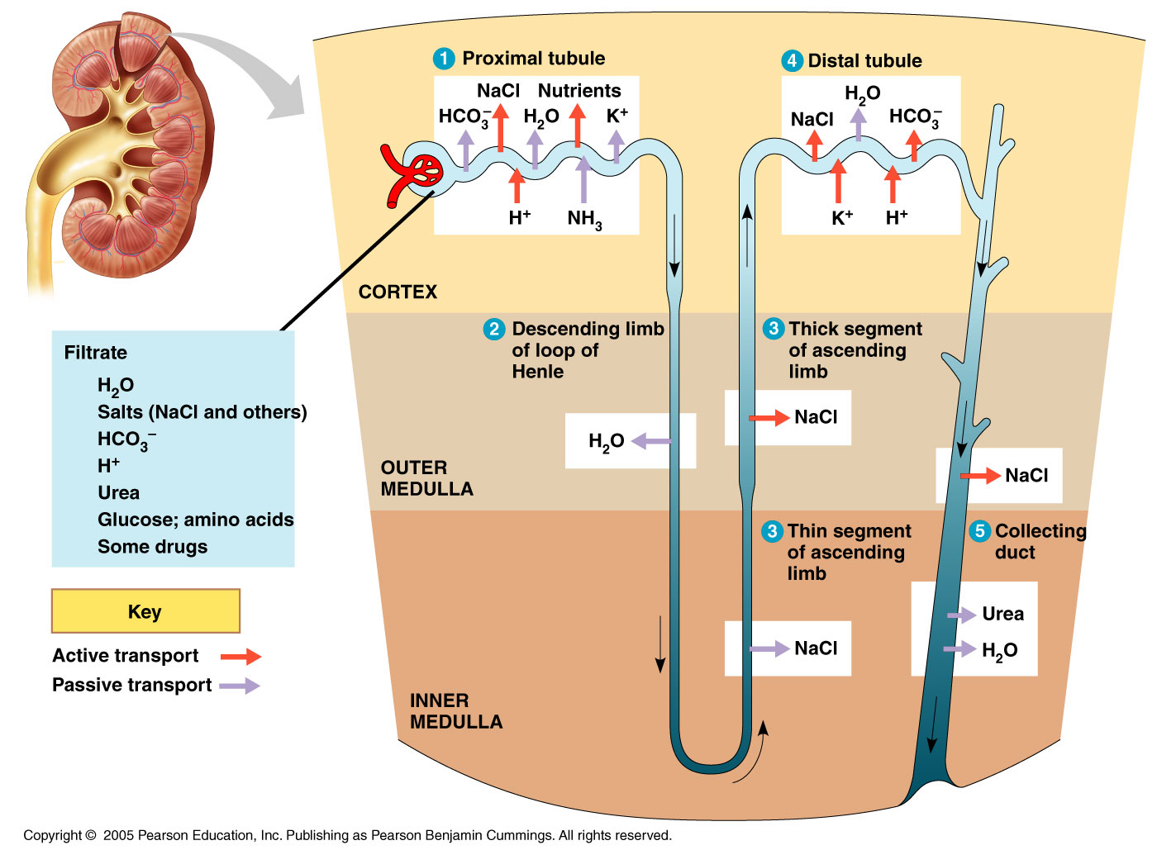
travismulthaupt.com

Slide 19
https://basicmedicalkey.com/diuretic-agents/
travismulthaupt.com

Slide 20
Mammalian Kidney
Filtration occurs as blood pressure forces fluid from the blood in the glomerulus into the lumen of Bowman’s capsule.
The porous capillaries along with podocytes are permeable to water and small solutes.
Larger molecules cannot pass through.
http://www.liv.ac.uk/~petesmif/teaching/1bds_mb/notes/kidney/images/prox.gif
http://www.uni-ulm.de/elektronenmikroskopie/GLOMERULUS.jpg

Slide 21
Mammalian Kidney
The filtrate contains salts, glucose, amino acids, vitamins, nitrogenous wastes.
After filtration in Bowman’s capsule, the filtrate passes through 3 regions of the nephron:
1. The proximal tubules
2. The loop of Henle
3. The distal tubule
http://www.lab.anhb.uwa.edu.au/mb140/CorePages/Urinary/Images/kidneydiagram.jpg

Slide 22
Mammalian Kidney
1. The proximal tubule is the first part of the tubule that leaves Bowman’s capsule.
The proximal convoluted tubule selectively reabsorbs useful substances by active transport.
http://www.lab.anhb.uwa.edu.au/mb140/CorePages/Urinary/Images/kidneydiagram.jpg

Slide 23
Mammalian Kidney
2. The loop of Henle consists of the descending limb, a sharp hairpin turn, and the ascending limb.
The length of the loop of Henle is positively correlated with the need for water conservation in animals.
The drier the environment, the longer the loop of Henle.
http://www.lab.anhb.uwa.edu.au/mb140/CorePages/Urinary/Images/kidneydiagram.jpg

Slide 24
Mammalian Kidney
3. The distal tubule empties into the collecting duct. The collecting duct flows into the renal pelvis and gets drained by the ureter.
http://www.lab.anhb.uwa.edu.au/mb140/CorePages/Urinary/Images/kidneydiagram.jpg

Slide 25
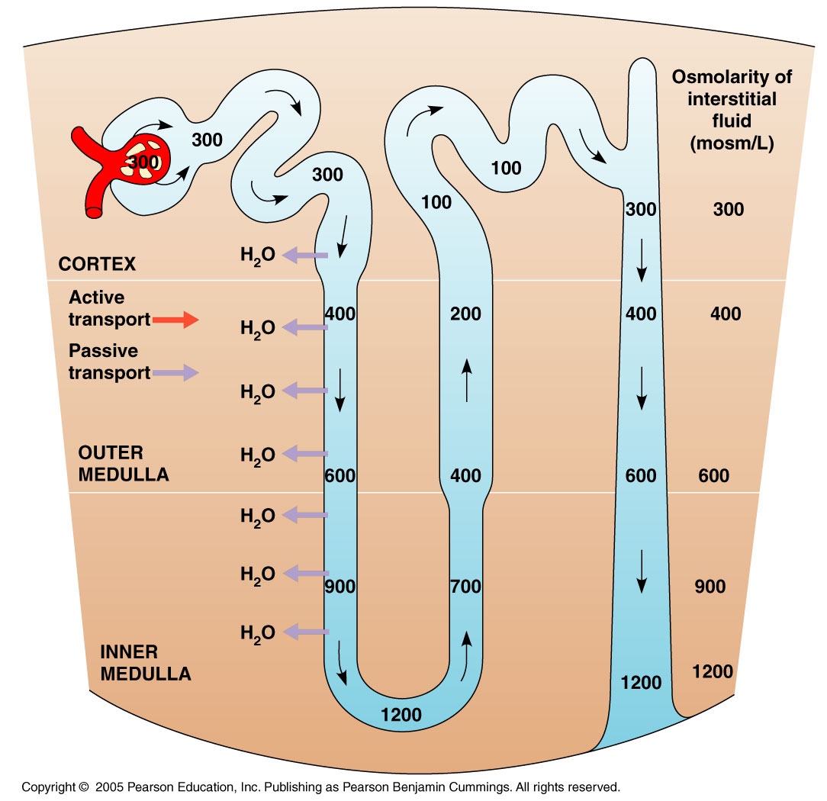
travismulthaupt.com

Slide 26
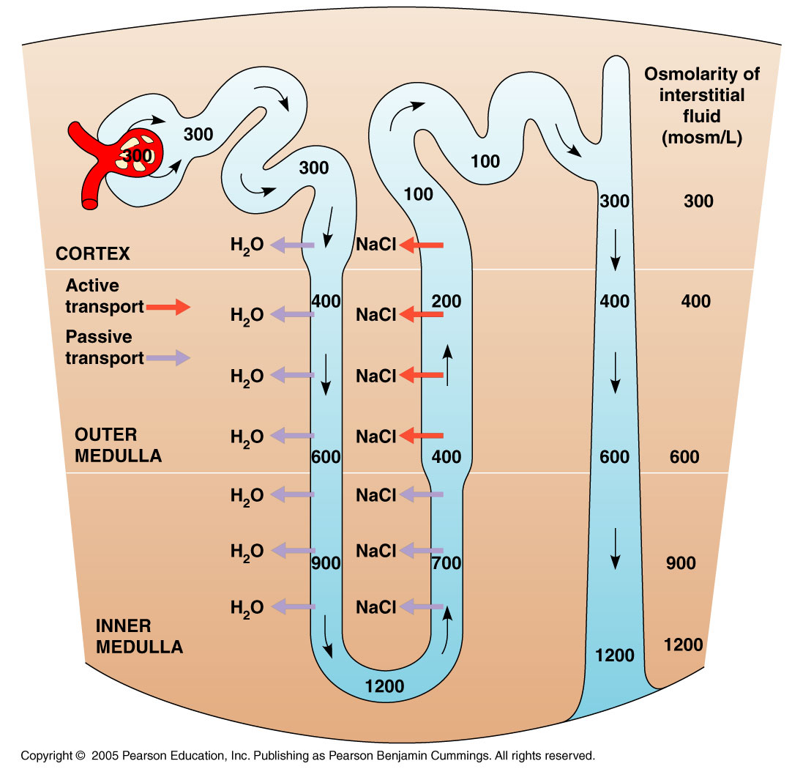
travismulthaupt.com

Slide 27
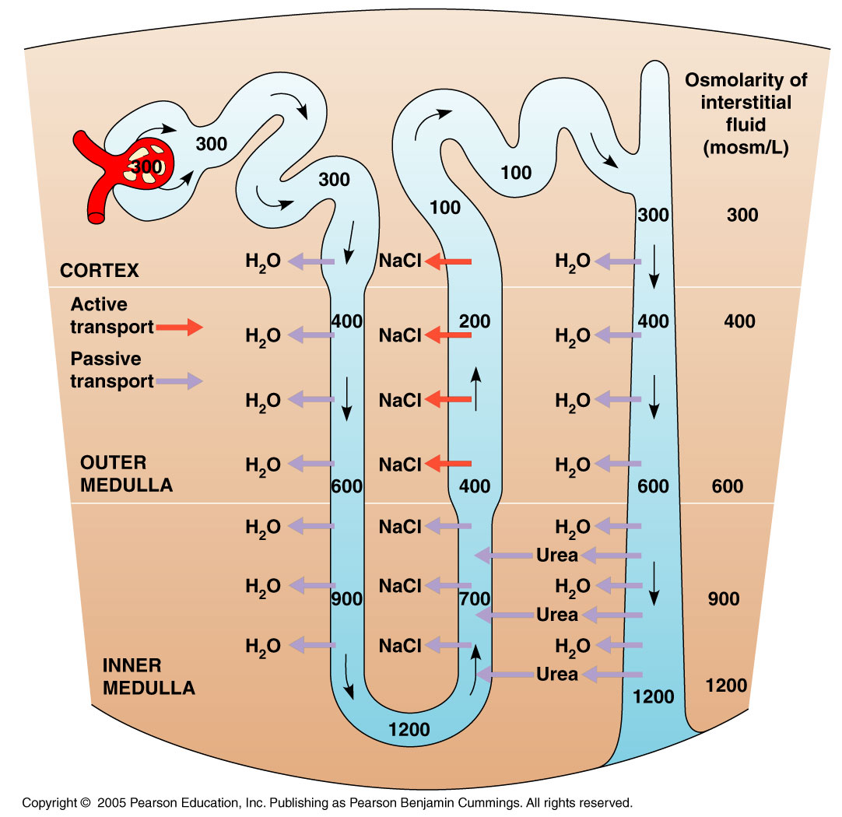
travismulthaupt.com

Slide 28
Mammalian Kidney
There are two main types of nephrons:
1. Cortical nephrons
80% of the nephrons. Have reduced loops of Henle and are confined to the renal cortex.

Slide 29
Mammalian Kidney
2. Juxtamedullary nephrons
The remaining 20% of nephrons. Have well developed loops of Henle.
Only mammals and birds have juxtamedullary nephrons.
These nephrons are important because they enable the production of hyperosmotic urine.
They are urine concentrating organs. They are key adaptations. They get rid of waste, and not much water.

Slide 30
Mammalian Kidney
The nephron is lined with transport epithelium that processes filtrate and forms urine.
The epithelium has an important task: Reabsorption of dissolved solutes and water.
http://www.astrographics.com/GalleryPrints/Display/GP2079.jpg

Slide 31
Mammalian Kidney
About 1100-2000L of blood flow through the kidneys each day.
About 180L of filtrate is formed, and from this 99%+ of all dissolved sugars, vitamins, organic nutrients, and water are reabsorbed.
Only about 1.5L becomes urine.

Slide 32
Mammalian Kidney
Obviously the blood that goes into the kidney (supplied by the renal artery) is different from the blood that comes out (renal vein).

Slide 33
Mammalian Kidney
Bowman’s capsule is what does the filtering of the blood.
The ultrastructure is what’s important for forming the ultrafiltrate.

Slide 34
https://mmegias.webs.uvigo.es/02-english/8-tipos-celulares/podocito.php

Slide 35
https://mmegias.webs.uvigo.es/02-english/8-tipos-celulares/podocito.php

Slide 36
https://de.wikipedia.org/wiki/Datei:Glomerulum_of_mouse_kidney_in_Scanning_Electron_Microscope,_magnification_5,000x.GIF

Slide 37
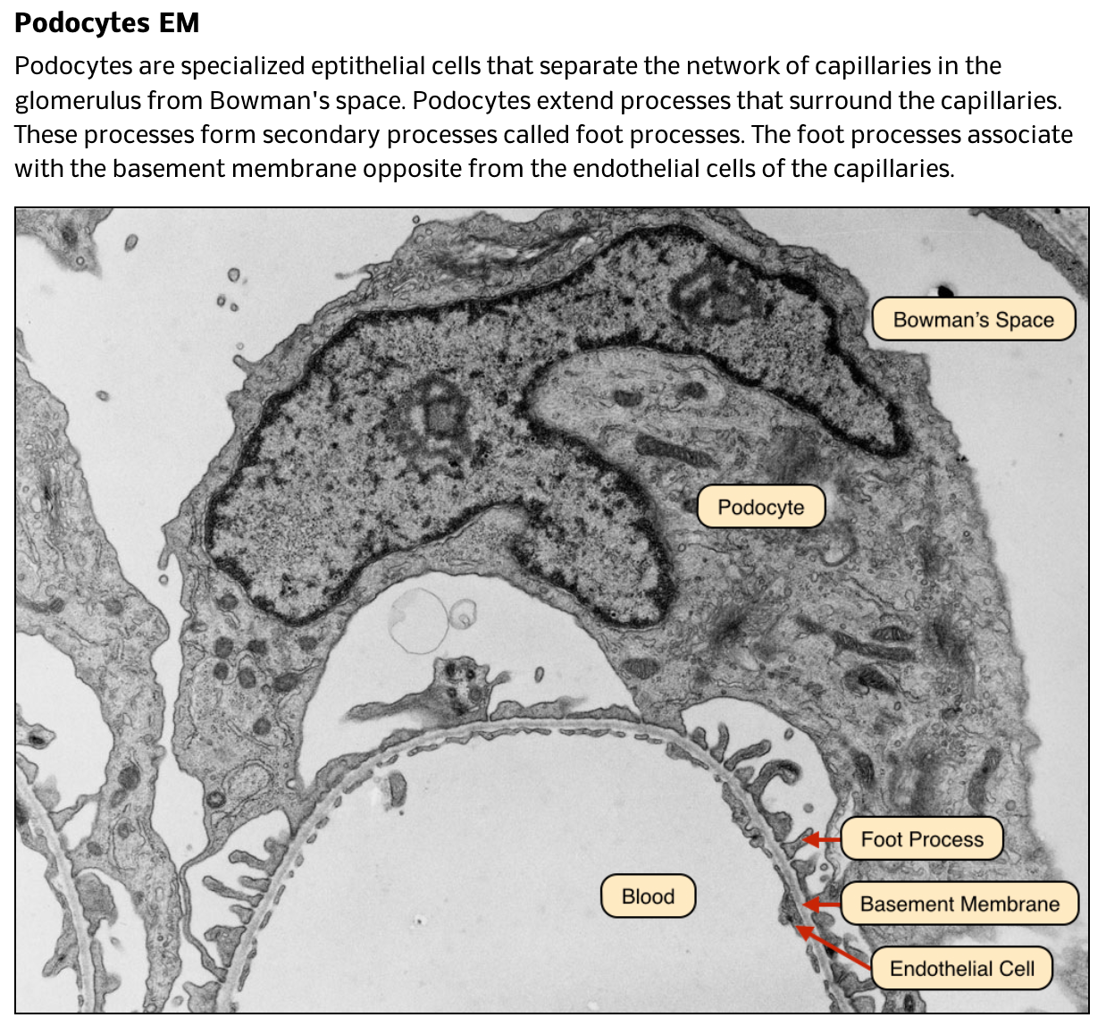

Slide 38
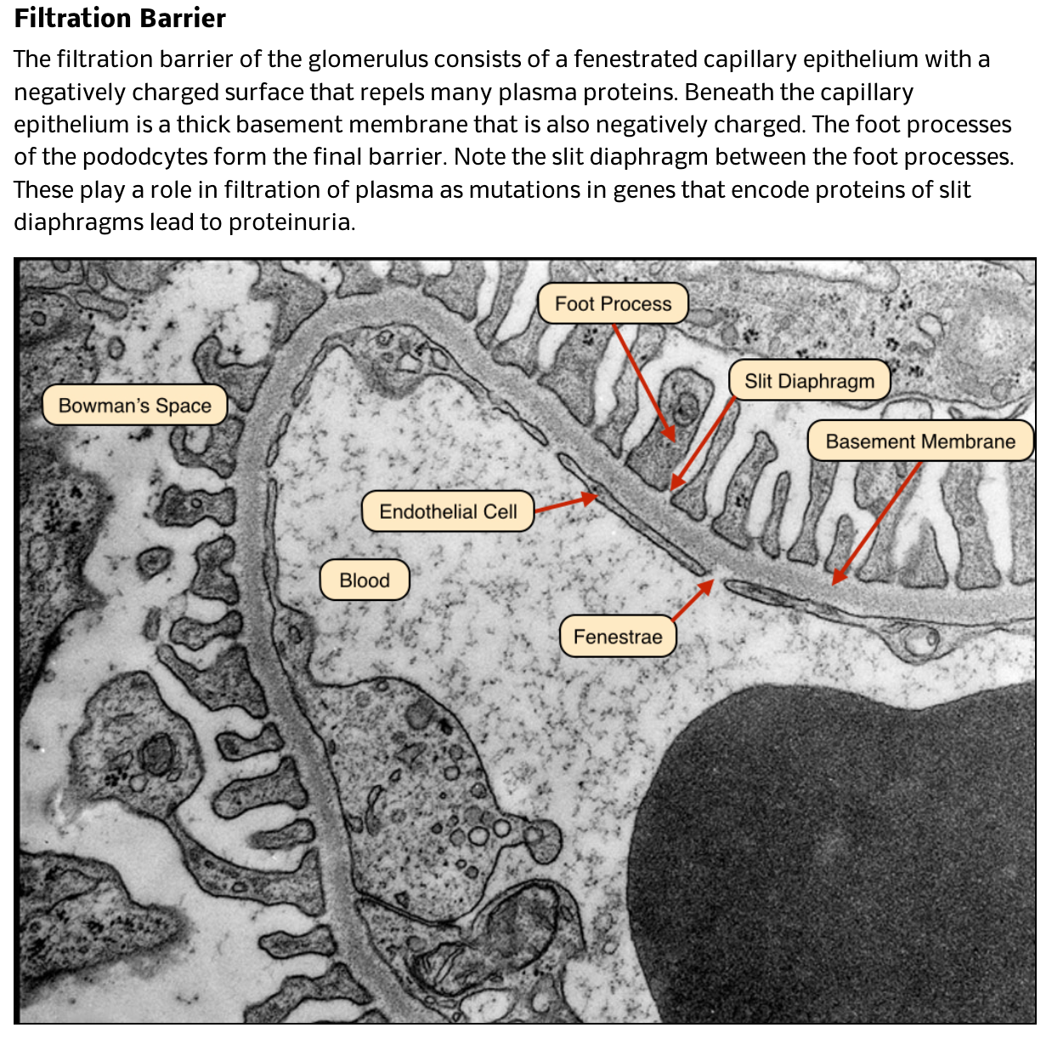

Slide 39
https://med.libretexts.org/Courses/Skyline_College/Human_Physiology_for_Allied_Health_Professionals/17%3A_The_Urinary_System/17.04%3A_Microscopic_Anatomy_of_the_Kidney

Slide 40
https://vmicro.iusm.iu.edu/hs_vm/docs/lab11_3.htm

Slide 41
Mammalian Kidney
The afferent arteriole supplies blood to the nephron.
This branch of the renal artery becomes the capillaries of the glomerulus.
As the capillaries leave, they become the efferent arteriole.
The efferent arteriole subdivides and becomes the peritubular capillary that surrounds the proximal and distal tubules.
http://www.anatomy.iupui.edu/courses/histo_D502/D502f04/lecture.f04/urinaryf04/C44-21C.jpg

Slide 42
travismulthaupt.com

Slide 43
Mammalian Kidney
Capillaries extend downward and form the vasa recta.
These form a loop and serve the loop of Henle.
The tubules and capillaries don’t exchange materials directly, they are bathed in interstitial fluid.
Various substances diffuse through this fluid and the filtrate in the nephron becomes urine.
http://www.anatomy.iupui.edu/courses/histo_D502/D502f04/lecture.f04/urinaryf04/C44-21C.jpg

Slide 44
Mammalian Kidney—The Proximal Tubule
The proximal tubule cells maintain a constant pH within the lumen, they actively control secretion of H⁺.
They reabsorb about 90% of HCO₃⁻ to maintain the pH of body fluids.
Drugs and other poisons pass from the peritubular capillary, into the interstitial fluid, across the epithelium of the proximal tubule and into the lumen of the nephron.
http://www.anatomy.iupui.edu/courses/histo_D502/D502f04/lecture.f04/urinaryf04/C44-21C.jpg

Slide 45
Mammalian Kidney—The Proximal Tubule
In contrast, the useful nutrients pass from the lumen of the proximal tubule across the transport epithelium into the interstitial fluid and to the peritubular capillaries.
One of the most important functions is the reabsorption of NaCl and H₂O.
http://www.anatomy.iupui.edu/courses/histo_D502/D502f04/lecture.f04/urinaryf04/C44-21C.jpg

Slide 46
Mammalian Kidney—The Proximal Tubule
Sodium diffuses into the transport epithelium.
It is actively pumped into the interstitial fluid.
Cl⁻ follows passively to balance charge.
H₂O follows by osmosis.
NaCl and H₂O now diffuse into the peritubular capillary.
http://www.anatomy.iupui.edu/courses/histo_D502/D502f04/lecture.f04/urinaryf04/C44-21C.jpg

Slide 47
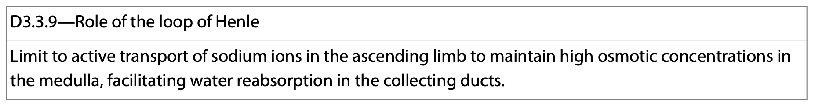
Mammalian Kidney—The Descending Loop of Henle
The descending loop is freely permeable to water.
It is not permeable to NaCl.
The interstitial fluid becomes progressively more concentrated (hypertonic) as you go from the cortex to the medulla, and water flows out of the loop.
http://www.anatomy.iupui.edu/courses/histo_D502/D502f04/lecture.f04/urinaryf04/C44-21C.jpg

Slide 48
travismulthaupt.com

Slide 49
Mammalian Kidney—The Ascending Loop of Henle
Moving up the loop, the transport epithelium is now permeable to NaCl and not H₂O.
There are 2 regions of the ascending limb:
1. A thin region—NaCl diffuses out and into the interstitial fluid.
2. A thick region—NaCl is actively pumped out of the tubule and into the interstitial fluid.
http://www.anatomy.iupui.edu/courses/histo_D502/D502f04/lecture.f04/urinaryf04/C44-21C.jpg

Slide 50
Mammalian Kidney—The Ascending Loop of Henle
These mechanisms increase the osmolarity of the interstitial fluid and create a more dilute filtrate.
In this way, the loop of Henle maintains hypertonic conditions in the medulla to produce urine.

Slide 51
Mammalian Kidney—The Distal Tubule
The distal tubule regulates the pH like the proximal tubule.
It also regulates the amount of K⁺ and NaCl concentrations of body fluids by varying the amount of K⁺ secreted and NaCl absorbed from the filtrate.
http://www.anatomy.iupui.edu/courses/histo_D502/D502f04/lecture.f04/urinaryf04/C44-21C.jpg

Slide 52
Mammalian Kidney—The Collecting Duct
The collecting duct actively reabsorbs small amounts of NaCl.
The degree of permeability of NaCl is under hormonal control (aldosterone).
The epithelium is permeable to water and not to salt.
As the collecting duct traverses the gradient of osmolarity in the kidney, the filtrate becomes increasingly more concentrated.

Slide 53
Mammalian Kidney—The Collecting Duct
The collecting duct is permeable to urea in the medulla (not the cortex).
Some urea diffuses out of the duct and into the interstitial fluid increasing the osmolarity.
The high osmolarity of the kidney enables it to conserve water by creating urine hyperosmotic to the general body fluids.
Provides a good example of structure-function relationship.

Slide 54
Mammalian Kidney
It is a versatile organ.
It is under nervous and hormonal control.
This is how it regulates the amount of urine produced and its concentration.

Slide 55
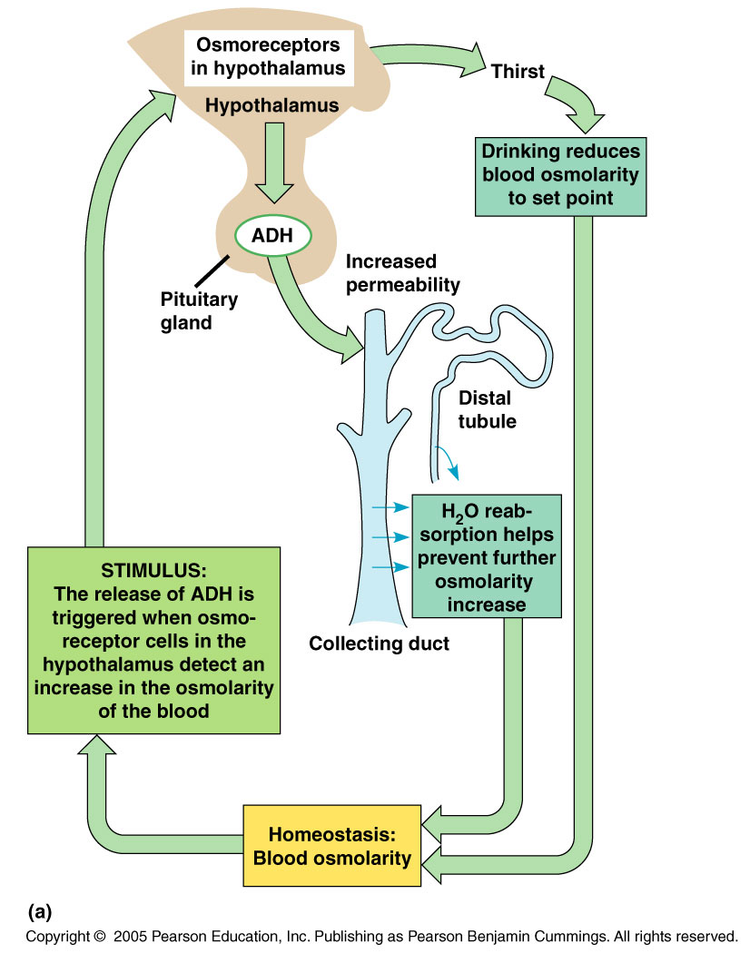
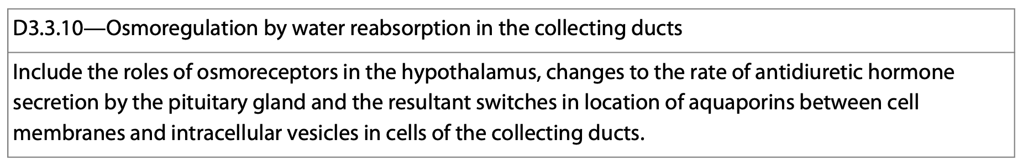
Mammalian Kidney—Hormones
ADH is a water regulating hormone.
It is produced in the hypothalamus.
It is stored and released by the pituitary.

Slide 56
Mammalian Kidney—Hormones
The hypothalamus has osmoreceptor cells. Their set point is 300 mOsm/L
When the osmolarity of blood goes above this, ADH is released and acts on the distal tubules and collecting ducts.
The hormone increases the permeability of the cells of the tubes.
Water reabsorption is increased and the concentration of the urine increases.

Slide 57
Mammalian Kidney—Hormones
In the short term, the ADH stimulates the collecting duct epithelium to absorb more water.
It does this by stimulating the insertion of aquaporins into the apical membrane facing the filtrate.
https://www.semanticscholar.org/paper/Vasopressin-in-chronic-kidney-disease%2C-in-ADPKD-%3A-Zittema/bdfca377e1c300f77c7d703102e30d4d52e7d88c

Slide 58
Mammalian Kidney—Hormones
In the long term, ADH secretion stimulates the increase in transcription and translation of genes associated with aquaporin production.
https://www.ncbi.nlm.nih.gov/pmc/articles/PMC3775849/

Slide 59
Mammalian Kidney—Hormones
The give the cell a “head start” on inserting the aquaporins into the cell membrane when blood osmolarity increases.
https://www.ncbi.nlm.nih.gov/pmc/articles/PMC3775849/

Slide 60
Mammalian Kidney—Hormones
As more water gets reabsorbed, ADH release slows and the osmolarity goes down.
A negative feedback example.

Slide 61
Mammalian Kidney—Hormones
When a lot of water is consumed, little ADH is released.
Water reabsorption is slowed and a large volume of urine is produced.

Slide 63
Mammalian Kidney—RAAS Hormones
Renin-angiotensin-aldosterone system
There is a second regulatory mechanism involving the JGA.
It is near the afferent arteriole which supplies the blood to the glomerulus.

Slide 64
Mammalian Kidney—RAAS Hormones
When blood pressure decreases, an enzyme called renin initiates a chemical reaction.
Angiotensinogen in the blood is converted into angiotensin II mainly in the lungs.
Angiotensin II increases the blood pressure by constricting the arterioles.
This decreases blood flow to the capillaries.

Slide 65
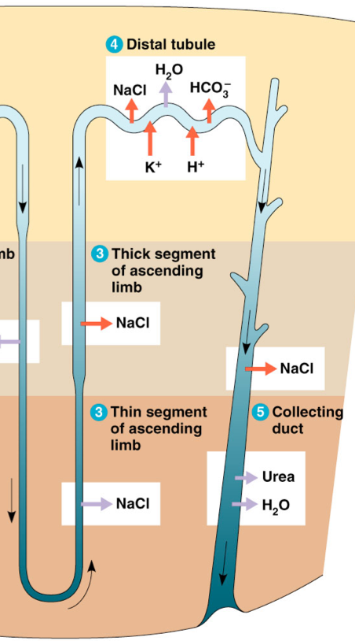
Mammalian Kidney—RAAS Hormones
Angiotensin II stimulates the adrenal glands to release aldosterone.
Aldosterone acts on the nephron’s distal tubules causing them to reabsorb more sodium and water.
This also increases blood volume and blood pressure.

Slide 66
Mammalian Kidney—RAAS Hormones

Slide 67
Mammalian Kidney—RAAS Hormones
Angiotensin II also has a stimulatory effect on the proximal tubules to absorb more H₂O and NaCl.
This decreases the amount of salt and water in the urine increasing the blood volume and blood pressure.

Slide 68
Mammalian Kidney—RAAS Hormones
Angiotensin II stimulates the adrenal glands to release aldosterone.
Aldosterone acts on the nephron’s distal tubules causing them to reabsorb more sodium and water.
This also increases blood volume and blood pressure.

