Slide 1
Chapter 50: Movement
Essential Idea: The roles of musculoskeletal system are movement, support and protection.

Slide 2
Skeletons
There are a number of different skeletons in the animal world. The ones important to us are:
Exoskeletons
Bones (endoskeletons)
Bones and exoskeletons provide an anchorage for muscles to act as levers.

Slide 3
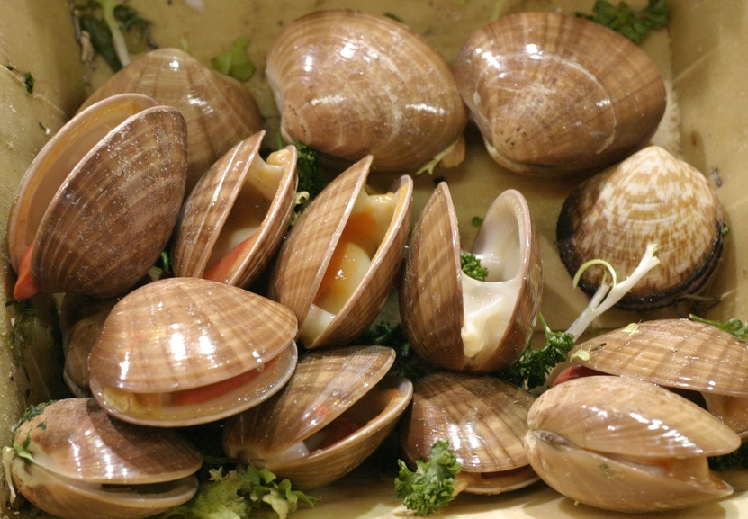
Skeletons
Exoskeletons are comprised of a hard encasement on the animal’s surface.
Clams, insects, crustaceans.
Chitin, calcium carbonate
http://blog.friendseat.com/clams-uses-recipes

Slide 4
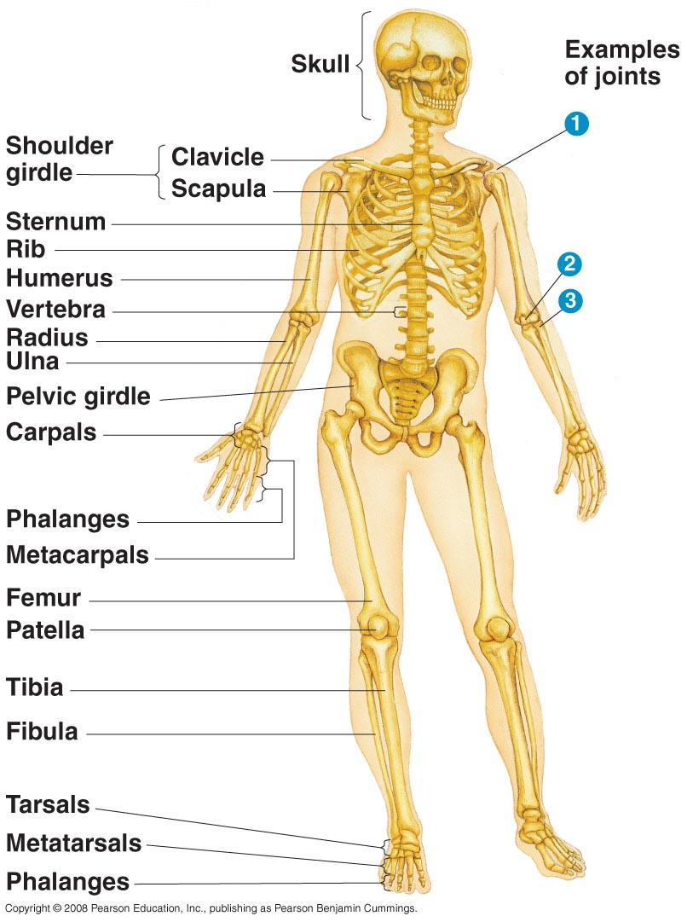
Skeletons
Endoskeletons consists of hard supporting elements like bones, cartilage, bony plates.
These are most familiar to us.
Within our body, bones are comprised of calcium carbonate.

Slide 5
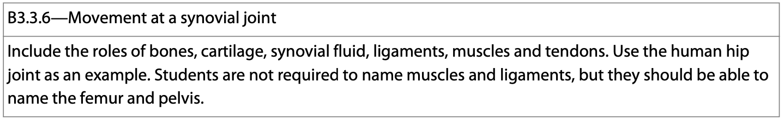
Synovial Joints
Synovial joints are the most common joint in the human body.
They are freely moveable and are characterized by having a joint cavity filled with fluid to ease the movement of the joint and to reduce friction.

Slide 6
Synovial Joints
There are six major types of synovial joints, and they all allow for different types of movements.
1. Ball and socket joint (shoulder/hip)
2. Gliding joint (small wrist bones)
3. Saddle joint (between thumb and wrist)
4. Hinge joint (elbow)
5. Pivot joint (radioulnar joints)
6. Condyloid/ellipsoid joint (radiocarpal joint)

Slide 7
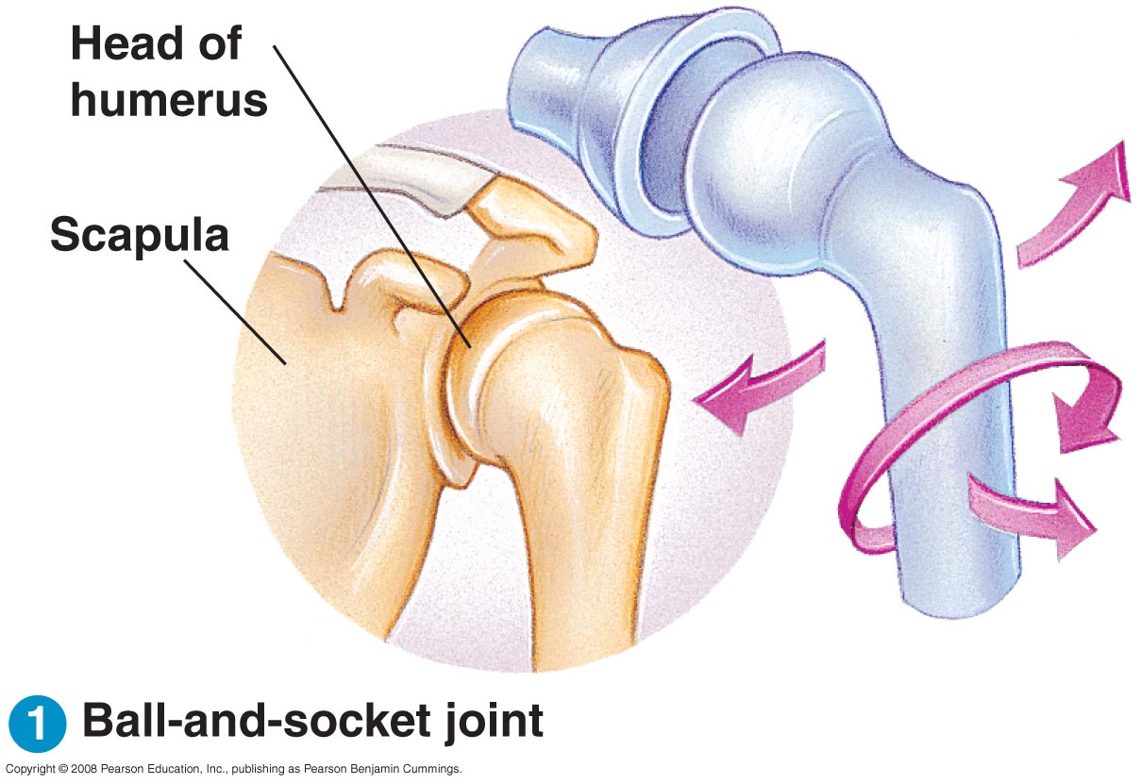
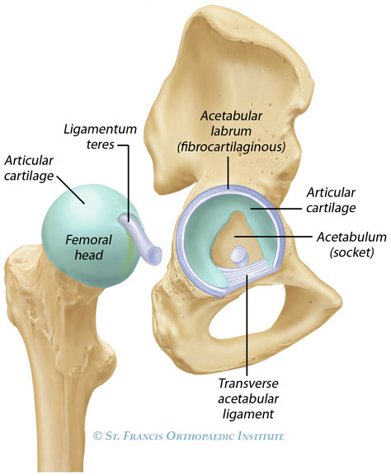
Ball and Socket Joints
1. Ball and socket joints—allows for rotation around the joint.
Hip and shoulder.

Slide 8
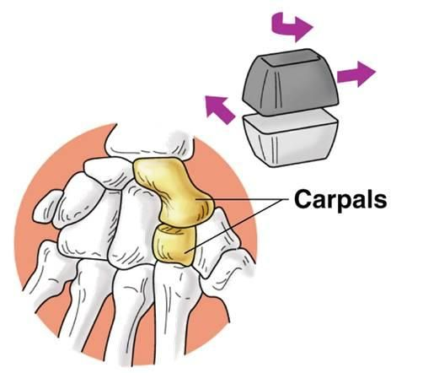
Gliding Joints
2. Gliding joints allow for movement in multiple directions.
These joints are common where bones meet in flat or nearly flat surfaces.
www.pinterest.com

Slide 9
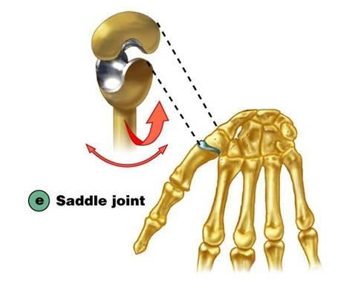
Saddle Joint
3. A saddle joint is where two bones meet and are shaped like a horse rider on a saddle.
The thumb joint is a common example.

Slide 10
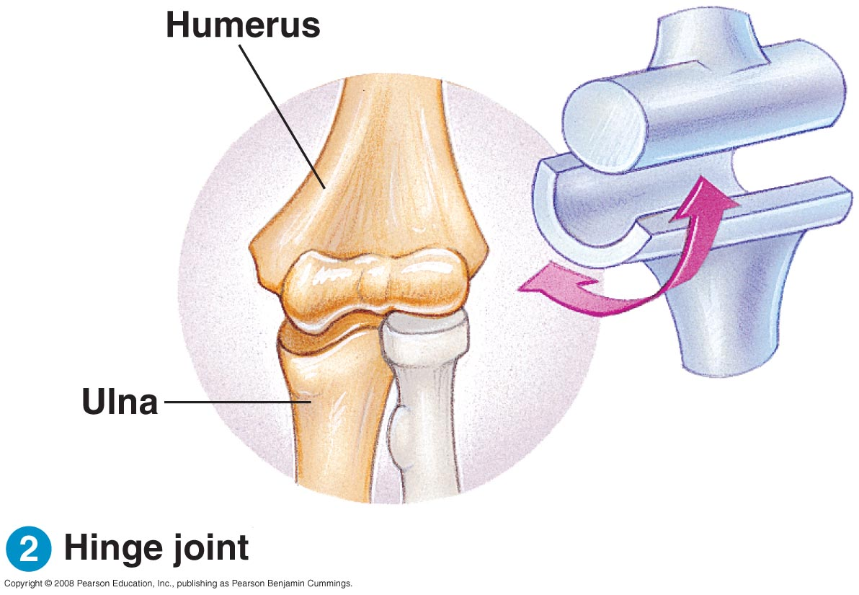
Joints
4. Hinge joints—restrict movement to a single plane.
Ankle, elbow and knee.

Slide 11
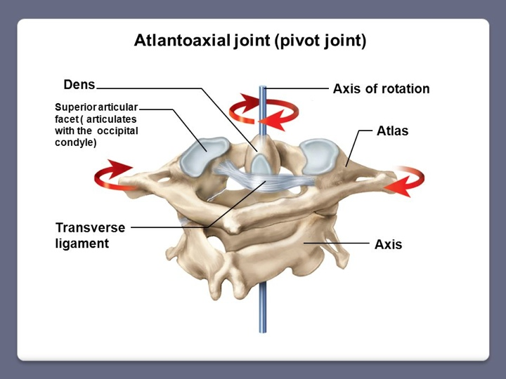
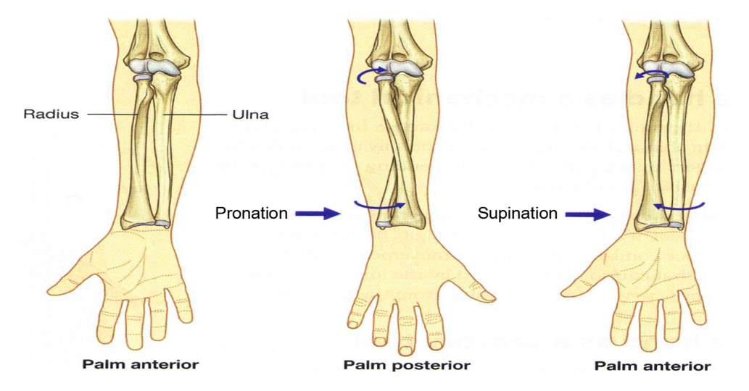
Pivot Joint
5. Pivot joints allow for rotary movement along an axis parallel with the longitudinal axis of the bone.
Wrist and neck.
www.slideplayer.com
http://corewalking.com/three-joints-elbow/

Slide 12
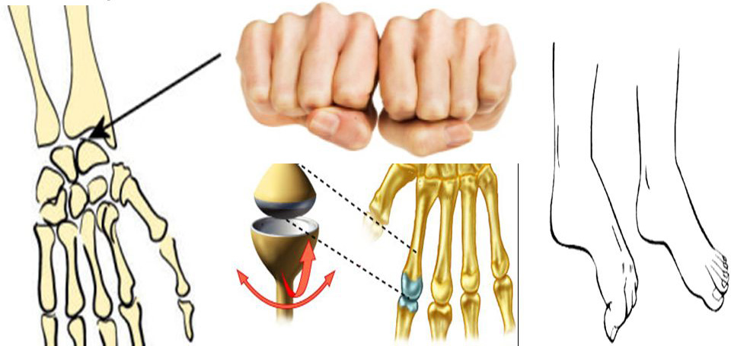
Condyloid Joint
6. Joints where both surfaces articulate about one another and have oval surfaces.
Wrists, knuckles of fingers and toes.
www.slideplayer.com

Slide 13
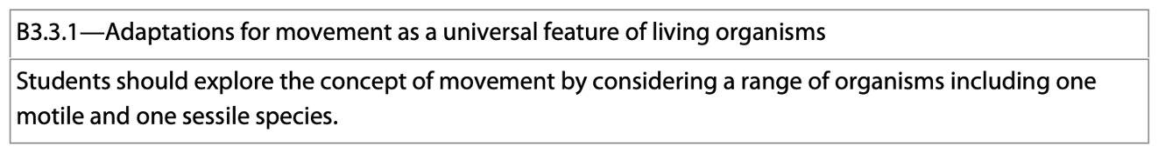
Movement
Movement is a fundamental feature of all living things.
Some organisms may not physically move (sponges, trees), but their gametes do, and therefore their populations can spread.
Other organisms can move using a variety of means—cilia, flagella, muscle contractions

Slide 14
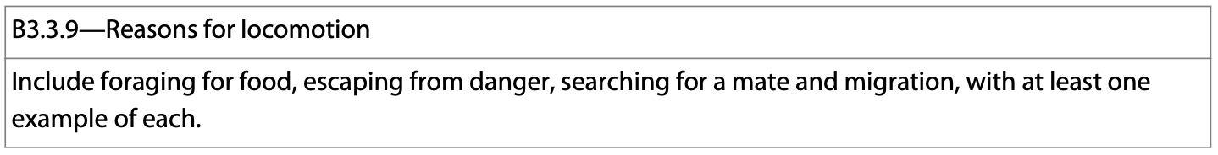
Movement--Locomotion
There are a number of reasons for movement, including foraging for food, escaping danger, finding a mate, migration.

Slide 15
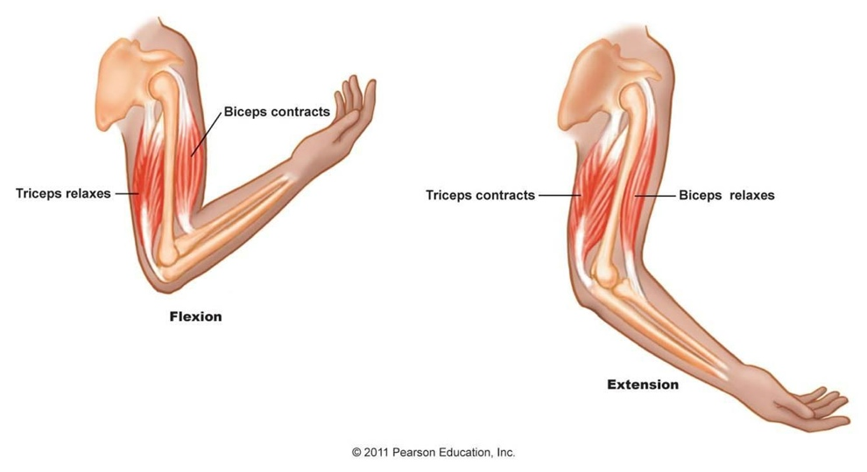
Joint Movement
The movement in your body requires muscles to work in antagonistic pairs.

Slide 16
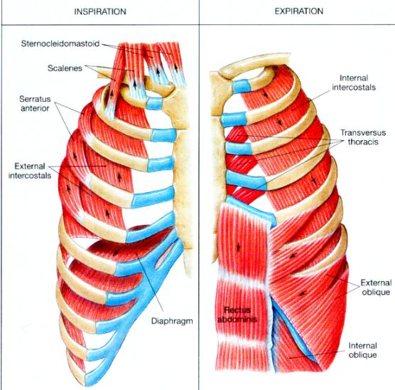
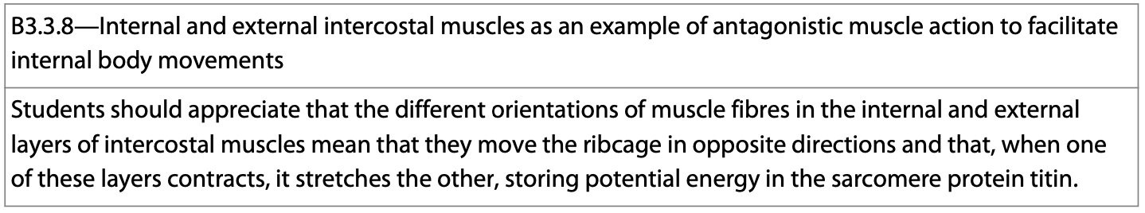
Joint Movement
The internal and external intercostal muscles that we learned about during the gas exchange topic are also antagonistic pairs.
http://www.howtosingbettertoday.com/how-to-improve-your-voice-role-support/

Slide 17
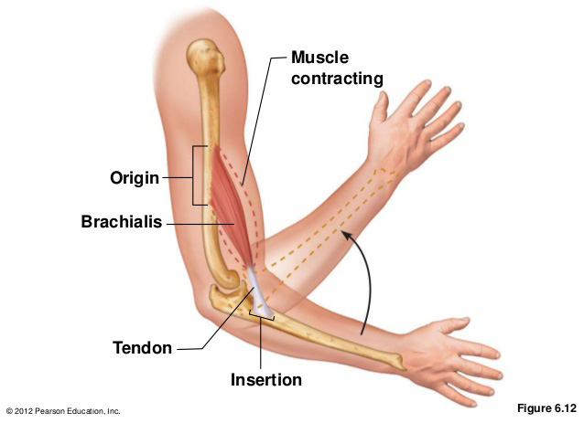
Joint Movement
Movements are due to the muscles being attached to the bones which articulate about your joints.
Muscles always contracts and provide movement toward the origin of the fiber.

Slide 18
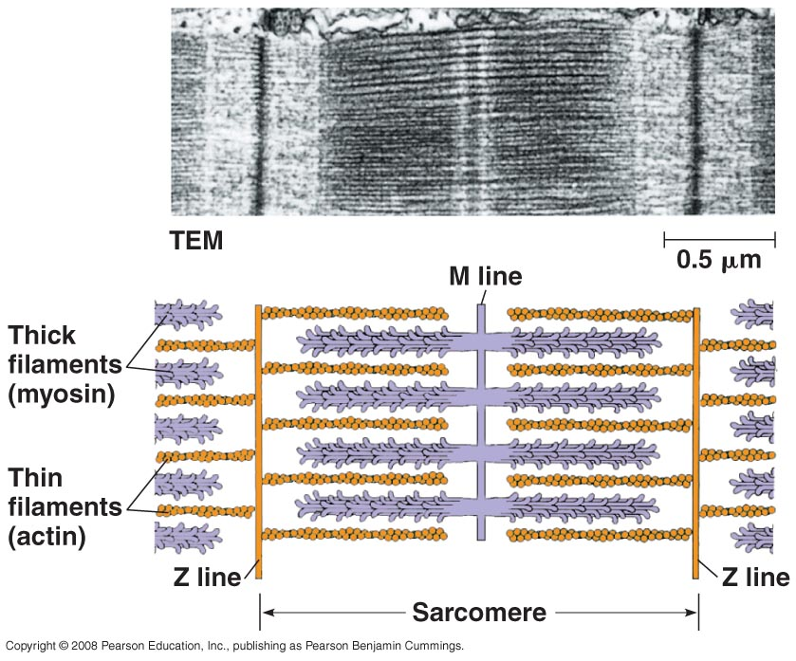
Muscle Cell Components
The function of muscle cells relies on microfilaments—the actin components of the cytoskeleton.
Microfilament movement is governed by chemical energy transformations that result in contraction.

Slide 19
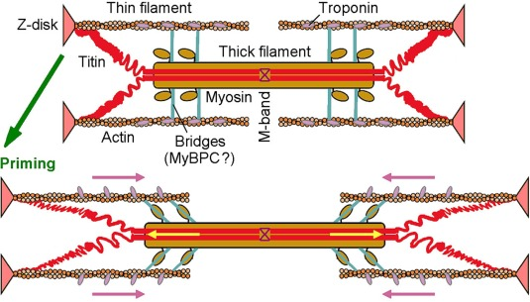
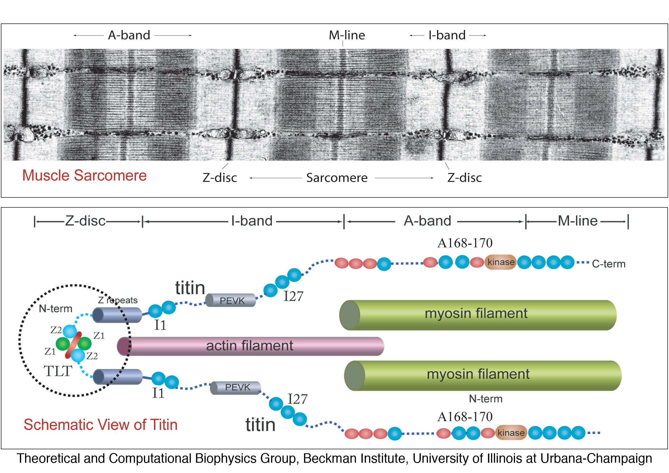
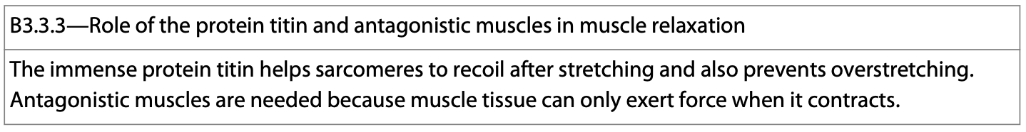
Muscle Cell Components
Titin is a large muscle protein that plays an important role in muscle contraction and relaxation.
https://ars.els-cdn.com/content/image/1-s2.0-S0021929023001227-gr7.jpg

Slide 20
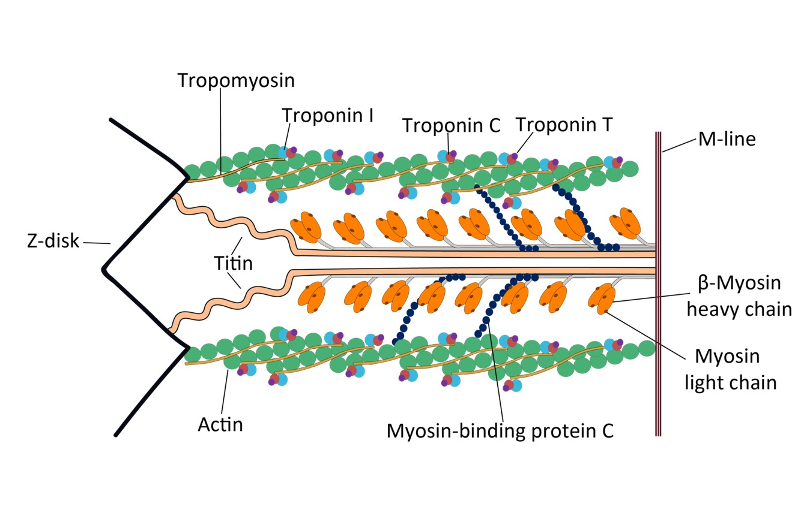
Muscle Cell Components
Titin also plays the role of preventing overstretching of the muscle and assists with recoil after stretching.
It works a lot like a spring after it has been stretched.
https://cellgs.e2ecdn.co.uk/ArticleImages/Titin.jpg

Slide 21
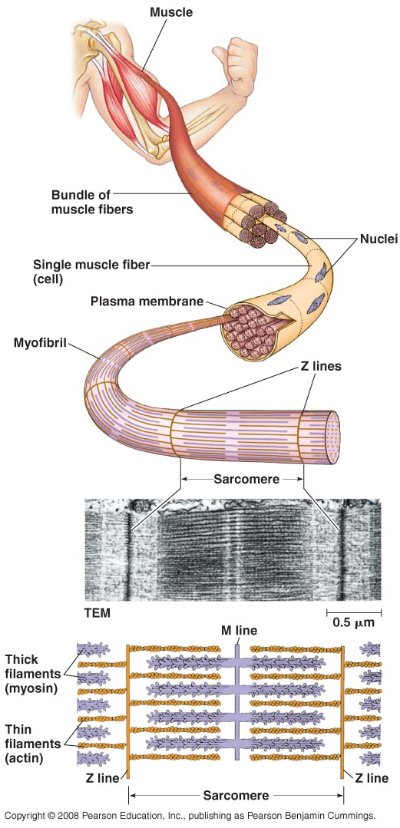
Vertebrate Skeletal Muscle
Skeletal muscle (also called striated muscle) is attached to bones and is responsible for movement.
It is organized in a hierarchal scheme of smaller and smaller units.
Most skeletal muscles consist of a bundle of long fibers consisting of a single, multinucleated cell.

Slide 22
Vertebrate Skeletal Muscle
Muscle fibers contain numerous bundles of small subunits called myofibrils.
The myofibrils are composed of both thin and thick filaments.
Thin filaments contain two strands of actin and two strands of tropomyosin coiled around one another.
Thick filaments consist of myosin molecules.

Slide 23
The Sarcomere
The sarcomere is the contractile unit of the myofibril (muscle).
Borders of each sarcomere line up with adjacent myofibrils.
Thin filaments are attached at the Z lines and extend inward toward the center of the contractile unit. Thick filaments, on the other hand, are attached to the M lines in the center of the sarcomere.

Slide 24
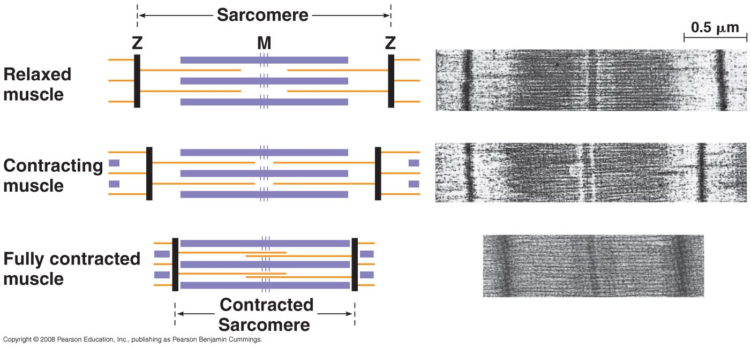
The Sarcomere
In resting muscles, thick and thin fibers only partially overlap. At the edges of the sarcomere, you can see only thin filaments, whereas at the center only thick filaments overlap. Such an arrangement allows for contraction to occur.

Slide 25
The Sliding-Filament Model
The sliding-filament model explains skeletal muscle contraction and is based upon the interaction of actin and myosin which comprise the filaments.

Slide 26
The Sliding-Filament Model
Neither the thick nor the thin model change length during contraction.
Instead, the filaments slide past one another along their lengths increasing the amount of overlap.

Slide 27
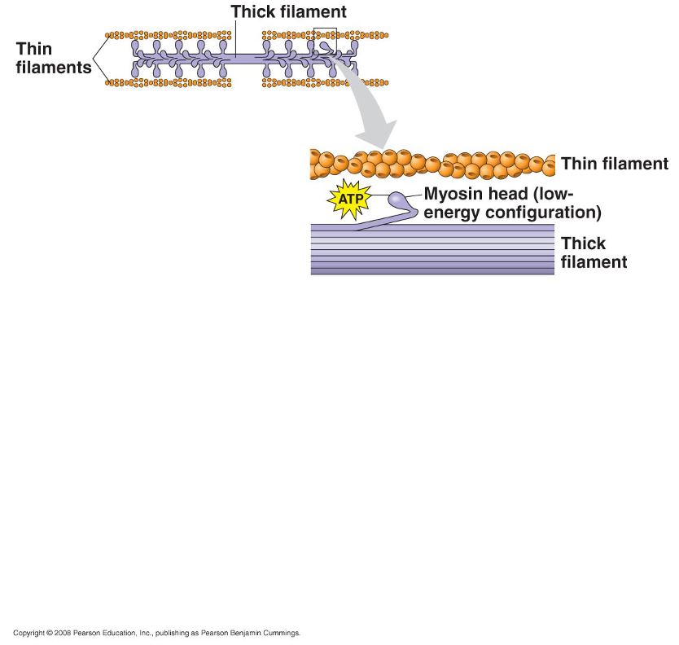
The Sliding-Filament Model
The myosin molecules are comprised of a long tail and a globular head that extend out to the side of each thick filament.
The head is the main region where the reactions that power muscle contraction occur.

Slide 28
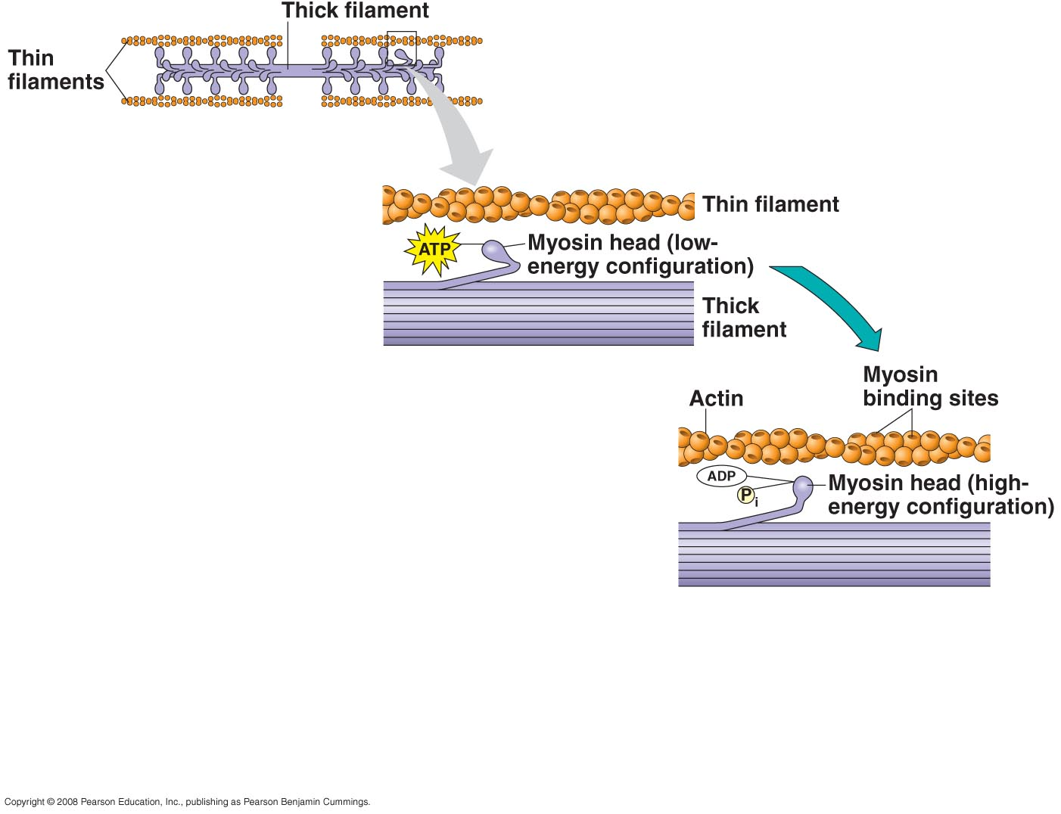
The Sliding-Filament Model
The head binds ATP and hydrolyzes it into ADP + P_{i} thus changing the myosin head into a high energy form capable of binding actin.

Slide 29
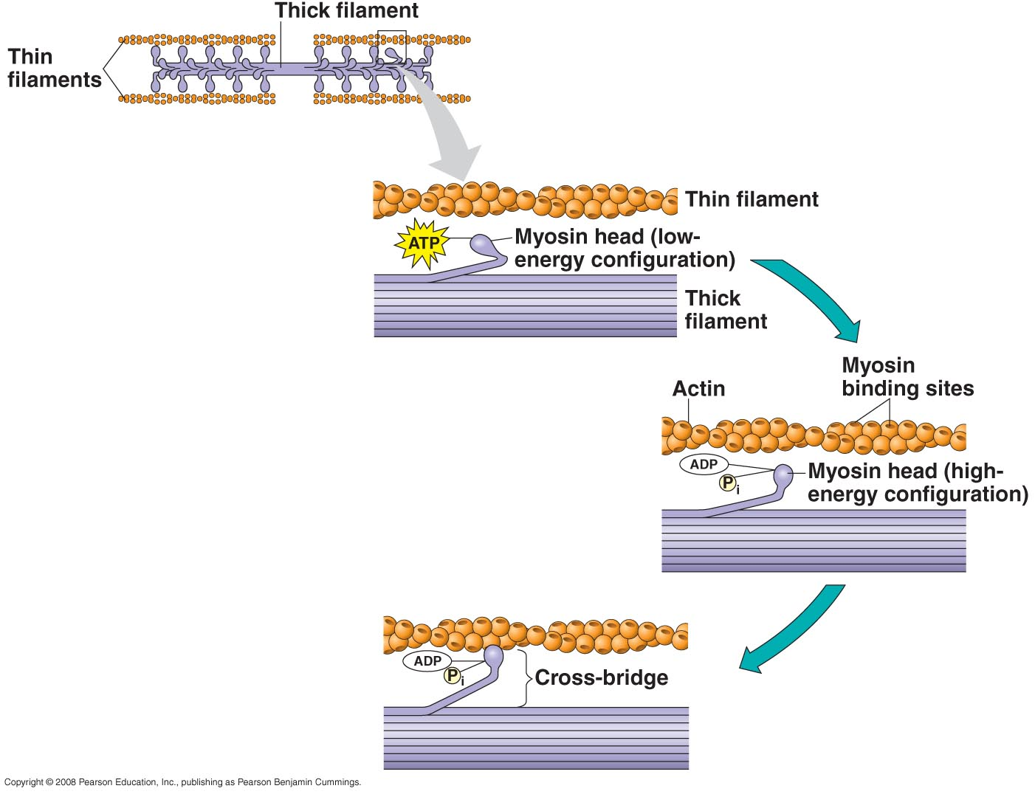
The Sliding-Filament Model
When actin and myosin bind, a cross-bridge is formed and the myosin acts to pull the actin filament toward the center of the sarcomere.
Notes:
There are approximately 350 heads on each thick filament, and each one forms about 5 cross-bridges each second.

Slide 30
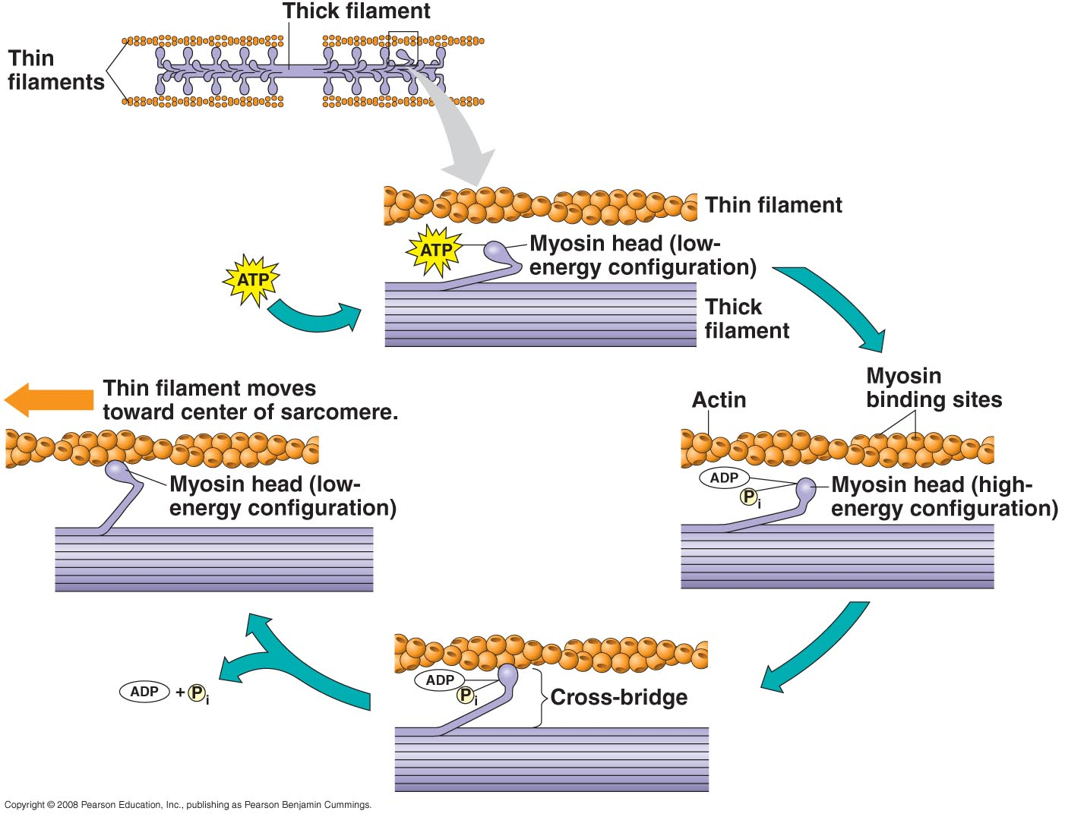
The Sliding-Filament Model
The myosin head ‘lets go’ when a new ATP molecule binds to its head.
These reactions repeat themselves very rapidly resulting in contraction.

Slide 31
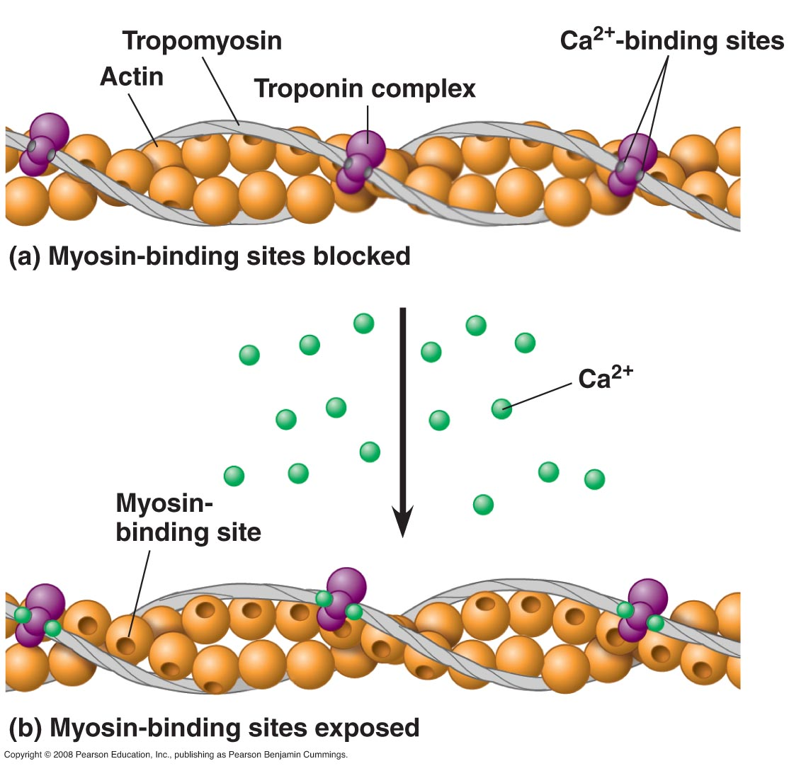
Ca²⁺ and Regulatory Proteins
The regulatory protein, tropomyosin, and the troponin complex (additional regulatory proteins) bind to actin strands and are involved in muscle contraction and relaxation.

Slide 32
Ca²⁺ and Regulatory Proteins
At rest, tropomyosin covers the myosin binding sites along the actin filament—this prevents actin-myosin interactions.
As Ca²⁺ accumulates in the cytosol, it binds to the troponin complex causing proteins bound along the actin strand to move and expose myosin-binding sites.

Slide 33
Ca²⁺ and Regulatory Proteins
With myosin binding sites now available on the actin filaments, myosin can bind.
This binding is what contraction is—the sliding of actin and myosin fibers past one another.

Slide 34
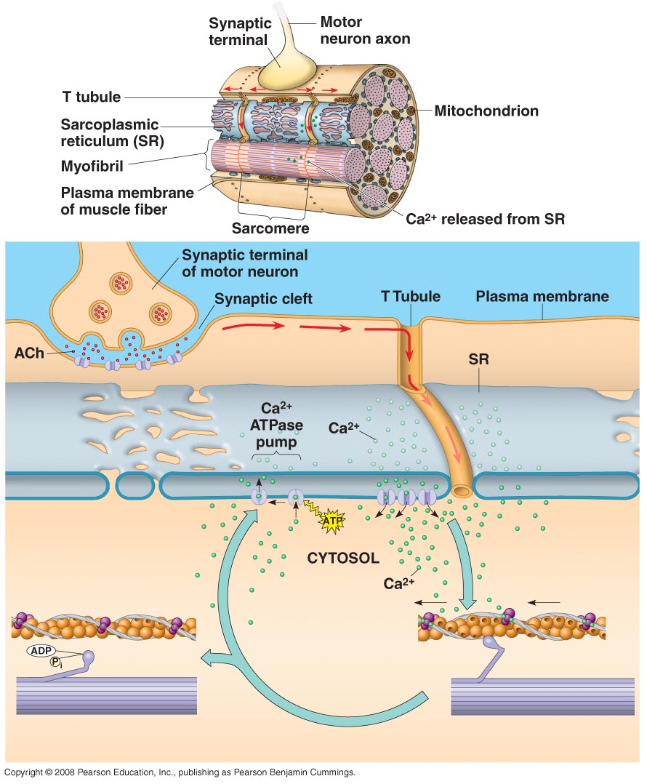
Ca²⁺ and Regulatory Proteins
The increase in Ca²⁺ concentration results in contraction.
As the concentration of Ca²⁺ falls, the muscles relax as the binding sites are covered again.

Slide 35
Motor Neurons and Muscle Contraction—The Motor Unit
Signals from motor neurons stimulate the release of Ca²⁺ ions into the cytosol of muscle cells.
Ca²⁺ concentration within the muscle cell is a regulated, multistep process involving numerous cell structures.

Slide 36
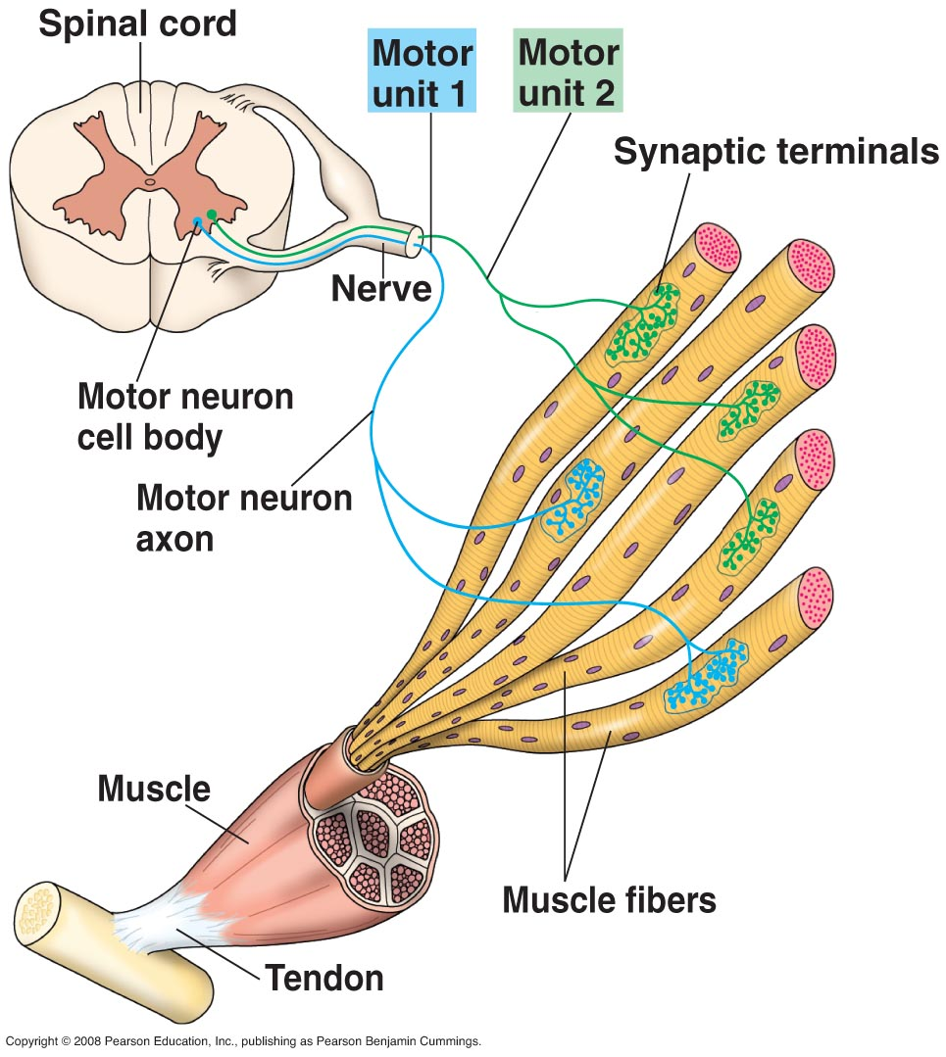
Motor Neurons and Muscle Contraction
The first step in muscle contraction is the arrival of an action potential at the synaptic terminal of a motor neuron.
An action potential stimulates the release of acetylcholine which binds to receptors on the muscle fiber.

Slide 37
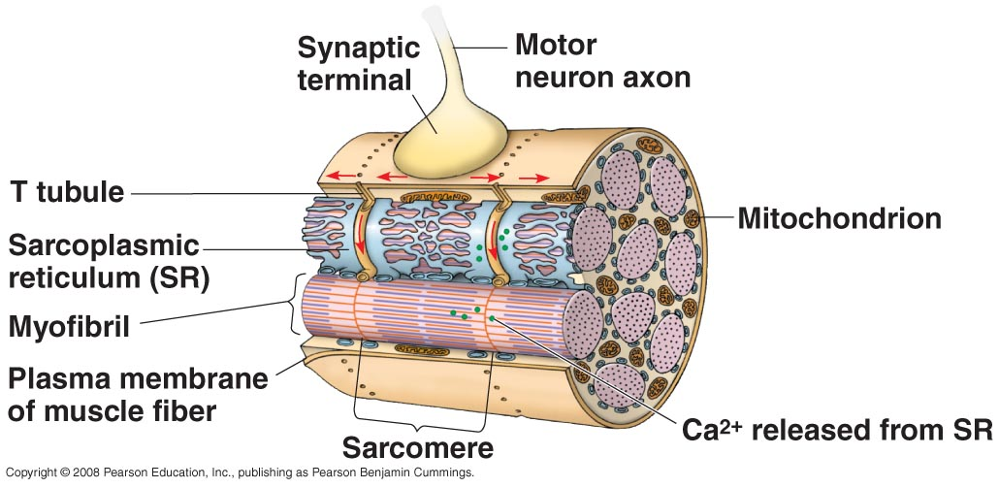
Motor Neurons and Muscle Contraction
This leads to a depolarization within the plasma membrane of the muscle fiber and triggers an action potential within the cell.
The muscle cell contains transverse (T) tubules, and the action potential spreads to the interior of the cell through these structures.

Slide 38
Motor Neurons and Muscle Contraction
From the T-tubules, the action potential spreads to the sarcoplasmic reticulum (SR), causing the release of Ca²⁺
The Ca²⁺ enters the cytosol, binds to the troponin complex causing it to move and open myosin binding sites stimulating contraction of the muscle.

Slide 39
Motor Neurons and Muscle Contraction
Relaxation of the muscle occurs when the neural input stops.
During this phase, transport proteins within the SR pump Ca²⁺ out of the cytosol allowing regulatory proteins to bind to the thin filament and block the myosin binding sites.
Ca²⁺ accumulates in the SR and the muscle cell is ready for the next round of contraction.

Slide 40
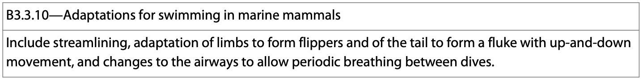
Adaptations for Swimming
Marine and fresh-water organisms have a variety of adaptations for swimming.
Using your device, find some different adaptations for swimming and explain how the muscle contractions are involved in these adaptations.
*Not all of the adaptations involve muscle contractions.

