Slide 1
Integration of Body Systems
Organisms must have a way to integrate information from the surroundings within a central processor to coordinate an output.

Slide 2
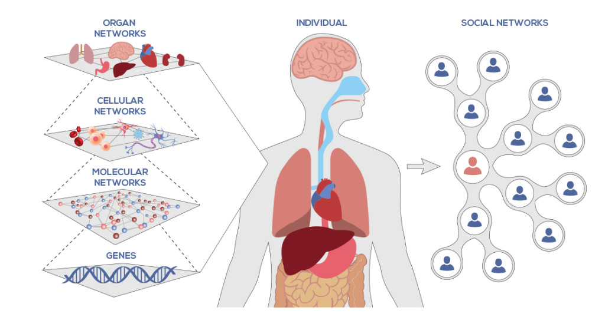
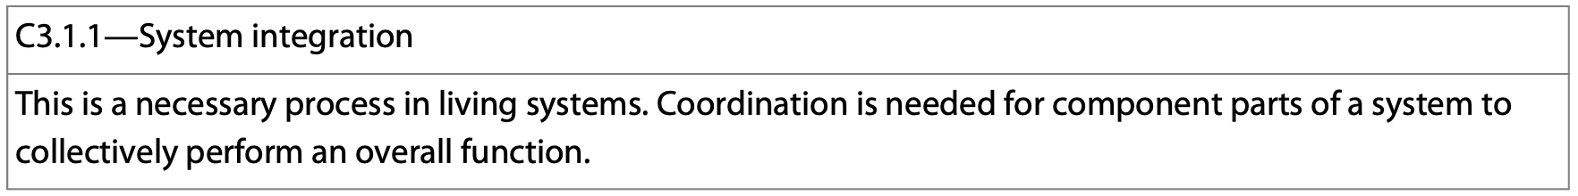
System integration
Living systems need to be able to integrate information from the surroundings to coordinate a response.
There are usually several components to the system that allow for an organism to perform an overall function.
https://isbscience.org/what-is-systems-biology/

Slide 3
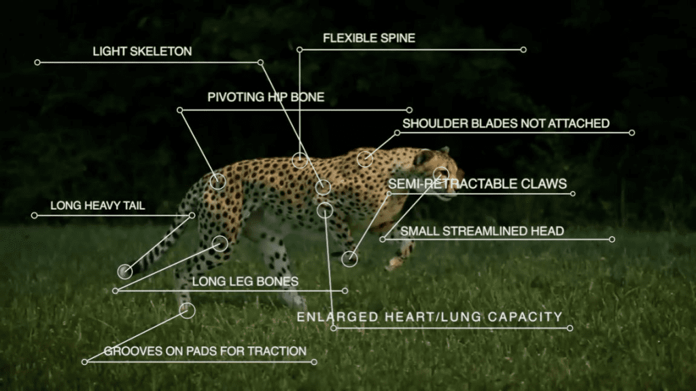
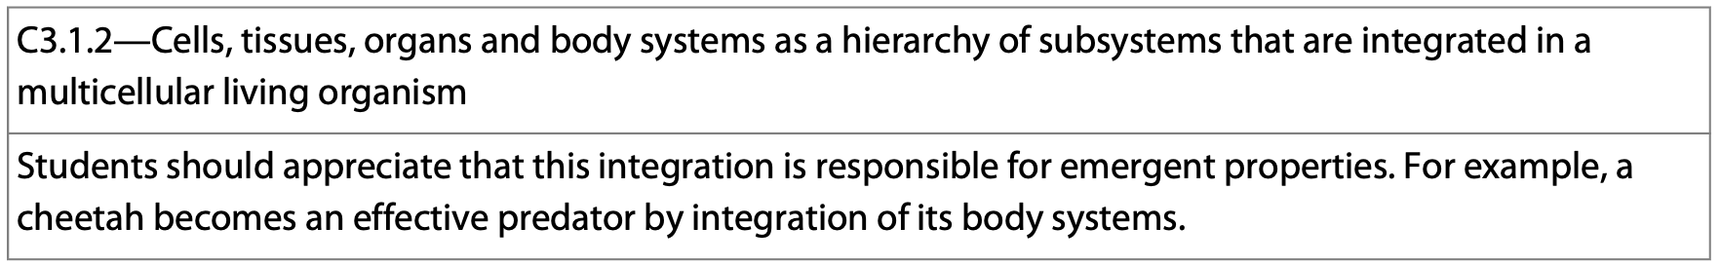
System integration—Emergent Properties
The way in which you look at an organism reveals certain aspects of that organism—the emergence of properties related to the function of the organism.
Examining each part of a cheetah reveals important components of this organism in relation to its ability to capture prey.
https://www.pugdundeesafaris.com/blog/species-of-cheetah/

Slide 4
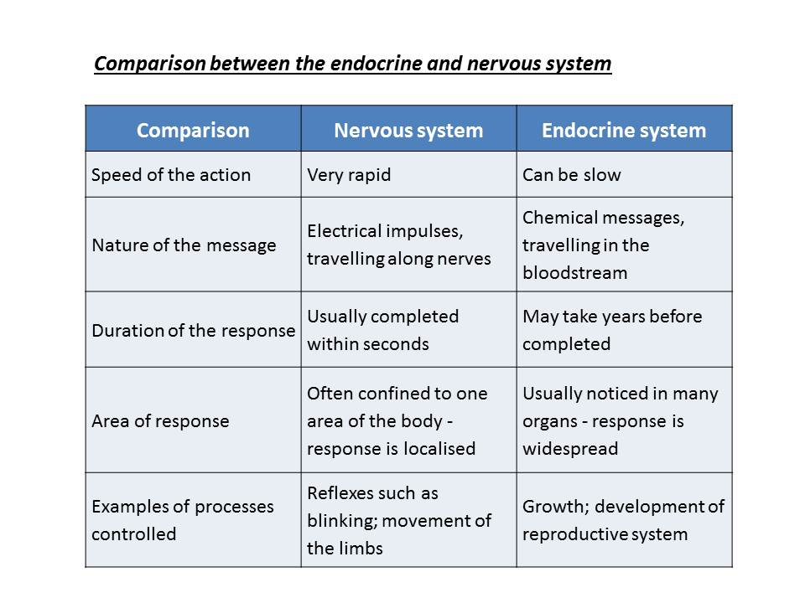
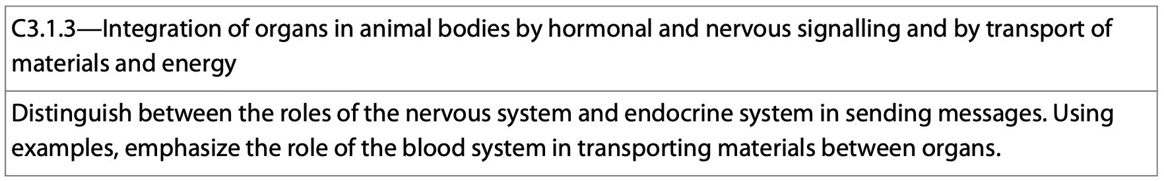
Internal Communication
Animals have 2 systems of internal communication to regulate and maintain homeostasis:
1. The endocrine system—often a slower and more sustained response to a stimulus.
2. The nervous system—usually a rapid response to a stimulus.

Slide 5
1. The Endocrine System
The endocrine system is composed of all of the animal’s hormone secreting cells.
The endocrine system coordinates a slow, long-lasting response.

Slide 6
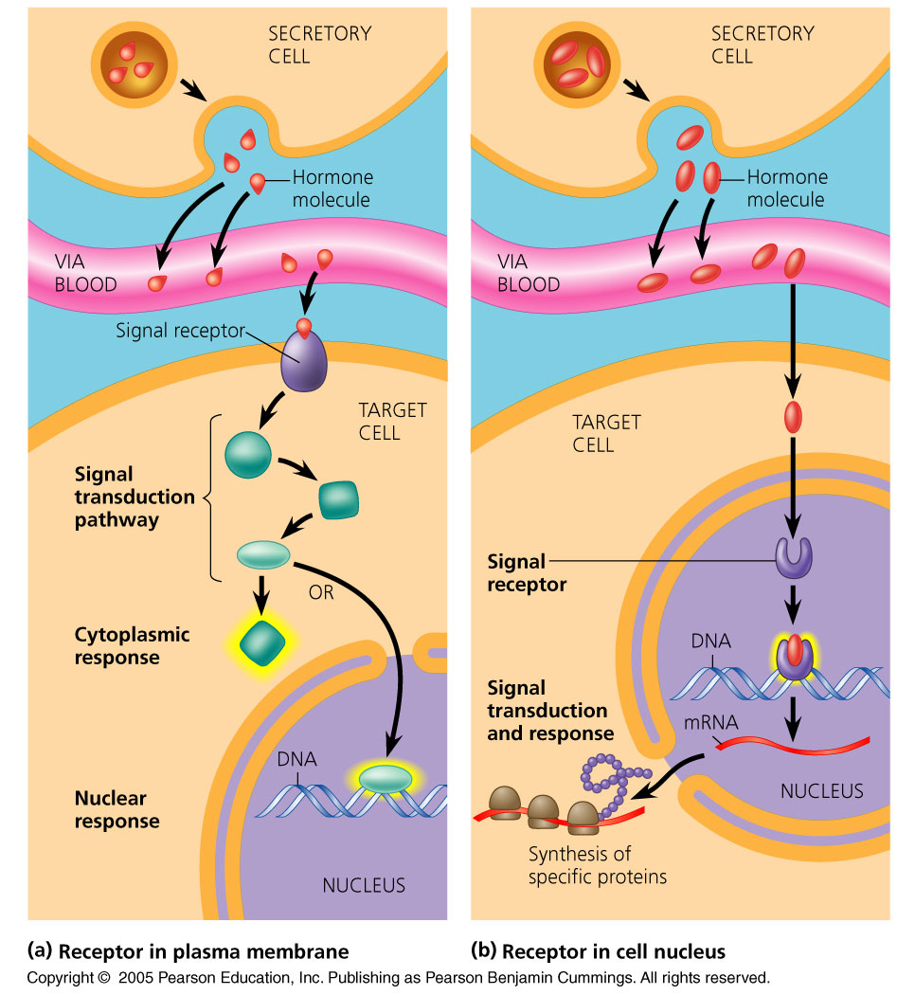
Endocrine Glands
Endocrine glands are hormone secreting organs.
They are ductless glands.
Their product is secreted into extracellular fluid which then diffuses into circulation.
It travels through the blood to the target cell and initiates a change either by binding to a receptor in the plasma membrane, or by diffusing into the cell.

Slide 7
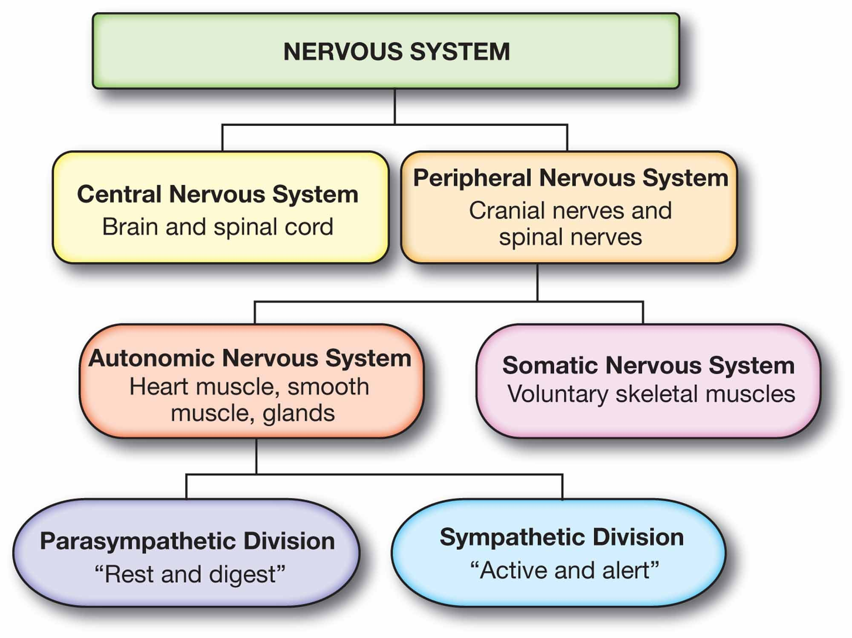
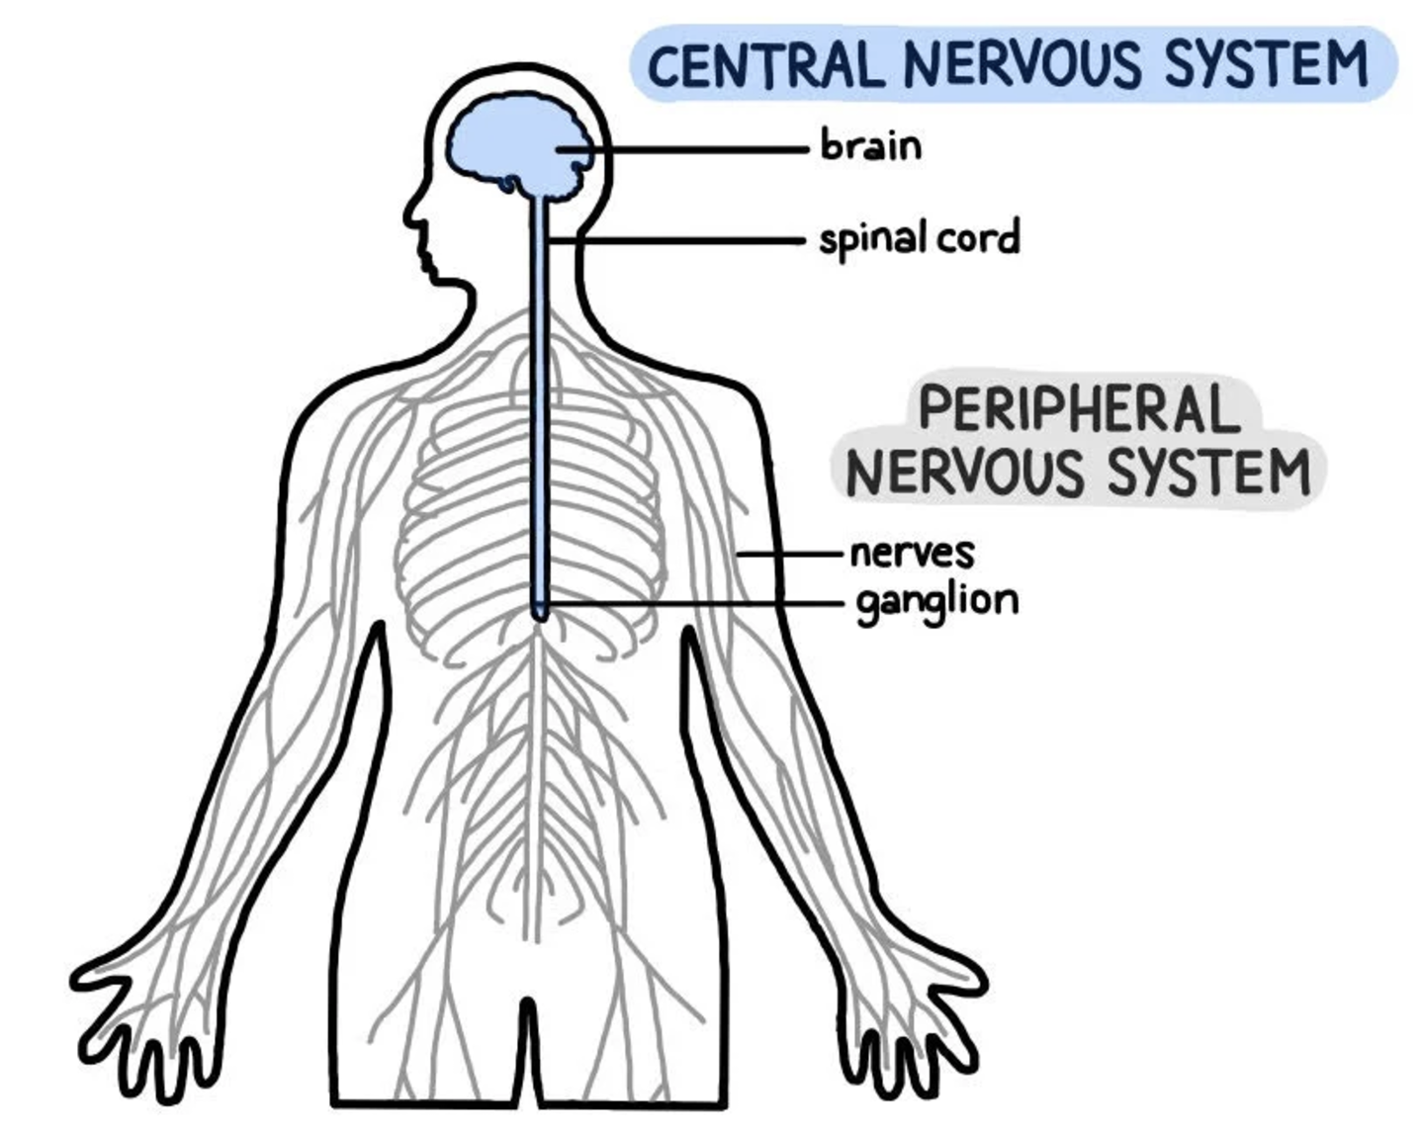
2. The Nervous System
The nervous system is the pathway of communication involving high speed electrical signals.
There are two portions to it:
CNS
PNS
https://www.simplypsychology.org/peripheral-nervous-system.html
https://www.simplypsychology.org/peripheral-nervous-system.html

Slide 8
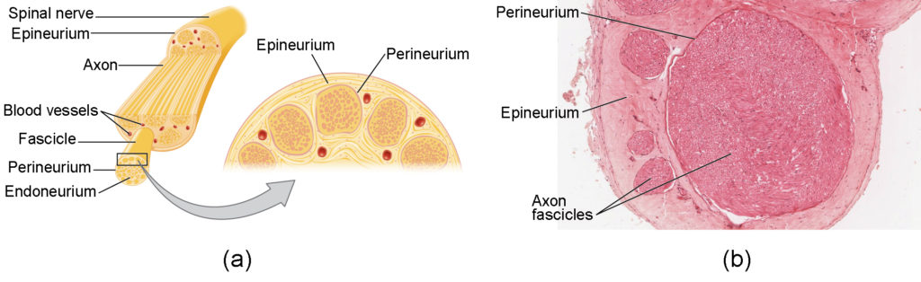
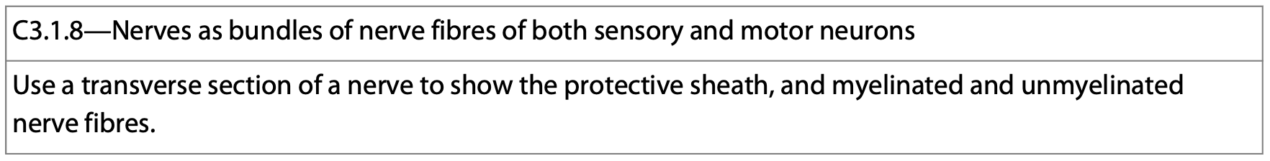
Nerves
Nerves contain both myelinated and unmyelinated fibers and are surrounded by a protective sheath called the epineurium which protects them.

Slide 9
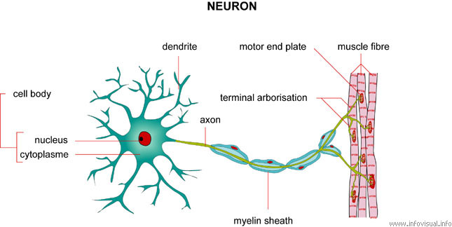
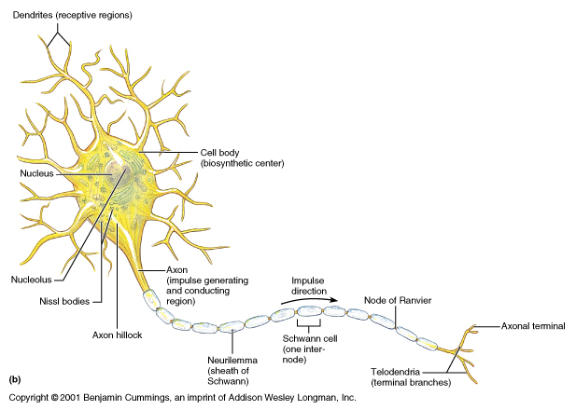
Nerves
Nerves are bundles of nerves wrapped in connective tissue that transfers information about the environment to and from the CNS using electrical signals.

Slide 10
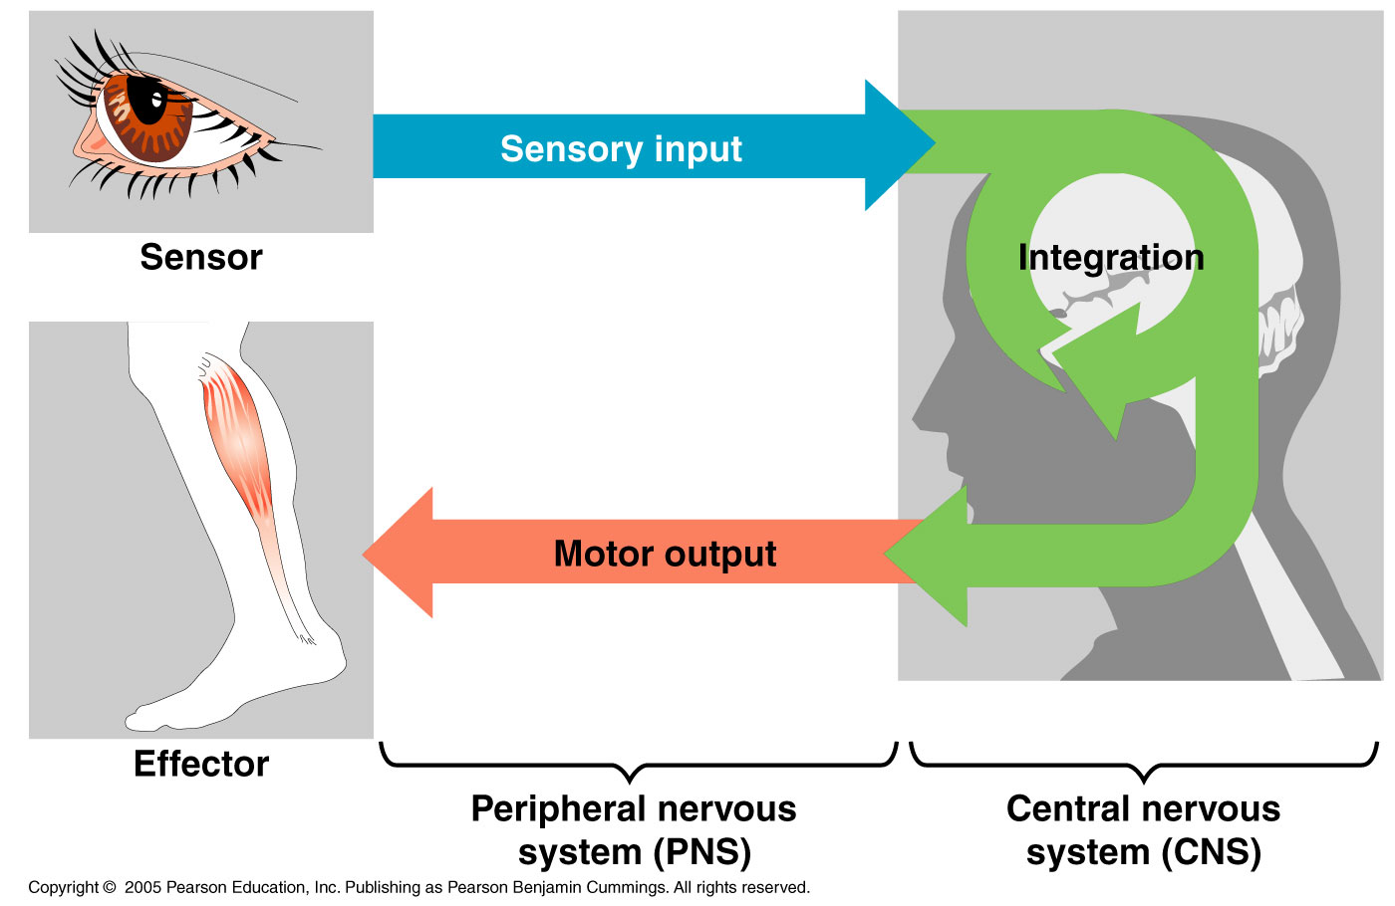
How do nerve systems work?
Nerve systems work by processing information in 3 stages:
Sensory input
Integration
Motor output

Slide 11
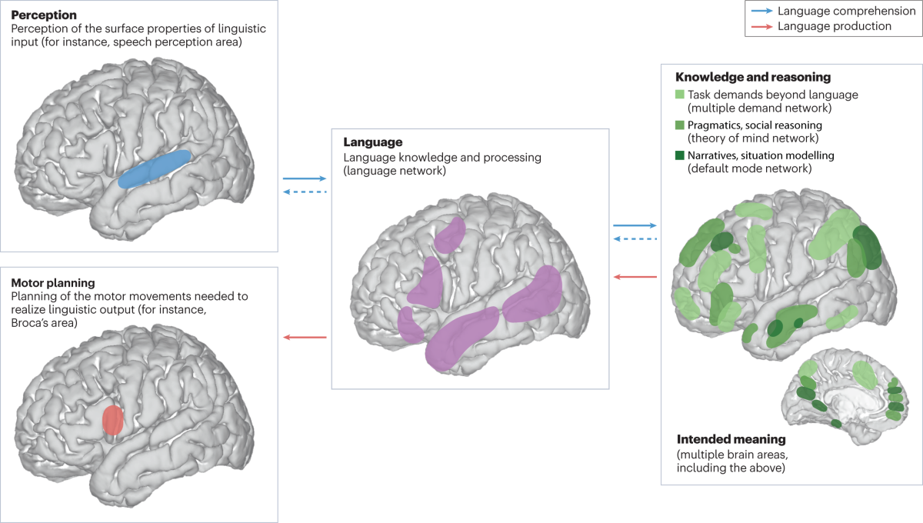
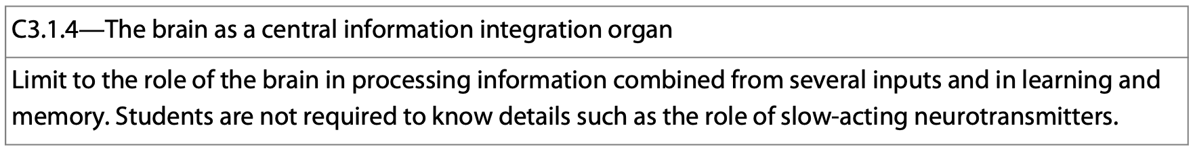
The brain
The brain is the central processing organ used to integrate the input and make sense of the information it receives from a variety of sources.
https://www.nature.com/articles/s41583-024-00802-4

Slide 12
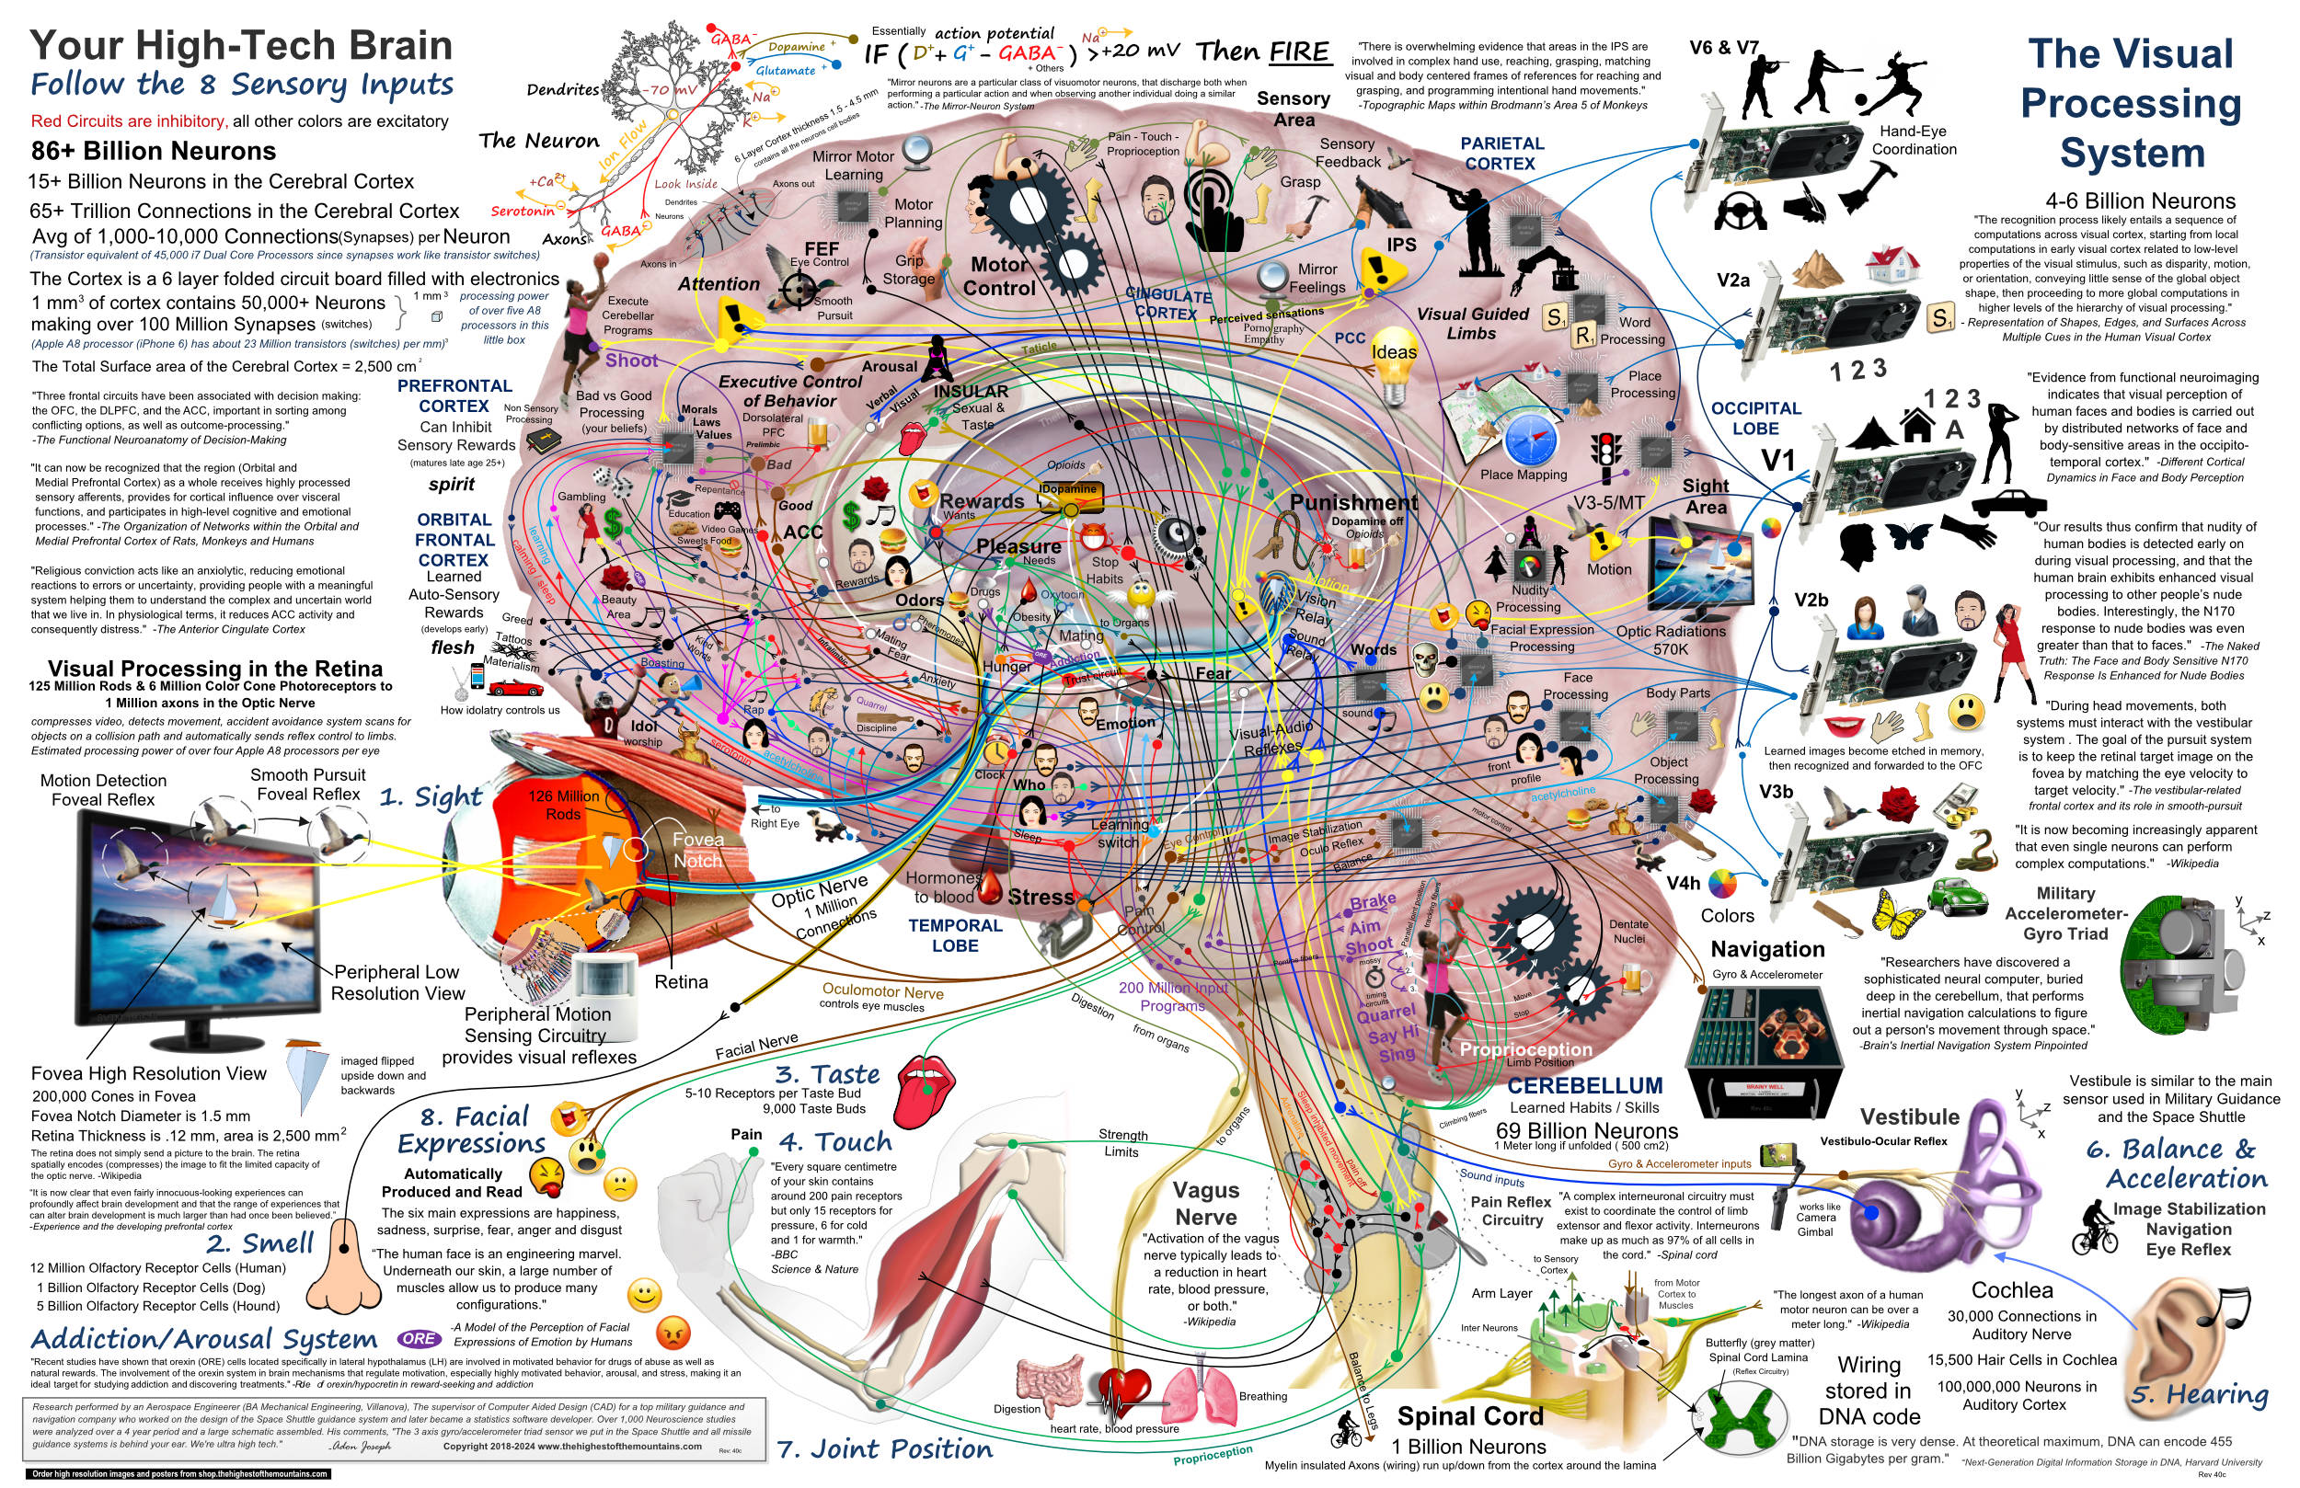
The brain
The brain receives information from multiple inputs.
It must then coordinate an output based on memories built from learning, and from reacting to the stimulus.
The response is often fast and doesn’t always require conscious thought.
Think of a time when you got out of the way of something to avoid being injured.
https://thehighestofthemountains.com/brainmaps.html

Slide 13
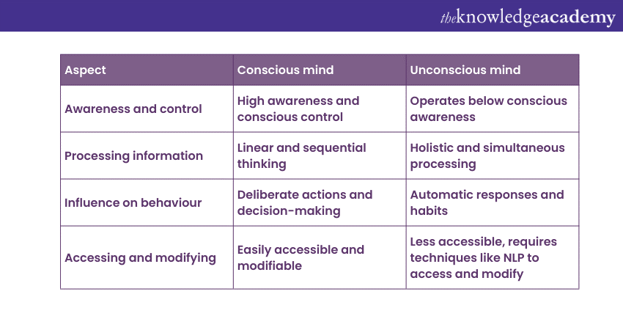
Conscious vs. unconscious processes
Some of the processes occurring in nerve systems are conscious, others are unconscious.
A conscious process is one that involves intentional, voluntary, and deliberate actions.
Unconscious processes occur automatically, involuntarily, and are reflexive.

Slide 14
A conscious process
We make conscious decisions all the time. I am going to go for a walk.
I am going to eat a sandwich.
These are different from unconscious decisions.
https://thehighestofthemountains.com/brainmaps.html

Slide 15
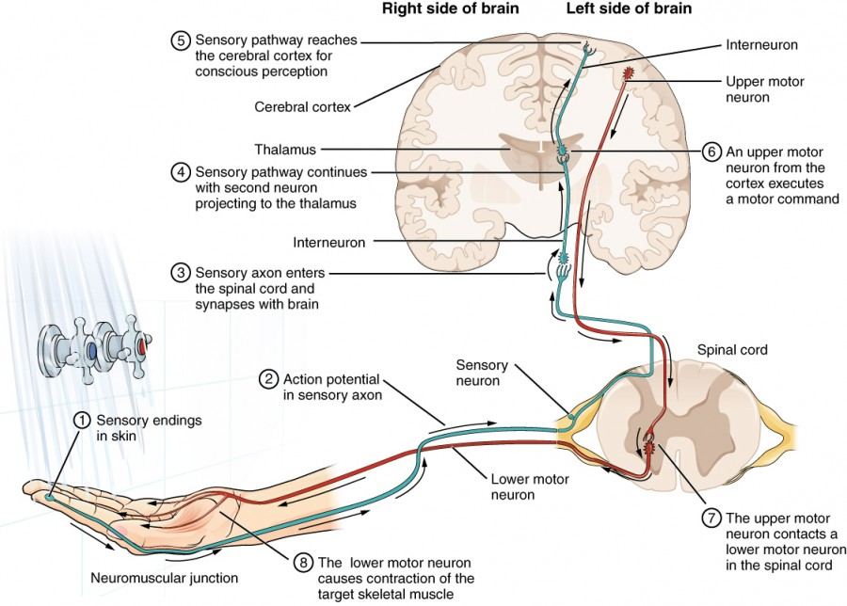
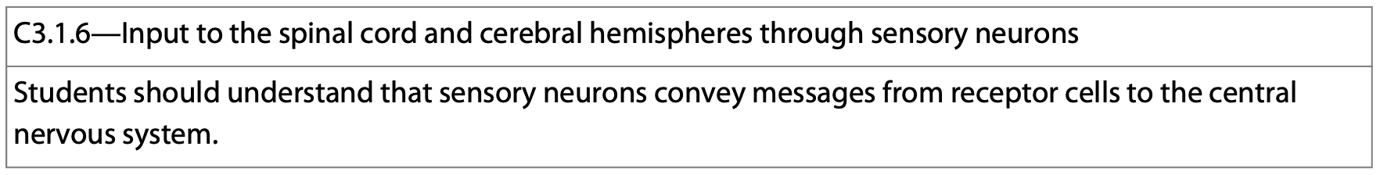
Sensory input
All sensory input comes from sensory nerves.
Sensory nerves transmit information to the brain and spinal cord.
https://courses.lumenlearning.com/suny-dutchess-anatomy-physiology/chapter/the-function-of-nervous-tissue/

Slide 16
Unconscious Processes—a Reflex
Motor output leaves the CNS via motor neurons which communicate with effector cells eliciting a change.
These motor neurons can be due to voluntary control, or involuntary control.

Slide 17
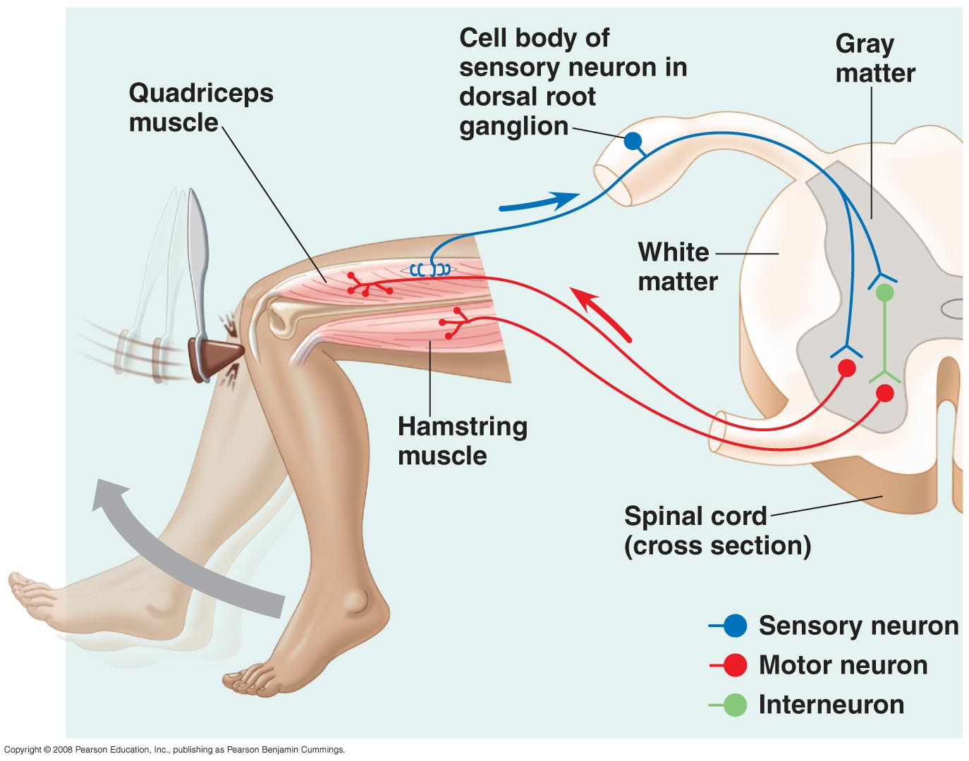
Unconscious Processes—a Reflex
The three stages are handled by specialized neurons.
Sensory neurons transmit information from sensors that detect external stimuli and internal conditions.
All sensory input comes from sensory nerves.
These receptors are usually specialized neurons or epithelial cells.

Slide 18
Unconscious Processes—a Reflex
The three stages are handled by specialized neurons.
Interneurons integrate and analyze sensory input. They allow the spinal cord to work independently of the brain and provide reflexes.
The reflex is an automatic response to certain stimuli and acts to protect the body from harm—think about touching something hot.

Slide 19
Unconscious Processes—a Reflex
The interneurons also provide inhibitory signals to opposing muscles allowing the reflex to produce the desired result.
The CNS also provides integrative power for the organism—specifically the brain.

Slide 20
Unconscious Processes—a Reflex
Motor output leaves the CNS via motor neurons which communicates with the quads causing them to contract, and with the hamstrings, causing them to relax.

Slide 21
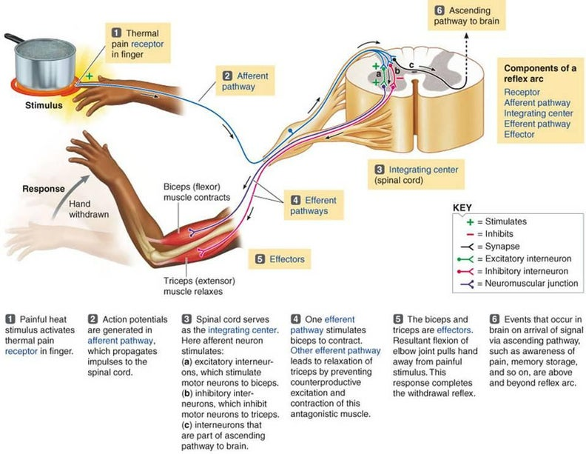
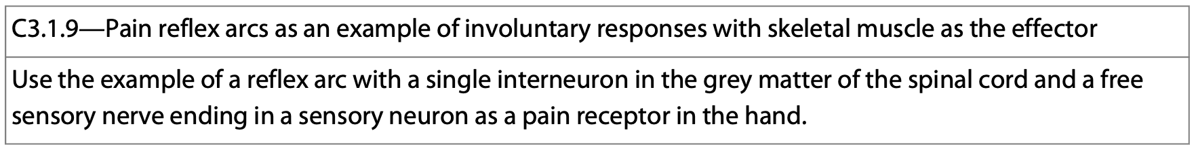
The pain reflex arc
Hand touches the hot pan.
Motor neurons carry the information to the PNS.
Spinal cord processes the signal and sends information to the antagonistic pairs of muscles.
Hand is withdrawn from stimulus.
Other sensory information is sent to the brain for processing—pain.
https://www.instructables.com/Arduino-Mechanotronic-Human-Pain-Reflex/

Slide 22
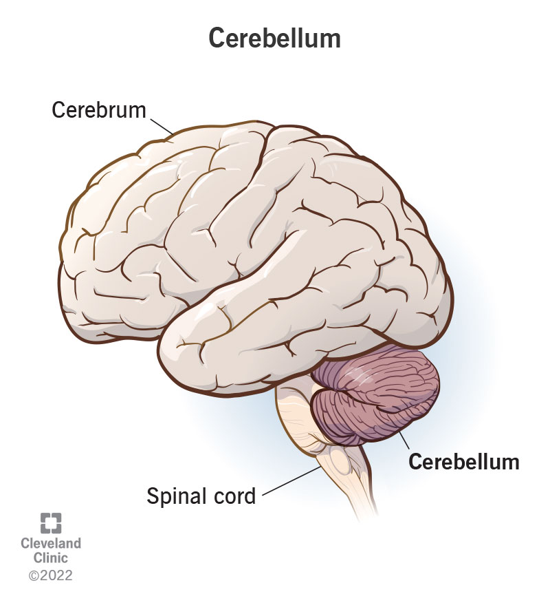
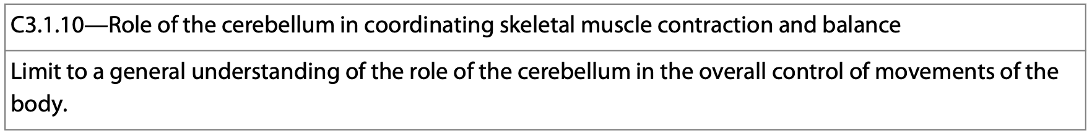
The cerebellum and balance
The cerebellum functions in balance by coordinating skeletal muscle contractions and normal muscle tone. Normal muscle tone controls posture and balance.
https://www.instructables.com/Arduino-Mechanotronic-Human-Pain-Reflex/

Slide 23
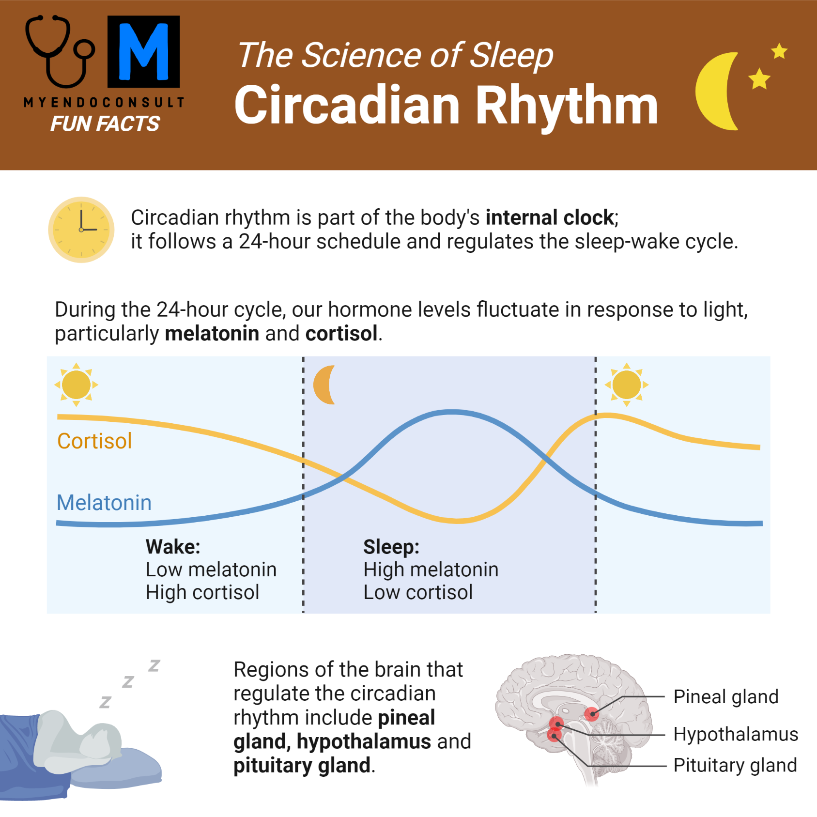
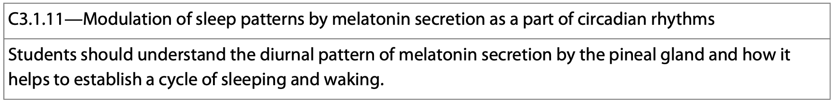
Modulation of Sleep patterns
The circadian rhythm is the body’s 24-hour cycle that regulates physical, mental, and behavioral changes within our bodies.
During the day, cortisol levels are high, and melatonin levels are low.
During the hours of darkness, cortisol secretion slows, and the pineal gland secretes melatonin.
https://myendoconsult.com/learn/pineal-gland/

Slide 24
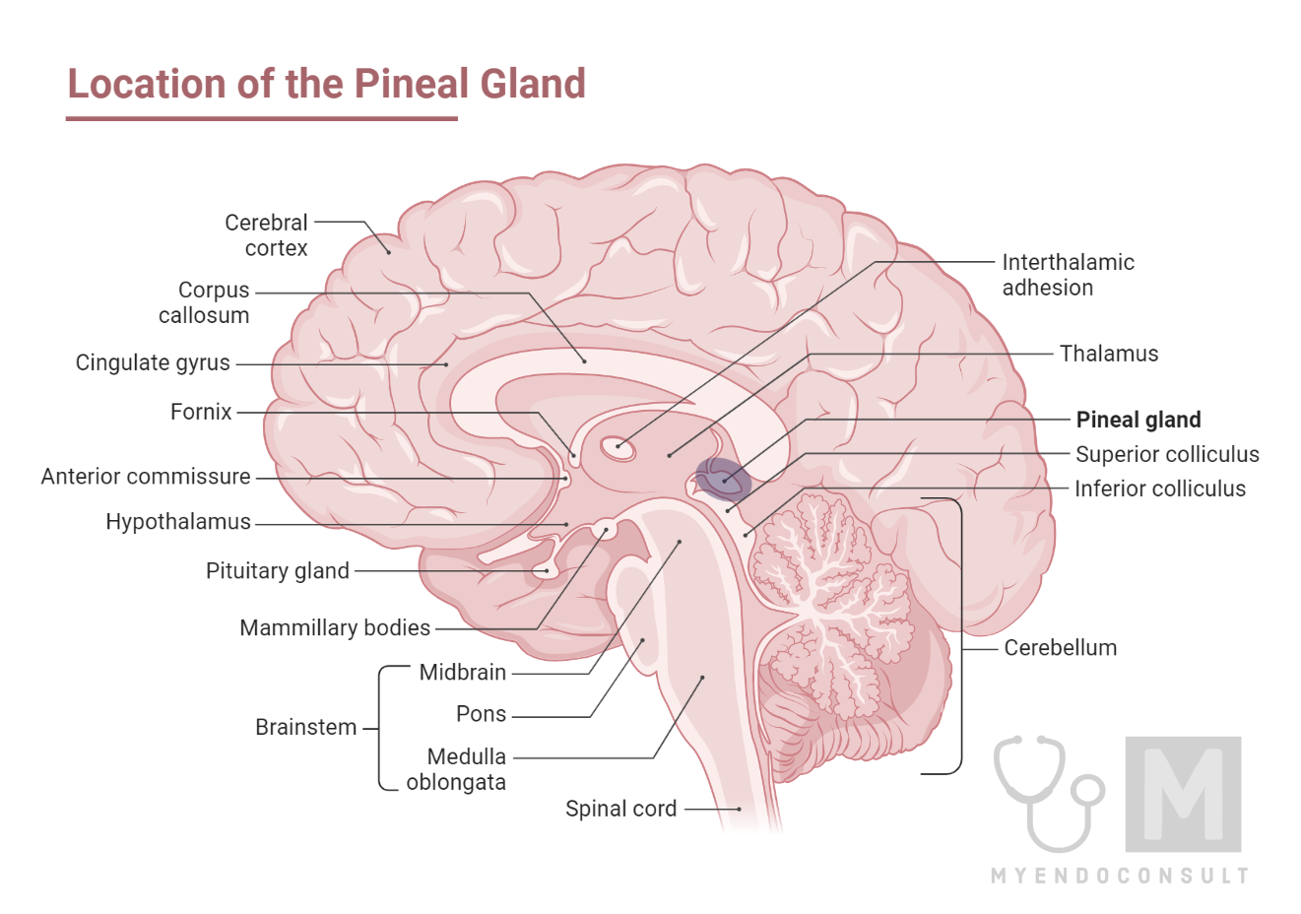
The pineal gland
As light levels decrease, that information is relayed in the form of action potentials from the retinal cells to superchiasmatic nucleus in the hypothalamus.
The information is then relayed to the pineal gland which controls the release of melatonin.
Melatonin is involved in controlling circadian rhythms.
It regulates metabolism, sleep/wake cycles, mood, body temperature.
https://myendoconsult.com/learn/pineal-gland/

Slide 25
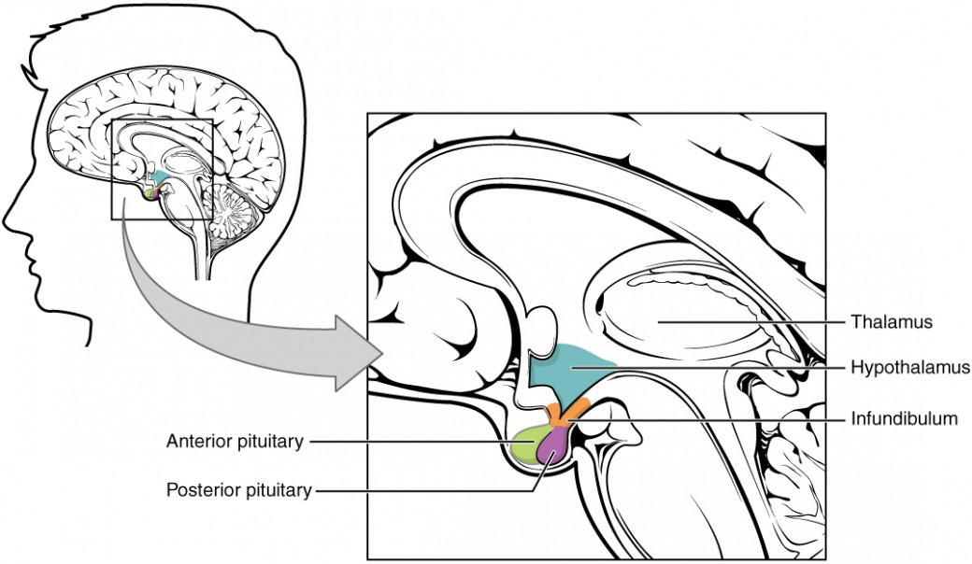
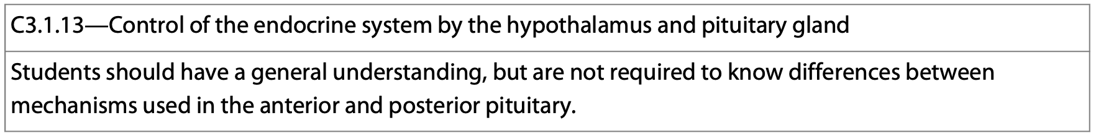
The Hypothalamus and pituitary gland
The hypothalamus and pituitary gland work together to control many functions within the body.
The hypothalamus is located at the base of the brain and is involved in regulating body temperature, blood pressure, heart rate, sleep, appetite, and water balance.
The pituitary gland is a pea-sized organ located at the base of the brain and controls may endocrine functions.
It produces many hormones that control vital aspects of homeostasis.
https://courses.lumenlearning.com/suny-ap2/chapter/the-pituitary-gland-and-hypothalamus/

Slide 26
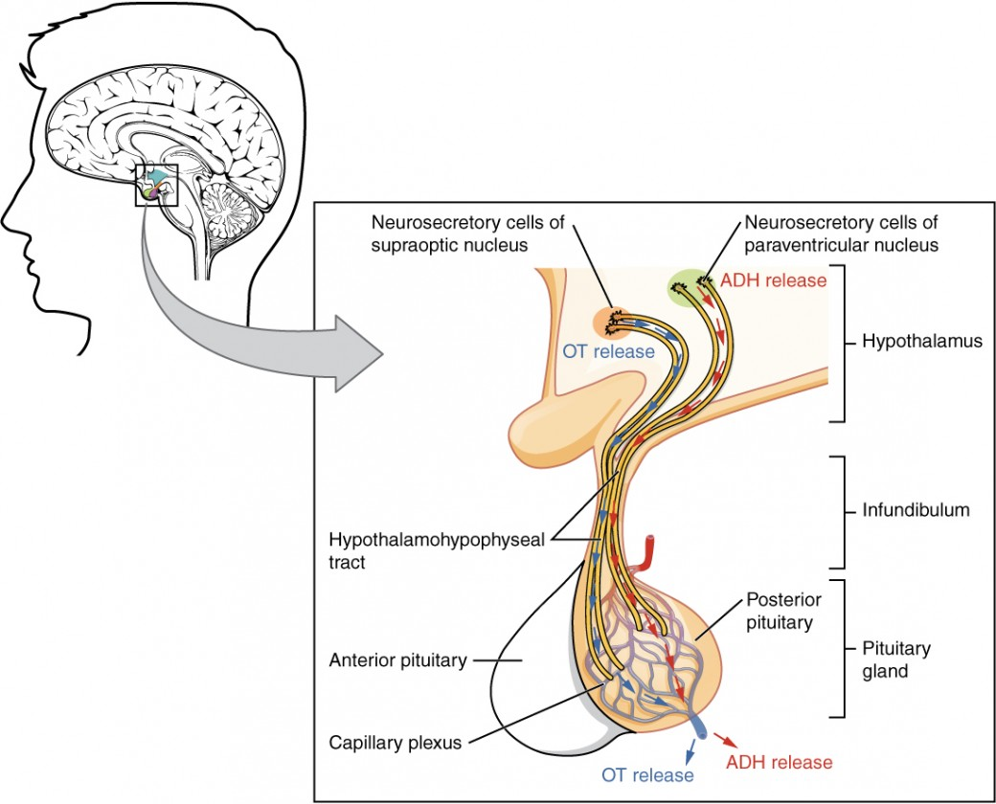
The Hypothalamus and pituitary gland
The hypothalamus and pituitary gland are connected by a stalk of blood vessels and nerves called the infundibulum which serves as a communication port.
https://courses.lumenlearning.com/suny-ap2/chapter/the-pituitary-gland-and-hypothalamus/

Slide 27
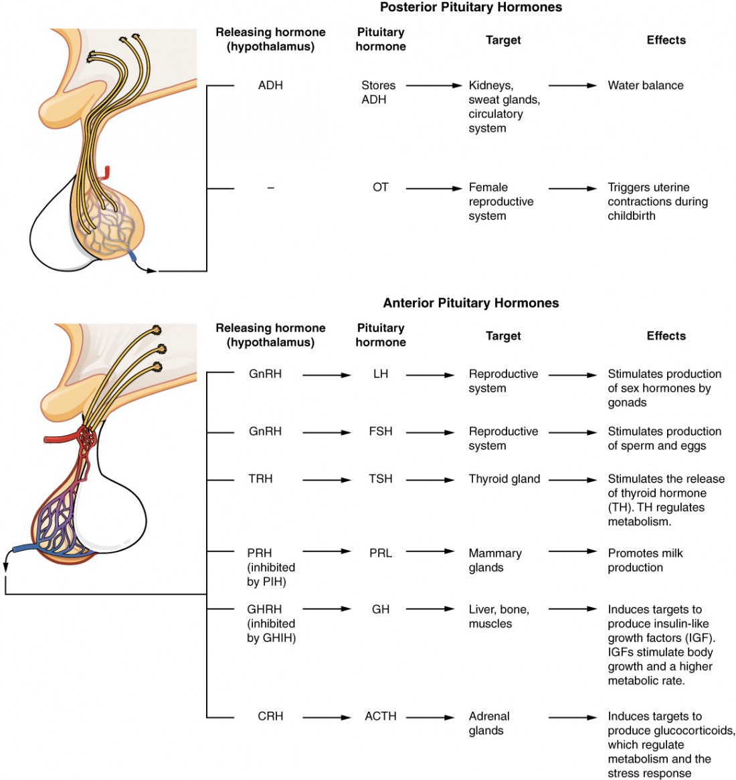
The Hypothalamus and pituitary gland
The hypothalamus communicates with the pituitary gland using hormones and nerve impulses.
Some common examples:
ADH is made by the hypothalamus and stored in the posterior pituitary.
Gonadotropin releasing hormones stimulate the pituitary to release LH and FSH.
Thyroid releasing hormone causes the pituitary to release TSH to stimulate the thyroid and control metabolism.
Corticotropin releasing hormone stimulates the pituitary gland to release ACTH which then works on the adrenal glands to regulate metabolism.
https://courses.lumenlearning.com/suny-ap2/chapter/the-pituitary-gland-and-hypothalamus/

Slide 28
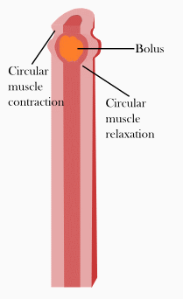
Peristalsis
The involuntary movement of food through the digestive system is called peristalsis.
You voluntarily ingest food and swallow it. You also can voluntarily control the release of waste when you go to the bathroom.
https://www.dreamstime.com/illustration/enteric-nervous-system.html

Slide 29
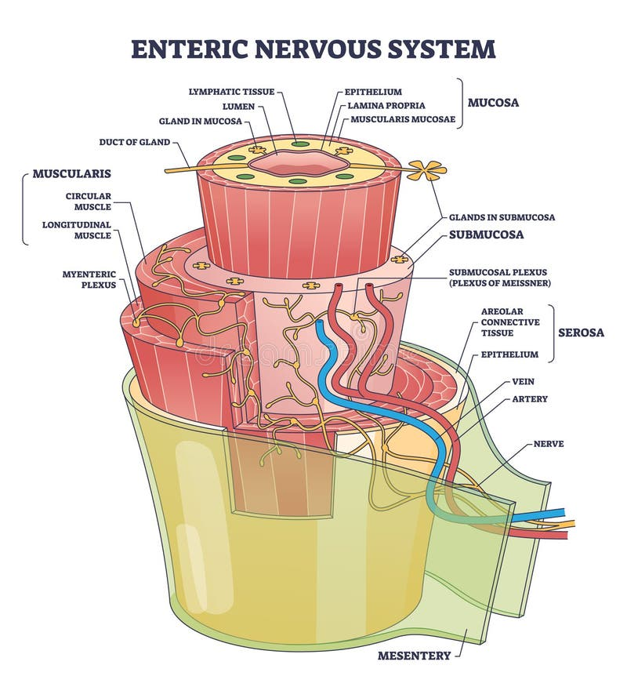
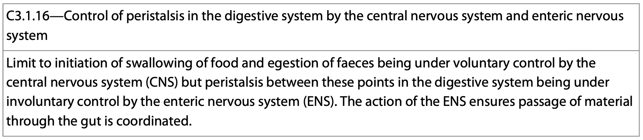
Peristalsis
When food is in between these two processes, it is moved through the rhythmic contraction of smooth muscle within the enteric nervous system (ENS) and the associated smooth muscle.
https://www.dreamstime.com/illustration/enteric-nervous-system.html

Slide 30
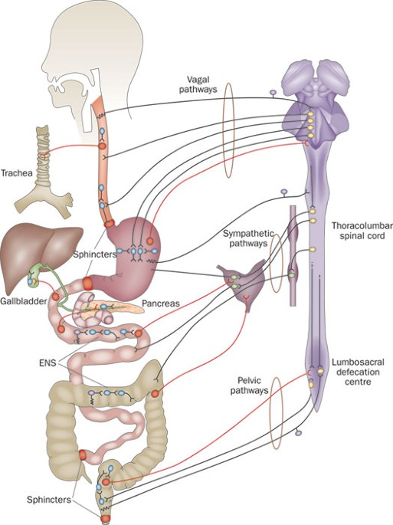
Enteric nervous system
The ENS is located in the walls of the digestive tract.
It is made up of two thin layers of neurons with thousands of ganglia associated with many different types of neurons.
It is capable of working independently of the CNS, but often communicates with it during homeostasis.
It works independently to move food, but stimulus from the digestive system can speed up or slow down movement.
https://www.nature.com/articles/nrgastro.2012.32

