Slide 1
Chapters 48: Neurons and Synapses
“I like nonsense; it wakes up the brain cells.”
–Dr. Seuss
1

Slide 2
Linking and Guiding Questions:
Linking Questions:
What patterns exist in communication in biological systems?
In what ways is negative feedback evident at all levels of biological organization?
Guiding Questions:
How are electrical signals generated and moved within neurons?
How can neurons interact with other cells?
2

Slide 3
Nerve Systems
Except for sponges, all animals have some type of nervous system. The thing that sets them apart is their organization.
Some animals, such as hydra, have highly diffuse nerve nets without much organization.
Other animals, such as humans, have highly organized nerve systems.
3

Slide 4
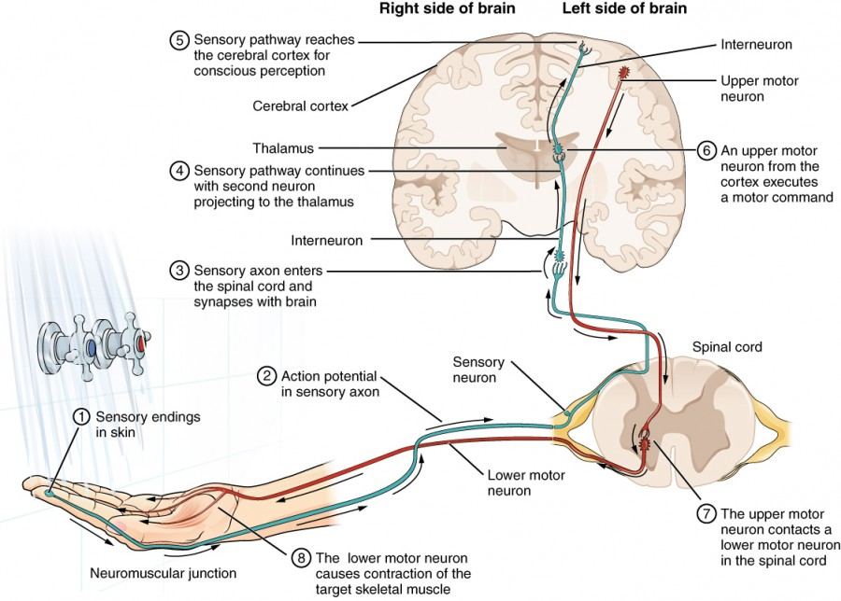
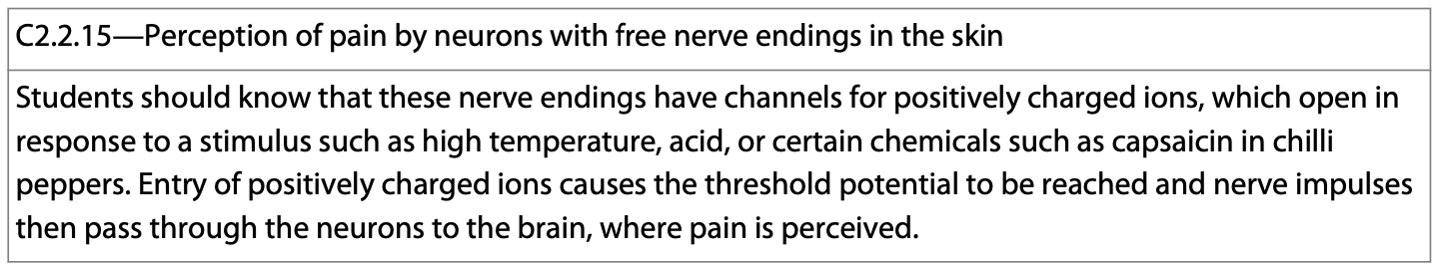
Nerve Systems
Perception of sensory input by the nerve leads to the sensation of that input.
Nerve endings have different ways of receiving sensory input which is then sent to the brain for processing.
https://courses.lumenlearning.com/suny-dutchess-anatomy-physiology/chapter/the-function-of-nervous-tissue/
4

Slide 5
Supporting Cells of the Nervous System
Glia are the supporting cells of the nervous system.
There are several different types, among them are:
1. Schwann cells
2. Oligodendrocytes
3. Radial glia
4. Astrocytes.
5

Slide 6
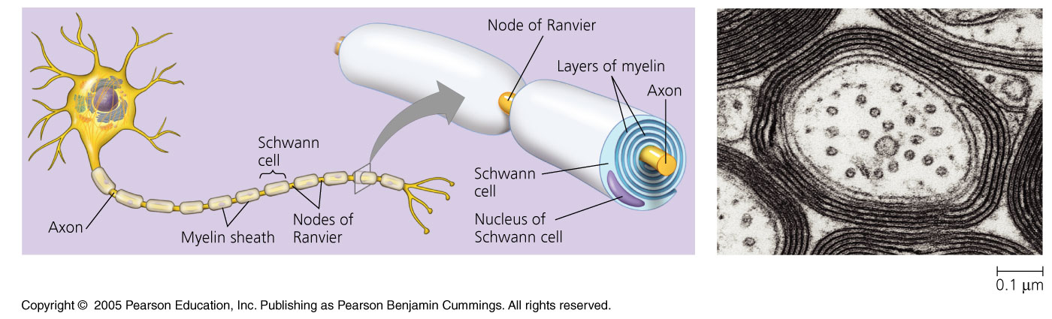
1. Schwann Cells
Schwann cells are an important type of supportive cell. They are associated with the PNS and form myelin sheaths around the axons of many vertebrate neurons.
The myelin sheath allows for saltatory conduction.
6

Slide 7
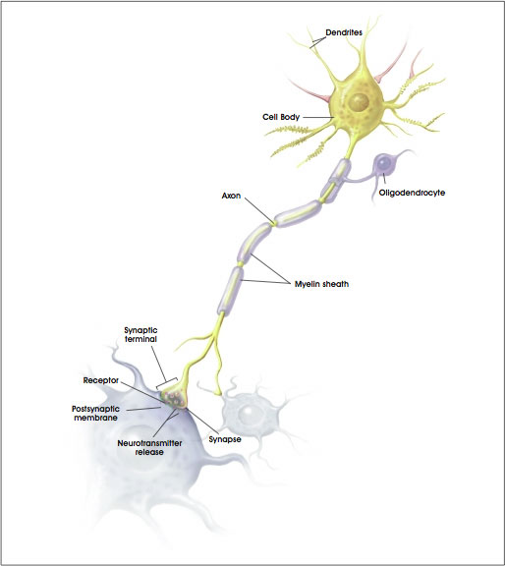
2. Oligodendrocytes
Oligodendrocytes are associated with the CNS and do the same thing as Schwann cells.
The myelin sheath generated by these cells forms an insulation blanket. This aids in saltatory nerve conduction.
7

Slide 8
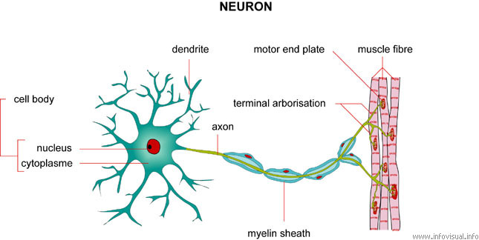
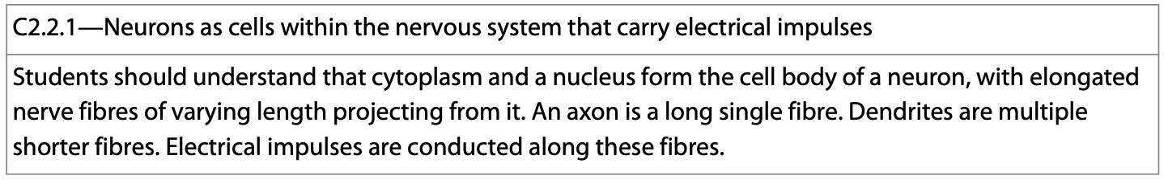
Neurons
A neuron is a nerve cell, and it transmits electrical impulses throughout the body.
There are approximately 100 billion of them in the brain.
They are organized into nerves and nerve systems.
8

Slide 9
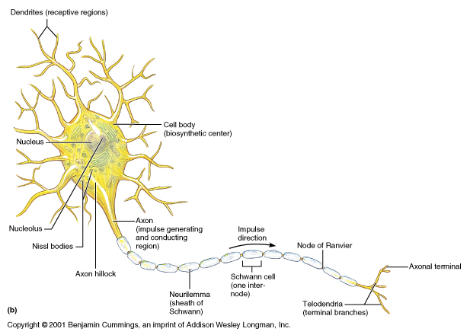
What is a nerve?
A nerve is a bundle of neurons wrapped in connective tissue that transfers information about the environment to and from the CNS using electrical signals.
9

Slide 10
What is a nerve?
The information is transmitted in the form of action potentials which get propagated along the axons of neuron where they synapse with other cells.
10

Slide 11
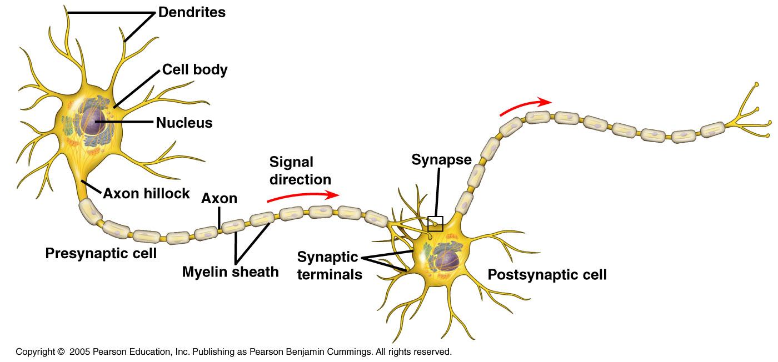
What is a Nerve?—Form Fitting Function
The organelles of a neuron are located in the cell body. Two main extensions arise from the cell body.
1. Axons—longer, transmit signals.
2. Dendrites—highly branched, receive signals.
11

Slide 12
Synaptic Transmission
When the organism receives information from the outside, it must be relayed quickly so that an appropriate response can occur.
This relay of information is accomplished via an action potential which synapses with a series of other neurons along the way—sometimes up to 100,000!
12

Slide 13
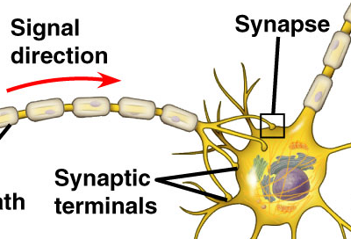
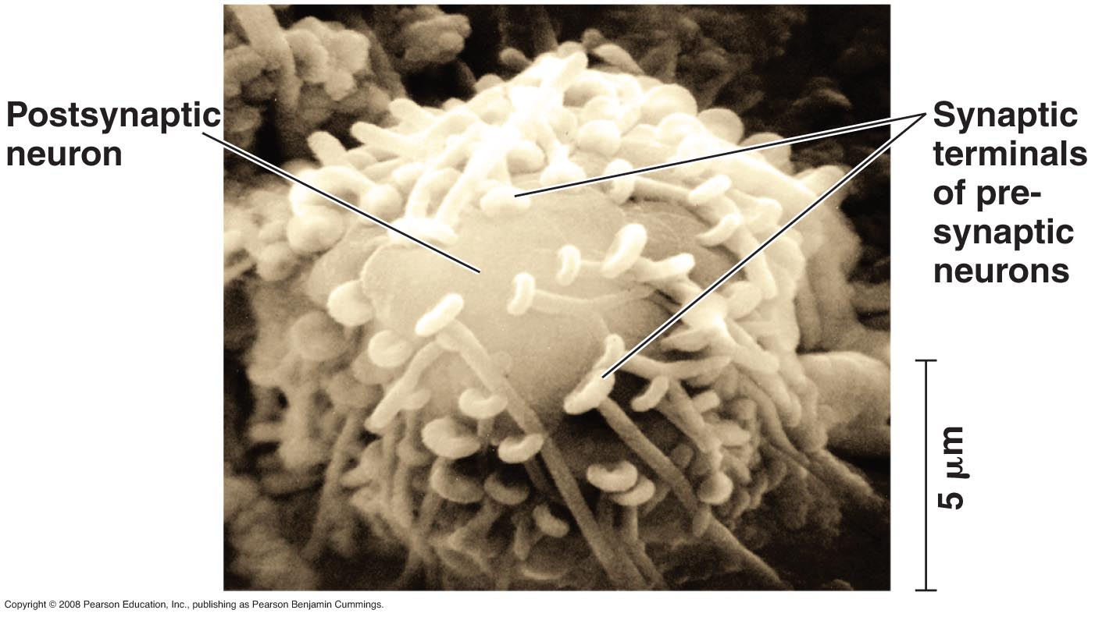
A Synapse—Form Fitting Function
Near its end, an axon divides into several branches, each ending in a synaptic terminal where it communicates with the next neuron via the synapse.
13
Copyright ©2005 Pearson Education, Inc. Publishing as Pearson Benjamin Cummings. All rights reserved.

Slide 14
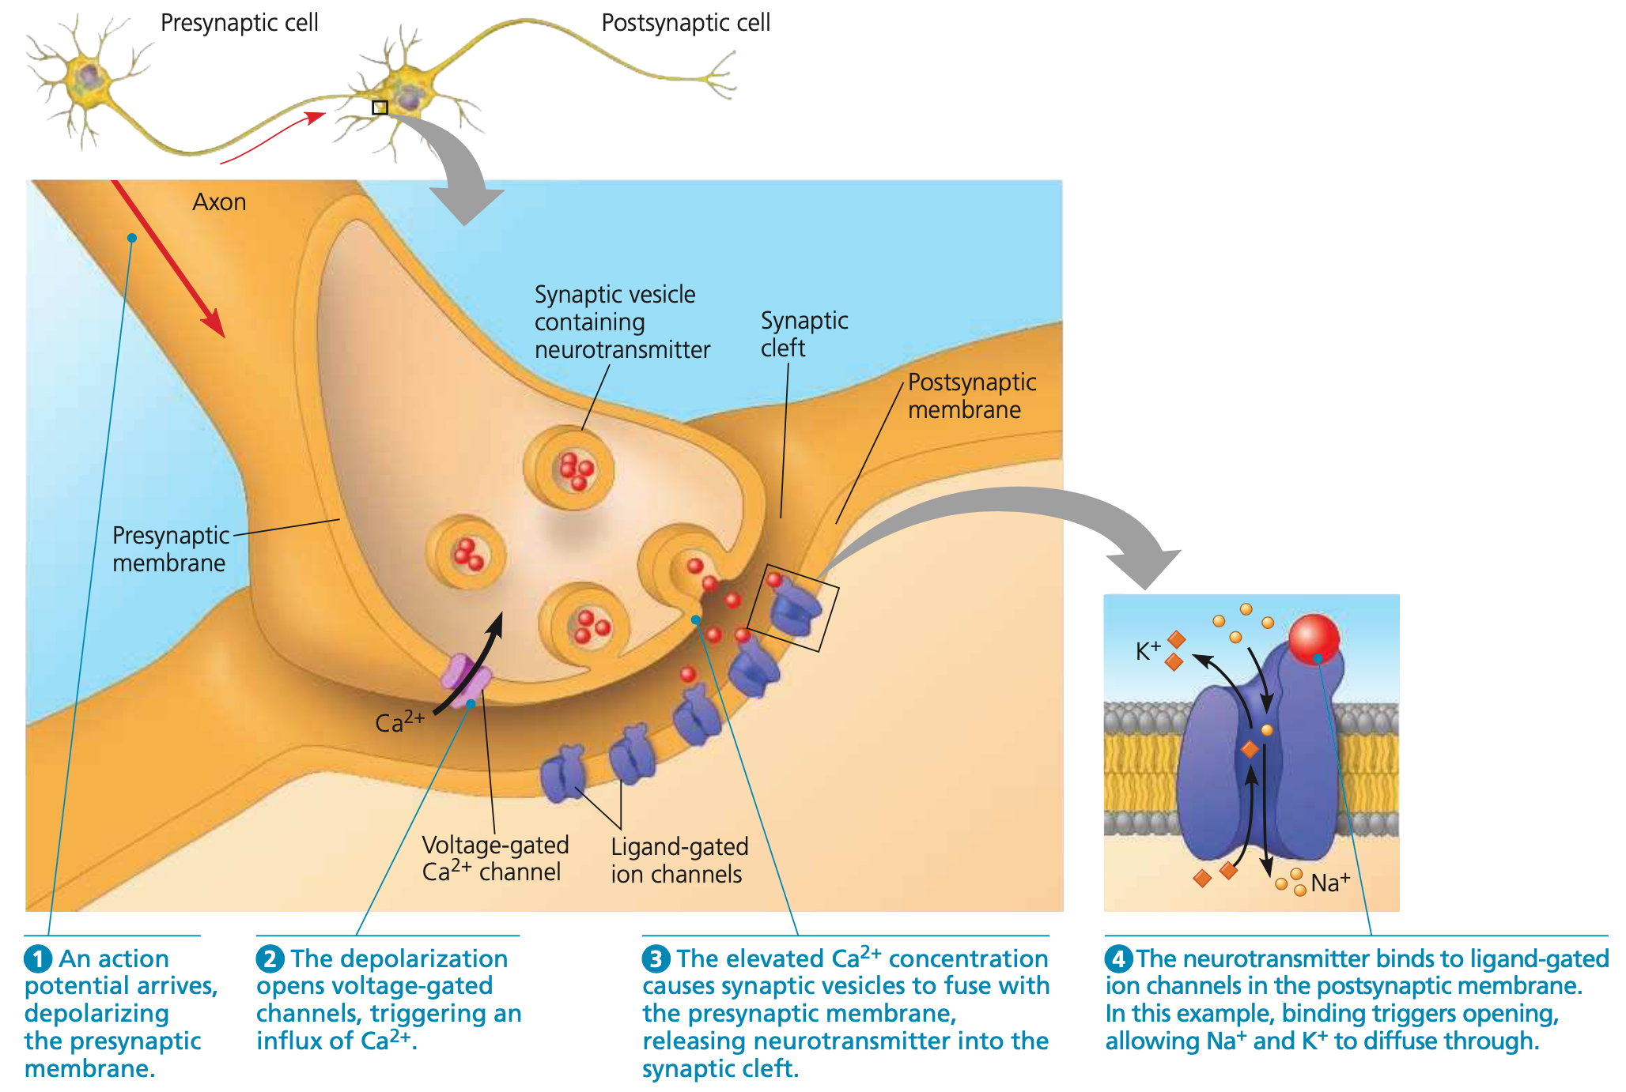
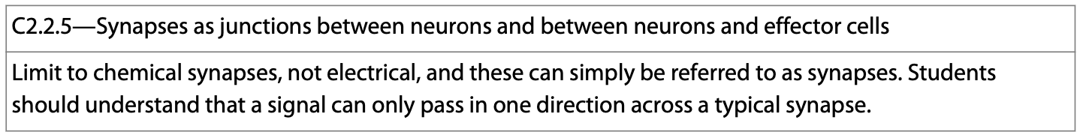
A Synapse—Form Fitting Function
The synapse is the site of communication between one nerve and another.
14

Slide 15
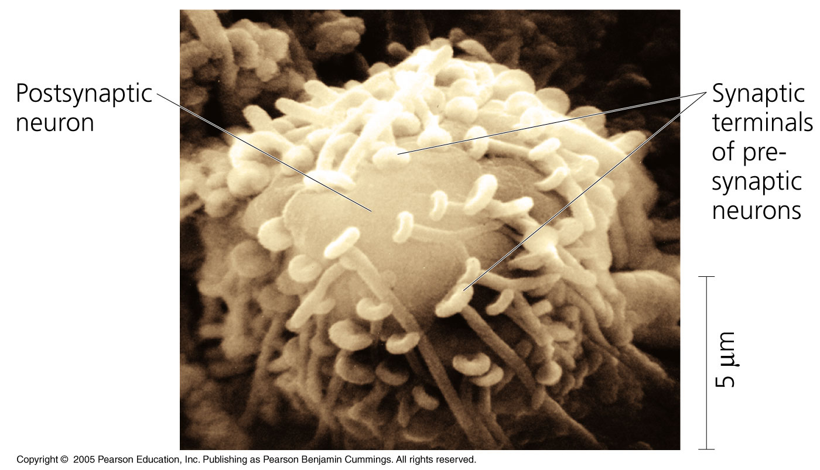
Action Potentials—Synapses
When action potentials reach the ends of axons, they contribute one of 2 general mechanisms of information transfer.
1. Electrical synapse.
2. Chemical synapse.
15

Slide 16
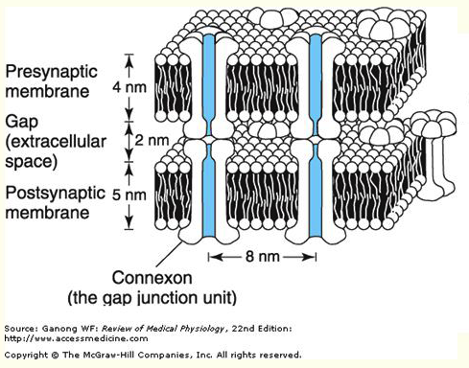
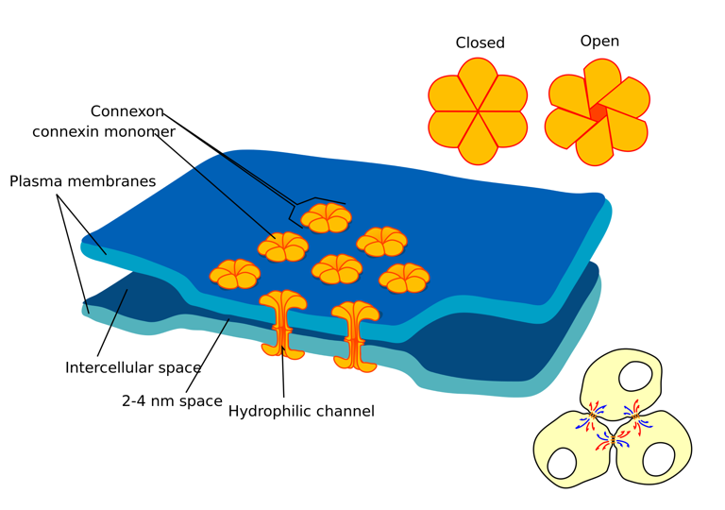
Synapses—Electrical
1. Electrical synapses contain gap junctions which allow electric current to flow from one neuron to the next.
The roles of the gap junction are to allow for cell-to-cell communication and propagation of an electrical signal.
16
https://en.wikipedia.org/wiki/Gap_junction

Slide 17
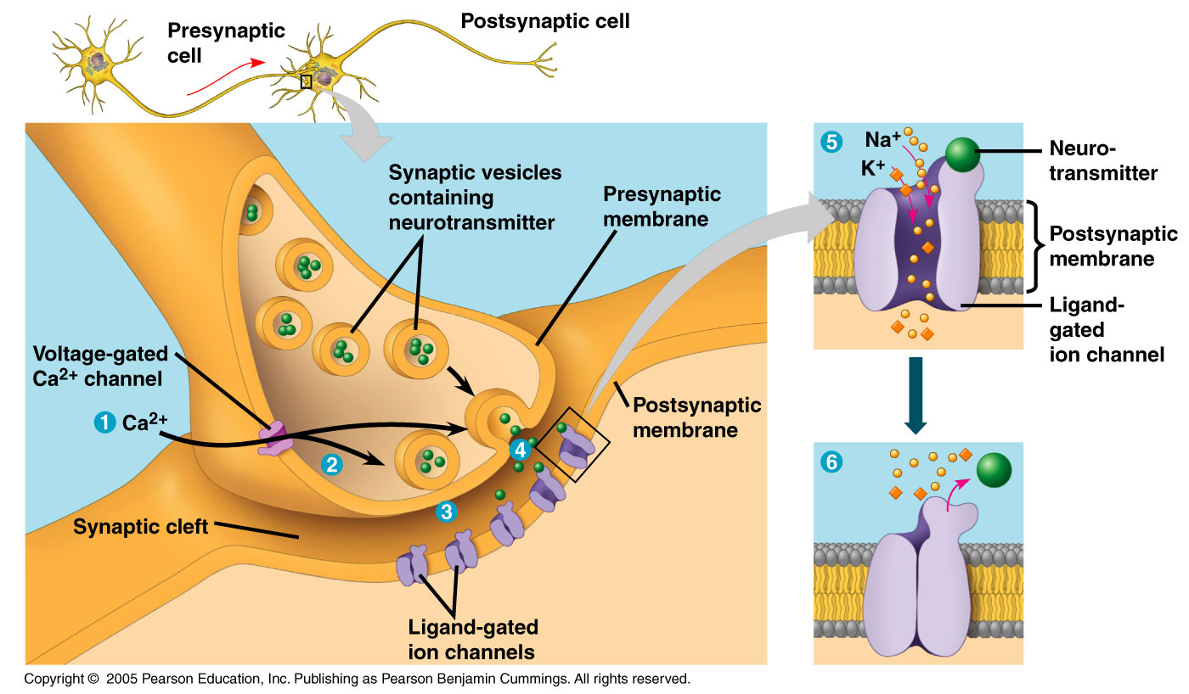
Synapses—Chemical
2. Chemical synapses make up the vast majority of synapses.
When depolarized, pre-synaptic neurons release chemical neurotransmitters into the synapse via synaptic vesicles.
The neurotransmitters from the synaptic vesicles interact with the dendrites of a post-synaptic neuron.
17

Slide 18
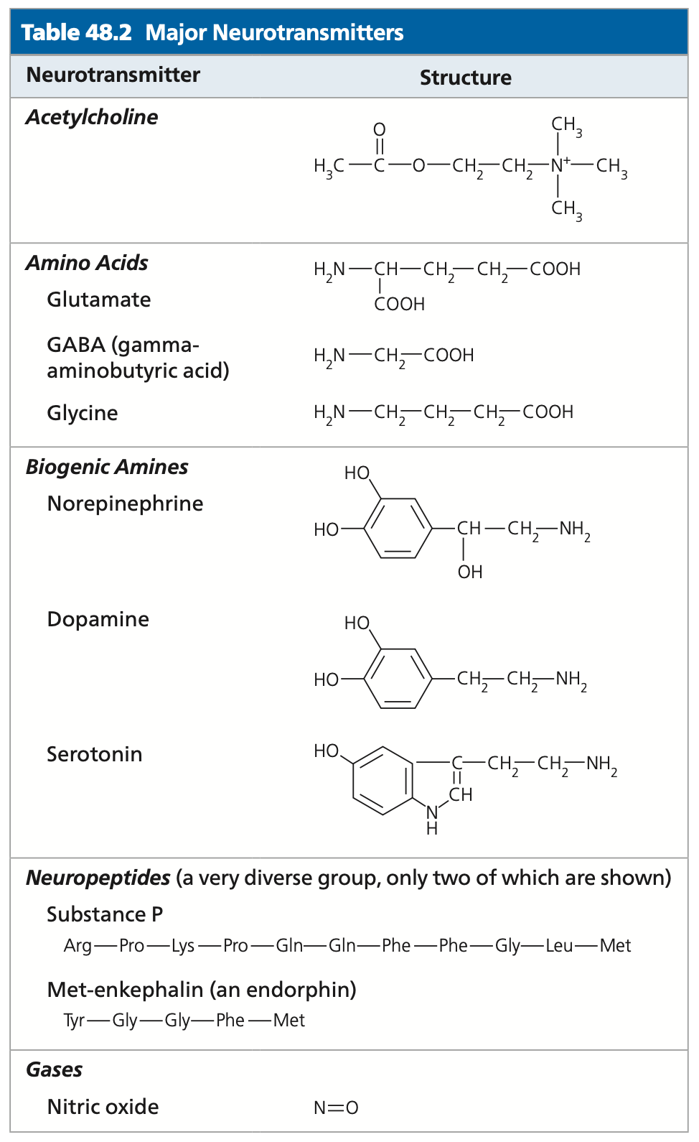
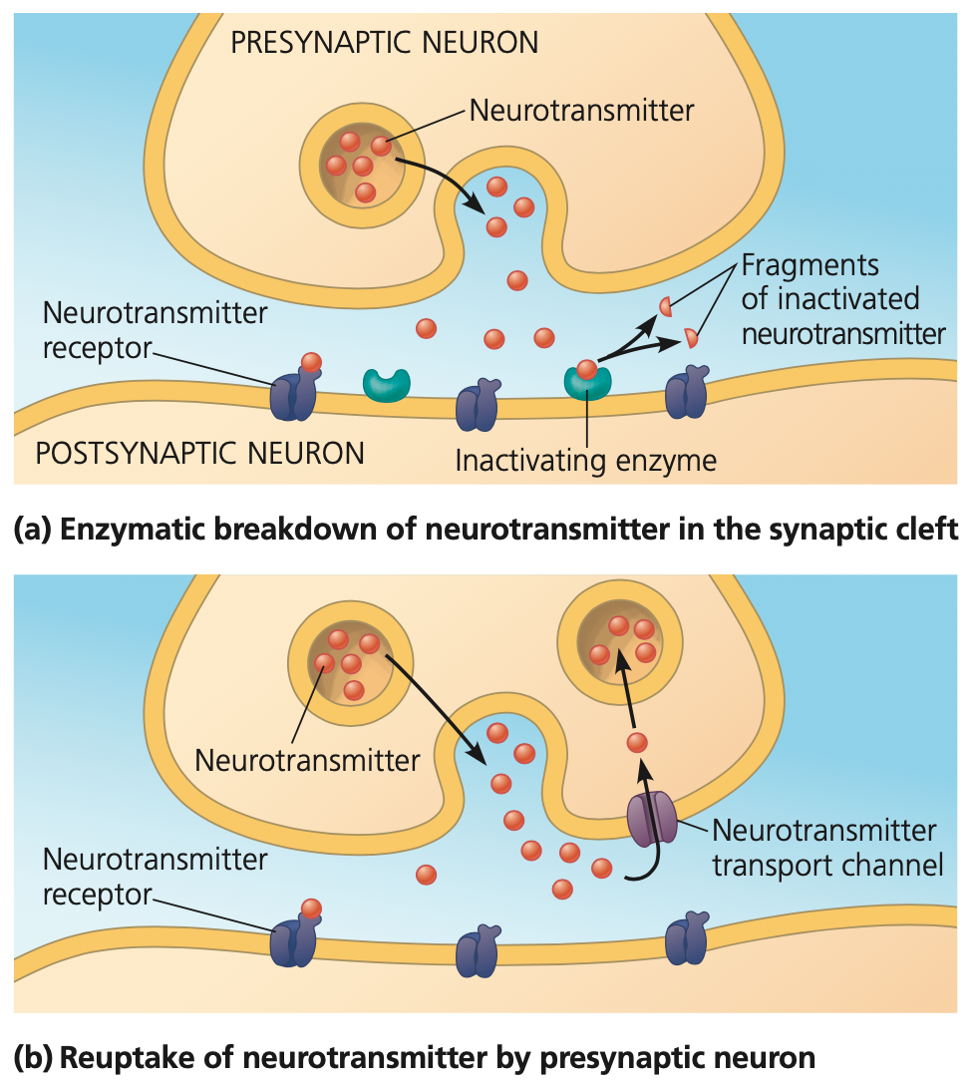
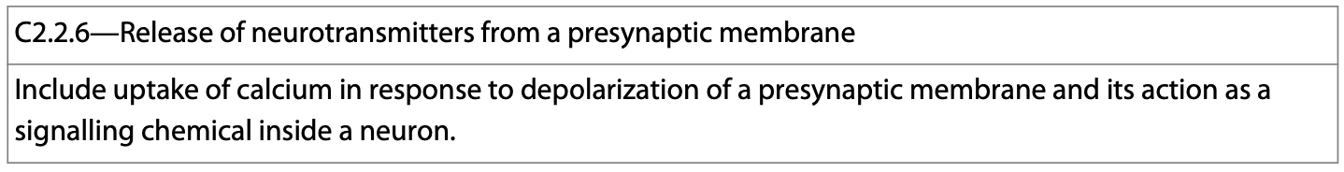
Neurotransmitters
Neurotransmitters transmit the signal from a pre-synaptic cell to a post-synaptic neuron.
18

Slide 19
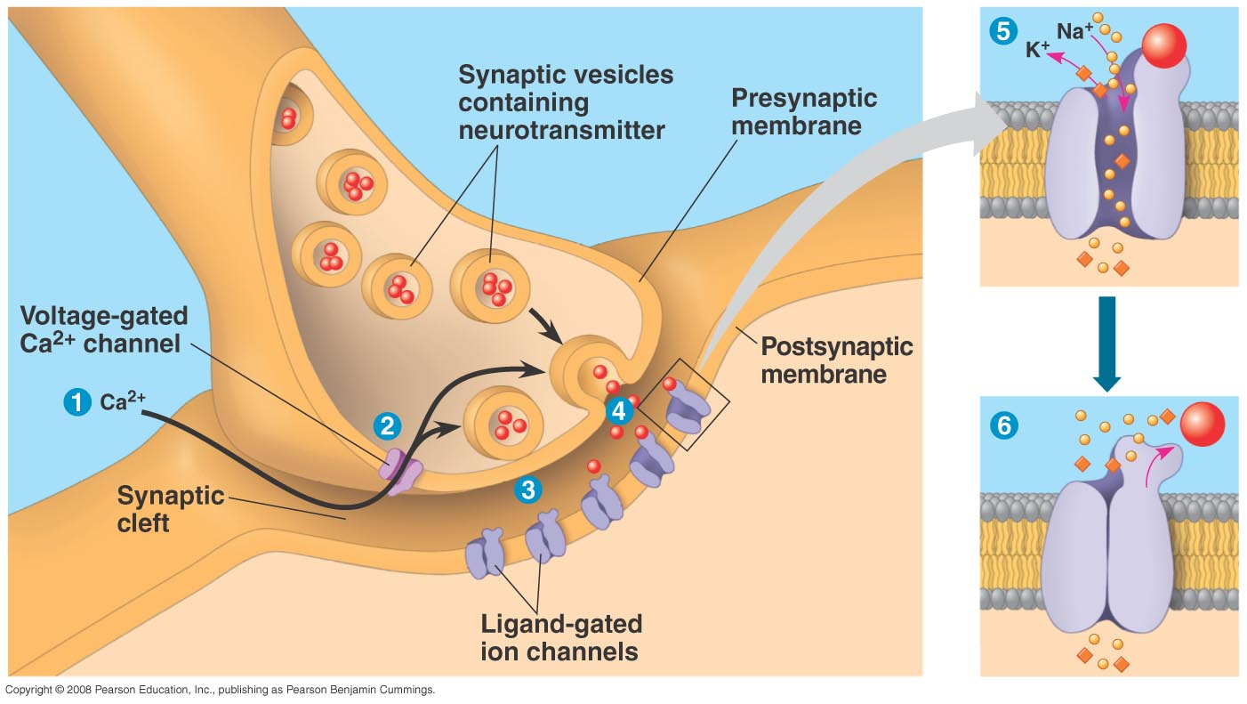
Synaptic Transmission
The release of neurotransmitters to the neighboring cell acts to transmit the signal and elicit the appropriate response. Some responses are excitatory, others are inhibitory.
19

Slide 20
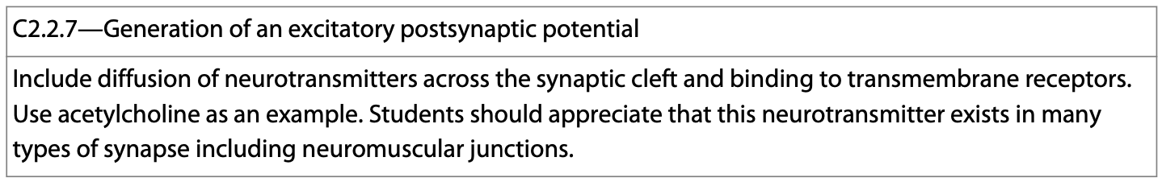
Excitatory Postsynaptic Potentials
When neurotransmitter diffuses across the synapse and binds to the receptors on the postsynaptic cell, the receptors open allowing passage of ions.
This can excite the postsynaptic cell and generate an action potential.
20

Slide 21
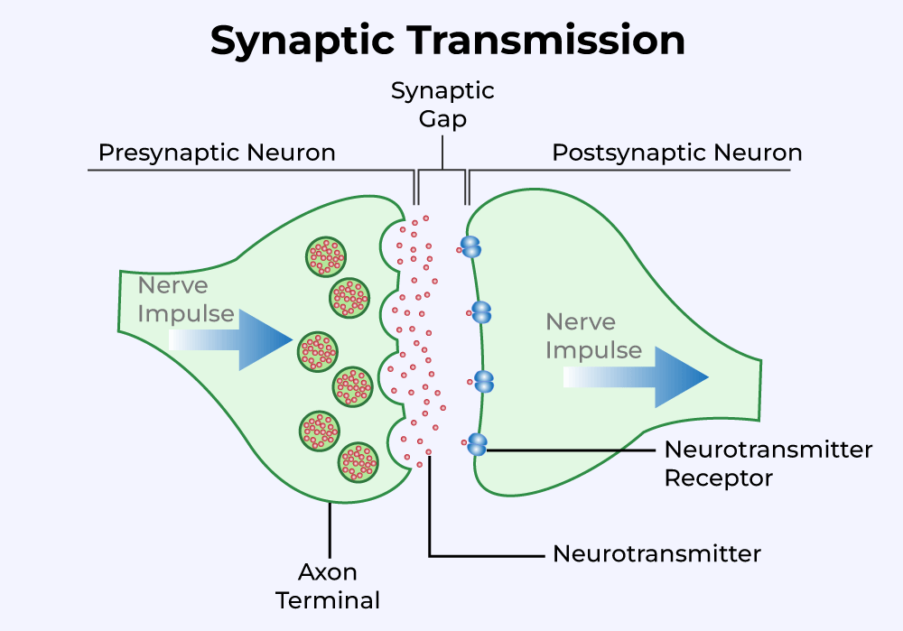
Excitatory Postsynaptic Potentials
The action potential then moves through the postsynaptic cell and onto the postsynaptic cell, along the nerve, and to the next target.
21
https://www.geeksforgeeks.org/transmission-of-impulses/

Slide 22
Inhibitory Postsynaptic Potentials
Some neurotransmitters diffuses across the synapse and binds to the receptors on the postsynaptic cell, the receptors open allowing passage of ions OUT of the cell leading to hyperpolarization.
This can inhibit the postsynaptic cell and generate an action potential.
22

Slide 23
Synaptic Transmission
The transmission of information from the presynaptic neuron to the postsynaptic neuron due to an action potential can trigger short- and long-term changes—membrane potential or signal cascades.
23

Slide 24
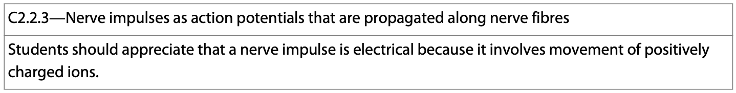
Action Potentials
Action potentials are all or none. They carry electrical signals over a long distance along axons. They are very brief, and can be generated at a high frequency.
Both Na⁺ and K⁺ voltage-gated ion channels are involved in the production of an action potential.
Both open due to depolarization of the membrane.
Na⁺ opens 1st, K⁺ 2nd.
24

Slide 25
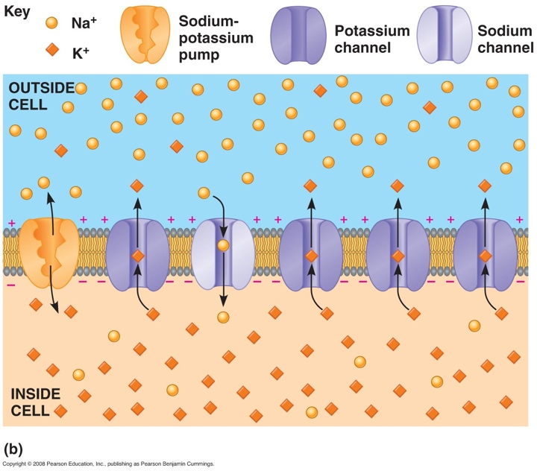
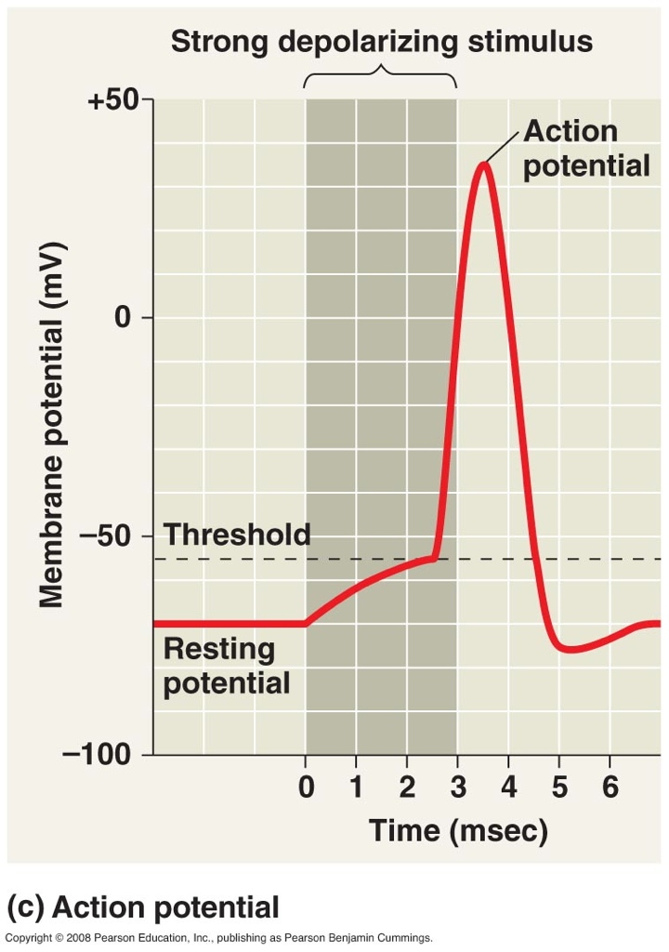
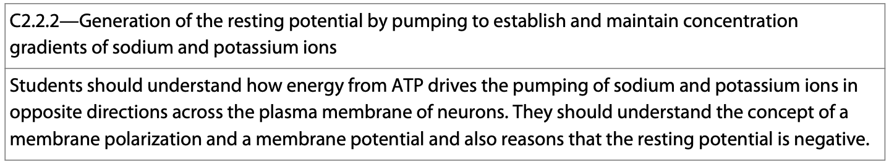
Resting Membrane Potential
At rest, neurons pump sodium and potassium ions across their membranes to generate a resting potential.
25

Slide 26
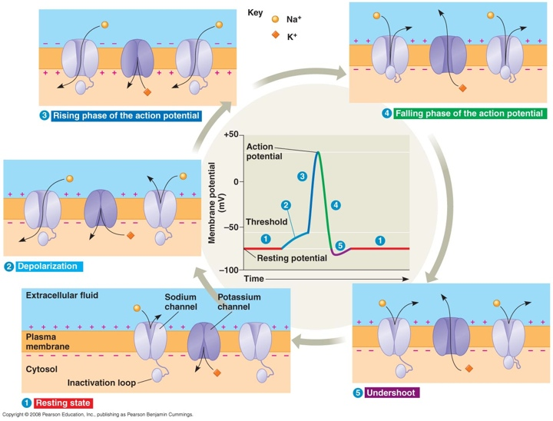
Action Potentials
The resting potential aids in the formation of an action potential.
The action potential consists of a depolarization and repolarization of the neuron due to the opening and closing of ion channels.
26

Slide 27
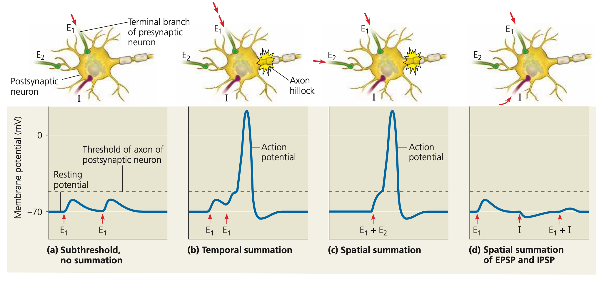
Action Potentials
An action potential results from a series of events which trigger changes in membrane voltage that has been set up by sodium-potassium pumps within the neuron’s cell membrane.
Disruptions in the resting membrane potential from multiple inputs result in propagation of the action potential—summation.
27

Slide 28
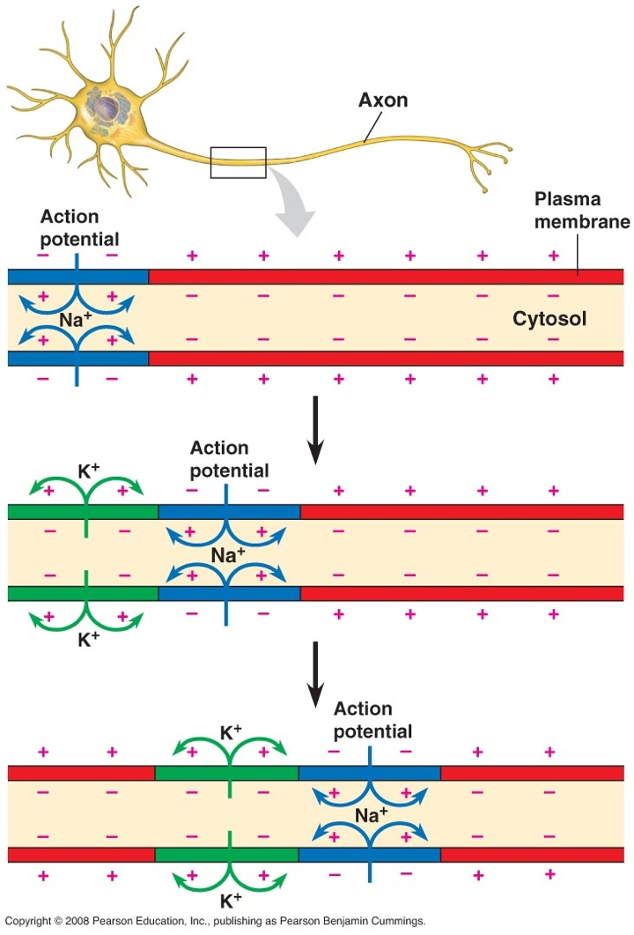
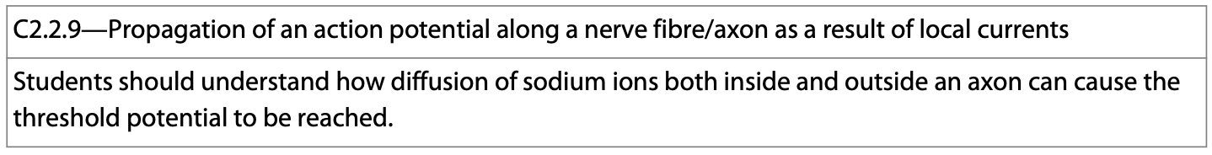
Action Potentials
Propagation of nerve impulses is the result of local currents that cause each successive part of the axon to reach the threshold potential.
These currents are the result of the movements of sodium ions.
28

Slide 29
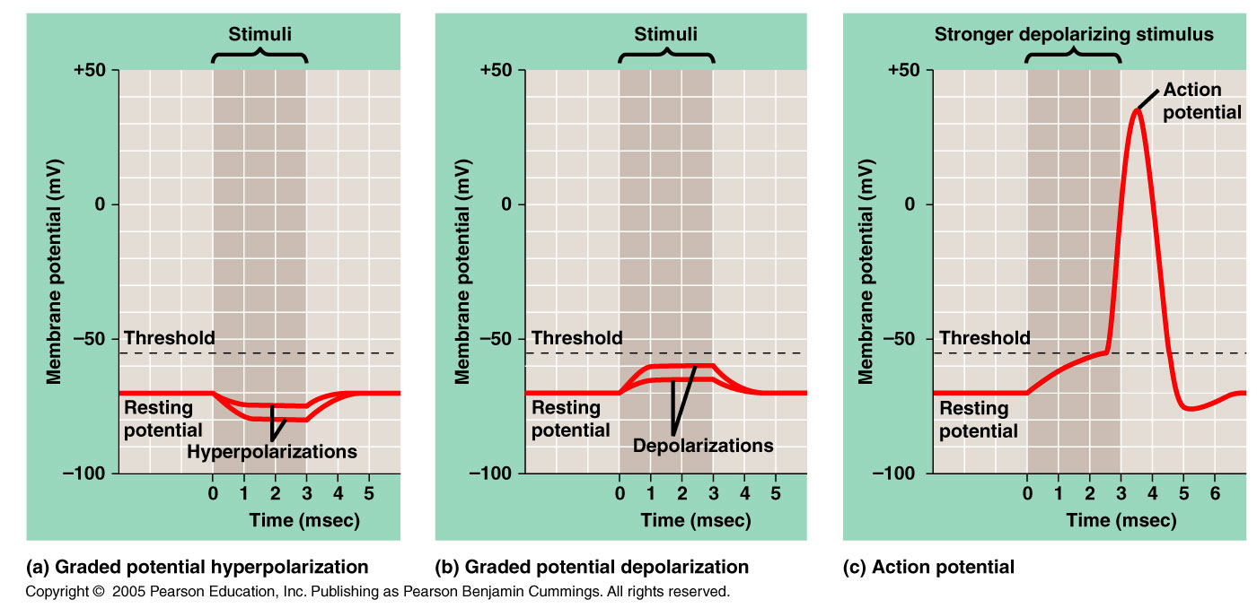
Membrane Potential
Membrane potential is the basis of nearly all electrical signals in the nervous system.
The membrane potential can change from its resting value when the membrane’s permeability to a particular ion changes—due to the opening/closing of ion channels.
Na⁺, K⁺, Ca²⁺, and Cl⁻ all play major roles in nerve signal transmission (as well as muscle contraction).
29

Slide 30
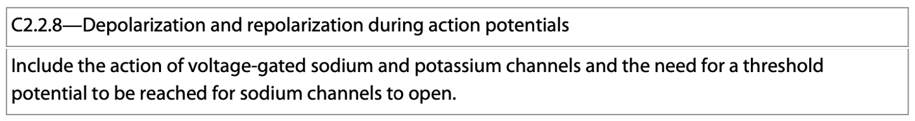
Ion Channels
Ion channels that are always open, they are said to be ungated.
Gated ion channels switch open and closed due to one of three kinds of stimuli:
Stretch gated ion channels sense stretch.
Ligand gated ion channels open and close in response to specific signals.
Voltage gated ion channels open and close due to changes in membrane potential.
Stimulating gated ion channels can trigger hyperpolarization or depolarization.
30

Slide 31
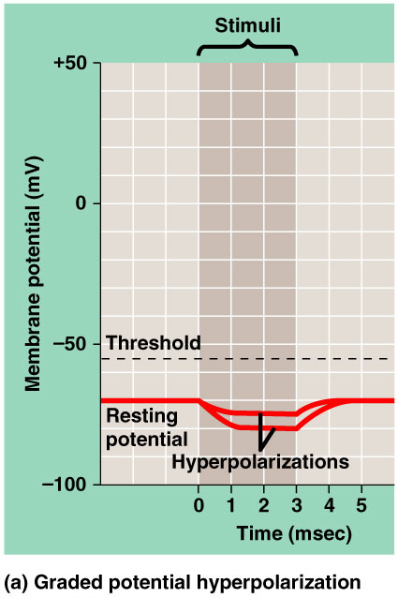
Ion Channel Stimulation
Hyperpolarization results in an increased magnitude of membrane potential—the inside of the membrane becomes more negative.
31
travismulthaupt.com
Copyright ©2005 Pearson Education, Inc. Publishing as Pearson Benjamin Cummings. All rights reserved.

Slide 32
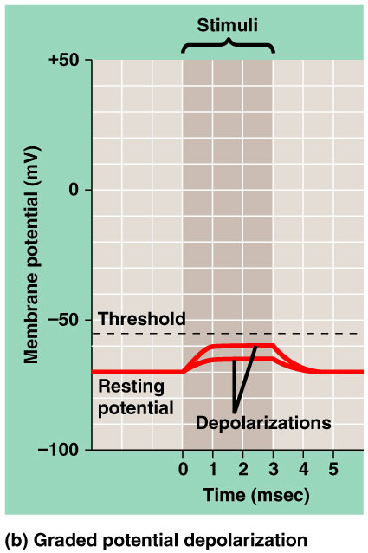
Ion Channel Stimulation
Depolarization reduces the magnitude of the membrane potential—the inside becomes less negative.
Multiple inputs can lead to greater depolarization—called summation.
32
travismulthaupt.com
Copyright ©2005 Pearson Education, Inc. Publishing as Pearson Benjamin Cummings. All rights reserved.

Slide 33
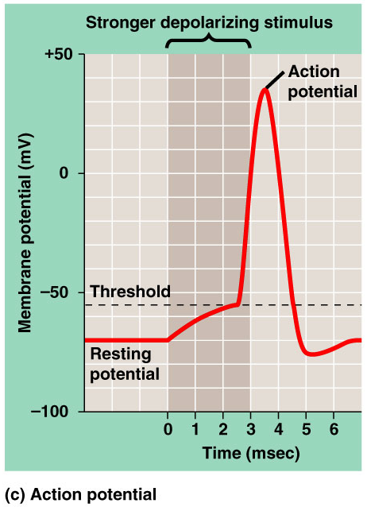
Ion Channel Stimulation
A nerve impulse is only initiated if the threshold potential is reached.
In most neurons, depolarizations are graded up to a certain threshold.
Once a stimulus has reached a threshold, an action potential is triggered.
Summation is often needed for threshold to be reached.
33
travismulthaupt.com
Copyright ©2005 Pearson Education, Inc. Publishing as Pearson Benjamin Cummings. All rights reserved.

Slide 34
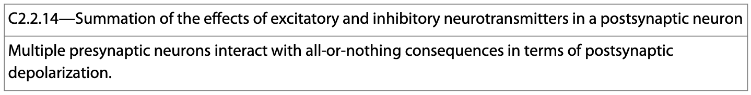
Action Potentials
Below is a summary of the events leading to the generation of an action potential.
Some subthreshold inputs that fail to produce an action potential, whereas different forms of summation do lead to the generation of an action potential.
34

Slide 35
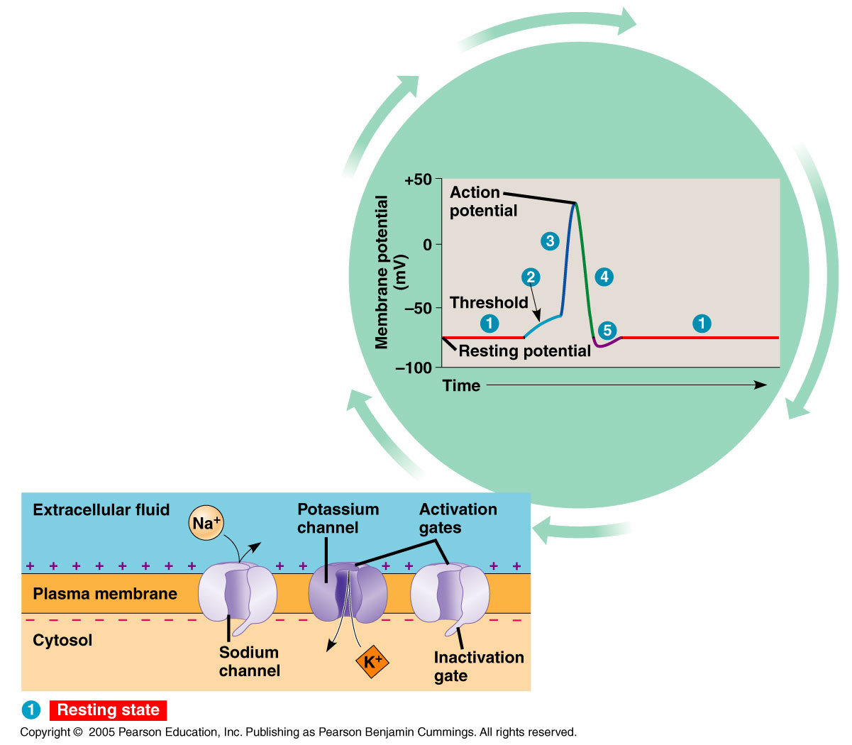
Action Potentials
Na⁺ channels have 2 gates—an activation gate and an inactivation gate. Both must be open for Na⁺ to get through.
1. At resting potential, the activation gate is closed, inactivation gate is open. (For Na⁺).
Depolarization rapidly opens the activation gate and slowly closes the inactivation gate.
For K⁺, the activation gate is closed at resting potential.
Depolarization slowly opens the gate.
35

Slide 36
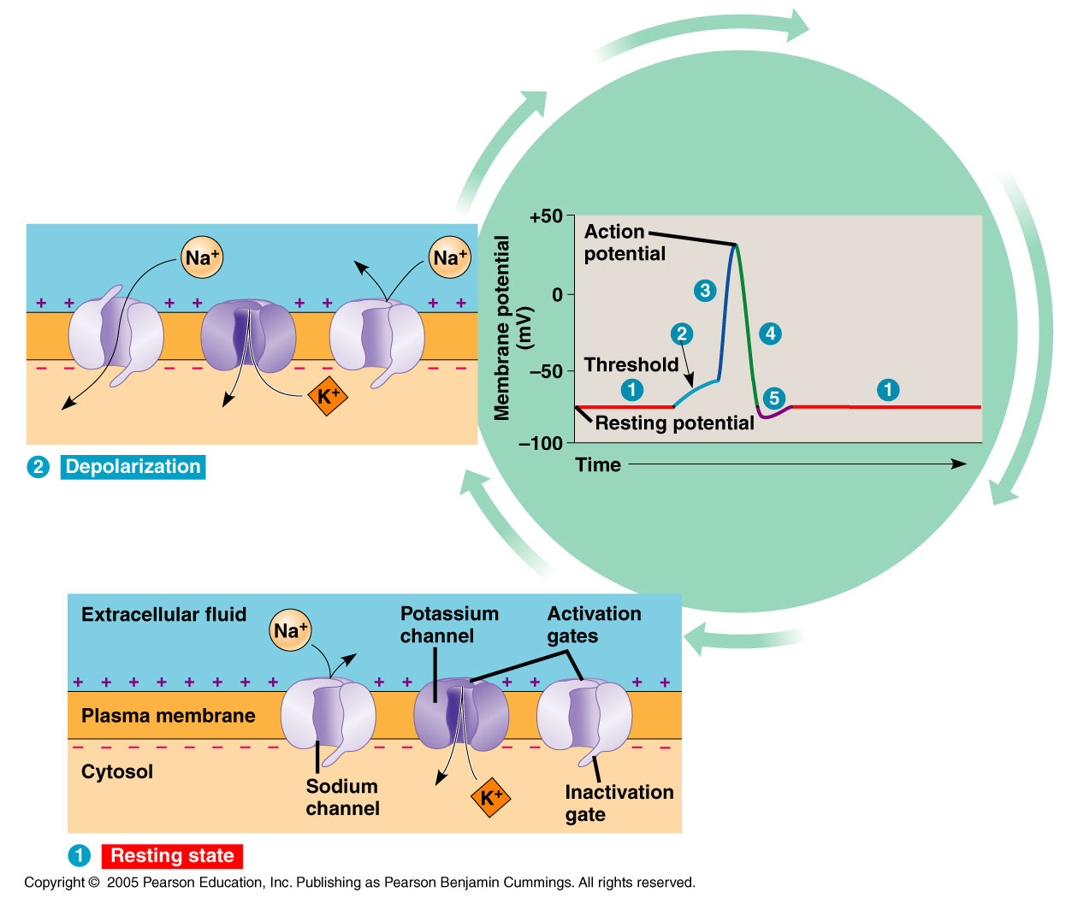
Action Potentials
2. When a stimulus depolarizes the membrane, the activation gates open on some channels allowing some Na⁺ in.
Na⁺ influx causes depolarization opening more activation gates and so on (positive feedback).
36

Slide 37
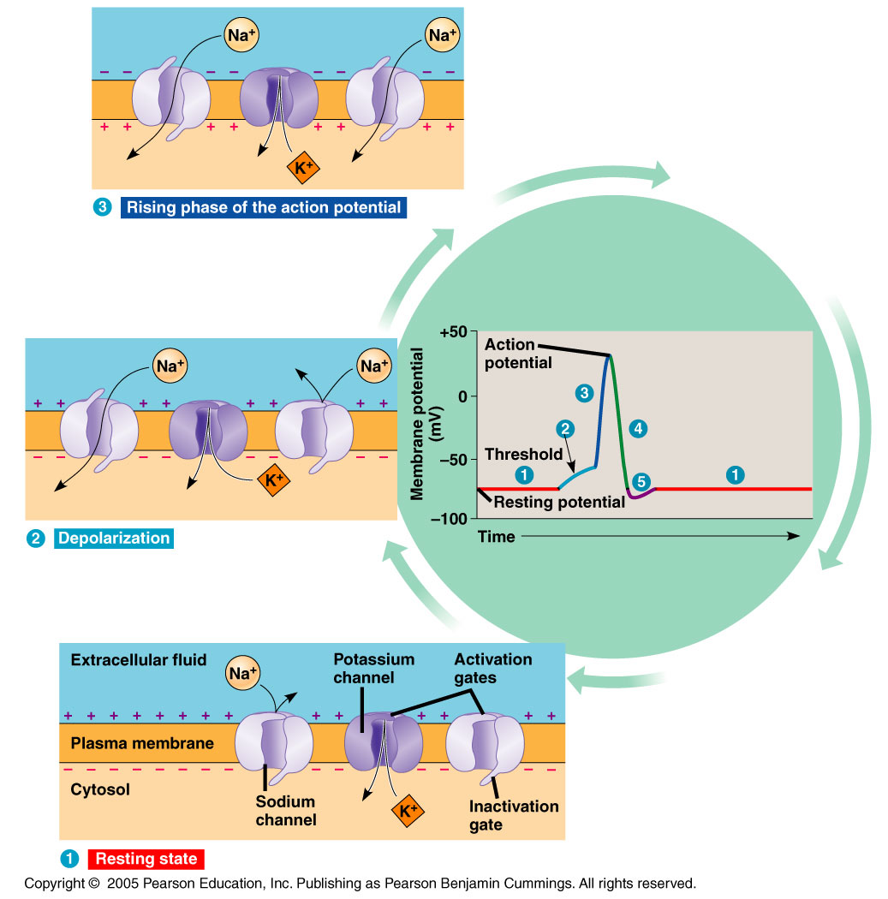
Action Potentials
3. When the threshold is crossed, this positive feedback cycle brings the membrane potential close to E_{Na} (equilibrium potential) during the rising phase.
37

Slide 38
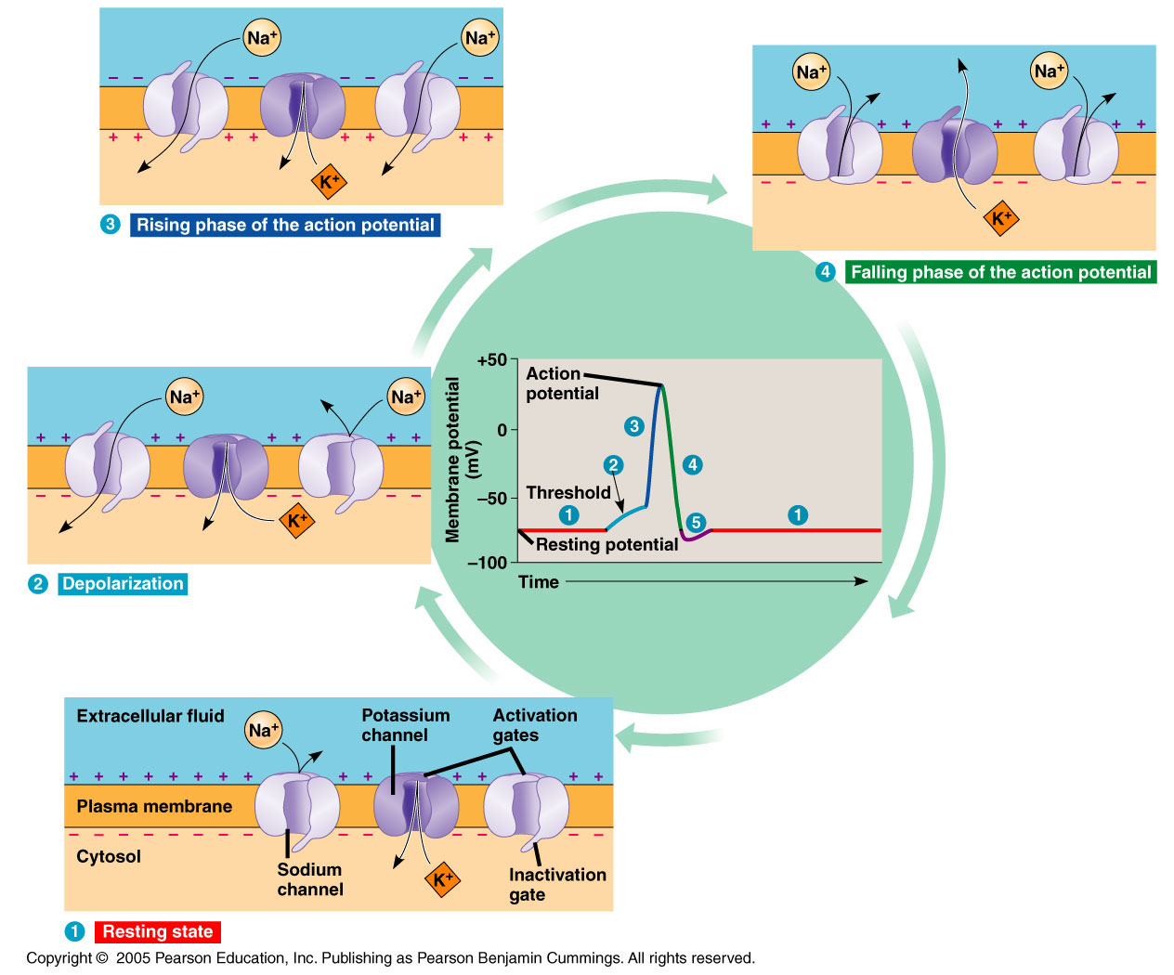
Action Potentials
4. E_{Na} is not reached:
Activation gates close most Na⁺ channels halting Na⁺ influx.
K⁺ activation gates open causing efflux of K⁺ decreasing the membrane potential.
38

Slide 39
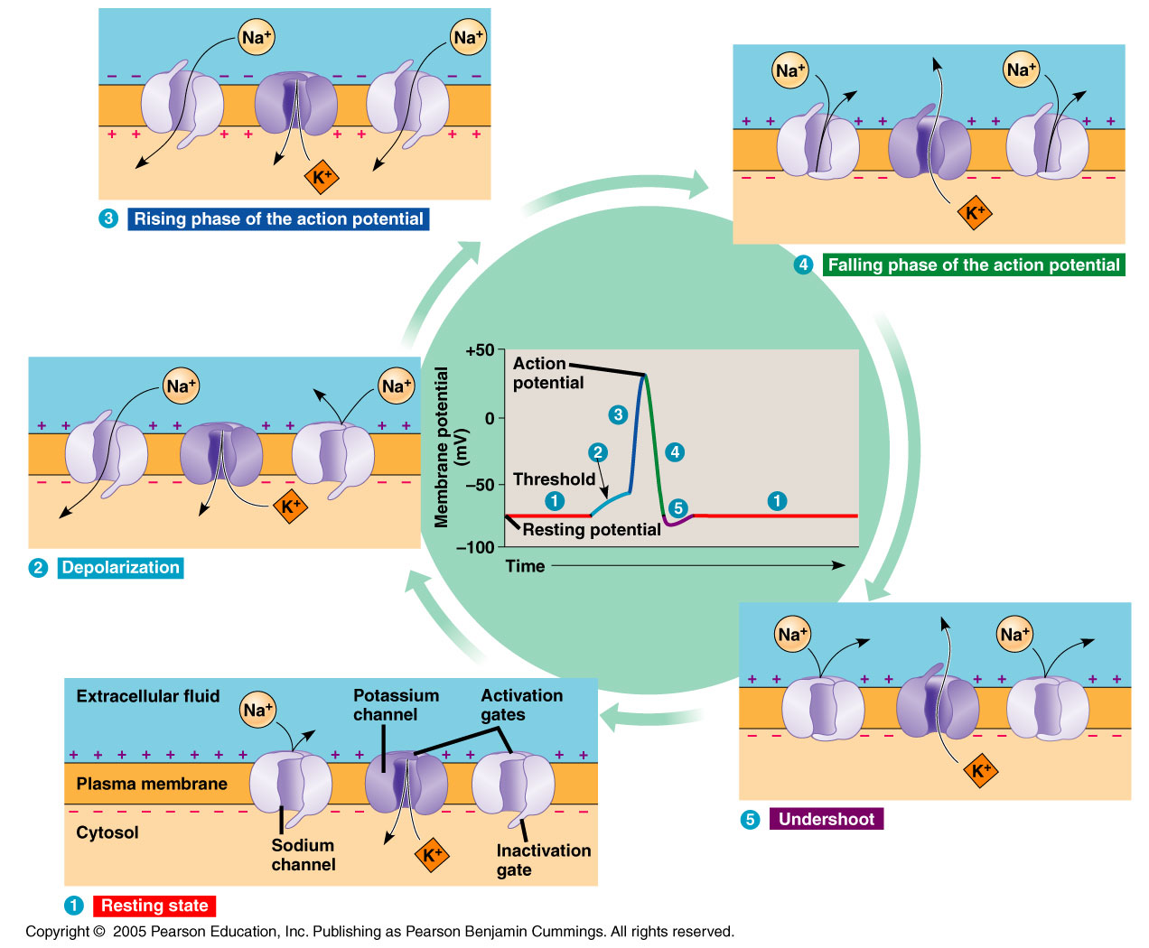
Action Potentials
5. Undershoot occurs as too much K⁺ leaves the cell. Eventually, K⁺ activation gates close and the membrane returns to its membrane resting potential.
39

Slide 40
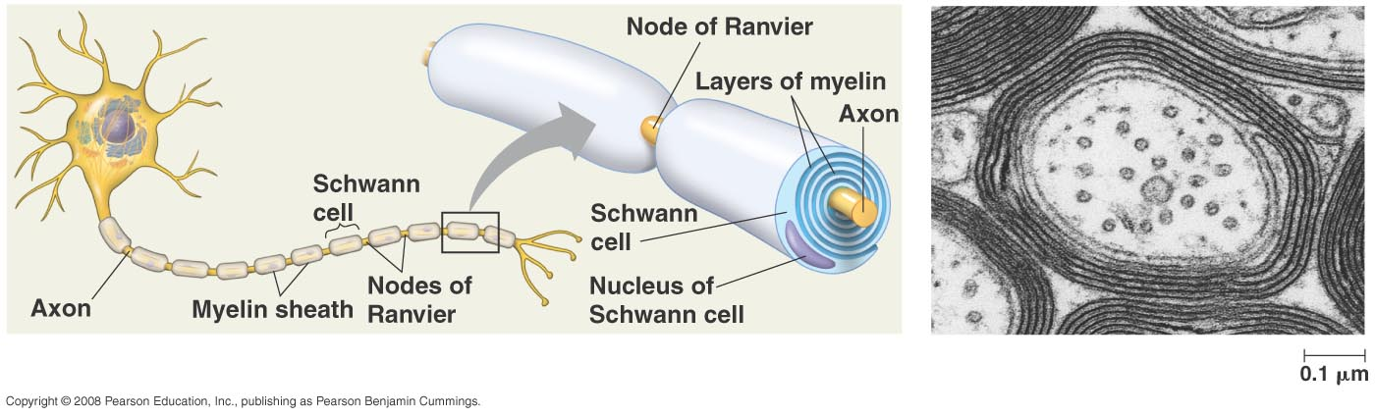
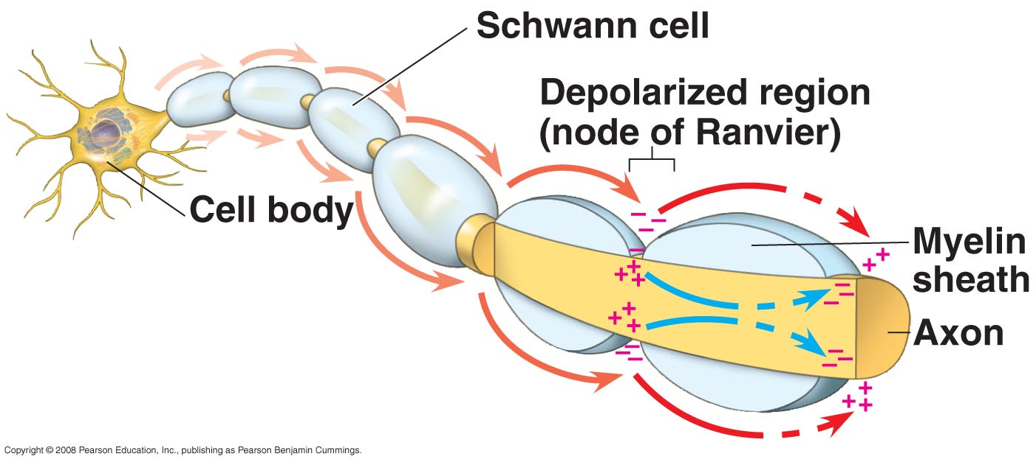
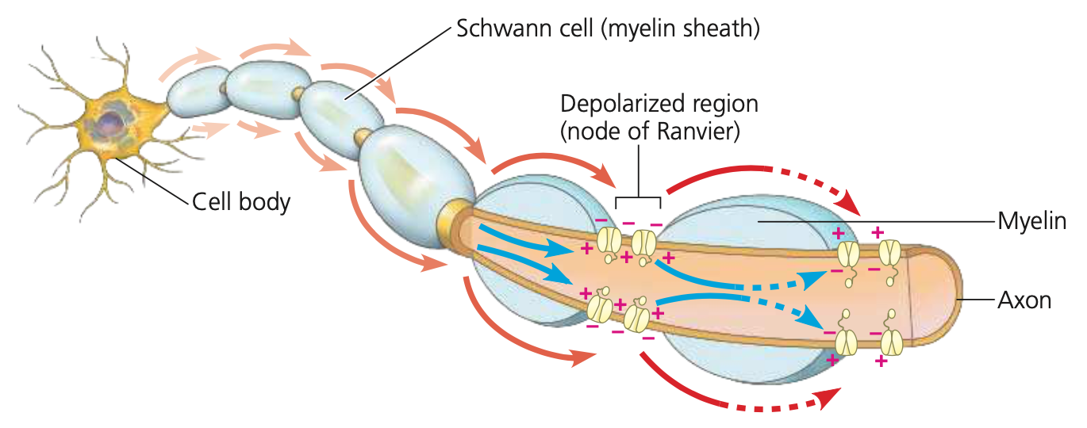
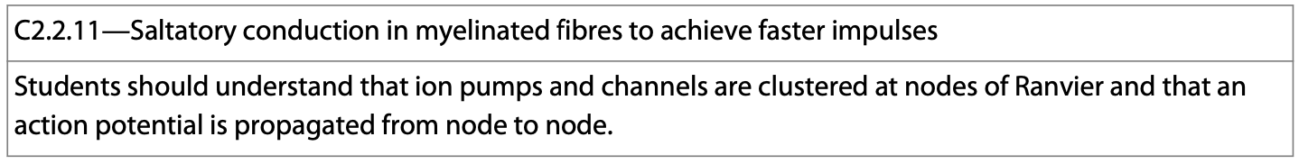
Action Potentials
Schwann cells myelinate axons and contribute to rapid transmission of an action potential—termed saltatory conduction.
40

Slide 41
Action Potentials—One Way Transmission
Action potentials transmit information from the point of sensory input, to the processing center. A refractory period prevents the backflow of information and also limits the number of action potentials that can be generated within a given time period.
41

Slide 42
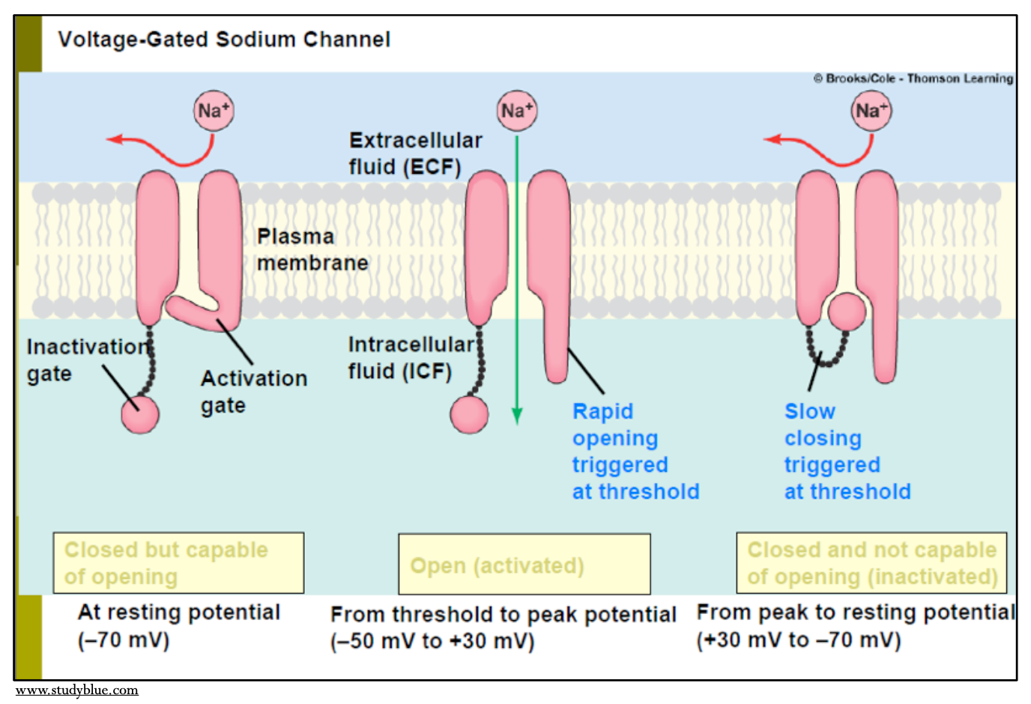
Refractory Period
An absolute refractory period occurs when the Na⁺ channels remain closed which prevents the triggering of another action potential.
This is what prevents the backflow of a stimulus.
42

Slide 43
Refractory Period
A relative refractory period occurs when the Na⁺ channels are newly closed and a very strong stimulus is needed for an action potential to occur.
This relative refractory period occurs during hyperpolarization.
This, too, works to prevent the backflow of a stimulus.
43
travismulthaupt.com

